Slide 1
Glossary
(Parent) Population – whole set of individuals, items or data from which a statistical sample is drawn.
Sample – part of the population. Intended to give information about the population so must be representative of it.
Census - when information about every member of the population is collected.
Sampling frame – a list of the items to be sampled (where possible) that helps you to identify each member of the population or sample.
Parameters – (of the population) often defined by its mean, $μ$.

Slide 2
Task
Describe the advantages of using a census rather than a sample.
Describe the disadvantages of using a census rather than a sample
A large school has 1800 pupils. The head teacher wants to find out how far the pupils have to travel to school.
What is the population he could use?
Would you use a census or a sample?
Explain why you would give this advice.

Slide 3
Sampling
Simple Random – every member of the population is equally likely to be selected. A sampling frame is compulsory. Can be done using a random number generator.
Stratified – proportionally representative of the strata (sub-groups) within the population. The selection of items to be sampled within each stratum is usually done by simple random sampling.
Quota – like stratified, but the choice of who is sampled is left up to the interviewer so it non-random.
Cluster – similar to stratified, but the strata are called clusters, and we need a variety of characteristics in each cluster. One or several of the clusters are sampled. Instead of selection from the whole population, just a limited number of clusters.

Slide 4
Sampling
Systematic – choosing every x member from the sampling frame. Look out for cyclic patterns within the data.
Opportunity – used when circumstances make a sample readily available. Likely to lead to bias results. Can be useful for an initial pilot study before a wider investigation.
Self-Selecting – when people volunteer or are given the choice to participate or decline.

Slide 5
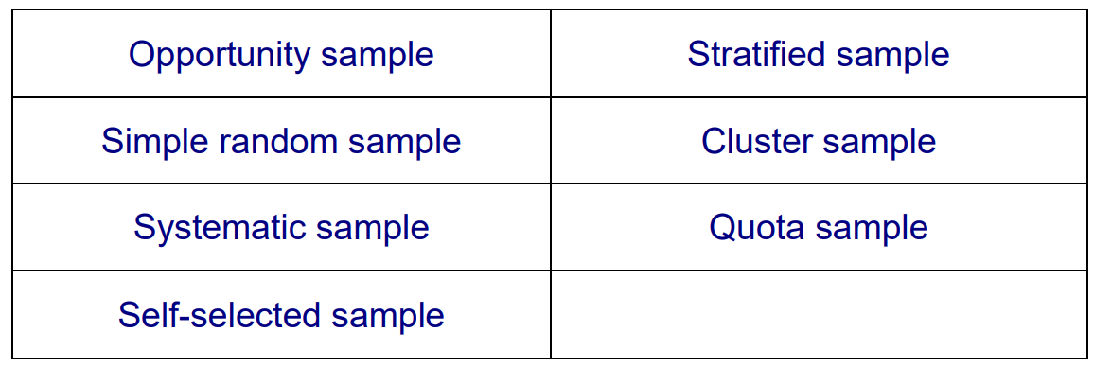
Group Task
Match the characteristics with the sampling methods.
Think about which characteristics are (or could be) advantages and which are (or could be) disadvantages.
What other advantages and disadvantages does each sampling method have?

Slide 6
Which Method of Sampling is Best?
There are three main factors when we think about what sample we are going to take.
What size of sample can you expect to take, given limited time, money and resources?
How is the sample to be selected to avoid bias?
How is the data going to be collected to avoid bias?

Slide 7
Task
Which sampling procedure would be best in each of the following situations? You must justify your answers.
An education officer wants to estimate the mean number of children per family on a large housing estate.
A consumer protection group wants to estimate the proportion of buses that are late.
A marketing consultant wants to investigate the proportion of households in the town with more than one car.
A parliamentary candidate wants to investigate voters’ views on wind farms within the constituency.
A health inspector wants to know what proportion of people wear glasses.
Government officials wish to estimate the proportion of cars with illegally worn tyres.
A dog rescue centre wants to estimate the proportion of dog owners who do not have their dogs micro-chipped.
The police want to find out the average speed at which cars travel in the outside lane of the motorway.
A sociologist wants to know how many friends 18 year old girls have on average.
The headteacher of a school wants to estimate the average number of hours of homework done per week by the students.
In most cases there are several correct sampling procedures so there is not one correct answer. Do you agree with what your peers have put?

