Slide 1
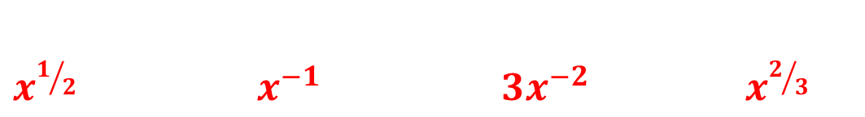
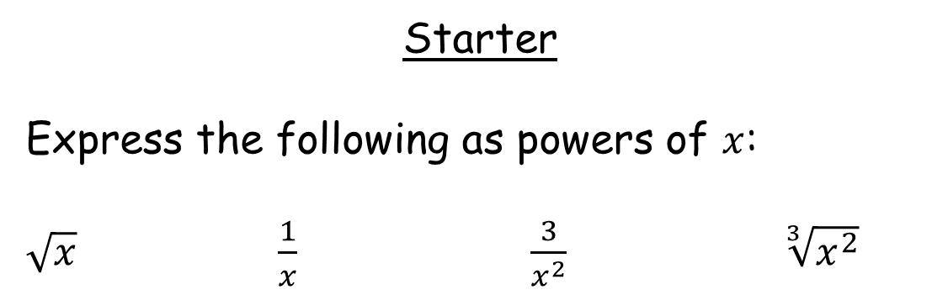
Starter
Express the following as powers of $x$:
$\sqrt{x}$ $\frac{1}{x}$ $\frac{3}{x^{2}}$ $\sqrt[3]{x^{2}}$
$x^{1/2}$ $x^{−1}$ ${3x}^{−2}$ $x^{2/3}$

Slide 2
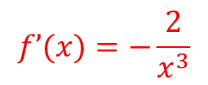
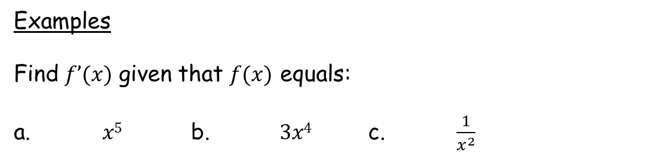

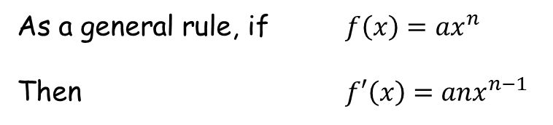



As a general rule, if $f\left(x\right)={ax}^{n}$
Then $f′\left(x\right)={anx}^{n−1}$
Multiply the coefficient by the index, then reduce the index by 1
Examples
Find $f’(x)$ given that $f(x)$ equals:
a. $x5$ b. $3x4$ c. $\frac{1}{x^{2}}$
$f’(x)=5x4$
$$f’(x)=12x3$$
$$f(x)=x^{−2}$$
$$f’\left(x\right)=−2x^{−3}$$
$$f’(x)=−\frac{2}{x^{3}}$$

Slide 3

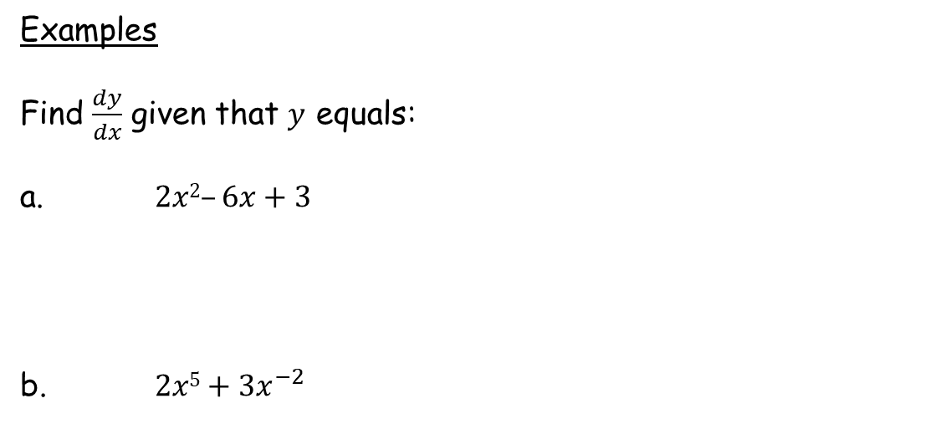







Examples
Find $\frac{dy}{dx}$ given that $y$ equals:
a. $2x2–6x+3$
b. $2x5+3x^{−2}$
$\frac{dy}{dx}=$
$$4x$$
$$−6$$
Complete the differentiation worksheet.
Make sure you’ve written everything as a power of $x$ before differentiating!
$\frac{dy}{dx}=$
$$10x4$$
$$−6x^{−3}$$
$\frac{dy}{dx}=$ $10x4$ - $\frac{6}{x^{3}}$
Notes:
Discuss what happens to constants (index of x is 0, anything multiplied by 0 = 0)

Slide 4
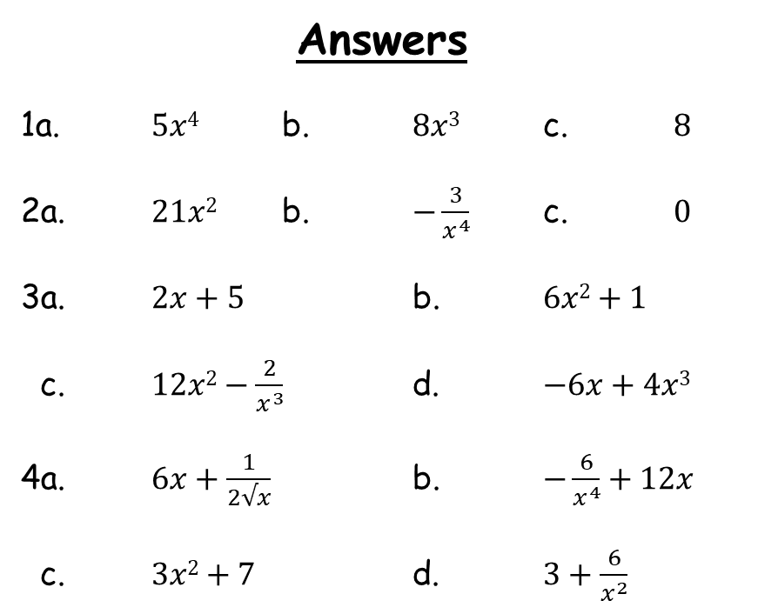
Answers
1a. $5x4$ b. $8x3$ c. $8$
2a. $21x2$ b. $−\frac{3}{x^{4}}$ c. $0$
3a. $2x+5$ b. $6x2+1$
c. $12x2−\frac{2}{x^{3}}$ d. $−6x+4x3$
4a. $6x+\frac{1}{2√x}$ b. $−\frac{6}{x^{4}}+12x$
c. $3x2+7$ d. $3+\frac{6}{x^{2}}$

