Slide 1
What’s the same and what’s different?
$$x+1=4$$ | $$3+1=4$$
$$x+3$$ | $$3x$$
Can you sort them into groups?
Could you define what an equation is?

Slide 2
Glossary
Operation →
Term →
Expression →
Equation →
Identity →
Things used to solve problems, eg. $+$, $−$, $×$, $÷$
Contains a number, a variable or a product ($x$) of both
Contains at least one term and operation
Mathematical statement containing an equals ($=$) sign
An equation that is always true ($≡$)
$$5x+7$$
coefficient
constant
variable

Slide 3
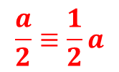
Sort the following into the correct column of the table:
Operation | Term | Expression | Equation | Identity
$$5x+6y$$
$$7a$$
$$y=mx+c$$
$$\frac{a}{2}≡\frac{1}{2}a$$
$$c²$$
$$+$$
$$6(m−n)$$
$$sin²x+cos²x≡1$$
$$7c−9=54$$
$$3a+4b−2$$
$$−$$
$$½y$$

Slide 4
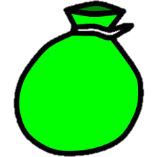
I have 3 bags of marbles. Altogether I have 24 marbles.
How many marbles are in each bag?
+ + = 24
8 8 8

Slide 5
I have 3 bags of marbles. Altogether I have 24 marbles.
How many marbles are in each bag?
Using algebra:
$$3b=24$$
$÷3$ $÷3$
$$b=8$$

Slide 6
Your turn!
$$4x=20$$
$$x=3$$ | $$x=16$$
$$x=24$$ | $$x=5$$
A
B
C
D

Slide 7
Your turn!
$$4x=20$$
$$x=3$$ | $$x=16$$
$$x=24$$ | $$x=5$$
A
B
C
D

Slide 8
Your turn!
$$3y=18$$
$$y=15$$ | $$y=7$$
$$y=6$$ | $$y=54$$
A
B
C
D

Slide 9
Your turn!
$$3y=18$$
$$y=15$$ | $$y=7$$
$$y=6$$ | $$y=54$$
A
B
C
D

Slide 10
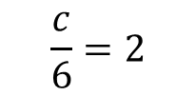
Your turn!
$$\frac{c}{6}=2$$
$$c=12$$ | $$c=0.3$$
$$c=3$$ | $$c=6$$
A
B
C
D

Slide 11
Your turn!
$$\frac{c}{6}=2$$
$$c=12$$ | $$c=0.3$$
$$c=3$$ | $$c=6$$
A
B
C
D

Slide 12
Your turn!
$$5a=−15$$
$$a=3$$ | $$a=−3$$
$$a=5$$ | $$a=−5$$
A
B
C
D

Slide 13
Your turn!
$$5a=−15$$
$$a=3$$ | $$a=−3$$
$$a=5$$ | $$a=−5$$
A
B
C
D

Slide 14
I have 1 bag of marbles. I put in 3 extra marbles. There are now 9 marbles in the bag.
How many marbles were in the bag to begin with?
6
+ 3 = 9

Slide 15
I have 1 bag of marbles. I put in 3 extra marbles. There are now 9 marbles in the bag.
How many marbles were in the bag to begin with?
Using algebra:
$$b+3=9$$
$−3$ $−3$
$b=6$

Slide 16
Your turn!
$$m+5=8$$
$$m=13$$ | $$m=5$$
$$m=3$$ | $$m=12$$
A
B
C
D

Slide 17
Your turn!
$$m+5=8$$
$$m=13$$ | $$m=5$$
$$m=3$$ | $$m=12$$
A
B
C
D

Slide 18
Your turn!
$$p−8=3$$
$$p=11$$ | $$p=−5$$
$$p=−11$$ | $$p=5$$
A
B
C
D

Slide 19
Your turn!
$$p−8=3$$
$$p=11$$ | $$p=−5$$
$$p=−11$$ | $$p=5$$
A
B
C
D

Slide 20
Your turn!
$$v+5=2$$
$$v=7$$ | $$v=3$$
$$v=−7$$ | $$v=−3$$
A
B
C
D

Slide 21
Your turn!
$$v+5=2$$
$$v=7$$ | $$v=3$$
$$v=−7$$ | $$v=−3$$
A
B
C
D

Slide 22
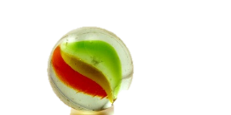
I have 2 bags of marbles and 5 extras. Altogether I have 13 marbles.
How many marbles are in each bag?
+ + = 13
4 4

Slide 23
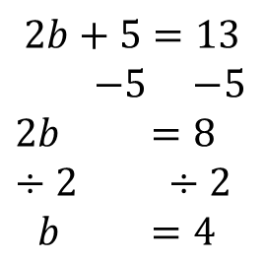
I have 2 bags of marbles and 5 extras. Altogether I have 13 marbles.
How many marbles are in each bag?
Using algebra:
$$2b+5=13$$
$−5$ $−5$
$2b$ $=8$
$÷2$ $÷2$
$b$ $=4$

Slide 24
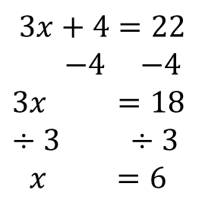
Let’s try this one:
$$3x+4=22$$
$−4$ $−4$
$3x$ $=18$
$÷3$ $÷3$
$x$ $=6$

Slide 25
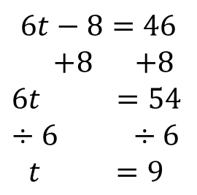
One more:
$$6t−8=46$$
$+8$ $+8$
$6t$ $=54$
$÷6$ $÷6$
$t$ $=9$

Slide 26
Your turn!
$$2k+1=7$$
$$k=3.5$$ | $$k=4$$
$$k=3$$ | $$k=6$$
A
B
C
D

Slide 27
Your turn!
$$2k+1=7$$
$$k=3.5$$ | $$k=4$$
$$k=3$$ | $$k=6$$
A
B
C
D

Slide 28
Your turn!
$$3g−2=19$$
$$g=6.5$$ | $$g=5.67$$
$$g=6$$ | $$g=7$$
A
B
C
D

Slide 29
Your turn!
$$3g−2=19$$
$$g=6.5$$ | $$g=5.67$$
$$g=6$$ | $$g=7$$
A
B
C
D

Slide 30
Your turn!
$$4n+2=50$$
$$n=13$$ | $$n=12.5$$
$$n=12$$ | $$n=13.5$$
A
B
C
D

Slide 31
Your turn!
$$4n+2=50$$
$$n=13$$ | $$n=12.5$$
$$n=12$$ | $$n=13.5$$
A
B
C
D

Slide 32
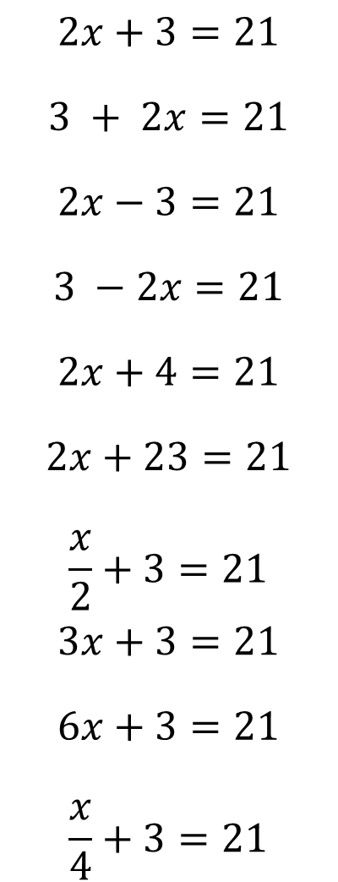
$$2x+3=21$$
$$3 + 2x=21$$
$$2x−3=21$$
$$3 −2x=21$$
$$2x+4=21$$
$$2x+23=21$$
$$\frac{x}{2}+3=21$$
$$3x+3=21$$
$$6x+3=21$$
$$\frac{x}{4}+3=21$$
VariationTheory.com
Notes:
Created by Richard Tock

Slide 33
$$2x+3=21$$
$$3 + 2x=21$$
$$2x−3=21$$
$$3 −2x=21$$
$$2x+4=21$$
$$2x+23=21$$
$$\frac{x}{2}+3=21$$
$$3x+3=21$$
$$6x+3=21$$
$$\frac{x}{4}+3=21$$
$$x=9$$
$$x=9$$
$$x=12$$
$$x=−9$$
$$x=8.5$$
$$x=−1$$
$$x=36$$
$$x=6$$
$$x=3$$
$$x=72$$
VariationTheory.com
Notes:
Created by Richard Tock

Slide 34
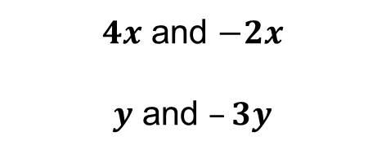
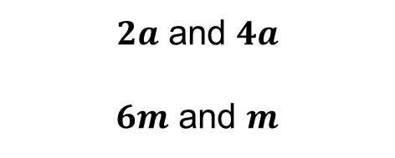
When there is a variable on both sides of the equals sign, start by eliminating the smallest variable.
Which is the smallest variable in the following pairs?
$2a$ and $4a$
$6m$ and $m$
$4x$ and $−2x$
$y$ and $–3y$

Slide 35


Examples
Solve: $2a+5=4a−1$ $6x+4=2x+6$
$−2a$ $−2a$
$5=2a−1$
$+1$ $+1$
$6=2a$
$÷2$ $÷2$
$3=a$
$−2x$ $−2x$
$4x+4=6$
$−4$ $−4$
$4x=2$
$÷4$ $÷4$
$x=\frac{1}{2}$

Slide 37
Answers
$a=2$ $b=3$
$c=13$ $d=8$
$e=3$ $f=12$
$g=−4$ $h=\frac{2}{5}$
$i=2$ $j=−\frac{1}{5}$

Slide 38
Plenary
Can you right down three different equations where $x=4$?

