Slide 1
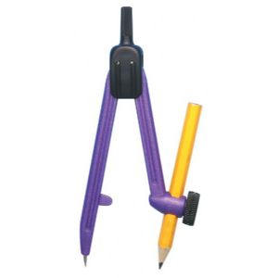
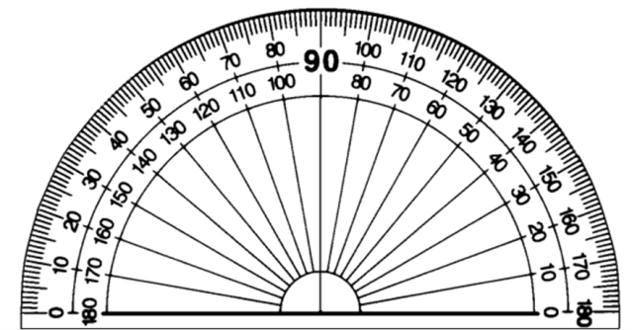
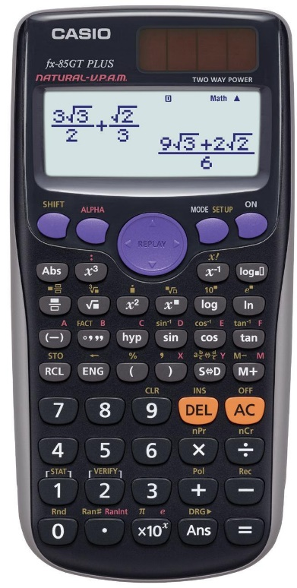
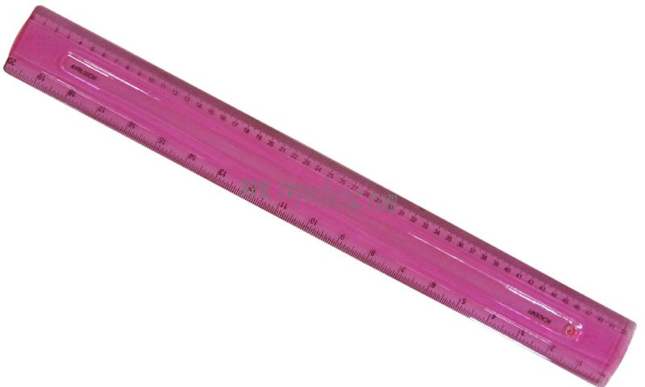
Autumn Term
Spring Term
Summer Term

Slide 2
Autumn Term
Week 1 | Lesson 1 | Lesson 2 | Lesson 3 | Lesson 4
Week 2 | Lesson 1 | Lesson 2 | Lesson 3 | Lesson 4
Week 3 | Lesson 1 | Lesson 2 | Lesson 3 | Lesson 4
Week 4 | Lesson 1 | Lesson 2 | Lesson 3 | Lesson 4
Week 5 | Lesson 1 | Lesson 2 | Lesson 3 | Lesson 4
Week 6 | Lesson 1 | Lesson 2 | Lesson 3 | Lesson 4
Week 7 | Lesson 1 | Lesson 2 | Lesson 3 | Lesson 4
Week 8 | Lesson 1 | Lesson 2 | Lesson 3 | Lesson 4
Week 9 | Lesson 1 | Lesson 2 | Lesson 3 | Lesson 4
Week 10 | Lesson 1 | Lesson 2 | Lesson 3 | Lesson 4
Week 11 | Lesson 1 | Lesson 2 | Lesson 3 | Lesson 4
Week 12 | Lesson 1 | Lesson 2 | Lesson 3 | Lesson 4
Week 13 | Lesson 1 | Lesson 2 | Lesson 3 | Lesson 4
Week 14 | Lesson 1 | Lesson 2 | Lesson 3 | Lesson 4

Slide 3
Spring Term
Week 1 | Lesson 1 | Lesson 2 | Lesson 3 | Lesson 4
Week 2 | Lesson 1 | Lesson 2 | Lesson 3 | Lesson 4
Week 3 | Lesson 1 | Lesson 2 | Lesson 3 | Lesson 4
Week 4 | Lesson 1 | Lesson 2 | Lesson 3 | Lesson 4
Week 5 | Lesson 1 | Lesson 2 | Lesson 3 | Lesson 4
Week 6 | Lesson 1 | Lesson 2 | Lesson 3 | Lesson 4
Week 7 | Lesson 1 | Lesson 2 | Lesson 3 | Lesson 4
Week 8 | Lesson 1 | Lesson 2 | Lesson 3 | Lesson 4
Week 9 | Lesson 1 | Lesson 2 | Lesson 3 | Lesson 4
Week 10 | Lesson 1 | Lesson 2 | Lesson 3 | Lesson 4
Week 11 | Lesson 1 | Lesson 2 | Lesson 3 | Lesson 4
Week 12 | Lesson 1 | Lesson 2 | Lesson 3 | Lesson 4
Week 13 | Lesson 1 | Lesson 2 | Lesson 3 | Lesson 4
Week 14 | Lesson 1 | Lesson 2 | Lesson 3 | Lesson 4

Slide 4
Summer Term
Week 1 | Lesson 1 | Lesson 2 | Lesson 3 | Lesson 4
Week 2 | Lesson 1 | Lesson 2 | Lesson 3 | Lesson 4
Week 3 | Lesson 1 | Lesson 2 | Lesson 3 | Lesson 4
Week 4 | Lesson 1 | Lesson 2 | Lesson 3 | Lesson 4
Week 5 | Lesson 1 | Lesson 2 | Lesson 3 | Lesson 4
Week 6 | Lesson 1 | Lesson 2 | Lesson 3 | Lesson 4
Week 7 | Lesson 1 | Lesson 2 | Lesson 3 | Lesson 4
Week 8 | Lesson 1 | Lesson 2 | Lesson 3 | Lesson 4
Week 9 | Lesson 1 | Lesson 2 | Lesson 3 | Lesson 4
Week 10 | Lesson 1 | Lesson 2 | Lesson 3 | Lesson 4
Week 11 | Lesson 1 | Lesson 2 | Lesson 3 | Lesson 4
Week 12 | Lesson 1 | Lesson 2 | Lesson 3 | Lesson 4
Week 13 | Lesson 1 | Lesson 2 | Lesson 3 | Lesson 4
Week 14 | Lesson 1 | Lesson 2 | Lesson 3 | Lesson 4

Slide 5
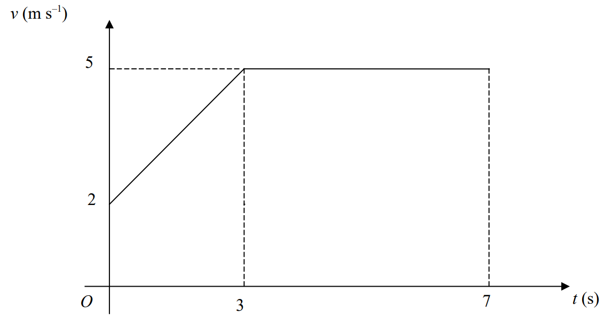
A circle $C$ has centre (2,5). The point $A$ (11, 8) lies on the circumference of the circle. Find the equation of the tangent to the circle at $A$.
Below is the sketch of a speed time graph for a cyclist moving on a straight road for 7 seconds.
Work out the acceleration for the first 3 seconds.
Calculate the total distance covered by the cyclist.

Slide 6
Draw the graph of $x^{2}+y^{2}=49$, showing all points of intersection with axes.
Prove that the angle subtended by an arc at the centre of a circle is twice the angle subtended at any point on the circumference.

Slide 7
Prove algebraically that the sum of any two consecutive integers is always an odd number.
Work out the length of $BC$. Give your answer to 3 significant figures.
$$B$$
$$5 m$$
$$42°$$
$$A$$
$$53°$$
$$C$$

Slide 8
Write $x²–6x+1$ in the form $(x+a)²+b$ where $a$ and $b$ are integers. Hence, or otherwise, write down the coordinates of the turning point of the graph of $y=x²–6x+1$.
The population of a form of algae is believed to grow exponentially. On day 1, the population of algae was 2240. By day 4 it increased to 35000. Calculate the population of the algae by day 10.

Slide 9
Expand and simplify $(2+\sqrt{3})(2−\sqrt{3})$.
$\vec{OA}=a$ and $\vec{OB}=b$
$P$ is the point on $AB$ such that $AP:PB=1:3$
$\vec{OP}=k(3a+b)$
Find the value of $k$.
$$A$$
$$a$$
$$B$$
$$O$$
$$b$$

Slide 10
The nth term of a sequence is $2n^{2}+4n−1$. Work out the 10th term of the sequence.
Solve the simultaneous equations:
$x^{2}+y^{2}=13$
$x=y−5$

Slide 11
Given that $f\left(x\right)=x^{2}−3$, find $f^{−1}(x)$.
Sketch the graph of $y=\sin{x}$, showing all intersections with the axes.

Slide 12
$V=\frac{s}{t}$ $s=4.15$ correct to 2 decimal places
$t=2.516$ correct to 3 decimal places
Work out the upper bound for $V$.
The diagram shows a sector of a circle, centre $O$. The radius of the circle is 13 cm. The angle of the sector is 150º. Calculate the area of the sector. Give your answer correct to 3 significant figures.
$$150°$$
$$13 cm$$

Slide 13
The table shows information about the age of 80 teachers. Draw a histogram for the information in the table.
A scientist wants to estimate the number of fish in a lake. He catches 50 fish from the lake and marks them with a dye. The fish are then returned to the lake. The next day the scientist catches another 50 fish. 4 of these fish are marked with the dye. Work out an estimate for the total number of fish in the lake. You must write down any assumptions you have made.
Age (years) | Frequency
$$20<a≤30$$ | 20
$30<a≤3$5 | 22
$$35<a≤40$$ | 16
$$40<a≤50$$ | 13
$$50<a≤65$$ | 9

Slide 14
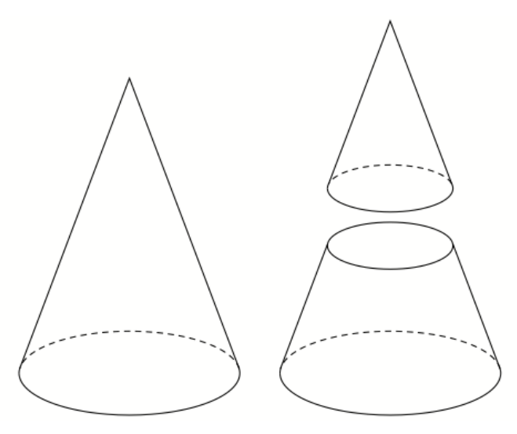
Expand and simplify $(2x+1)(x−2)(x+3)$
A large cone is cut into two parts, a smaller cone and a frustum of a cone. The height of the large cone is 20 cm. The height of the smaller cone is 10 cm. The radius of the base of the large cone is 8 cm. The radius of the base of the smaller cone is 4 cm. Work out the volume of the frustum.

Slide 15
There are some red counters and some blue counters in a bag. The ratio of red counters to blue counters is 3 : 1. Two counters are removed at random. The probability that both the counters taken are blue is $\frac{1}{20}$. Work how many counters were in the bag before any counters were removed.
Solve $x^{2}+4x+3>0$

Slide 16
Given that $f\left(x\right)=2x−4$ and $g\left(x\right)=3x+5$, find $gf(3)$.
Work out the value of $x$. Give your answer to 1 decimal place.
$$10 cm$$
$$100°$$
$$13 cm$$
$$x cm$$

Slide 17
Draw the graph of $x^{2}+y^{2}=81$, showing all points of intersection with axes.
Prove algebraically that the recurring decimal $0.\dot{8}$ can be written as $\frac{8}{9}$.

Slide 18
Prove the angle subtended at the circumference by a semicircle is a right angle.
Factorise $2x^{2}+5x+2$

Slide 19
Prove algebraically that the sum of any three consecutive even integers is always a multiple of 6.
A straight line, L, passes through the point with coordinates (4, 7) and is perpendicular to the line with equation $y=2x+3$. Find an equation of the straight line L.

Slide 20
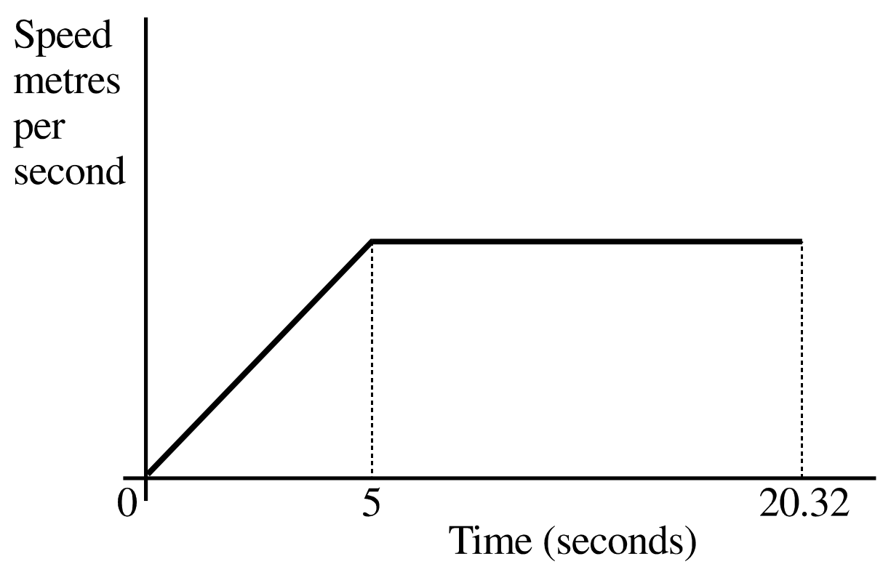
$P$ is the point (1, 2) on the circle $x^{2}+y^{2}=5$. Work out the equation of the tangent to the circle at $P$.
A sprinter runs a race of 200 m. His total time for running the race is 20.32 seconds. Below is a sketch of the speed-time graph for the motion of the sprinter.
Work out the maximum speed of the sprinter during the race.
Calculate the distance covered by the sprinter in the first 5 seconds of the race.

Slide 21
Write ${(3+\sqrt{5})}^{2}$ in the form $a+b\sqrt{5}$, where $a$ and $b$ are integers.
Solve the simultaneous equations:
$x^{2}+y^{2}=34$
$x−y=2$

Slide 22
$\vec{OA}=2a$ and $\vec{OB}=3b$
$P$ is the point on $AB$ such that $AP:PB=3:2$
$\vec{OP}=k(4a+9b)$
Find the value of $k$.
Simplify fully $\frac{{3x}^{2}+9x}{x^{2}−9}$
$$A$$
$$2a$$
$$B$$
$$O$$
$$3b$$

Slide 23
The nth term of a sequence is $n^{2}+3n$. Work out the first 5 terms in the sequence.
On day 1 of a viral campaign, a website gets 12000 visitors. By day 3 the website was receiving 38880 visitors. Assuming the number of visitors to the website is growing exponentially, how many visitors should the website expect to receive at the end of the first week?

Slide 24
Write $x²+8x+5$ in the form $(x+a)²+b$ where $a$ and $b$ are integers. Hence, or otherwise, write down the coordinates of the turning point of the graph of $y=x²+8x+5$.
There are some red counters and some blue counters in a bag. The ratio of red counters to blue counters is 4 : 1. Two counters are removed at random. The probability that both the counters taken are red is $\frac{22}{35}$. Work how many blue counters are in the bag.

Slide 25
Given that $f\left(x\right)=2x−4$, find $f^{−1}(x)$.
Prove algebraically that the recurring decimal $0.4\dot{7}$ can be written as $\frac{43}{90}$.

Slide 26
Expand and simplify $(x+5)(x+4)(x−2)$
Work out the value of $x$. Give your answer to 3 significant figures.
$$5.4 cm$$
$$95°$$
$$x°$$
$$6.7 cm$$

Slide 27
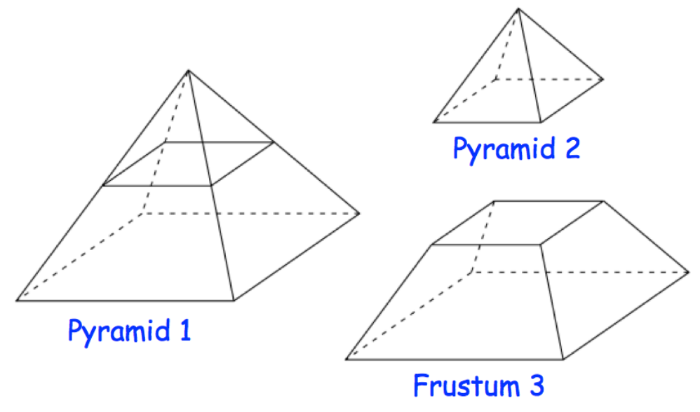
A square based pyramid 1 is divided into two parts:
a square based pyramid 2
a frustum 3, as shown.
Pyramid 1 has a base of side length 8 cm. Pyramid 2 has a base of side length 4 cm. The perpendicular height of pyramid 1 is 10 cm. Calculate the volume of frustum 3.
Factorise $2x^{2}+11x+12$

Slide 28
Given that $f\left(x\right)=3x+1$ and $g\left(x\right)=x^{2}$, write down an expression for $fg(x)$.
Solve $x^{2}−x−20<0$

Slide 29
Draw the graph of $x^{2}+y^{2}=16$, showing all points of intersection with axes.
The diagram shows a sector of a circle, centre $O$, radius 10 cm. The arc length of the sector is 15 cm. Calculate the area of the sector.
15 cm
10 cm
10 cm

Slide 30
Expand and simplify ${(2+\sqrt{3})}^{2}−{(2−\sqrt{3})}^{2}$.
Make $a$ the subject of the formula $v^{2}=u^{2}+2as$

Slide 31
$n$ is an integer. Prove algebraically that the sum of $n(n+1)$ and $n+1$ is always a square number.
Sketch the graph of $y=\cos{x}$, showing all intersections with the axes.

Slide 32
Prove that angles in the same segment are equal.
A farmer wants to estimate the number of rabbits on his farm. On Monday he catches 120 rabbits. He puts a tag on each rabbit. He then lets the rabbits run away. On Tuesday the farmer catches 70 rabbits. 15 of these rabbits have a tag on them. Work out an estimate for the total number of rabbits on the farm. You must write down any assumptions you have made.
d
c
b
a

Slide 33
Work out the formula for the $n$^{th} term of the quadratic sequence:
5, 11, 19, 29...
Simplify fully $\frac{x^{2}−x−12}{x^{2}−9x+20}$

Slide 34
The table shows information about the speed, in mph, of 120 cars. Draw a histogram to show the information in the table.
Make $a$ the subject of the formula
$s=ut+\frac{1}{2}at^{2}$
Speed (mph) | Frequency
$$40<a≤55$$ | 6
$$55<a≤60$$ | 10
$$60<a≤65$$ | 46
$$65<a≤75$$ | 48
$$75<a≤90$$ | 6

Slide 35
Write $x²+10x+2$ in the form $(x+a)²+b$ where $a$ and $b$ are integers. Hence, or otherwise, write down the coordinates of the turning point of the graph of $y=x²+10x+2$.
There are 5 red counters and y blue counters in a bag. Imogen takes a counter from the bag at random. She puts the counter back into the bag. Imogen then takes another counter at random from the bag. The probability that the first counter Imogen takes is red and the second counter Imogen takes is red is $\frac{1}{9}$. Work how many blue counters are in the bag.

Slide 36
V=IR $I=5.92$ correct to 2 decimal places
$R=12.356$ correct to 3 decimal places
Work out the upper bound for V. Give your answer to 3 decimal places.
A straight line passes through the points (0, 5) and (3, 17). Find the equation of the straight line.

Slide 37
$ABCDEF$ is a regular hexagon with centre $O$.
$\vec{OA}=a$ and $\vec{OB}=b$
$M$ is the midpoint of $BC$.
$X$ is the point on $AB$ extended, such that $AB:BX=3:2$
Prove that $E$, $M$ and $X$ are on the same straight line.
Write $0.2\dot{7}$ as a fraction in its simplest form.
$$A$$
$$B$$
$$M$$
$$a$$
$$b$$
$$F$$
$$C$$
$$E$$
$$D$$

Slide 38
Given that $f\left(x\right)=x^{2}$, work out an expression for $f^{−1}(x)$.
Solve the simultaneous equations. Give your answers to 3 significant figures.
$x^{2}+y^{2}=20$
$2x+y=3$

Slide 39
Rationalise the denominator $\frac{6}{\sqrt{3}}$
$OAB$ is a sector of a circle, centre $O$. Angle $AOB=60°$. $OA=OB=12 cm$. Work out the length of the arc $AB$. Give your answer in terms of $π$.
$$B$$
$$A$$
$$12 cm$$
$$60°$$
$$12 cm$$
$$O$$

Slide 40
Prove that ${(2n+3)}^{2}−{(2n−3)}^{2}$ is always a multiple of 12, for all positive integer values of $n$.
In 2010, 40000 people were unemployed in Tidmouth. By 2012, this had decreased to 39601. Assuming the unemployment rate is decreasing exponentially, how many people would you expect to be unemployed in Tidmouth by 2020?

Slide 41
Expand and simplify $(x−3)(x+2)(x+1)$
Solve $x^{2}−5x−24≤0$

Slide 42
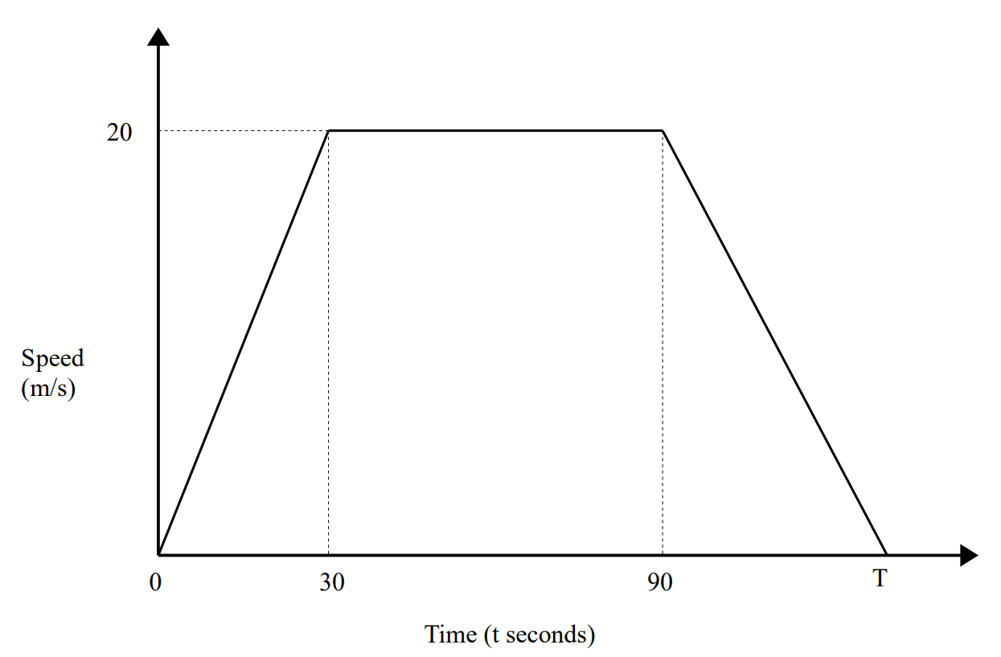
Work out the formula for the $n$^{th} term of the quadratic sequence:
2, 10, 22, 38, …
Here is a speed-time graph for a train journey between 2 stations. The train travelled 2 km in T seconds. Work out the value of T.

Slide 43
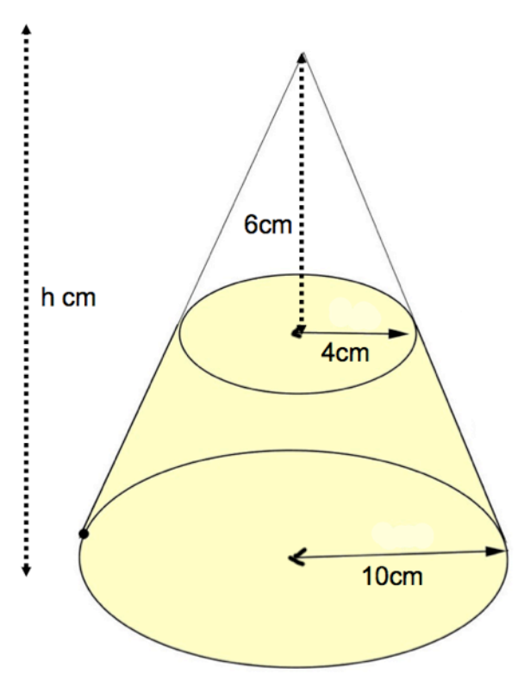
Draw the graph of $x^{2}+y^{2}=9$, showing all points of intersection with axes.
A cone below has base radius 10 cm and height $h$ cm. A smaller cone radius 4 cm and height 6 cm is cut from the top. Calculate the volume of the frustum.

Slide 44
Find the equation of the tangent to the circle $x^{2}+y^{2}=25$ at (3, 4).
Work out the value of $x$. Give your answer to 3 significant figures.
$$15 cm$$
$$x°$$
$$16 cm$$
$$20 cm$$

Slide 45
$P=\frac{E}{t}$ $E=812$ correct to 3 significant figures
$T=9.2$ correct to 1 decimal place
By considering bounds, work out the value of $P$ to a suitable degree of accuracy. Give a reason for your answer.
Simplify fully $\frac{x+4}{x^{2}−16}$

Slide 46
$\vec{OA}=5a$ and $\vec{OB}=3b$
$C$ is the point such that $OC:CA=4:1$
$M$ is the midpoint of $AB$
$D$ is the point such that $OB:OD=3:4$
Show that $C$, $M$ and $D$ are on the same straight line.
Sketch the graph of $y=\tan{x}$, showing all intersections with the axes.
$$A$$
$$5a$$
$$M$$
$$O$$
$$3b$$
$$B$$
$$D$$

Slide 47
Write $0.3\dot{9}\dot{4}$ as a fraction in its simplest form.
Make $v$ the subject of the formula $T=\frac{1}{2}mv^{2}$

Slide 48
Solve $x^{2}−12x+35≥0$
Solve $\frac{8}{x+3}+\frac{3}{x+8}=1$

Slide 49
Write $x²–2x–1$ in the form $(x+a)²+b$ where $a$ and $b$ are integers. Hence, or otherwise, write down the coordinates of the turning point of the graph of $y=x²–2x–1$.
Factorise and solve $3x^{2}+17x+10=0$

Slide 50
There are $N$ beads in a jar. 40 of these beads are black. Julie takes at random a sample of 50 beads from the jar. 5 of the beads in her sample are black. Work out an estimate for the value of $N$.
Make $x$ the subject of the formula $2x+a=b(x–2)$

Slide 51
Show that line $3y=4x−14$ is perpendicular to line $4y=−3x+48$.
Write $\frac{{3x}^{2}+11x−4}{x^{2}+3x−4}$ in the form $\frac{ax+b}{x+c}$ where $a$, $b$ and $c$ are integers.

Slide 52
Prove that the sum of 3 consecutive odd numbers is always a multiple of 3.
Solve the simultaneous equations:
$y=x^{2}$
$y=x+2$

Slide 53
Expand and simplify $(x−6)(x+1)(x−2)$
The diagram shows an equilateral triangle $ABC$ with sides of length 6 cm. $P$ is the midpoint of $AB$. $Q$ is the midpoint of $AC$. $APQ$ is a sector of a circle, centre $A$. Calculate the area of the shaded region. Give your answer correct to 3 significant figures.
$$B$$
$$6 cm$$
$$6 cm$$
$$P$$
$$Q$$
$$A$$
$$C$$
$$6 cm$$

Slide 54
Simplify $\frac{3+\sqrt{6}}{\sqrt{3}}$
Solve $x^{2}−7x+12<0$

Slide 55
$f=\frac{\sqrt{g}}{h}$ $g=12.7$ correct to 3 significant figures
$h=9.294$ correct to 3 decimal places
By considering bounds, work out the value of $f$ to a suitable degree of accuracy.
The population of rabbits increases exponentially. In year 1, there were 400 rabbits. By year 3, there were 529 rabbits. How many rabbits were there by year 5?

Slide 56
Given that $f\left(x\right)=3x+1$ and $g\left(x\right)=x^{2}$, write down an expression for $gf(x)$.
There are 4 red counters and x blue counters in a bag. 2 counters are removed from the bag at random. The probability that both the counters taken are blue is $\frac{1}{3}$. Work out the value of x.

Slide 57
Clive wants to estimate the number of bees in a beehive. Clive catches 50 bees from the beehive. He marks each bee with a dye. He then lets the bees go. The next day, Clive catches 40 bees from the beehive. 8 of these bees have been marked with the dye. Work out an estimate for the number of bees in the beehive.
Make $x$ the subject of the formula $x(2+a)=b(x+3)$

Slide 58
Work out the formula for the $n$^{th} term of the quadratic sequence:
15, 19, 25, 33, …
Factorise $2x^{2}−x−1$

Slide 59
$OMN$ is a triangle.
$P$ is the point on $OM$ such that $OP=\frac{1}{4}OM$
$Q$ is the midpoint of $ON$
$R$ is the midpoint of $PN$
$\vec{OP}=p$ and $\vec{OQ}=q$
Use a vector method to prove that $QR$ is parallel to $OP$.
Write $0.\dot{3}8\dot{6}$ as a fraction in its simplest form.
$$M$$
$$P$$
$$O$$
$$R$$
$$Q$$
$$N$$

Slide 60
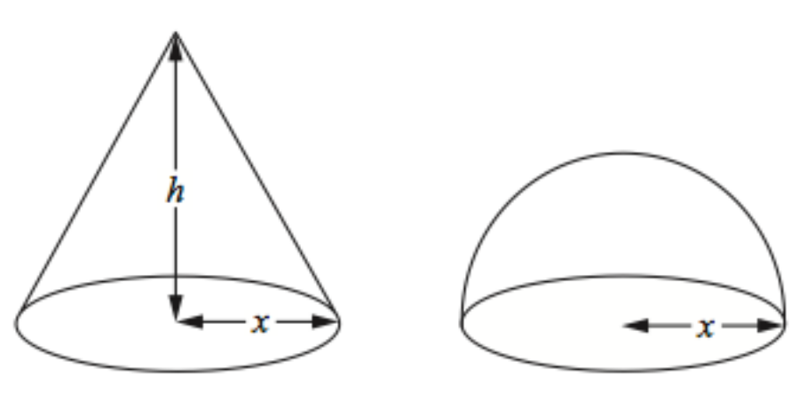
Draw the graph of $x^{2}+y^{2}=64$, showing all points of intersection with axes.
The diagram shows a cone and a hemisphere. The hemisphere has base radius $x$ cm. The cone has base radius $x$ cm and perpendicular height $h$ cm. The volume of the cone is equal to the volume of the hemisphere. The volume of a hemisphere is $⅔πr³$. Find an expression for $h$ in terms of $x$.

Slide 61
Work out the size of angle $BAC$. Give your answer to 3 significant figures.
The point $A$ has the coordinates (2, 5). The point $B$ has the coordinates (6, 7). Find the midpoint of $AB$.
$$B$$
$$5.2 cm$$
$$6.9 cm$$
$$A$$
$$7.3 cm$$
$$C$$

Slide 62
Given that $g\left(x\right)=x+3$, work out an expression for $g^{−1}(x)$.
The diagram shows a sector $OABC$ of a circle with centre $O$. $OA=OC=10.4 cm$. Angle $AOC=120°$. Calculate the area of the shaded segment $ABC$. Give your answer correct to 3 significant figures.
$$B$$
$$A$$
$$C$$
$$120°$$
$$10.4 cm$$
$$10.4 cm$$
$$O$$

Slide 63
Prove that opposite angles of a cyclic quadrilateral sum to 180°.
Sketch the graph of $y=\sin{x}$, showing all intersections with the axes.

Slide 64
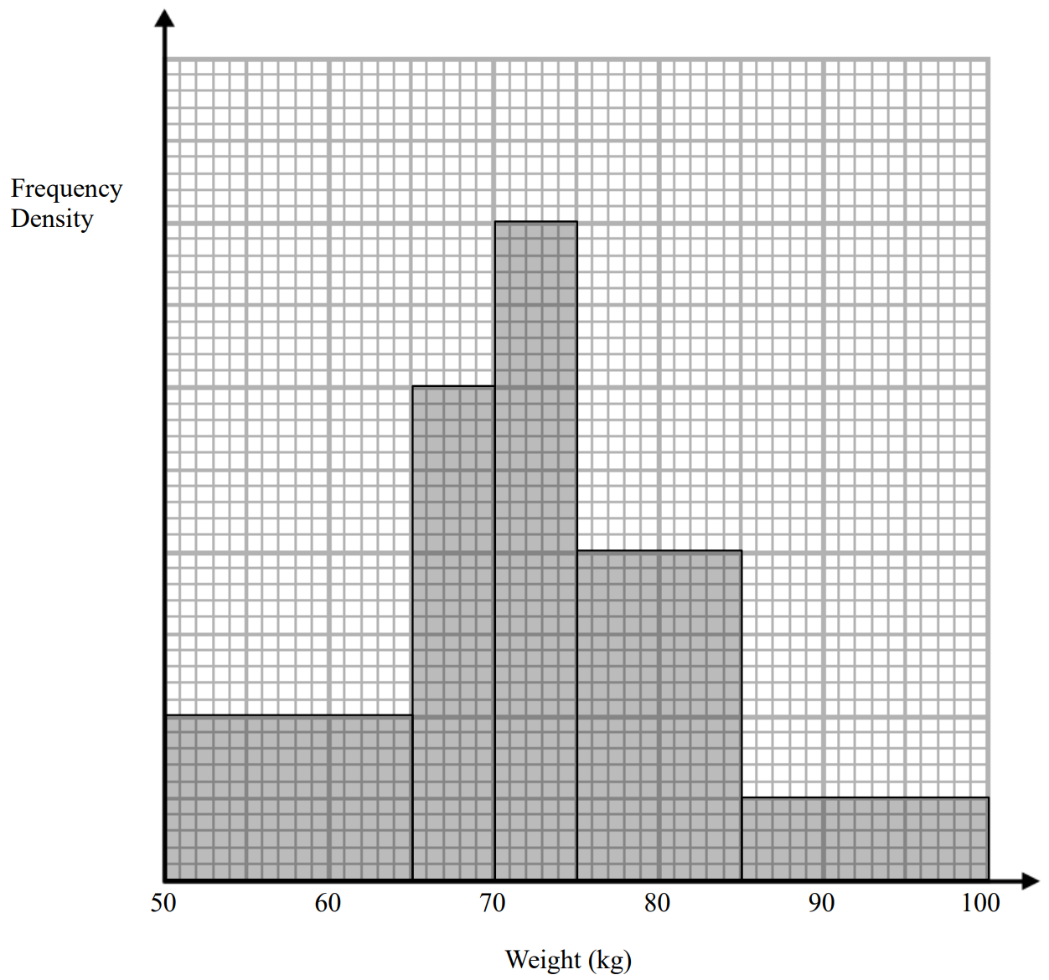
The histogram shows information about the weight of pigs. 30 pigs weigh between 50 and 65 kg. Work out an estimate for the number of pigs which weigh more than 80kg.
Solve $\frac{8}{3x−2}+\frac{6}{x+1}=2$

Slide 65
$P=\frac{F}{A}$ $F=25.14N$ correct 2 decimal places
$A=4.29m^{2}$ correct to 3 significant figures
By considering bounds, work out the value of $P$ to a suitable degree of accuracy. Give a reason for your answer.
Make $x$ the subject of the formula $a=\frac{x+4}{x+2}$

Slide 66
Simplify fully $\frac{(4+2\sqrt{3})(4−2\sqrt{3})}{\sqrt{11}}$
Solve the simultaneous equations:
$y=x^{2}−3x+4$
$y−x=1$

Slide 67
Prove algebraically that the sum of the squares of any 2 even positive integers is always a multiple of 4.
By completing the square, find the coordinates of the turning point of the curve with the equation $y=x²+8x+3$. You must show all your working.

Slide 68
Work out the formula for the $n$^{th} term of the quadratic sequence:
19, 15, 9, 1, …
In 2008, 1.7 million iPhones were sold. In 2012, 35.2 million iPhones were sold. Assuming the sales of iPhones increases exponentially, how many iPhones should be expected to be sold in 2020?

Slide 69
Expand and simplify $(x−7)(x+3)(x−1)$
There are $n$ counters in a bag. 4 of the counters are red and the rest are blue. Ross takes a counter from the bag at random and does not replace it. He then takes another counter at random from the bag. The probability that Ross takes two blue counters is $\frac{1}{3}$
Show that $n^{2}−13n+30=0$
Find the value of $n$.

Slide 70
Solve $x^{2}+2x−35≥0$
The point $A$ has the coordinates (2, 5). The point $B$ has the coordinates (6, 7). Find the equation of the perpendicular bisector to $AB$.

Slide 71
Toga wants to estimate the number of termites in a nest. On Monday Toga catches 80 termites. He puts a mark on each termite. He then puts all 80 termites back in the nest. On Tuesday Toga catches 60 termites. 12 of these termites have a mark on them. Work out an estimate for the total number of termites in the nest. You must write down any assumptions you have made.
Write $\frac{x^{2}+7x−18}{{2x}^{2}−x−6}$ in the form $\frac{x+a}{bx+c}$ where $a$, $b$ and $c$ are integers.

Slide 72
Factorise $3x^{2}−11x+6$
Make $x$ the subject of the formula $a=\frac{x+c}{x−b}$

Slide 73
Sketch the graph of $y=\cos{x}$, showing all intersections with the axes.
Solve $\frac{2}{5−x}+\frac{3}{x+7}=1$

Slide 74
$OPQ$ is a triangle.
$R$ is the midpoint of $OP$
$S$ is the midpoint of $PQ$
$\vec{OP}=p$ and $\vec{OQ}=q$
Show that $RS$ is parallel to $OQ$.
Make $x$ the subject of the formula
$\frac{a}{b}=\frac{2x}{x+5}$
$$P$$
$$p$$
$$R$$
$$S$$
$$O$$
$$q$$
$$Q$$

Slide 75
Draw the graph of $x^{2}+y^{2}=36$, showing all points of intersection with axes.
Factorise and solve $4x^{2}−19x−5=0$

Slide 76
There are a large number of white beads in a bag. There are only white beads in the bag. Felicity wants to find an estimate for the number of beads in the bag. Felicity replaces 30 of the white beads in the bag with 30 black beads. She then takes 50 beads from the bag. 2 of the 50 beads are black. Felicity then puts the 50 beads back in the bag. Work out an estimate for the number of beads in the bag.
Simplify fully $\frac{2x−2}{x+5}÷\frac{x^{2}−4x+3}{{2x}^{2}+13x+15}$

Slide 77
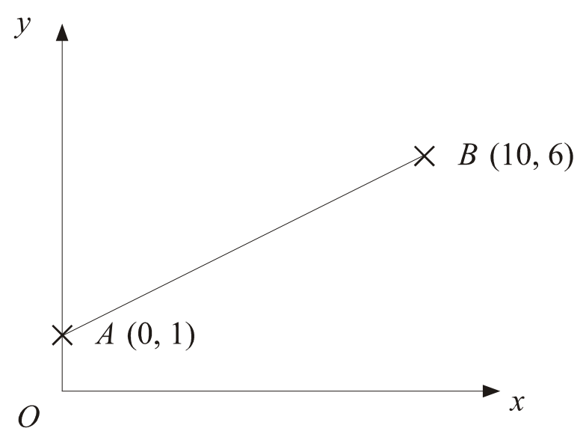
Write $2.3\dot{4}\dot{5}$ as a fraction in its simplest form.
$A$ is the point (0, 1). $B$ is the point (10, 6). Find the equation of the line perpendicular to $AB$ passing through $B$.

Slide 78
$v^{2}=u^{2}+2as$ $v=35.2$ correct to 1 decimal place
$a=9.8$ correct to 1 decimal place
$s=60.35$ correct to decimal places
Work out the upper bound for $u$. Give your answer to 3 significant figures.
Make $x$ the subject of the formula $a=\frac{4+2bx}{2x−3}$

Slide 79
The diagram shows a sector of a circle, centre $O$. The radius of the circle is 6 cm. Angle $AOB=120°$. Work out the perimeter of the sector. Give your answer in terms of $π$ in its simplest form.
Solve $\frac{7}{x+1}−\frac{4}{3x−2}=1$
$$A$$
$$B$$
$$120°$$
$$6 cm$$
$$6 cm$$
$$O$$

Slide 80
Show that $\frac{5+2\sqrt{3}}{2+\sqrt{3}}$ can be written as $4−\sqrt{3}$.
There are $n$ counters in a bag. 8 of the counters are red and the rest are blue. Adam takes a counter from the bag at random and does not replace it. He then takes another counter at random from the bag. The probability that Adam takes two blue counters is $\frac{1}{5}$
Show that $n^{2}−21n+90=0$
Find the value of $n$.

Slide 81
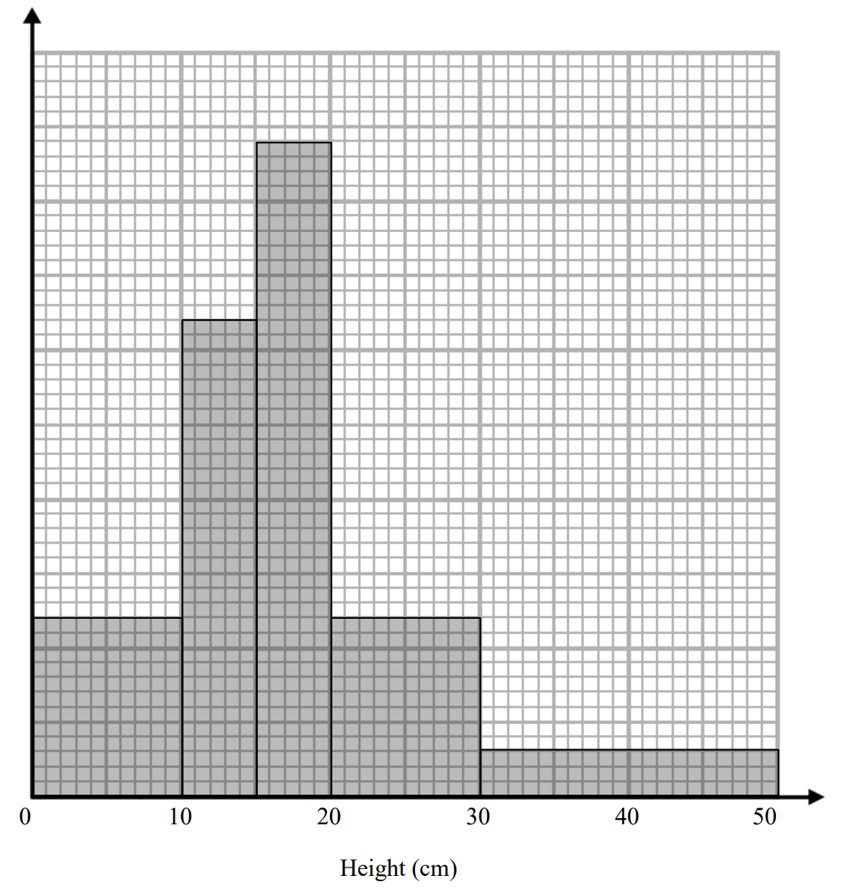
The histogram shows information about the height of some plants. Work out an estimate for the proportion of plants over 25 cm tall.
Solve the simultaneous equations. Give your answers to 3 significant figures:
$y=x^{2}+2x−7$
$x+y=5$

Slide 82
Expand and simplify ${(x−3)}^{3}$
Work out the value of $x$. Give your answer to 1 decimal place.
$$x cm$$
$$65°$$
$$13 cm$$
$$40°$$
$$5 cm$$

Slide 83
A newly born octopus weighed 180 grams. After 2 days, it weighed 202 grams. The octopus’ weight increases exponentially for the first few weeks of its life. How much will the octopus weigh after 2 weeks?
Make $b$ the subject of the formula $\frac{1}{a}=\frac{1}{b}+\frac{1}{c}$

Slide 84
Prove that the difference between the squares of any 2 consecutive integers is equal to the sum of these integers.
Solve $x^{2}<100$

Slide 85
By completing the square, find the coordinates of the turning point of the curve with the equation $y=x²+3x–7$. You must show all your working.
Sketch the graph of $y=\tan{x}$, showing all intersections with the axes.

Slide 86
Given that $f\left(x\right)=4x−1$ and $g\left(x\right)=kx^{2}$ where $k$ is a constant. Given that $fg\left(2\right)=12$, work out the value of $k$.
Factorise and solve $5x^{2}+11x−12=0$

Slide 87
Prove algebraically that $0.\dot{9}=1$.
Solve $x^{2}−49>0$

Slide 88
Expand and simplify ${(x+1)(x−2)}^{2}$
$P$ is the point (4, -9). $Q$ is the point (-2, 0). Find the equation of the perpendicular bisector of $PQ$.

