Slide 1




Starter – Premier League Attendance
Write the attendance in words (don’t forget spelling!) and then round each attendance to the nearest 10, nearest 100, nearest 1000 and nearest 10000.

Slide 2
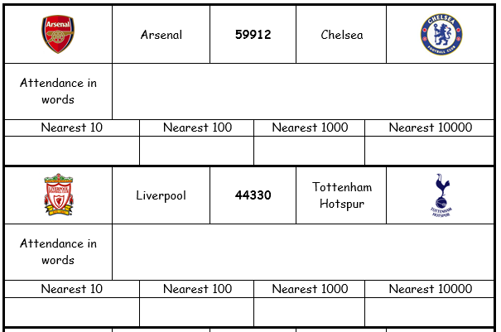
Answers
Fifty-nine thousand, nine hundred and twelve
59910
59900
60000
60000
Forty-four thousand, three hundred and thirty
44330
44300
44000
40000

Slide 3
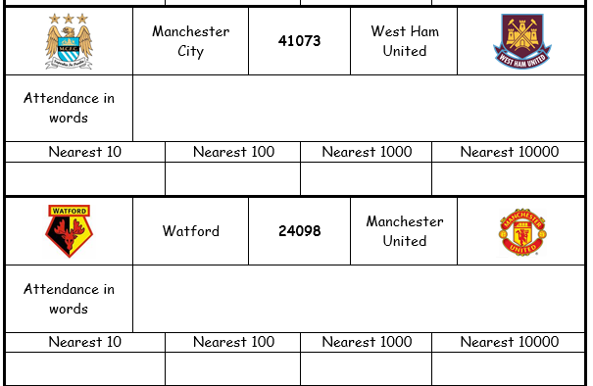
Answers
Forty-one thousand and seventy-three
41070
41100
41000
40000
Twenty-four thousand and ninety-eight
24100
24100
24000
20000

Slide 4
4 . 8 5 2
1DP
2DP
3DP
1 . 6 9 4 9
5 . 2 6 2 7
5 or more?
5 or more?
5 or more?
Yes
No
Yes
4 . 9
1 . 6 9
5 . 2 6 3
Choose
red,
amber
or
green
Number | To 1DP | To 2DP | To 3DP
63.4721
87.6564
149.9875
3.54029
0.59999
63.5
63.47
63.472
Your Turn
87.7
87.66
87.656
150.0
149.99
149.988
3.5
3.54
3.540
0.6
0.60
0.600

Slide 5
Significant Figures
If you read that the attendance at a football match was exactly 41,786 and a friend asked you about the attendance, you would probably say “about 40,000”.
In this case you are giving an approximate answer to one significant figure.

Slide 6
Significant Figures
The first significant figure is the first non-zero digit.
Every digit after the first significant figure is also significant.
Round how you normally would (0, 1, 2, 3 and 4 round down, 5, 6, 7, 8 and 9 round up).
You must maintain place value using zero place-holders where necessary.

Slide 7
Significant Figures
Examples
4 5 9 6 1 3 7 8 9 4 0 . 0 0 2 3 6 8 0 7 6

Slide 8
Significant Figures
Examples
Round the following to 1 significant figure.
4 5 9 6 1 3 7 8 9 4 0 . 0 0 2 3 6 8 0 7 6
5
Which is the first significant figure?
0 0 0
Round up or down?
Maintain place value!

Slide 9
Significant Figures
Examples
Round the following to 1 significant figure.
4 5 9 6 1 3 7 8 9 4 0 . 0 0 2 3 6 8 0 7 6
5
Which is the first significant figure?
0 0 0
1
0 0 0 0 0
Round up or down?
Maintain place value!

Slide 10
Significant Figures
Examples
Round the following to 1 significant figure.
4 5 9 6 1 3 7 8 9 4 0 . 0 0 2 3 6 8 0 7 6
5
Which is the first significant figure?
0 0 0
1
0 0 0 0 0
0 . 0 0
2
Round up or down?
Maintain place value!

Slide 11
Significant Figures
Examples
Round the following to 1 significant figure.
4 5 9 6 1 3 7 8 9 4 0 . 0 0 2 3 6 8 0 7 6
5
Which is the first significant figure?
0 0 0
1
0 0 0 0 0
0 . 0 0
2
8
0 0 0
Round up or down?
Maintain place value!

Slide 12
Significant Figures
Examples
Round the following to 1 significant figure.
Round the following to 2 significant figures.
4 5 9 6 1 3 7 8 9 4 0 . 0 0 2 3 6 8 0 7 6
5
Which is the second significant figure?
0 0 0
1
0 0 0 0 0
0 . 0 0
2
8
0 0 0
4 6
0 0
Round up or down?
Maintain place value!

Slide 13
Significant Figures
Examples
Round the following to 1 significant figure.
Round the following to 2 significant figures.
4 5 9 6 1 3 7 8 9 4 0 . 0 0 2 3 6 8 0 7 6
5
Which is the second significant figure?
0 0 0
1
0 0 0 0 0
0 . 0 0
2
8
0 0 0
4 6
0 0
1 4
0 0 0 0
Round up or down?
Maintain place value!

Slide 14
Significant Figures
Examples
Round the following to 1 significant figure.
Round the following to 2 significant figures.
4 5 9 6 1 3 7 8 9 4 0 . 0 0 2 3 6 8 0 7 6
5
Which is the second significant figure?
0 0 0
1
0 0 0 0 0
0 . 0 0
2
8
0 0 0
4 6
0 0
1 4
0 0 0 0
0 . 0 0
2 4
Round up or down?
Maintain place value!

Slide 15
Significant Figures
Examples
Round the following to 1 significant figure.
Round the following to 2 significant figures.
4 5 9 6 1 3 7 8 9 4 0 . 0 0 2 3 6 8 0 7 6
5
Which is the second significant figure?
0 0 0
1
0 0 0 0 0
0 . 0 0
2
8
0 0 0
4 6
0 0
1 4
0 0 0 0
0 . 0 0
2 4
8 1
0 0
Round up or down?
Maintain place value!

Slide 17
Answers
Q1
(a) 3 (b) 4 (c) 1
(d) 2 (e) 4 (f) 6
Q2
(a) 92 850 (b) 92 800
(c) 93 000 (d) 90 000
Q3
(a) 0.08 (b) 0.9
(c) 0.005 (d) 0.001
Q4
(a) 0.14 (b) 0.90
(c) 0.058 (d) 0.0060
Q5
(a) 1630 (b) 1600

Slide 18


Estimating
To estimate the answer to a calculation, first round every number to 1 significant figure.
Examples
$2.23×6.81$
$8.173÷1.97$
$3621×639$
$\sqrt{95.1}×2.48$
$≈$
This symbol means ‘approximately equal to’

Slide 19









Estimating
To estimate the answer to a calculation, first round every number to 1 significant figure.
Examples
$2.23×6.81$
$8.173÷1.97$
$3621×639$
$\sqrt{95.1}×2.48$
$≈2×7$
$=14$
$≈8÷2$
$=4$
$≈4000×600$
$=2 400 000$
$≈\sqrt{100}×2$
$=10×2$
$=20$

Slide 20
On a long haul flight an aeroplane flew 3123 miles in 9.6 hours. Work out an estimate of how many miles it flew each hour.
3000 | 30
300 | 3
A
B
C
D

Slide 21
On a long haul flight an aeroplane flew 3123 miles in 9.6 hours. Work out an estimate of how many miles it flew each hour.
3000 | 30
300 | 3
A
B
C
D

Slide 22

Estimate the answer to this question:
54.6 $×$ 2.91
?
15 | 1.5
1500 | 150
A
B
C
D

Slide 23
Estimate the answer to this question:
54.6 $×$ 2.91
?
15 | 1.5
1500 | 150
A
B
C
D

Slide 24

Martyn rode 287 kilometres in 11 days. Roughly how many kilometres did he ride each day?
3000 | 30
300 | 3
A
B
C
D

Slide 25
Martyn rode 287 kilometres in 11 days. Roughly how many kilometres did he ride each day?
3000 | 30
300 | 3
A
B
C
D

Slide 26

Estimate the answer to this question:
2.1 $×$ 9.7 $×$ 3.7
?
0.8 | 80
800 | 8
A
B
C
D

Slide 27
Estimate the answer to this question:
2.1 $×$ 9.7 $×$ 3.7
?
0.8 | 80
800 | 8
A
B
C
D

Slide 28
A square has edges of length 2.14cm. What is an estimate of the area?
0.4 | 40
400 | 4
A
B
C
D

Slide 29
A square has edges of length 2.14cm. What is an estimate of the area?
0.4 | 40
400 | 4
A
B
C
D

Slide 30

Estimate the answer to this question:
935 $×$ 29
?
27000 | 2700
27 | 270
A
B
C
D

Slide 31
Estimate the answer to this question:
935 $×$ 29
?
27000 | 2700
27 | 270
A
B
C
D

Slide 32
At a theatre they sold 73 cups of coffee during the interval at 68p a cup. Estimate the amount they took on coffee.
£4.90 | £490
£49 | £4900
A
B
C
D

Slide 33
At a theatre they sold 73 cups of coffee during the interval at 68p a cup. Estimate the amount they took on coffee.
£4.90 | £490
£49 | £4900
A
B
C
D

Slide 34

Estimate the answer to this question:
34.87 $×$ 20.27
?
0.6 | 60
600 | 6
A
B
C
D

Slide 35
Estimate the answer to this question:
34.87 $×$ 20.27
?
0.6 | 60
600 | 6
A
B
C
D

Slide 36

At Dave’s ice cream stall he sold 223 ice creams at 67p each. Estimate how much his takings were that day.
£1.40 | £140
£14 | £1400
A
B
C
D

Slide 37
At Dave’s ice cream stall he sold 223 ice creams at 67p each. Estimate how much his takings were that day.
£1.40 | £140
£14 | £1400
A
B
C
D

Slide 38

Estimate the answer to this question
3.14 $×$ 7.92
?
24000 | 2400
24 | 240
A
B
C
D

Slide 39
Estimate the answer to this question
3.14 $×$ 7.92
?
24000 | 2400
24 | 240
A
B
C
D

Slide 41
Answers
Use a calculator and fill in the last column on the green and red sheets. Write the actual answer next to the amber activity in your book.

