Slide 1
Starter
Round the following numbers to the nearest 10:
1. 37
2. 755
3. 754.999999999
4. 10
5. 10483923
Round the following numbers to 1 decimal place:
1. 0.345
2. 0.269
3. 3.34
4. 2.98
5. 19.99

Slide 2
Answers
Round the following numbers to the nearest 10:
1. 40
2. 760
3. 750
4. 10
5. 10483920
Round the following numbers to 1 decimal place:
1. 0.3
2. 0.3
3. 3.3
4. 3.0
5. 20.0

Slide 3
Can you answer this?
An IMAX cinema screen is 22 m by 16 m to the nearest metre.
Calculate the limits of accuracy for the area of the screen.

Slide 4
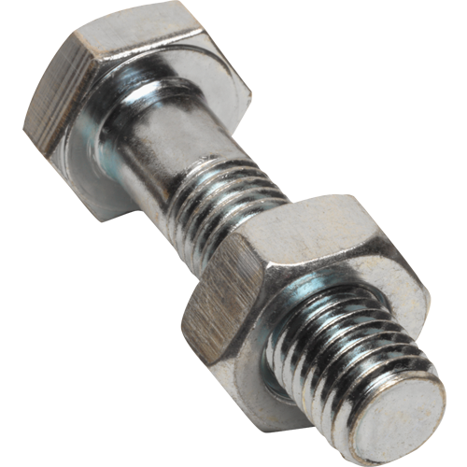
Think, Pair, Share
A company building a new formula one car decides to order its nuts and bolts to an accuracy of 0.1 mm. What problems could this cause?
7 mm $±$ 0.1 mm

Slide 5
A number has been rounded to the nearest whole number, what could it have been?
If it was rounded up, it could have been?
5
If it was rounded down, it could have been?
4.9
4.87
4.61
5.1
5.34
5.48
4.5
5.49999999999999…
5.5
What’s the smallest number it could have been?
What’s the biggest number it could have been?

Slide 6
The Empire State Building is 443 m tall, to the nearest metre.
444
443.5
442.5 ≤ Height < 443.5
Limits of
Accuracy
443
442.5
442

Slide 7
These numbers have been rounded to the nearest 10, write down the largest and smallest values they could be. Express your answers as inequalities in terms of $x$:
a. 50 b. 80 c. 110
45 $≤x<$ 55 75 $≤x<$ 85 105 $≤x<$ 115
These numbers have been rounded to the nearest whole number, write down the upper and lower bounds. Express your answers as inequalities in terms of $x$:
a. 3 b. 17 c. 100
2.5 $≤x<$ 3.5 17.5 $≤x<$ 18.5 99.5 $≤x<$ 100.5
These lengths have been rounded to the nearest tenth, write the upper and lower limits. Express your answers as inequalities in terms of x:
a. 12.5cm b. 21.7cm c. 52.1cm
12.45 $≤x<$ 12.55 21.65 $≤x<$ 21.75 52.05 $≤x<$ 52.15

Slide 8
Example
A room is measured as 6.4 $×$ 4.3 metres, measured to 1 decimal place.
Calculate the upper and lower bounds of the area of floor in the room.
LB = 6.35 m
6.4 m
UB = 6.45 m
UB = 4.35m
4.3 m
LB = 4.25 m
Minimum area = 6.35 $×$ 4.25
= 26.9875 m²
Maximum area = 6.45 $×$ 4.35
= 28.0575 m²
26.9875 m² $≤A<$ 28.0575 ²

Slide 9
Example
A room is measured as 6.4 $×$ 4.3 metres, measured to 1 decimal place.
What about the minimum and maximum length of the skirting board?
LB = 6.35 m
6.4 m
UB = 6.45 m
UB = 4.35m
4.3 m
LB = 4.25 m
Minimum length = 2 $×$ (6.35 + 4.25)
= 21.2 m
Maximum length = 2 $×$ (6.45 + 4.35)
= 21.6 m
21.2 m $≤L<$ 21.6 m

Slide 10
Example
The Bugatti Veyron can travel 800 metres (to the nearest 10 m) in 4.4 seconds (to 1 decimal place). Calculate the upper and lowers bounds of its maximum speed to 3 significant figures.
Lower bound = LB distance
UB time
Upper bound = UB distance
LB time
= 795
4.45
= 805
4.35
= 178.651685 m/s
= 185.057471 m/s
179 m/s $≤S<$ 185 m/s

Slide 12
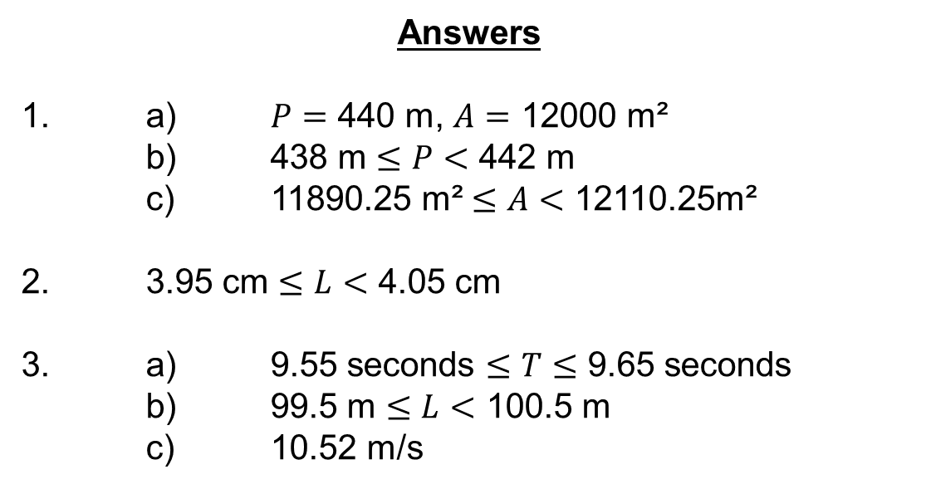
Answers
1. a) $P=$ 440 m, $A=$ 12000 m²
b) 438 m $≤P<$ 442 m
c) 11890.25 m² $≤A<$ 12110.25m²
2. 3.95 cm $≤L<$ 4.05 cm
3. a) 9.55 seconds $≤T≤$ 9.65 seconds
b) 99.5 m $≤L<$ 100.5 m
c) 10.52 m/s

Slide 13
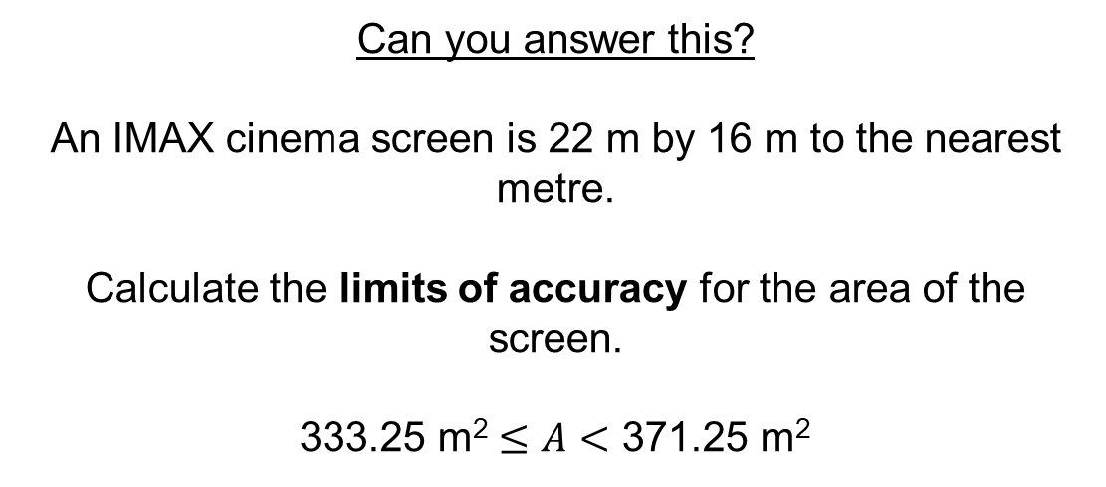
Can you answer this?
An IMAX cinema screen is 22 m by 16 m to the nearest metre.
Calculate the limits of accuracy for the area of the screen.
333.25 m² $≤A<$ 371.25 m²

