Slide 1
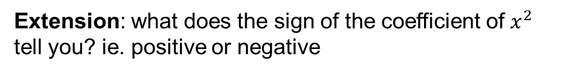
 | What is it? | How do we find it?
1
2
3
4
4
1
2
2
3
Extension: what does the sign of the coefficient of $x^{2}$ tell you? ie. positive or negative

Slide 2
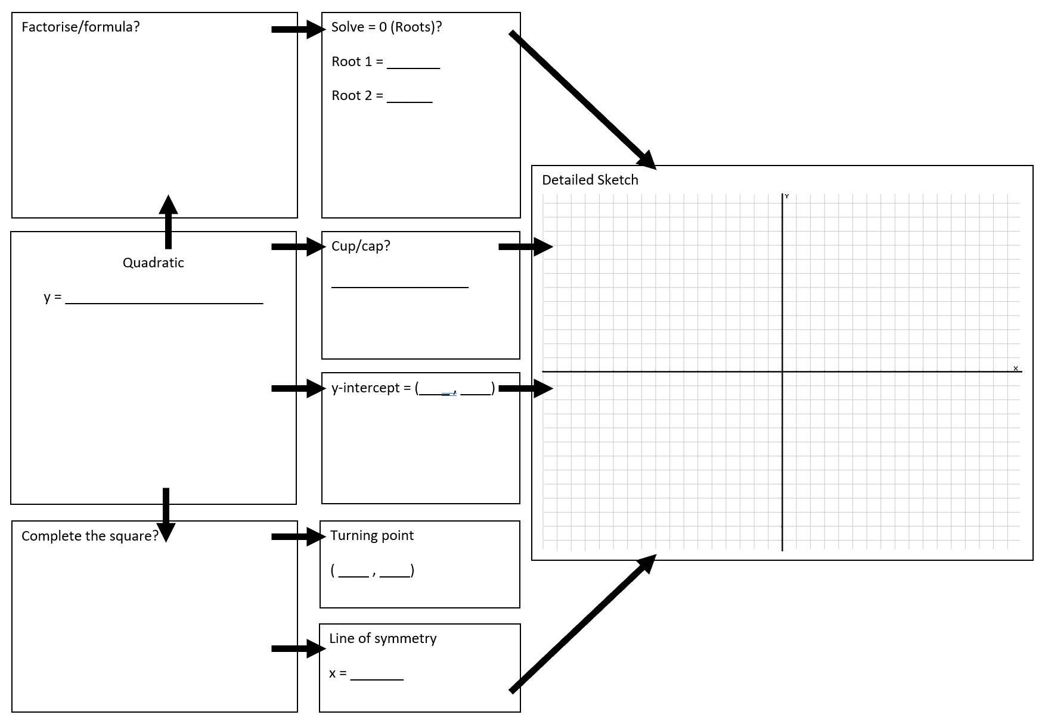
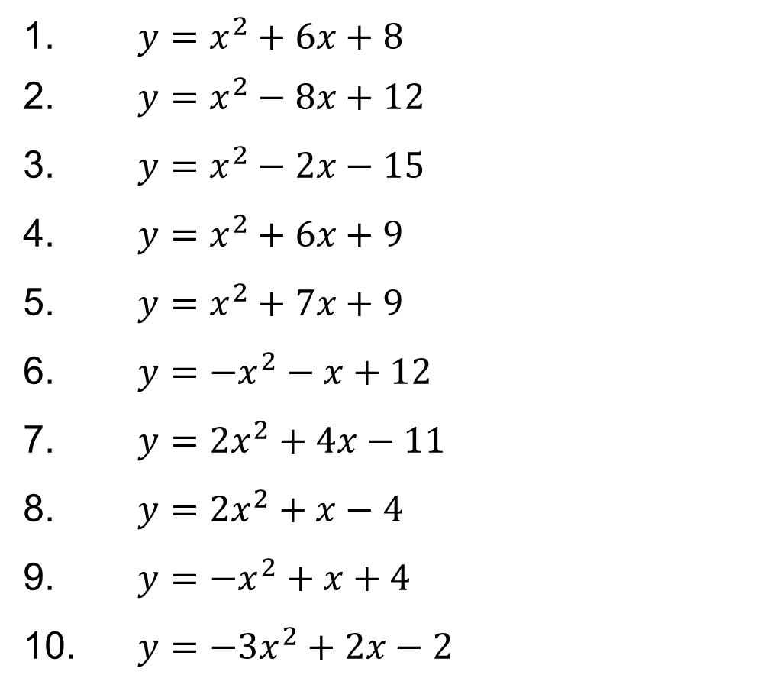
1. $y=x^{2}+6x+8$
2. $y=x^{2}−8x+12$
3. $y=x^{2}−2x−15$
4. $y=x^{2}+6x+9$
5. $y=x^{2}+7x+9$
6. $y=−x^{2}−x+12$
7. $y=2x^{2}+4x−11$
8. $y=2x^{2}+x−4$
9. $y=−x^{2}+x+4$
10. $y=−3x^{2}+2x−2$
Fill in the boxes for each of the quadratic functions!

