Slide 1
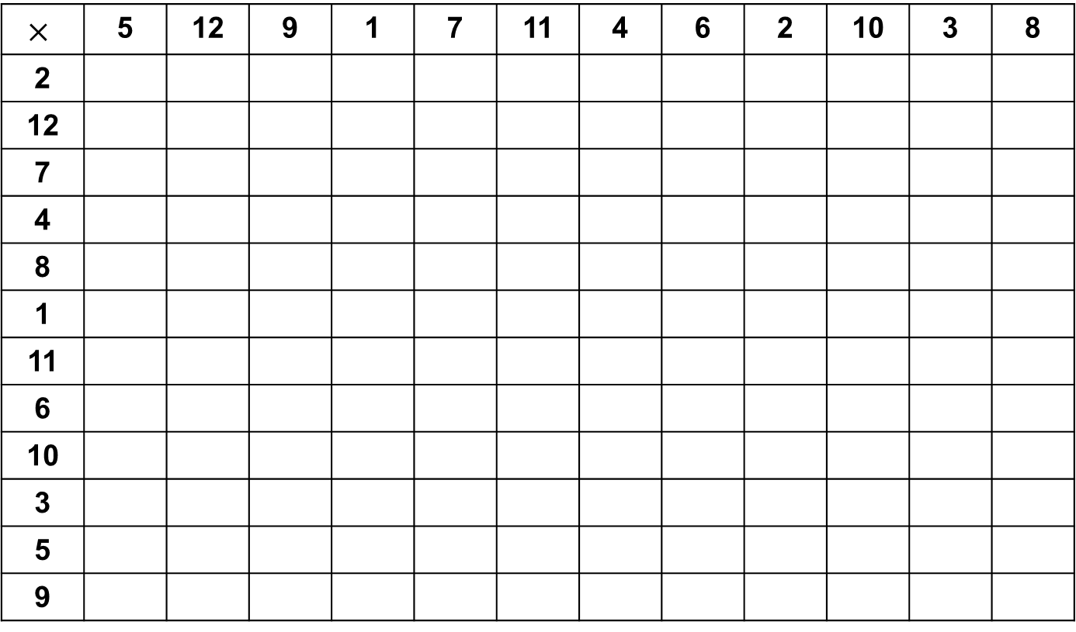
Starter – Fill in the jumbled-up times tables grid
$$×$$ | 5 | 12 | 9 | 1 | 7 | 11 | 4 | 6 | 2 | 10 | 3 | 8
2
12
7
4
8
1
11
6
10
3
5
9

Slide 2
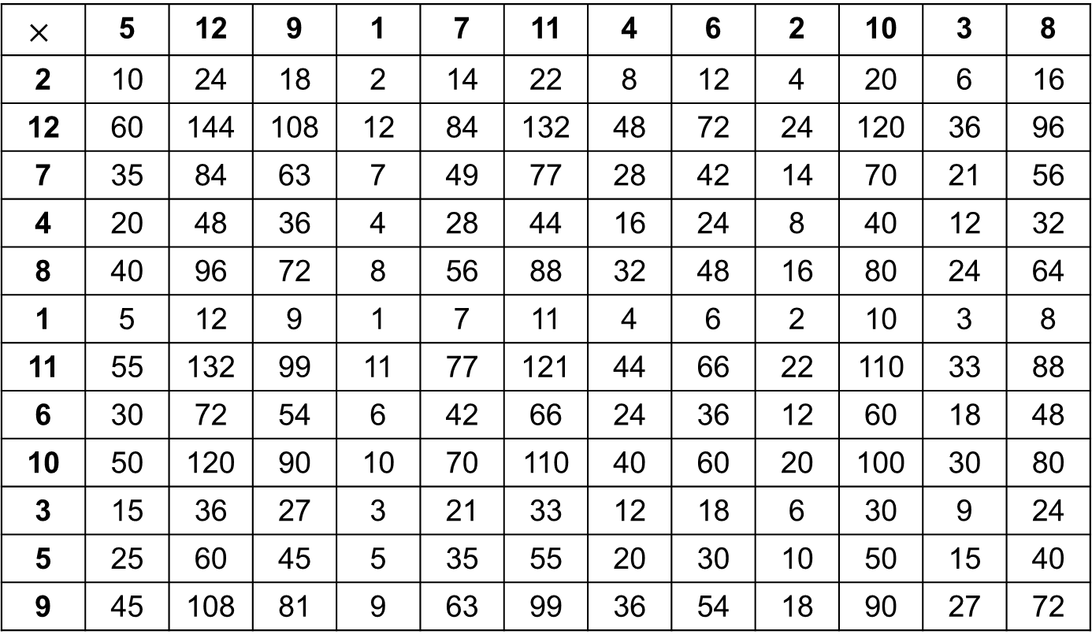
Answers
$$×$$ | 5 | 12 | 9 | 1 | 7 | 11 | 4 | 6 | 2 | 10 | 3 | 8
2 | 10 | 24 | 18 | 2 | 14 | 22 | 8 | 12 | 4 | 20 | 6 | 16
12 | 60 | 144 | 108 | 12 | 84 | 132 | 48 | 72 | 24 | 120 | 36 | 96
7 | 35 | 84 | 63 | 7 | 49 | 77 | 28 | 42 | 14 | 70 | 21 | 56
4 | 20 | 48 | 36 | 4 | 28 | 44 | 16 | 24 | 8 | 40 | 12 | 32
8 | 40 | 96 | 72 | 8 | 56 | 88 | 32 | 48 | 16 | 80 | 24 | 64
1 | 5 | 12 | 9 | 1 | 7 | 11 | 4 | 6 | 2 | 10 | 3 | 8
11 | 55 | 132 | 99 | 11 | 77 | 121 | 44 | 66 | 22 | 110 | 33 | 88
6 | 30 | 72 | 54 | 6 | 42 | 66 | 24 | 36 | 12 | 60 | 18 | 48
10 | 50 | 120 | 90 | 10 | 70 | 110 | 40 | 60 | 20 | 100 | 30 | 80
3 | 15 | 36 | 27 | 3 | 21 | 33 | 12 | 18 | 6 | 30 | 9 | 24
5 | 25 | 60 | 45 | 5 | 35 | 55 | 20 | 30 | 10 | 50 | 15 | 40
9 | 45 | 108 | 81 | 9 | 63 | 99 | 36 | 54 | 18 | 90 | 27 | 72

Slide 3
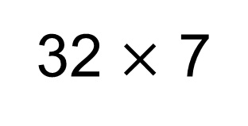
32 $×$ 7
= 224
3
2
2
2
1
7
1
4
2
4

Slide 4
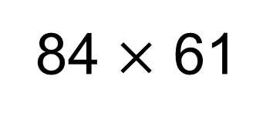
84 $×$ 61
= 5124
8
4
1
4
2
5
6
8
4
1
0
0
1
1
8
4
2
4

Slide 6
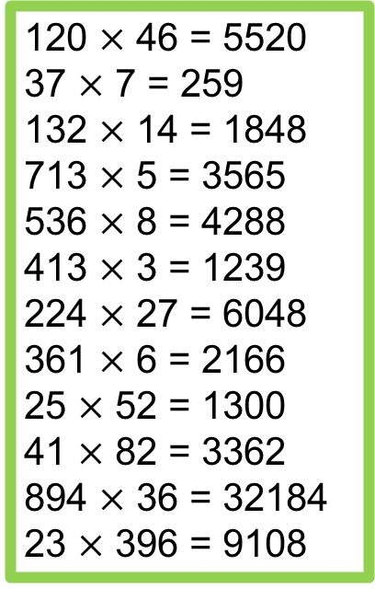
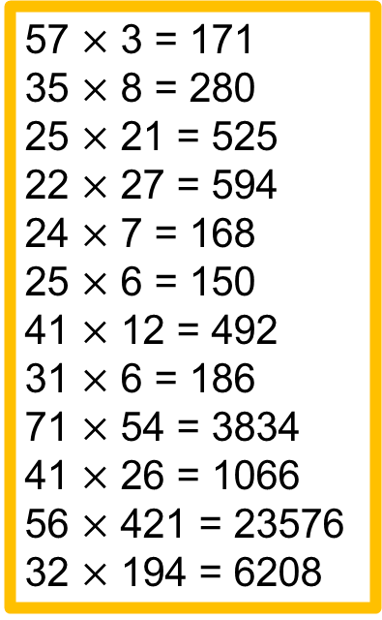
Answers
126
126
224
216
140
195
185
258
236
228
396
576
57 $×$ 3 = 171
35 $×$ 8 = 280
25 $×$ 21 = 525
22 $×$ 27 = 594
24 $×$ 7 = 168
25 $×$ 6 = 150
41 $×$ 12 = 492
31 $×$ 6 = 186
71 $×$ 54 = 3834
41 $×$ 26 = 1066
56 $×$ 421 = 23576
32 $×$ 194 = 6208
120 $×$ 46 = 5520
37 $×$ 7 = 259
132 $×$ 14 = 1848
713 $×$ 5 = 3565
536 $×$ 8 = 4288
413 $×$ 3 = 1239
224 $×$ 27 = 6048
361 $×$ 6 = 2166
25 $×$ 52 = 1300
41 $×$ 82 = 3362
894 $×$ 36 = 32184
23 $×$ 396 = 9108
420 pages
705 passengers
£152.40
£43.50
£21.75
£3150
£51.92
£63.83

