Slide 1
Graphs, Differentiation and Integration
Are all of the following properties possible for the same graph? Can you sketch it?
① Gradient function of $\frac{dy}{dx}=2x−4$
② Area under the graph for $0≤x≤6$ = 36 units²
③ Turning point at (2, -8)
④ y-intercept at (0, -12)
Which combinations of properties work?

Slide 2
Exponentials and Logarithms
Sort the questions found here into a Venn Diagram.
Think about:
Topics involved
Steps required
Crossovers with other areas of maths
Notes:
Click here for teacher notes: https://www.dropbox.com/s/0brszdbakxxpg8f/Teacher%20notes.docx?dl=0
And here for Venn diagram: https://www.dropbox.com/s/w8m0v5ieyogs0zl/Venn%20diagrams.pptx?dl=0

Slide 3
Vectors
Which one of these is the odd one out? Why?
$3i + 2j$ $\left[\begin{matrix}−6 \\ −4\end{matrix}\right]$ $(3.61, 123.7°)$
$(7.21, 33.7°)$ $\frac{3}{4}i + \frac{1}{2}j$ $\left[\begin{matrix}2 \\ 3\end{matrix}\right]$
Hint: Maybe a sketch or two would help?
Could any of the others be an odd one out? Why?
Can you arrange it so that each of these vectors has an individual property of their own?

Slide 4
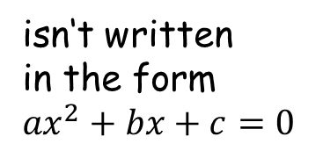
Quadratic Equations
Can you write a quadratic equation that satisfies each part of the Venn diagram below?
y-intercept is -4
isn‘t written
in the form
${ax}^{2}+bx+c=0$
has equal repeated roots

