Slide 1
Starter
On the same axes, sketch the graphs of the following using the given tables of values:
$y= 2^{x}$
$y= 3^{x}$
$y= 1^{x}$
$y= {\left(\frac{1}{2}\right)}^{x}$
What do you notice?
What’s the same? What’s different?
Can you justify your findings?
Make sure you label your graphs clearly!

Slide 2
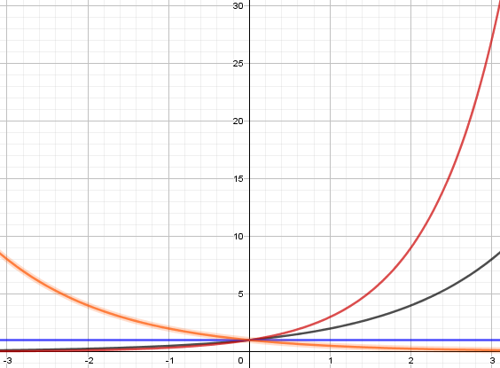
$y= 2^{x}$ and $y= 3^{x}$ are increasing functions
…because $2^{−1}=\frac{1}{2}$
$y= {\left(\frac{1}{2}\right)}^{x}$ is a reflection of $y= 2^{x}$ in x = 0
…because $1^{m}=1$
$y= {\left(\frac{1}{2}\right)}^{x}$ is a decreasing function
$y= 1^{x}$ is the same as $y=1$
$y=0$ is an asymptote to the curve
All intersect at (0, 1)
…because $a^{0}=1$

Slide 3
Functions of the form $f\left(x\right)=a^{x}$, where $a$ is a constant, are called exponential functions.
$x$ can be called an index, a power or an exponent.

Slide 4
Task
1a) Draw an accurate graph of $y ={\left(1.7\right)}^{x}$ for
$−4 ≤ x ≤ 4$
b) Use your graph to solve the equation ${\left(1.7\right)}^{x}=4$
2a) Draw an accurate graph of $y ={\left(0.6\right)}^{x}$ for
$−4 ≤ x ≤ 4$
b) Use your graph to solve the equation ${\left(0.6\right)}^{x}=2$
$$x≈2.6$$
$$x≈−1.4$$

Slide 5
The graphs of gradient functions of exponential functions are in a similar shape to the graphs of the functions themselves…
Click here to see on Autograph!
Something unique happens between a = 2 and a = 3 → the gradient function is exactly the same as the original function
Notes:
Teacher guidance for Autograph file from Pixi:
Click the constant controller at the top (k with arrows)
Press play
Discuss!

Slide 6
$y= e^{x}$ is a special case.
$e$ is an irrational constant approximately equal to 2.718281828459
$e$ is the base rate of growth shared by all continually growing processes. $e$ shows up whenever systems grow exponentially and continuously: population, radioactive decay, interest calculations, and more.

Slide 7
Differentiating $y=e^{x}$
For all real values of $x$ and for any constant $k$:
If $y=e^{kx}$ then $\frac{dy}{dx}={ke}^{kx}$
All the mathematical functions went to a party. There they saw the exponential function sitting by himself. They poked him, "C'mon man, join the party!“ To which he replied, “But integrating won’t make any difference…"

Slide 8
Examples
$y=e^{4x}$ $y=e^{−\frac{1}{2}x}$ $y={3e}^{2x}$
$$\frac{dy}{dx}={4e}^{4x}$$
$$\frac{dy}{dx}={−\frac{1}{2}e}^{−\frac{1}{2}x}$$
$$\frac{dy}{dx}={6e}^{2x}$$
Your Turn
$y=e^{6x}$ $y=e^{−7x}$ $y=e^{\frac{1}{2}x}$
$y=e^{−\frac{x}{4}}$ $y=e^{3x}+{2e}^{x}$ $y=e^{x}\left(e^{x}+1\right)$
$$\frac{dy}{dx}={6e}^{6x}$$
$$\frac{dy}{dx}={−7e}^{−7x}$$
$$\frac{dy}{dx}={\frac{1}{2}e}^{\frac{1}{2}x}$$
$$\frac{dy}{dx}={−\frac{1}{4}e}^{−\frac{x}{4}}$$
$$\frac{dy}{dx}={3e}^{3x}+{2e}^{x}$$
$$\frac{dy}{dx}={2e}^{2x}+e^{x}$$

Slide 9
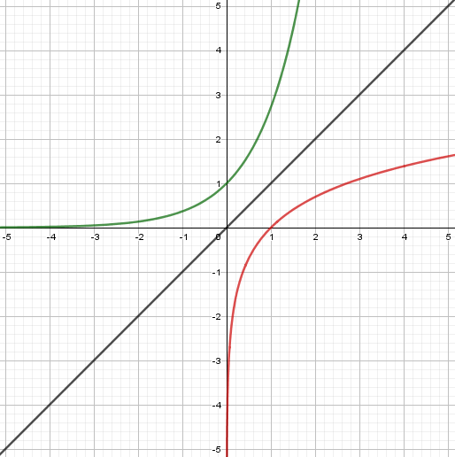
$$y=e^{x}$$
What do you notice?
Intercepts
Asymptotes
Symmetry
Similarities
Differences
$$y=x$$
$$y=ln x$$

Slide 10
Inverse Functions
Remember, inverse functions are reflections of the original functions in the line y = x
$$+4$$
$$^{3}$$
$$−4$$
$$\sqrt[3]{≤}$$
$$cos$$
$$e$$
$$\cos^{−1}$$
$$ln$$

Slide 11
We can use the fact that logarithms are the inverses of exponential functions to solve equations involving powers and logarithms.
$$e^{\ln{x}}=\ln\left(e^{x}\right)=x$$
$$\ln{x}=\log_{e}x$$

Slide 12
Pair Activity
Work together to complete the Tarsia jigsaw on exponentials and natural logarithms.
Make sure you both understand every question (I’ll be questioning you as I move around the room to check!) and that you show your working clearly in your books.

Slide 13
Solution

