Slide 1
Instructions
Five rounds of five questions
Combination of maths and Christmas (Christmaths?)
Think of a (sensible) team name and write it at the top of your answer sheet
Write your answers clearly in the correct places
Have fun!

Slide 2
Round 1
(Fairly easy)

Slide 3

R1 Q1
Simplify $\sqrt{48}$

Slide 4

R1 Q2
What is the value of $i^{4}$?

Slide 5

R1 Q3
Write the $2×2$ identity matrix

Slide 6
R1 Q4
What is the label on the vertical axis on an Argand diagram?

Slide 7
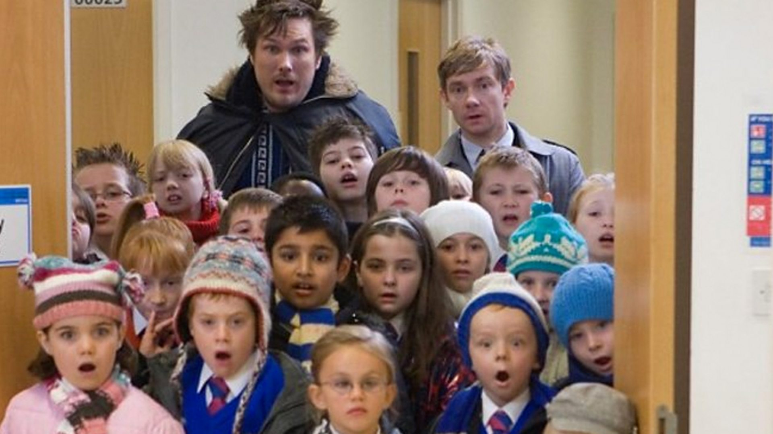
R1 Q5
Name the movie:

Slide 8
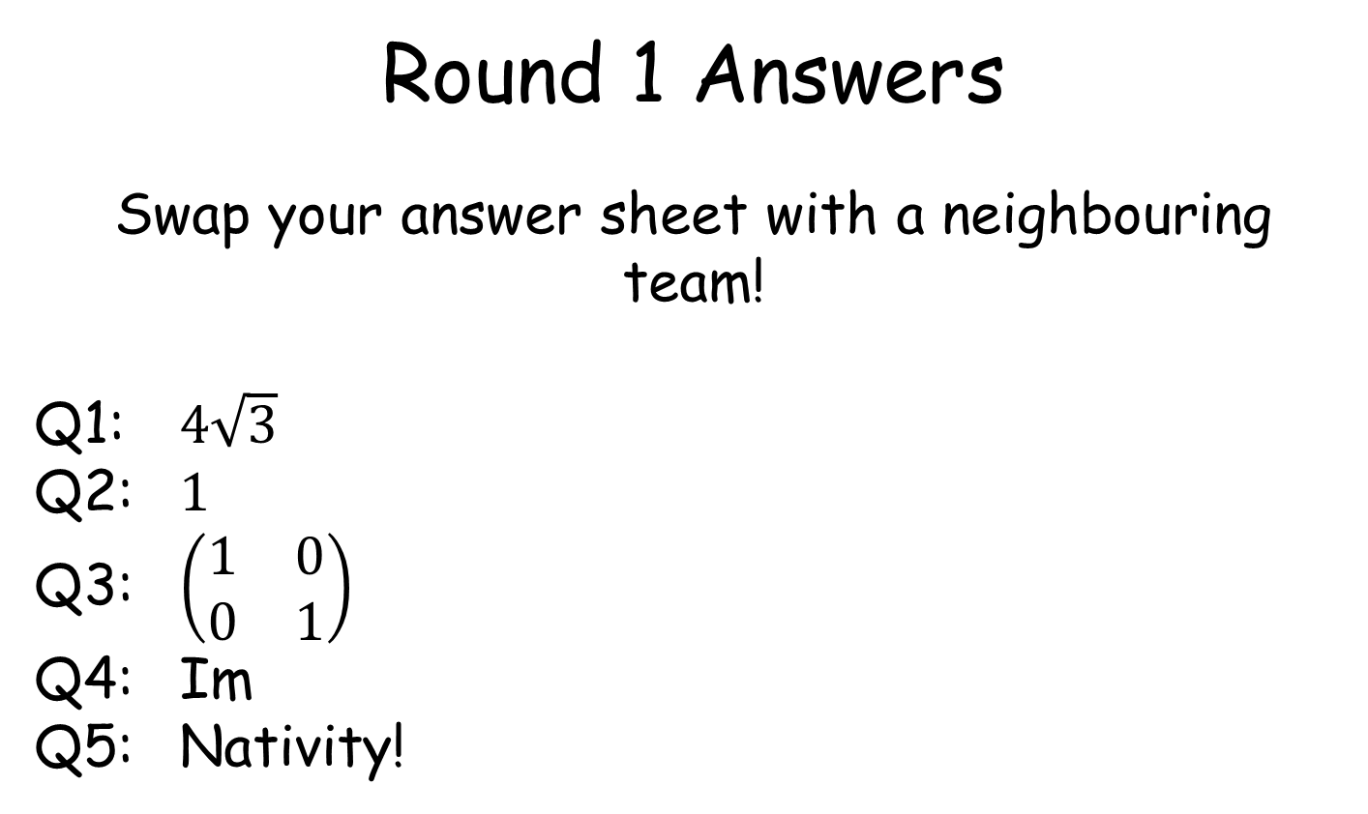
Round 1 Answers
Swap your answer sheet with a neighbouring team!
Q1: $4\sqrt{3}$
Q2: $1$
Q3: $\left(\begin{matrix}1 & 0 \\ 0 & 1\end{matrix}\right)$
Q4: Im
Q5: Nativity!
Swap back to see how you did ☺

Slide 9
Round 2
(Not too bad)

Slide 10
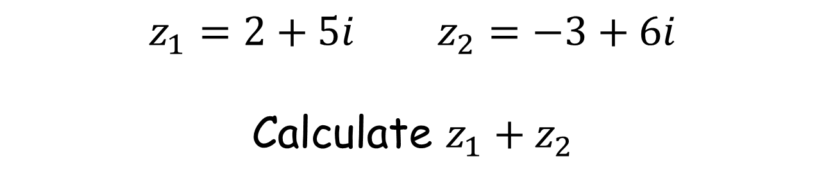
R2 Q1
$z_{1}=2+5i$ $z_{2}=−3+6i$
Calculate $z_{1}+z_{2}$

Slide 11

R2 Q2
Factorise $6x^{2}+x−12$

Slide 12

R2 Q3
$$A=\left(\begin{matrix}4 & −1 \\ 3 & 2\end{matrix}\right)$$
Find $det⁡(A)$

Slide 13
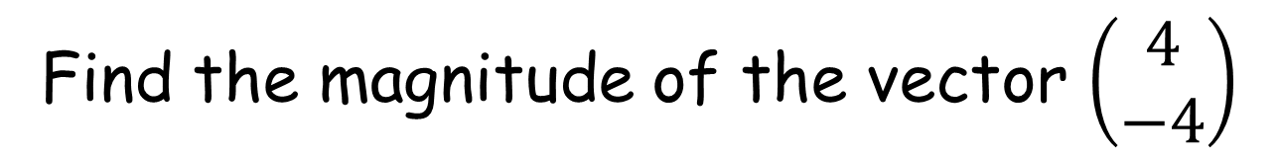
R2 Q4
Find the magnitude of the vector $\left(\begin{matrix}4 \\ −4\end{matrix}\right)$

Slide 14
R2 Q5
Name the song featuring the lyrics:
“So kiss me under the mistletoe
Pour out the wine
Let's toast and pray for December snow”

Slide 15
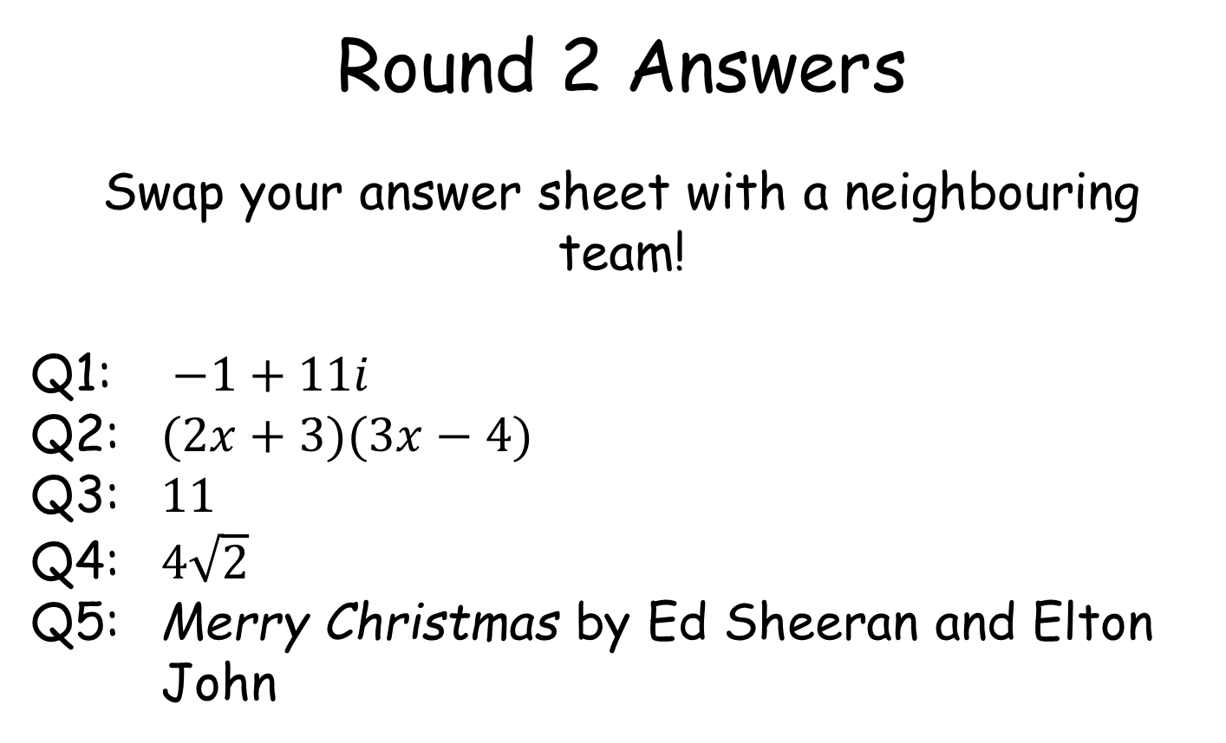
Round 2 Answers
Swap your answer sheet with a neighbouring team!
Q1: $−1+11i$
Q2: $(2x+3)(3x−4)$
Q3: $11$
Q4: $4\sqrt{2}$
Q5: Merry Christmas by Ed Sheeran and Elton John
Swap back to see how you did ☺

Slide 16
Round 3
(A little tricky)

Slide 17
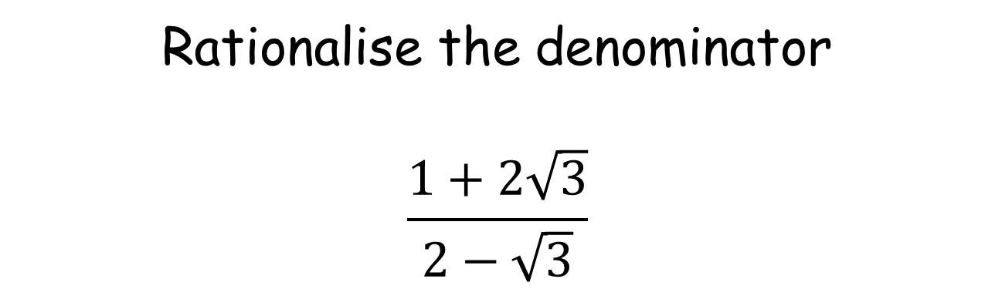
R3 Q1
Rationalise the denominator
$$\frac{1+2\sqrt{3}}{2−\sqrt{3}}$$

Slide 18

R3 Q2
Solve $z^{2}−12z+37=0$

Slide 19
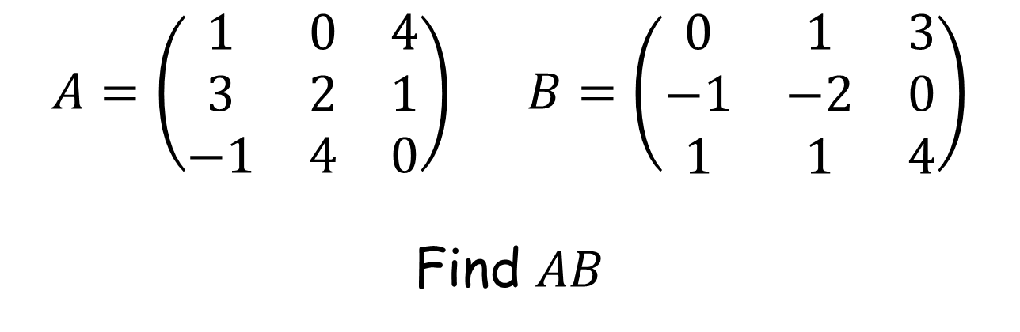
R3 Q3
$A=\left(\begin{matrix}1 & 0 & 4 \\ 3 & 2 & 1 \\ −1 & 4 & 0\end{matrix}\right)$ $B=\left(\begin{matrix}0 & 1 & 3 \\ −1 & −2 & 0 \\ 1 & 1 & 4\end{matrix}\right)$
Find $AB$

Slide 20

R3 Q4
Expand and simplify
$$i(3+4i)(2−i)$$

Slide 21
R3 Q5
Who played Kevin McCallister in Home Alone?

Slide 22
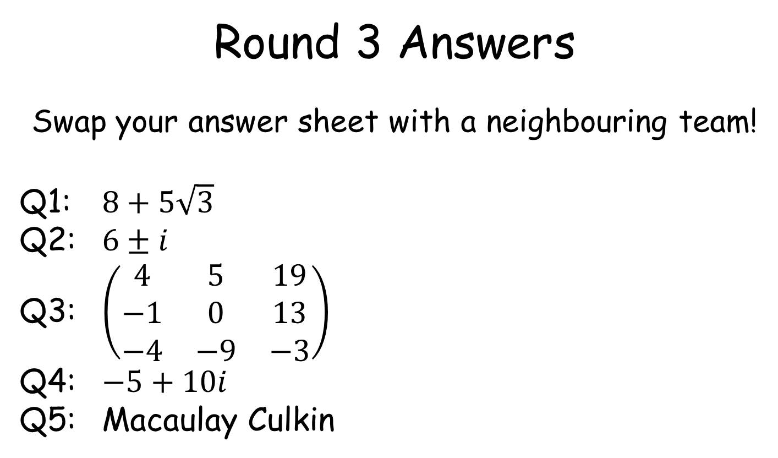
Round 3 Answers
Swap your answer sheet with a neighbouring team!
Q1: $8+5\sqrt{3}$
Q2: $6±i$
Q3: $\left(\begin{matrix}4 & 5 & 19 \\ −1 & 0 & 13 \\ −4 & −9 & −3\end{matrix}\right)$
Q4: $−5+10i$
Q5: Macaulay Culkin
Swap back to see how you did ☺

Slide 23
Round 4
(Pretty tough)

Slide 24
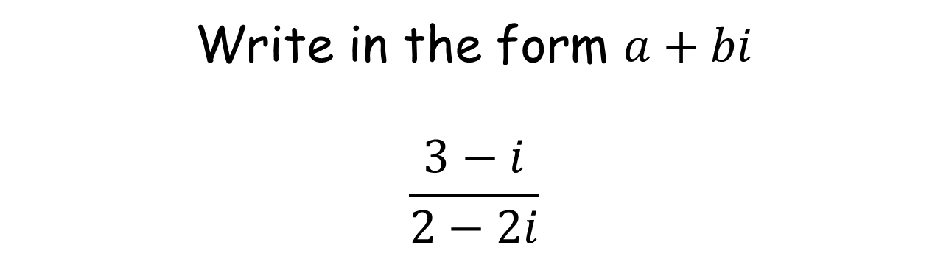
R4 Q1
Write in the form $a+bi$
$$\frac{3−i}{2−2i}$$

Slide 25
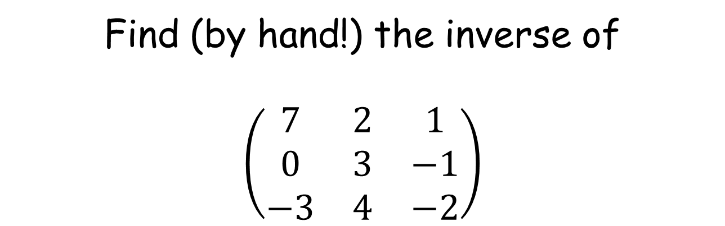
R4 Q2
Find (by hand!) the inverse of
$$\left(\begin{matrix}7 & 2 & 1 \\ 0 & 3 & −1 \\ −3 & 4 & −2\end{matrix}\right)$$

Slide 26
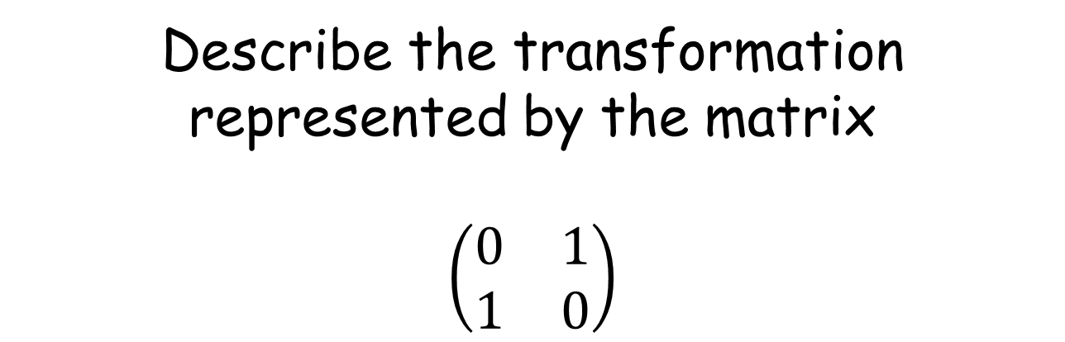
R4 Q3
Describe the transformation represented by the matrix
$$\left(\begin{matrix}0 & 1 \\ 1 & 0\end{matrix}\right)$$

Slide 27
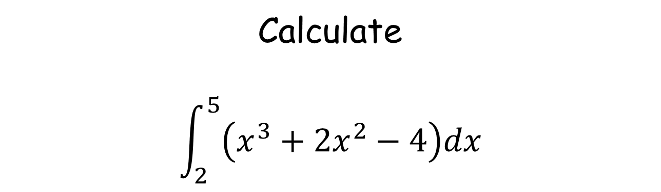
R4 Q4
Calculate
$$\int_{2}^{5}{\left(x^{3}+2x^{2}−4\right)dx}$$

Slide 28
R4 Q5
Can you name all eight original reindeer?

Slide 29
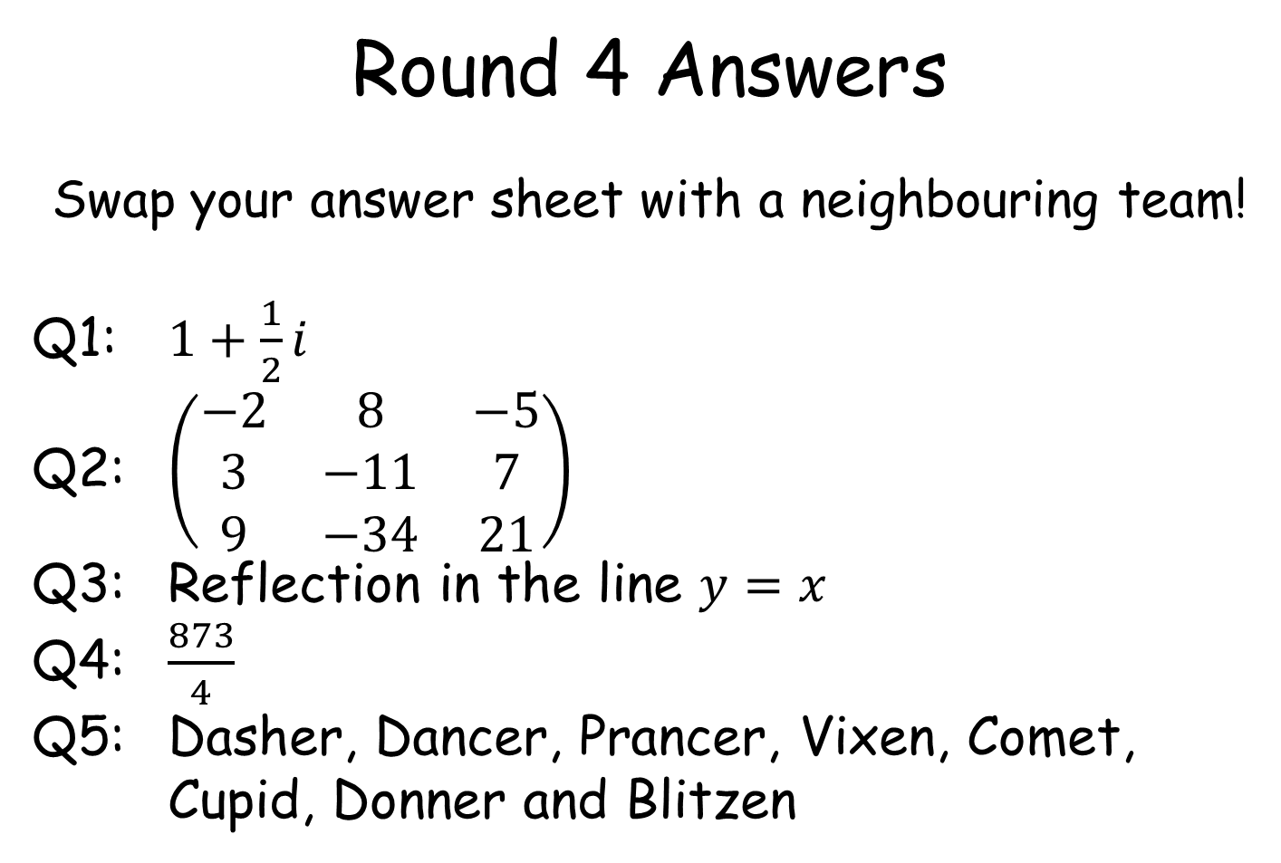
Round 4 Answers
Swap your answer sheet with a neighbouring team!
Q1: $1+\frac{1}{2}i$
Q2: $\left(\begin{matrix}−2 & 8 & −5 \\ 3 & −11 & 7 \\ 9 & −34 & 21\end{matrix}\right)$
Q3: Reflection in the line $y=x$
Q4: $\frac{873}{4}$
Q5: Dasher, Dancer, Prancer, Vixen, Comet, Cupid, Donner and Blitzen
Swap back to see how you did ☺

Slide 30
Round 5
(Hard as nails)

Slide 31
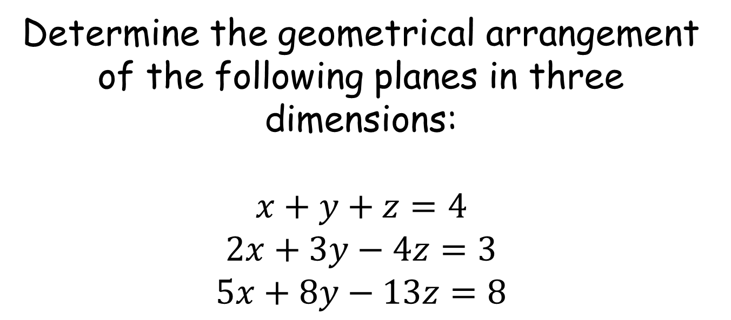
R5 Q1
Determine the geometrical arrangement of the following planes in three dimensions:
$$x+y+z=4$$
$$2x+3y−4z=3$$
$$5x+8y−13z=8$$

Slide 32

R5 Q2
Write $z=−3−i$ in modulus-argument form

Slide 33
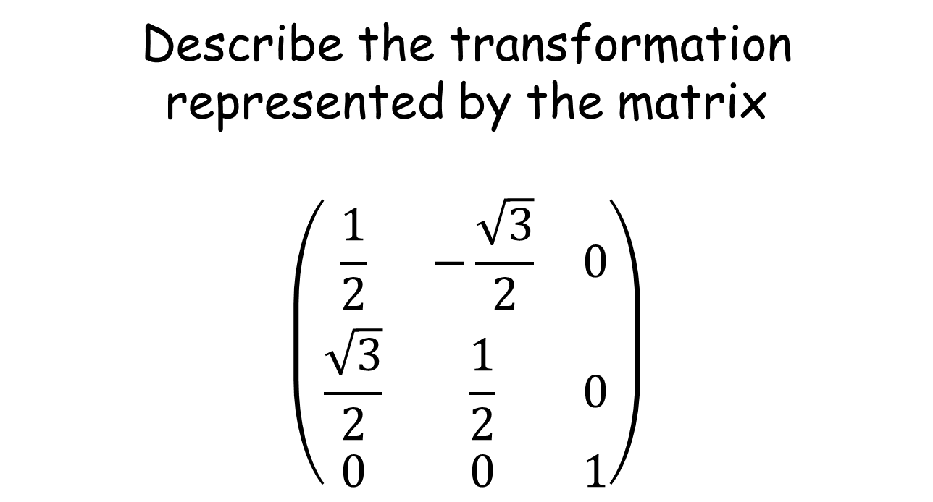
R5 Q3
Describe the transformation represented by the matrix
$$\left(\begin{matrix}\frac{1}{2} & −\frac{\sqrt{3}}{2} & 0 \\ \frac{\sqrt{3}}{2} & \frac{1}{2} & 0 \\ 0 & 0 & 1\end{matrix}\right)$$

Slide 34
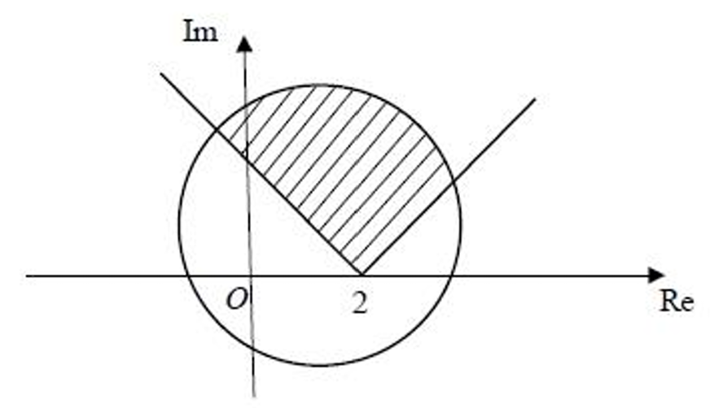
R5 Q4
Describe the shaded region using set notation

Slide 35
R5 Q5
Which year was Love Actually released?

Slide 36
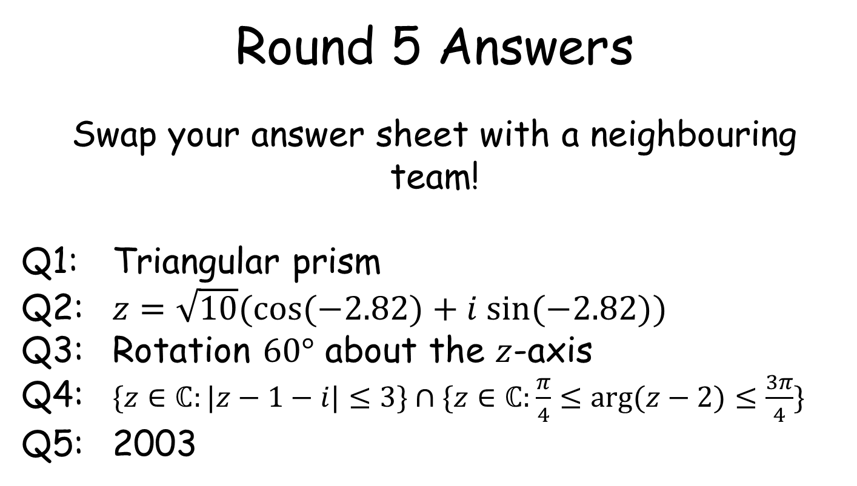
Round 5 Answers
Swap your answer sheet with a neighbouring team!
Q1: Triangular prism
Q2: $z=\sqrt{10}​(cos⁡(−2.82)+i sin⁡(−2.82))$
Q3: Rotation $60°$ about the $z$-axis
Q4: $\{z∈ℂ:|z−1−i|≤3\}∩$ $\{z∈ℂ:\frac{π}{4}≤arg⁡(z−2)≤\frac{3π}{4}\}$
Q5: 2003
Swap back to see how you did ☺

