Slide 1
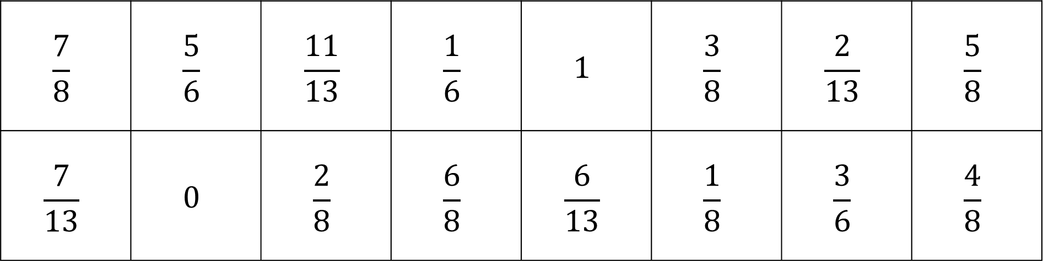
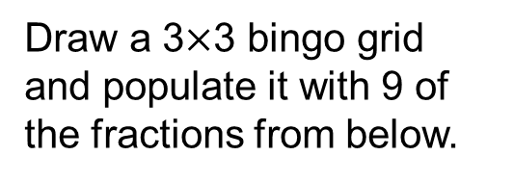
Draw a 3$×$3 bingo grid and populate it with 9 of the fractions from below.
No repeats! (You definitely won’t win if you do)
$$\frac{7}{8}$$ | $$\frac{5}{6}$$ | $$\frac{11}{13}$$ | $$\frac{1}{6}$$ | $$1$$ | $$\frac{3}{8}$$ | $$\frac{2}{13}$$ | $$\frac{5}{8}$$
$$\frac{7}{13}$$ | $$0$$ | $$\frac{2}{8}$$ | $$\frac{6}{8}$$ | $$\frac{6}{13}$$ | $$\frac{1}{8}$$ | $$\frac{3}{6}$$ | $$\frac{4}{8}$$

Slide 2
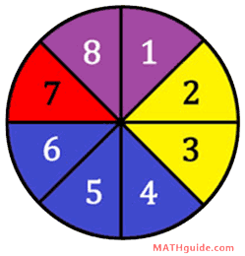
Shahista spins the spinner in the diagram.
What is the probability of landing on blue?

Slide 3
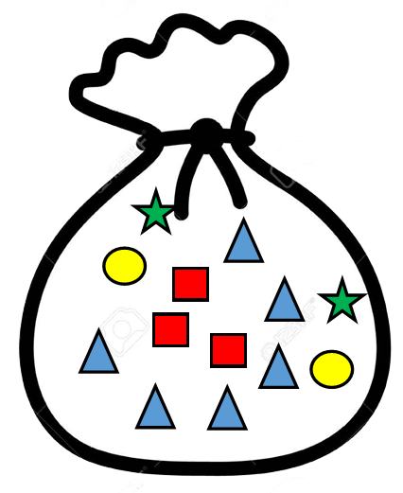
Yashjot removes a shape at random from the bag.
What is the probability of not taking a triangle?

Slide 4
Shahista spins the spinner in the diagram.
What is the probability of not landing on blue?

Slide 5
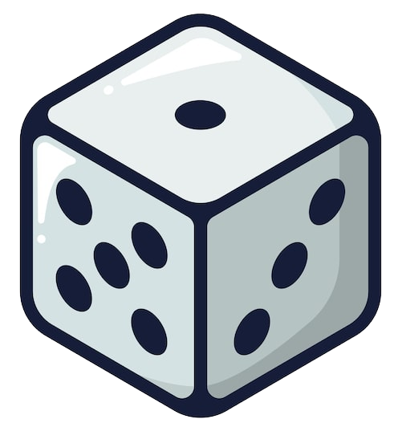
Dave rolls an ordinary 6-sided die.
What is the probability of rolling a prime number?

Slide 6
Yashjot removes a shape at random from the bag.
What is the probability of taking a heart?

Slide 7
Shahista spins the spinner in the diagram.
What is the probability of landing on a number greater than 7?

Slide 8
Yashjot removes a shape at random from the bag.
What is the probability of not taking a circle?

Slide 9
Dave rolls an ordinary 6-sided die.
What is the probability of rolling a number less than 7?

Slide 10
Shahista spins the spinner in the diagram.
What is the probability of not landing on red?

Slide 11
Dave rolls an ordinary 6-sided die.
What is the probability of rolling a 6?

Slide 12
Shahista spins the spinner in the diagram.
What is the probability of not landing on purple?

Slide 13
Yashjot removes a shape at random from the bag.
What is the probability of taking a triangle?

Slide 14
Shahista spins the spinner in the diagram.
What is the probability of landing on yellow?

Slide 15
Dave rolls an ordinary 6-sided die.
What is the probability of not rolling a 6?

Slide 16
Shahista spins the spinner in the diagram.
What is the probability of landing on a prime number?

Slide 17
Yashjot removes a shape at random from the bag.
What is the probability of taking a star?

