Slide 1
Starter
Simplify the following fractions:
$\frac{8}{12}$ $\frac{8}{6}$ $\frac{10}{15}$
$\frac{24}{12}$ $\frac{6}{16}$ $\frac{6}{9}$

Slide 2
Starter
Simplify the following fractions:
$\frac{8}{12}=\frac{2}{3}$ $\frac{8}{6}=\frac{4}{3}$ $\frac{10}{15}=\frac{2}{3}$
$\frac{24}{12}=2$ $\frac{6}{16}=\frac{3}{8}$ $\frac{6}{9}=\frac{2}{3}$

Slide 3
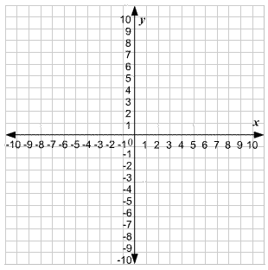
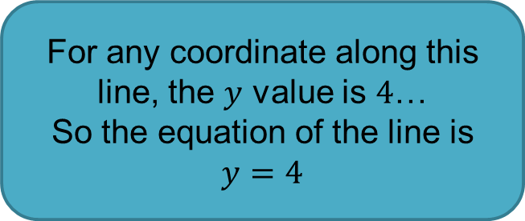
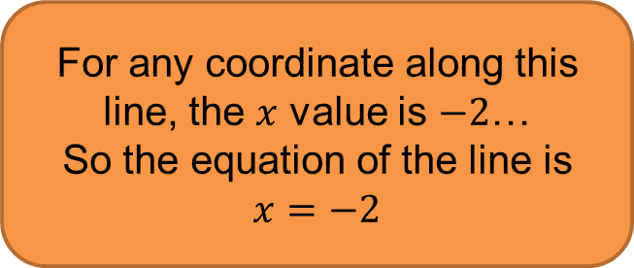
Calculate the equations of the graphs below.
For any coordinate along this line, the $y$ value is $4$…
So the equation of the line is $y=4$
For any coordinate along this line, the $x$ value is $−2$…
So the equation of the line is $x=−2$

Slide 4
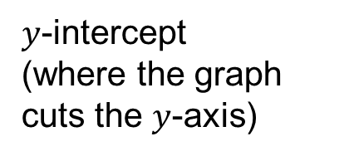
For any linear graphs that are not horizontal or vertical, we use:
$$y=mx+c$$
Gradient
(the slope of the line)
$y$-intercept
(where the graph cuts the $y$-axis)

Slide 5
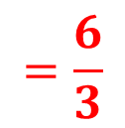
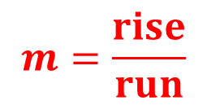
The gradient is
rise
run
But you also need to think about whether its +ve or –ve.
Calculate the equation of the graph below.
$$y=mx+c$$
$$m=\frac{rise}{run}$$
$$=\frac{6}{3}$$
$$6$$
$$=2$$
$$3$$
$$y=2x$$
$$+2$$

Slide 6
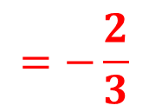
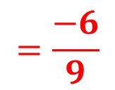
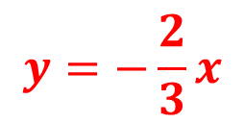
The gradient is
rise
run
But you also need to think about whether its +ve or –ve.
Calculate the equation of the graph below.
$$y=mx+c$$
$$−6$$
$$m=\frac{rise}{run}$$
$$=\frac{−6}{9}$$
$$=−\frac{2}{3}$$
$$9$$
$$y=−\frac{2}{3}x$$
$$+4$$

Slide 7
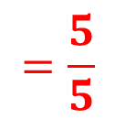
The gradient is
rise
run
But you also need to think about whether its +ve or –ve.
Calculate the equation of the graph below.
$$y=mx+c$$
$$m=\frac{rise}{run}$$
$$=\frac{5}{5}$$
$$5$$
$$=1$$
$$5$$
$$y=1x$$
$$+0$$
$$y=x$$

Slide 9
Answers
$x=2$ $y=1$ $y=3x−2$ $y=−2x−1$
$y=−10x+2$ $y=\frac{2}{3}x−10$ $y=6x+10$ $y=−3x−4$

