Slide 1
Starter
Sort the digits 1, 2, 3, 4, 5, 6, 7, 8, 9 into the grid so that they obey the row and column headings.
 | Odd | Even | Multiple of 3
Prime
Square
Factors of 168
5
2
3
1
4
9
7
8
6

Slide 2
Prime Factor Trees
36
Split the number into 2 factors that multiply to make the starting number.
Circle any factors that are prime numbers.
Continue to split any numbers that are not prime.
2
18
2
9
3
3
36 = 2 × 2 × 3 × 3
= 2² × 3²

Slide 3
Prime Factor Trees
36
42
2
18
2
21
2
9
3
7
3
3
36 = 2 × 2 × 3 × 3
42 = 2 × 3 × 7
= 2² × 3²

Slide 4
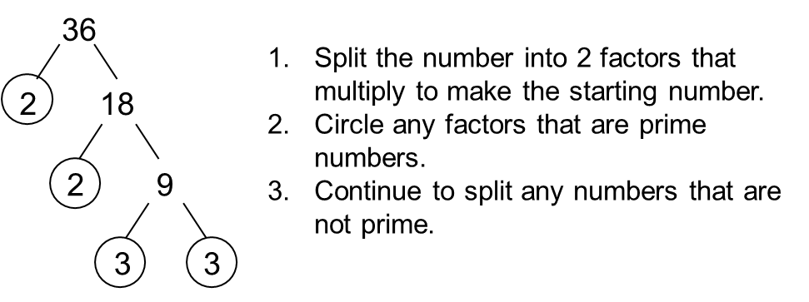
10 12 14 15 20 30
28 44 48 56 60 72
112 140 240 310 144 192

Slide 5
Answers
10 = 2x 5 12 = 2²x 3
14 = 2 x 7 15 = 3 x 5
20 = 2²x 5 30 = 2 x 3 x 5
28 = 2²x 7 42 = 2 x 3 x 7
48 = 2⁴ x 3 56 = 2³ x 7
60 = 2²x 3 x 5 72 = 2⁴ x 3²
112 = 2⁴ x 7 140 = 2²x 5 x 7
240 = 2⁴ x 3 x 5 310 = 2 x 5 x 31
144 = 2⁴ x 3² 192 = 2⁶ x 3

Slide 6
The highest common factor (HCF) of two numbers is the highest whole number which divides into both.
The lowest common multiple (LCM) of two numbers is the smallest number that is a multiple of both.

Slide 7
Calculate the HCF and LCM of 18 and 24.
24
18
2
12
2
9
2
6
3
3
2
3
Factors of 18
Factors of 24
3
2
3
2
2
HCF = 2 x 3
= 6
LCM = 3 x 2 x 3 x 2 x 2
= 72
Factors of both

Slide 8
Calculate the HCF and LCM of 42 and 36.
36
42
2
18
2
21
2
9
3
7
3
3
Factors of 42
Factors of 36
3
2
7
2
3
HCF = 2 x 3
= 6
LCM = 7 x 2 x 3 x 2 x 3
= 252
Factors of both

Slide 9
Extension: Answer the worded questions and match the answers

