Slide 1

Starter
Calculate the following:
1) 3 $×$ 2
2) 4 $×$ 1.5
3) 6 $×$ 2.5
4) 4 $×$ 1.25
5) 7 $×$ 2.5
= 6
= 6
= 15
= 5
= 17.5

Slide 2
Definitions
Congruent shapes have all sides and angles equal.
Similar shapes have all angles equal but one is an enlargement of the other.

Slide 3
Which coloured shape is mathematically similar to this white one?

Slide 4
Which coloured shape is mathematically similar to this white one?

Slide 5
Which coloured shape is mathematically similar to this white one?

Slide 6
Which coloured shape is mathematically similar to this white one?

Slide 7
Are these triangles similar?
☺ = yes, ☹ = no, 😐 = not sure
6 cm
10 cm
5 cm
3 cm
4 cm
8 cm

Slide 8
Are these triangles similar?
☺ = yes, ☹ = no, 😐 = not sure
6 cm
2 cm
2 cm
6 cm

Slide 9
Are these triangles similar?
☺ = yes, ☹ = no, 😐 = not sure
6 cm
2 cm
10 cm
4 cm

Slide 10
Are these triangles similar?
☺ = yes, ☹ = no, 😐 = not sure
4 cm
5 cm
2 cm
10 cm

Slide 11
Are these triangles similar?
☺ = yes, ☹ = no, 😐 = not sure
$x$ cm
7 cm
3 cm
15 cm

Slide 12
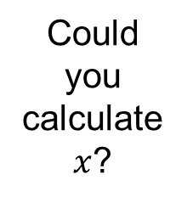
What about if I tell you they ARE mathematically similar.
$x$ cm
Could you calculate $x$?
7 cm
3 cm
15 cm

Slide 13
What about if I tell you they ARE mathematically similar.
$x$ cm
7 cm
These two represent the same side
3 cm
15 cm

Slide 14
What about if I tell you they ARE mathematically similar.
$x$ cm
$$×5$$
35 cm
7 cm
3 cm
$$×5$$
15 cm

Slide 15
These two shapes are mathematically similar.
Calculate $x$.
8 cm
$$×1.5$$
12 cm
10 cm
$$×1.5$$
$x$ cm
15 cm

Slide 16
These two shapes are mathematically similar.
Calculate $x$.
10 mm
25 mm
$$÷2.5$$
$x$ mm
18 mm
45 mm
$$÷2.5$$

Slide 17
Extension: Complete the exam questions

Slide 18
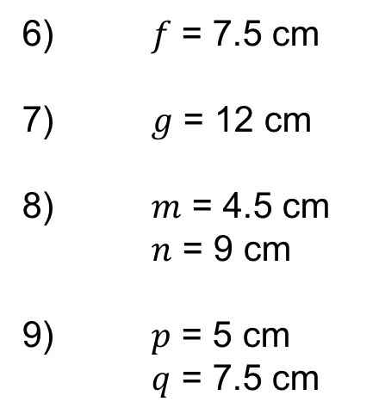
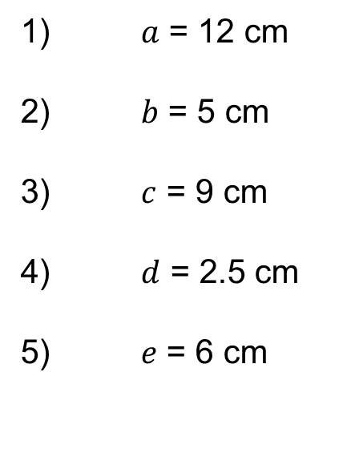
Answers
1) $a$ = 12 cm
2) $b$ = 5 cm
3) $c$ = 9 cm
4) $d$ = 2.5 cm
5) $e$ = 6 cm
6) $f$ = 7.5 cm
7) $g$ = 12 cm
8) $m$ = 4.5 cm
$n$ = 9 cm
9) $p$ = 5 cm
$q$ = 7.5 cm

