Slide 1
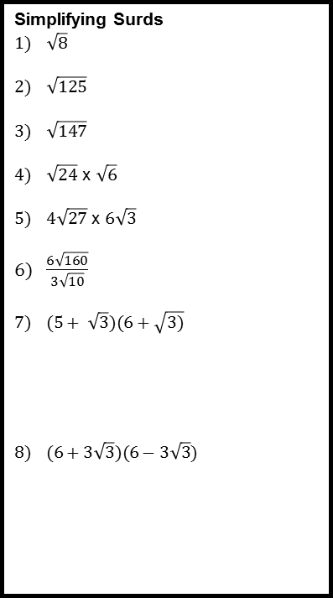
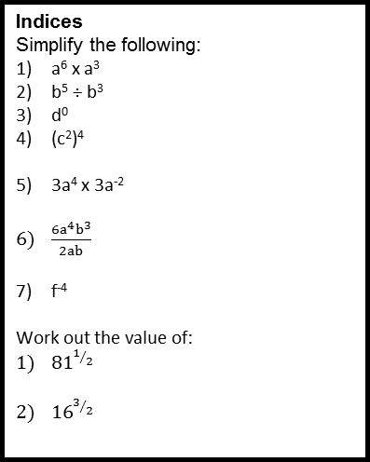
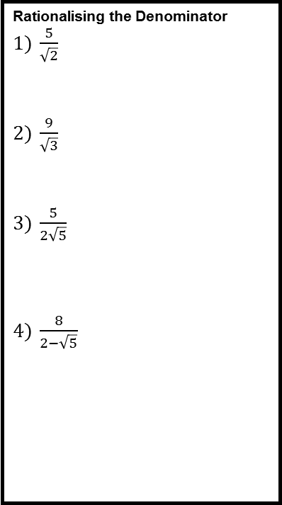
Number Revision Mat
Simplifying Surds
$\sqrt{8}$
$\sqrt{125}$
$\sqrt{147}$
$\sqrt{24}$ x $\sqrt{6}$
$4\sqrt{27}$ x $6\sqrt{3}$
$\frac{6\sqrt{160}}{3\sqrt{10}}$
$(5+ \sqrt{3})(6+\sqrt{3)}$
$(6+3\sqrt{3})(6−3\sqrt{3})$
Rationalising the Denominator
$\frac{5}{\sqrt{2}}$
$\frac{9}{\sqrt{3}}$
$\frac{5}{2\sqrt{5}}$
$\frac{8}{2−\sqrt{5}}$
Limits of Accuracy
These numbers have been rounded to the nearest hundred. Write down the upper and lower limits:
300
2700
These numbers have been rounded to the nearest whole number. Write down the upper and lower limits:
3
17
These numbers have been rounded to one decimal place. Write down the upper and lower limits:
6.2
15.9
These numbers have been rounded to one significant figure. Write down the upper and lower limits:
30
9
0.02
0.8
Indices
Simplify the following:
a⁶ x a³
b⁵ ÷ b³
d⁰
(c²)⁴
3a⁴ x 3a⁻²
$\frac{6a^{4}b^{3}}{2ab}$
f⁻⁴
Work out the value of:
${81}^{1/2}$
${16}^{3/2}$
Standard Form
Write as ordinary numbers:
2.6 x 10²
8.65 x 10⁻³
Write in standard form:
0.345
46700
1.6 x 10³ x 3.8 x 10³
(2 x 10⁻⁴) ÷ (5 x 10³)
Each day there are eight million cash withdrawals from 32000 cash machines. What is the average number of withdrawals per machine per day?
Bounds Calculations
Anthony measured the length and width of a rectangle. He measured the length to be 18cm correct to the nearest centimetre. He measured the width to be 10cm correct to the nearest 10 centimetres. Calculate the lower bound for the area of this rectangle.
A circular mirror has a diameter of 60cm to the nearest centimetre. Find the greatest possible area of the mirror. Give your answer in cm².
Identical wooden sheds are displayed side by side along a straight wall in a builders’ yard. The sheds are 270 cm wide, measured correct to the nearest 10 cm. The wall is 36 m long, measured to the nearest metre. How many sheds can the builders definitely display along the wall?

