Slide 1
Starter
Calculate $a$, $b$, $c$ and $d$
Scale factor 2
$c$ cm
2 cm
$b$ cm²
36 cm²
9 cm²
$d$ cm²
4 cm
$a$ cm
4.5 cm
9 cm
But 9 × 2 doesn’t equal 36!??

Slide 2
Linear scale factor: 3
Area scale factor: 3² = 9
4 cm
Volume scale factor: 3³ = 27
12 cm

Slide 3
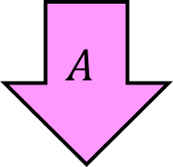
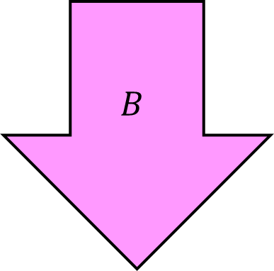
Example
Arrows $A$ and $B$ are similar.
The area of $A$ is 40 cm².
Calculate the area of arrow $B$.
Write this every time!
$$B$$
L:
A:
V:
2
$$A$$
2² = 4
2³ = 8
6 cm
12 cm
Area of $B$:
Area of $A×$ area scale factor
= 40 $×$ 4
= 160 cm²

Slide 4
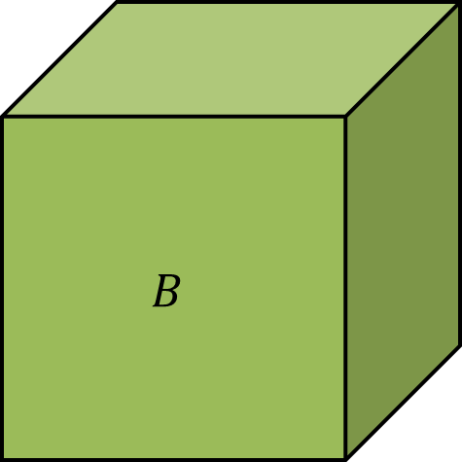
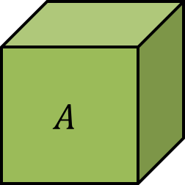
Example
Cuboids $A$ and $B$ are similar.
The volume of $A$ is 24 cm³.
The surface areas of $A$ and $B$ are 32 cm² and 288 cm² respectively.
Calculate the volume of cuboid $B$.
288 $÷$ 32 = 9
$$B$$
L:
A:
V:
$\sqrt{\text{9}}$ = 3
$$A$$
9
3³ = 27
Volume of $B$:
Volume of $A×$ volume scale factor
= 24 $×$ 27
= 648 cm³

Slide 5
Extension: Complete the exam questions

Slide 6
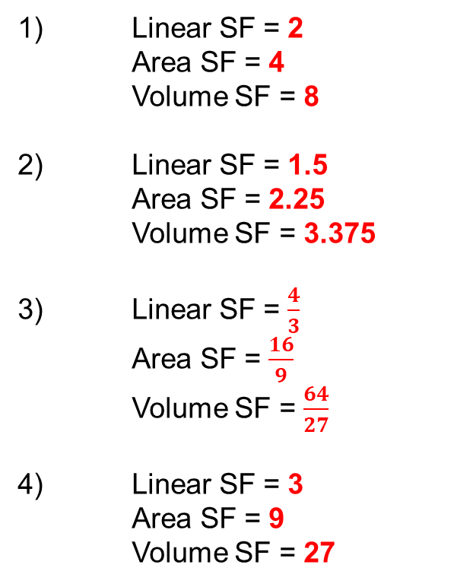
Answers
1) Linear SF = 2
Area SF = 4
Volume SF = 8
2) Linear SF = 1.5
Area SF = 2.25
Volume SF = 3.375
3) Linear SF = $\frac{4}{3}$
Area SF = $\frac{16}{9}$
Volume SF = $\frac{64}{27}$
4) Linear SF = 3
Area SF = 9
Volume SF = 27
5a) 6 cm
5b) 3.375
6) 80 cm
7a) £17.62
7b) 3.92 or 4 people
8) 3.9 kg

