Slide 1
Starter
Calculate these fractions of amounts (you are allowed to use a calculator!)
a) $\frac{1}{5}$ of 18
b) $\frac{3}{8}$ of 45
c) $\frac{13}{40}$ of 64
= 3.6
= 16.875
= 20.8

Slide 2
A fruit farmer wants to find out what proportion of her fruit trees are diseased.
Looking at the entire population of trees is called a census.
This would be time-consuming

Slide 3
A fruit farmer wants to find out what proportion of her fruit trees are diseased.
Looking at just some of the fruit trees is called a sample.

Slide 4
A fruit farmer wants to find out what proportion of her fruit trees are diseased.
She could take a random sample of the fruit trees.
Unfortunately no cherries were included!

Slide 5
A fruit farmer wants to find out what proportion of her fruit trees are diseased.
To make sure each fruit is fairly represented, she could take a stratified sample.

Slide 6
Example
A fruit farmer wants to find out what proportion of her fruit trees are diseased.
She is going to take a stratified sample of 15 fruit trees. How many of each type of fruit tree does the farmer need to test?
The sample is $\frac{15}{45}$ of the population.
So the farmer needs to test $\frac{15}{45}$ of each group.
Fruit tree | Frequency
Apple | 18
Pear | 12
Cherry | 9
Strawberry plant | 6

Slide 7
Example
A fruit farmer wants to find out what proportion of her fruit trees are diseased.
She is going to take a stratified sample of 15 fruit trees. How many of each type of fruit tree does the farmer need to test?
The sample is $\frac{15}{45}$ of the population.
So the farmer needs to test $\frac{15}{45}$ of each group.
Fruit tree | Frequency | Sample
Apple | 18
Pear | 12
Cherry | 9
Strawberry plant | 6

Slide 8
Example
A fruit farmer wants to find out what proportion of her fruit trees are diseased.
She is going to take a stratified sample of 15 fruit trees. How many of each type of fruit tree does the farmer need to test?
The sample is $\frac{15}{45}$ of the population.
So the farmer needs to test $\frac{15}{45}$ of each group.
Fruit tree | Frequency | Sample
Apple | 18 | $\frac{15}{45}$ of 18 = 6
Pear | 12
Cherry | 9
Strawberry plant | 6

Slide 9
Example
A fruit farmer wants to find out what proportion of her fruit trees are diseased.
She is going to take a stratified sample of 15 fruit trees. How many of each type of fruit tree does the farmer need to test?
The sample is $\frac{15}{45}$ of the population.
So the farmer needs to test $\frac{15}{45}$ of each group.
Fruit tree | Frequency | Sample
Apple | 18 | $\frac{15}{45}$ of 18 = 6
Pear | 12 | $\frac{15}{45}$ of 12 = 4
Cherry | 9
Strawberry plant | 6

Slide 10
Example
A fruit farmer wants to find out what proportion of her fruit trees are diseased.
She is going to take a stratified sample of 15 fruit trees. How many of each type of fruit tree does the farmer need to test?
The sample is $\frac{15}{45}$ of the population.
So the farmer needs to test $\frac{15}{45}$ of each group.
Fruit tree | Frequency | Sample
Apple | 18 | $\frac{15}{45}$ of 18 = 6
Pear | 12 | $\frac{15}{45}$ of 12 = 4
Cherry | 9 | $\frac{15}{45}$ of 9 = 3
Strawberry plant | 6

Slide 11
Example
A fruit farmer wants to find out what proportion of her fruit trees are diseased.
She is going to take a stratified sample of 15 fruit trees. How many of each type of fruit tree does the farmer need to test?
The sample is $\frac{15}{45}$ of the population.
So the farmer needs to test $\frac{15}{45}$ of each group.
Fruit tree | Frequency | Sample
Apple | 18 | $\frac{15}{45}$ of 18 = 6
Pear | 12 | $\frac{15}{45}$ of 12 = 4
Cherry | 9 | $\frac{15}{45}$ of 9 = 3
Strawberry plant | 6 | $\frac{15}{45}$ of 6 = 2
Do these numbers make sense?

Slide 12
Task
Complete the questions of stratified sampling.
You may need to round some answers.
Check: do your answers make sense?

Slide 13
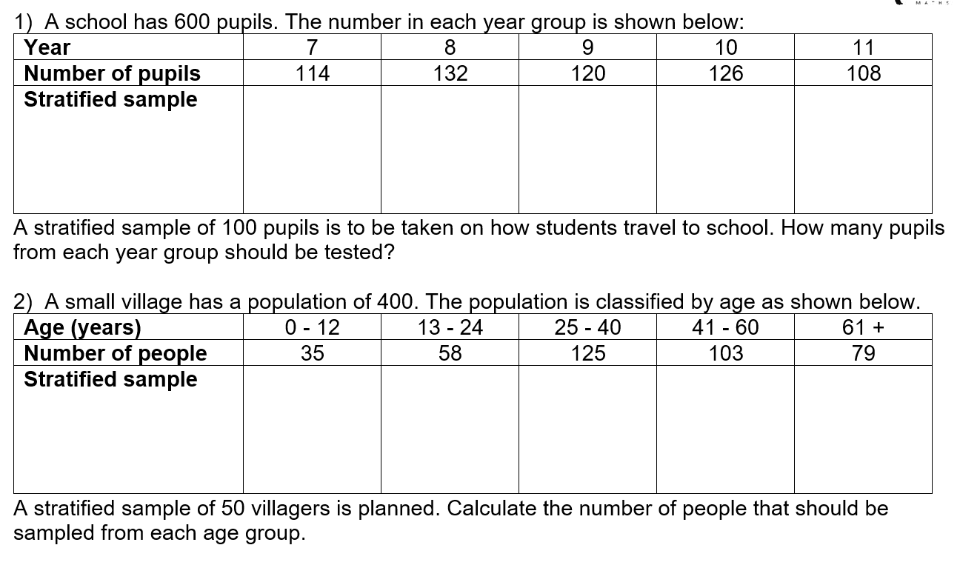

Slide 14
