Slide 1
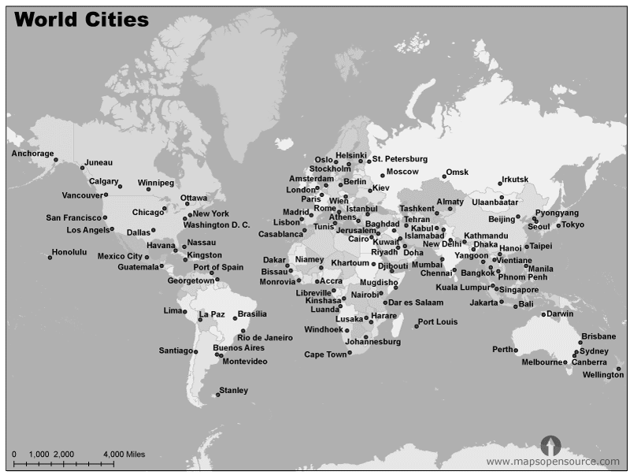
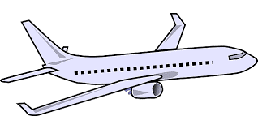
Plan a holiday around the world using your A3 map.
You must:
Visit at least 5 capital cities
Start in, and return to, London
State the bearing and the distance of each flight
Notes:
Map source: https://worldmapwithcountries.net/

Slide 2
Plan a holiday around the world using your A3 map.
You must:
Visit at least 5 capital cities
Start in, and return to, London
State the bearing and the distance of each flight
Extension tasks:
A plane flies at approximately 900 km/h. How long will each flight take?
What about if Africa is a no-fly zone?
Research flight costs… how much will all your flights cost?
What about hotels?
How much spending money will you need?
Have you factored in exchange rates?

