Slide 1


Starter
Calculate the following roots:
1. $\sqrt{4}$ 2. $\sqrt{121}$
3. $\sqrt{64}$ 4. $\sqrt[3]{64}$
5. $\sqrt[3]{8}$ 6. $\sqrt[4]{16}$
7. $\sqrt[3]{81}$ 8. $\sqrt[5]{32}$
$=2$
$=8$
$=2$
$=3$
$=11$
$=4$
$=2$
$=2$

Slide 2
Task
Discuss with your peers:
Which question on the top row matches with which answer on the bottom row?
Can you justify your answers?
Are there any that you don’t know?
Could you use patterns of what you know already to come to a conclusion?
$${25}^{1/2}$$ | $$8^{1/3}$$ | $${27}^{2/3}$$ | $${16}^{3/2}$$ | $$5^{−2}$$ | $$2^{−3}$$ | $${25}^{−1/2}$$
$$\frac{1}{25}$$ | $$9$$ | $$2$$ | $$5$$ | $$64$$ | $$\frac{1}{5}$$ | $$\frac{1}{8}$$

Slide 3
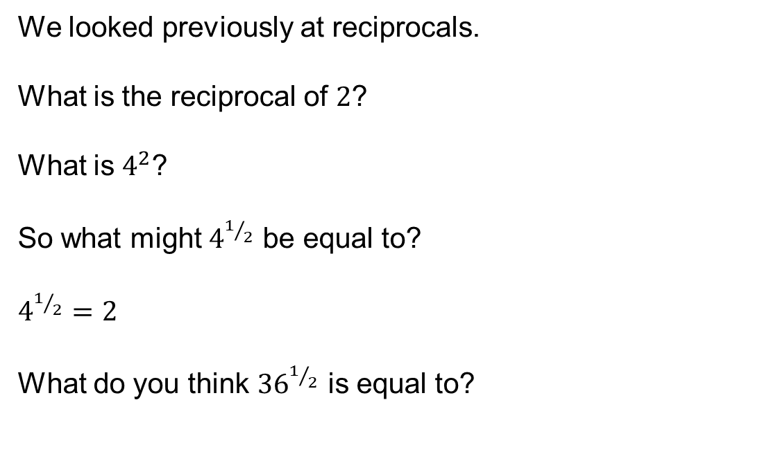
We looked previously at reciprocals.
What is the reciprocal of $2$?
What is $4^{2}$?
So what might $4^{1/2}$ be equal to?
$4^{1/2}=2$
What do you think ${36}^{1/2}$ is equal to?

Slide 4
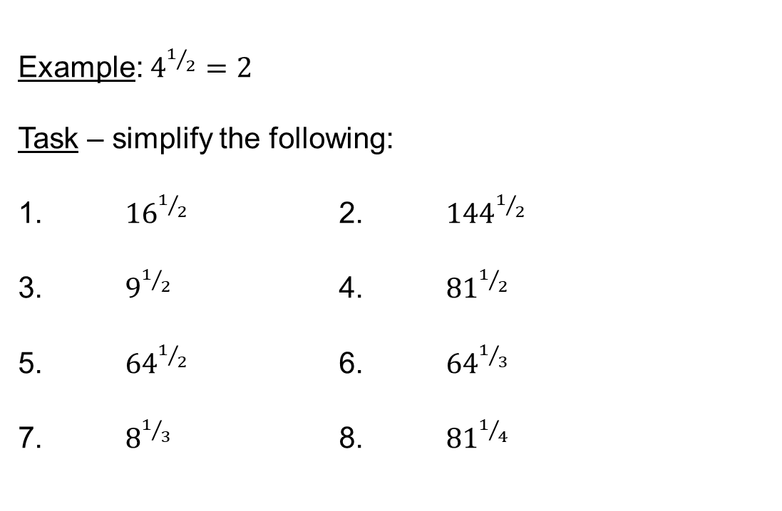

$$a^{1/n}=\sqrt[n]{a}$$
$$a^{1/2}=\sqrt{a}$$
Example: $4^{1/2}=2$
Task – simplify the following:
1. ${16}^{1/2}$ 2. ${144}^{1/2}$
3. $9^{1/2}$ 4. ${81}^{1/2}$
5. ${64}^{1/2}$ 6. ${64}^{1/3}$
7. $8^{1/3}$ 8. ${81}^{1/4}$
$$=4$$
$$=3$$
$$=8$$
$$=2$$
$$=12$$
$$=9$$
$$=4$$
$$=3$$

Slide 5
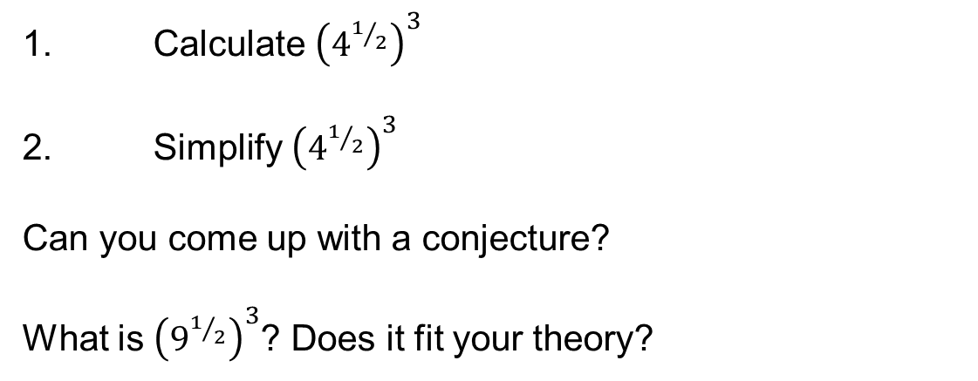
1. Calculate ${\left(4^{1/2}\right)}^{3}$
2. Simplify ${\left(4^{1/2}\right)}^{3}$
Can you come up with a conjecture?
What is ${\left(9^{1/2}\right)}^{3}$? Does it fit your theory?

Slide 6
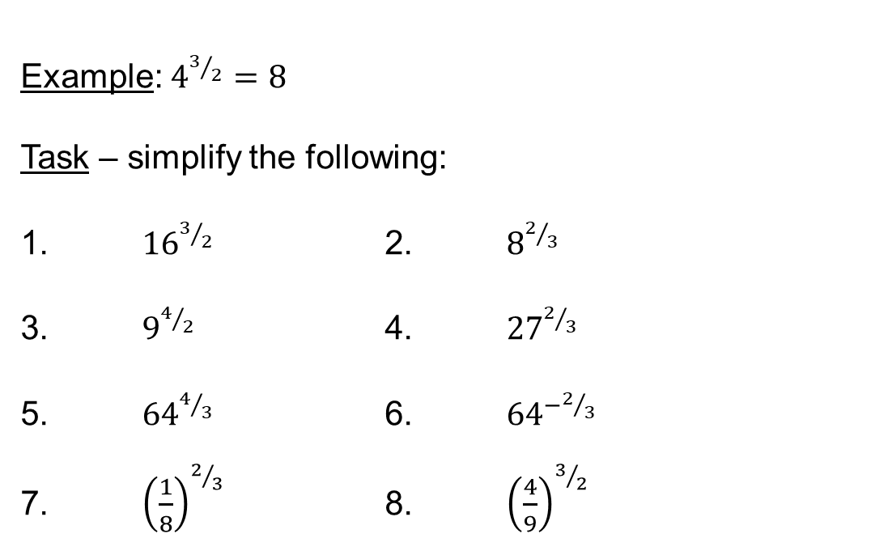

$$a^{m/n}={\left(\sqrt[n]{a}\right)}^{m}$$
Example: $4^{3/2}=8$
Task – simplify the following:
1. ${16}^{3/2}$ 2. $8^{2/3}$
3. $9^{4/2}$ 4. ${27}^{2/3}$
5. ${64}^{4/3}$ 6. ${64}^{−2/3}$
7. ${\left(\frac{1}{8}\right)}^{2/3}$ 8. ${\left(\frac{4}{9}\right)}^{3/2}$
$=64$
$=81$
$=256$
$=\frac{1}{4}$
$=4$
$=9$
$=\frac{1}{16}$
$=\frac{8}{27}$

Slide 7
Task
Discuss with your peers:
Which question on the top row matches with which answer on the bottom row?
Can you justify your answers?
Are there any that you don’t know?
Could you use patterns of what you know already to come to a conclusion?
$${25}^{1/2}$$ | $$8^{1/3}$$ | $${27}^{2/3}$$ | $${16}^{3/2}$$ | $$5^{−2}$$ | $$2^{−3}$$ | $${25}^{−1/2}$$
$$\frac{1}{25}$$ | $$9$$ | $$2$$ | $$5$$ | $$64$$ | $$\frac{1}{5}$$ | $$\frac{1}{8}$$

Slide 9
Answers

Slide 10
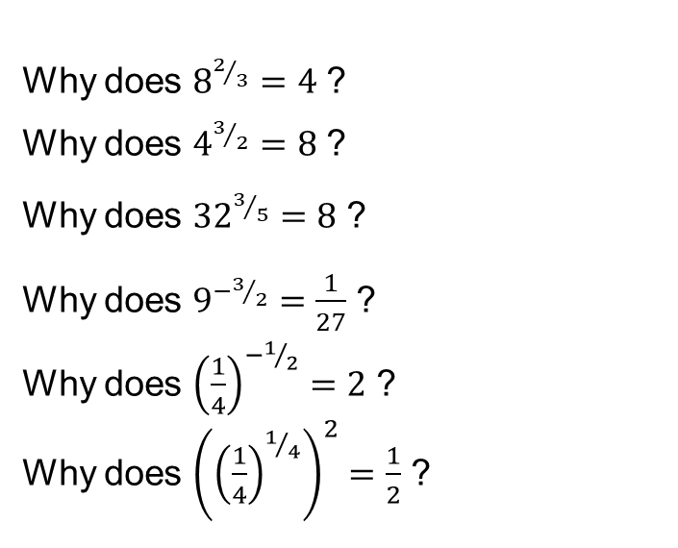
Why does $8^{2/3}=4$ ?
Why does $4^{3/2}=8$ ?
Why does ${32}^{3/5}=8$ ?
Why does $9^{−3/2}=\frac{1}{27}$ ?
Why does ${\left(\frac{1}{4}\right)}^{−1/2}=2$ ?
Why does ${\left({\left(\frac{1}{4}\right)}^{1/4}\right)}^{2}=\frac{1}{2}$ ?
Notes:
STEM files library https://www.stem.org.uk/system/files/elibrary-resources/legacy_files_migrated/29326-Starter%20Activities.pdf

Slide 11
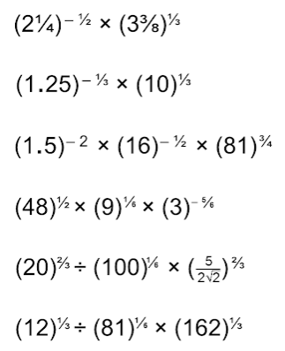
Group Task
You have 10 minutes to answer as many of these as you can without a calculator.
Hint: improper fractions are easier to work with than mixed numbers!
Notes:
Don Steward https://donsteward.blogspot.com/2011/12/mega-hard-powers-questions.html

