Slide 1
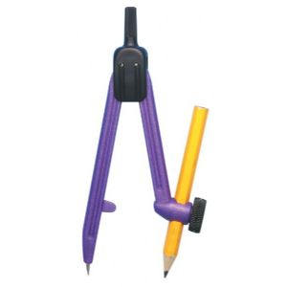
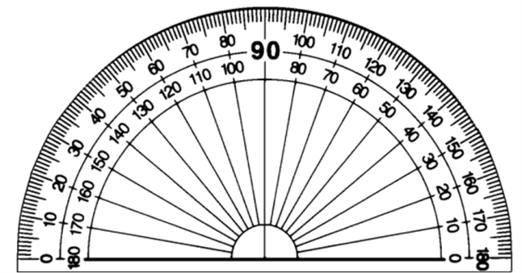
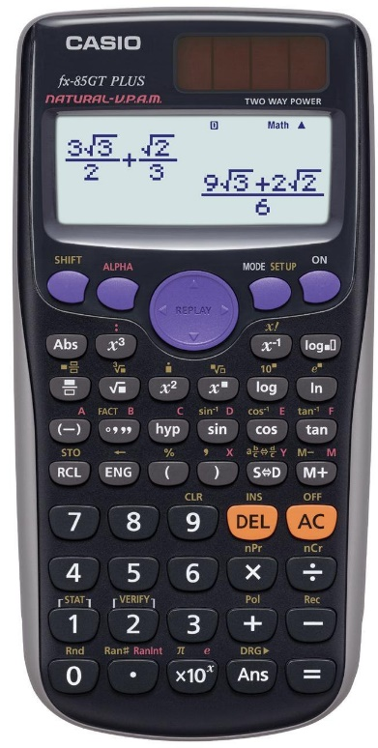
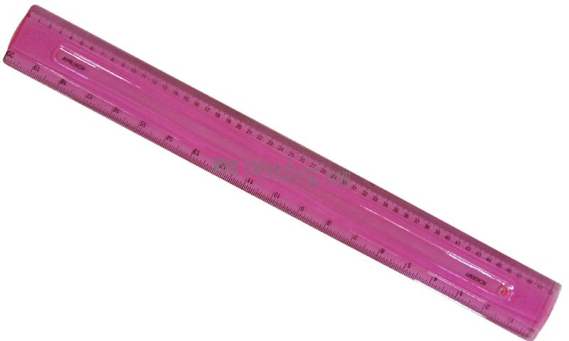
Autumn Term
Spring Term
Summer Term

Slide 2
Autumn Term
Week 1 | Lesson 1 | Lesson 2 | Lesson 3 | Lesson 4
Week 2 | Lesson 1 | Lesson 2 | Lesson 3 | Lesson 4
Week 3 | Lesson 1 | Lesson 2 | Lesson 3 | Lesson 4
Week 4 | Lesson 1 | Lesson 2 | Lesson 3 | Lesson 4
Week 5 | Lesson 1 | Lesson 2 | Lesson 3 | Lesson 4
Week 6 | Lesson 1 | Lesson 2 | Lesson 3 | Lesson 4
Week 7 | Lesson 1 | Lesson 2 | Lesson 3 | Lesson 4
Week 8 | Lesson 1 | Lesson 2 | Lesson 3 | Lesson 4
Week 9 | Lesson 1 | Lesson 2 | Lesson 3 | Lesson 4
Week 10 | Lesson 1 | Lesson 2 | Lesson 3 | Lesson 4
Week 11 | Lesson 1 | Lesson 2 | Lesson 3 | Lesson 4
Week 12 | Lesson 1 | Lesson 2 | Lesson 3 | Lesson 4
Week 13 | Lesson 1 | Lesson 2 | Lesson 3 | Lesson 4
Week 14 | Lesson 1 | Lesson 2 | Lesson 3 | Lesson 4

Slide 3
Spring Term
Week 1 | Lesson 1 | Lesson 2 | Lesson 3 | Lesson 4
Week 2 | Lesson 1 | Lesson 2 | Lesson 3 | Lesson 4
Week 3 | Lesson 1 | Lesson 2 | Lesson 3 | Lesson 4
Week 4 | Lesson 1 | Lesson 2 | Lesson 3 | Lesson 4
Week 5 | Lesson 1 | Lesson 2 | Lesson 3 | Lesson 4
Week 6 | Lesson 1 | Lesson 2 | Lesson 3 | Lesson 4
Week 7 | Lesson 1 | Lesson 2 | Lesson 3 | Lesson 4
Week 8 | Lesson 1 | Lesson 2 | Lesson 3 | Lesson 4
Week 9 | Lesson 1 | Lesson 2 | Lesson 3 | Lesson 4
Week 10 | Lesson 1 | Lesson 2 | Lesson 3 | Lesson 4
Week 11 | Lesson 1 | Lesson 2 | Lesson 3 | Lesson 4
Week 12 | Lesson 1 | Lesson 2 | Lesson 3 | Lesson 4
Week 13 | Lesson 1 | Lesson 2 | Lesson 3 | Lesson 4
Week 14 | Lesson 1 | Lesson 2 | Lesson 3 | Lesson 4

Slide 4
Summer Term
Week 1 | Lesson 1 | Lesson 2 | Lesson 3 | Lesson 4
Week 2 | Lesson 1 | Lesson 2 | Lesson 3 | Lesson 4
Week 3 | Lesson 1 | Lesson 2 | Lesson 3 | Lesson 4
Week 4 | Lesson 1 | Lesson 2 | Lesson 3 | Lesson 4
Week 5 | Lesson 1 | Lesson 2 | Lesson 3 | Lesson 4
Week 6 | Lesson 1 | Lesson 2 | Lesson 3 | Lesson 4
Week 7 | Lesson 1 | Lesson 2 | Lesson 3 | Lesson 4
Week 8 | Lesson 1 | Lesson 2 | Lesson 3 | Lesson 4
Week 9 | Lesson 1 | Lesson 2 | Lesson 3 | Lesson 4
Week 10 | Lesson 1 | Lesson 2 | Lesson 3 | Lesson 4
Week 11 | Lesson 1 | Lesson 2 | Lesson 3 | Lesson 4
Week 12 | Lesson 1 | Lesson 2 | Lesson 3 | Lesson 4
Week 13 | Lesson 1 | Lesson 2 | Lesson 3 | Lesson 4
Week 14 | Lesson 1 | Lesson 2 | Lesson 3 | Lesson 4

Slide 5
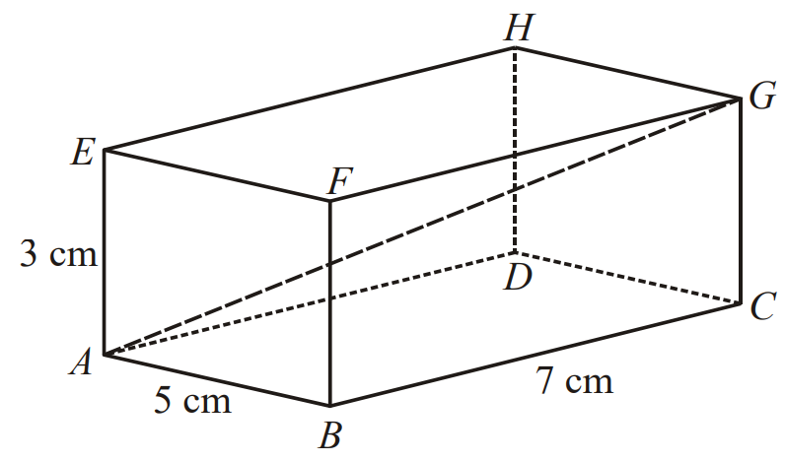
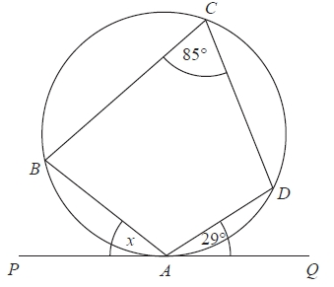
The diagram represents a cuboid ABCDEFGH. Calculate the length of AG. Give your answer correct to 3 significant figures.
In the diagram, the points A, B, C and D are on the circumference of a circle. The line PAQ is a tangent to the circle. Angle DAQ = 29° and angle BCD = 85°. Work out the size of the angle marked $x$. Give a reason for each stage
of your working.

Slide 6
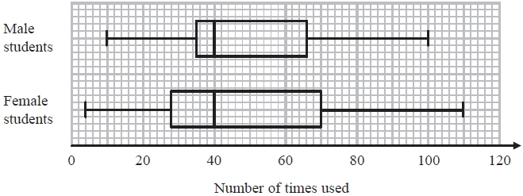
Sketch the graph of $y=x^{2}+2x−3$ and hence identify its turning point.
Some students were asked how many times they each used their mobile phones last week. The box plots give information about the male students' answers and about the female students' answers. Compare the two distributions represented by the box plots.

Slide 7
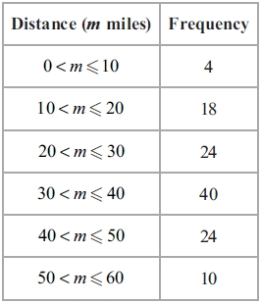
Calculate $(4×{10}^{3})×(2×{10}^{−6})$. Give your answer in standard form.
Lyndsey records the number of miles (m) she drives each day for 120 days. Some information about the results is given in the table. Draw a cumulative frequency graph to show this information.

Slide 8
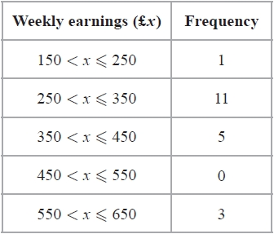
The table shows information about the weekly earnings of 20 people who work in a shop. Work out an estimate for the mean of the weekly earnings.
Work out the length of $BC$. Give your answer to 3 significant figures.
$$B$$
$$5 m$$
$$42°$$
$$A$$
$$53°$$
$$C$$

Slide 9
Write $x²–6x+1$ in the form $(x+a)²+b$ where $a$ and $b$ are integers. Hence, or otherwise, solve $x^{2}–6x+1=0$.
Accurately construct a triangle with sides 6 cm, 7 cm and 8 cm.
$a=\left(\begin{matrix}4 \\ 2\end{matrix}\right)$ and $b=\left(\begin{matrix}3 \\ −1\end{matrix}\right)$. Calculate $2a+b$.

Slide 10
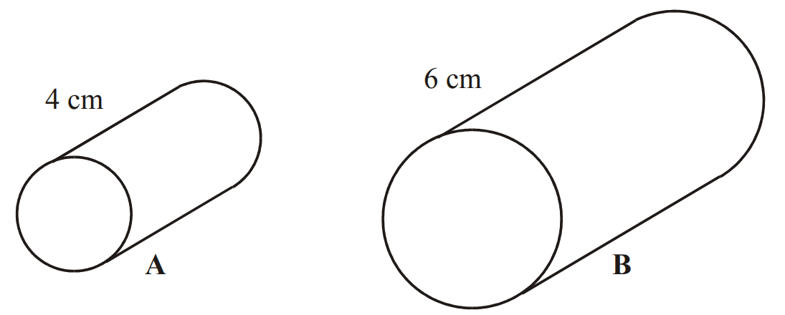
The number of rabbits in a field $t$ days from now is $P_{t}$ where
$P_{0}=220$
$P_{t+1}=1.15(P_{t}−20)$.
Work out the number of rabbits in the garden 3 days from now.
Cylinder A and cylinder B are mathematically similar. The volume of cylinder A is 80 cm³. Calculate the volume of cylinder B.

Slide 11
Simplify $\sqrt{72}$.
There are 5 red pens, 3 blue pens and 2 green pens in a box. Gary takes at random a pen from the box and gives the pen to his friend. Gary then takes at random another pen from the box. Work out the probability that both pens are the same colour. (Hint: draw a tree diagram)

Slide 12
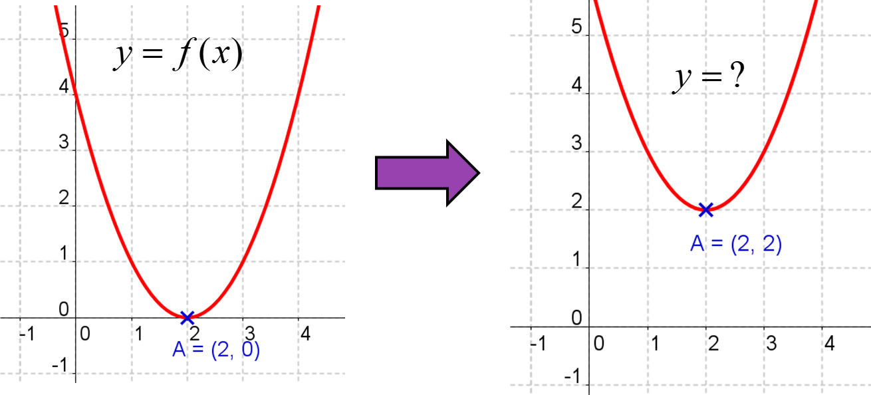
Expand and simplify $(2+\sqrt{3})(2−\sqrt{3})$.
Describe the second function following the transformation.

Slide 13
$V=\frac{s}{t}$ $s=4.15$ correct to 2 decimal places
$t=2.516$ correct to 3 decimal places
Work out the upper bound for $V$.
The diagram shows a sector of a circle, centre $O$. The radius of the circle is 13 cm. The angle of the sector is 150º. Calculate the area of the sector. Give your answer correct to 3 significant figures.
$$150°$$
$$13 cm$$

Slide 14
Solve $x^{2}+5x−12=0$. Give your answers correct to 1 decimal place.
A scientist wants to estimate the number of fish in a lake. He catches 50 fish from the lake and marks them with a dye. The fish are then returned to the lake. The next day the scientist catches another 50 fish. 4 of these fish are marked with the dye. Work out an estimate for the total number of fish in the lake. You must write down any assumptions you have made.

Slide 15
The point $A$ (3, 5) is on the curve $y=f(x)$. Where would point $A$ be on the graph of $y=f(x+2)$?
Work out the area of the triangle.
The number of people living in a town $t$ years from now is $P_{t}$ where
$P_{0}=55000$
$P_{t+1}=1.03(P_{t}−800)$
Work out the number of people in the town 3 years from now.

Slide 16
There are some red counters and some blue counters in a bag. The ratio of red counters to blue counters is 3 : 1. Two counters are removed at random. The probability that both the counters taken are blue is $\frac{1}{20}$. Work how many counters were in the bag before any counters were removed.
Describe the shape of a quadratic graph.

Slide 17
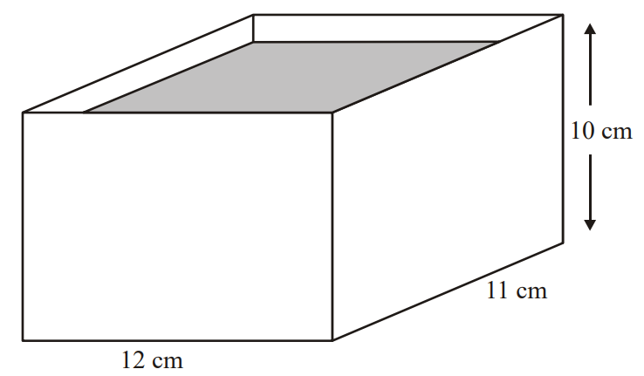
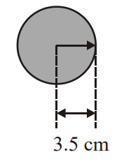
Work out the value of $x$. Give your answer to 1 decimal place.
A rectangular container is 12 cm long, 11 cm wide and 10 cm high. The container is filled with water to a depth of 8 cm. A metal sphere of radius 3.5 cm is placed in the water. It sinks to the bottom. Calculate the rise in the water level. Give your answer correct to 3 significant figures.
$$10 cm$$
$$100°$$
$$13 cm$$
$$x cm$$

Slide 18
Calculate $(4×{10}^{4})÷(2×{10}^{−7})$. Give your answer in standard form.
Prove algebraically that the recurring decimal $0.\dot{8}$ can be written as $\frac{8}{9}$.

Slide 19
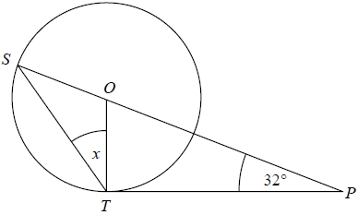
Factorise $2x^{2}+5x+2$
S and T are points on the circumference of a circle, centre O. PT is a tangent to the circle. SOP is a straight line. Angle OPT = 32°. Work out the size of the angle marked $x$. You must give a reason for each stage of your working.

Slide 20
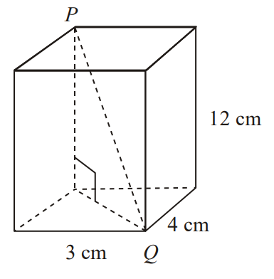
A cuboid has length 3 cm, width 4 cm and height 12 cm. Work out the length of PQ.
A straight line, L, passes through the point with coordinates (4, 7) and is perpendicular to the line with equation $y=2x+3$. Find an equation of the straight line L.

Slide 21
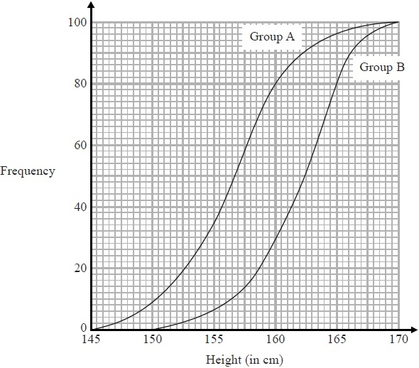
Sketch the graph of $y=x^{2}−4x−3$ and hence identify its turning point.
The cumulative frequency graphs give information about the heights of two groups of children, group A and group B. Compare the heights of the children in group A and the heights of the children in group B.

Slide 22
Write ${(3+\sqrt{5})}^{2}$ in the form $a+b\sqrt{5}$, where $a$ and $b$ are integers.
The table shows information about the lengths, in seconds, of 40 TV adverts. Draw a cumulative frequency graph to show this information.
Time ($T$ seconds) | Frequency
$$10<T≤20$$ | 4
$$20<T≤30$$ | 7
$$30<T≤40$$ | 13
$$40<T≤50$$ | 12
$$50<T≤60$$ | 4

Slide 23
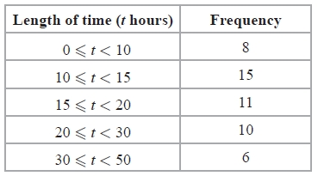
The table gives some information about the lengths of time, in hours, that some adults watched TV last week. Work out an estimate for the mean length of time.
Simplify fully $\frac{{3x}^{2}+9x}{x^{2}−9}$
$g$ is directly proportional to the square root of $h$. When $g=18$, $h=16$. Find the possible values of $h$ when $g=2$.

Slide 24
Calculate $(3.2×{10}^{2})×(1.2×{10}^{8})$. Give your answer in standard form.
Accurately construct a triangle with sides 5 cm, 7 cm and 6.5 cm.
Prove algebraically that the recurring decimal $0.4\dot{7}$ can be written as $\frac{43}{90}$.

Slide 25
Write $x²+8x+5$ in the form $(x+a)²+b$ where $a$ and $b$ are integers. Hence, or otherwise, solve $x^{2}+8x+5=0$.
There are some red counters and some blue counters in a bag. The ratio of red counters to blue counters is 4 : 1. Two counters are removed at random. The probability that both the counters taken are red is $\frac{22}{35}$. Work how many blue counters are in the bag.

Slide 26
Using $x_{n+1}=3+\frac{9}{{x_{n}}^{2}}$ with $x_{0}=0$, find the values of $x_{1}$, $x_{2}$ and $x_{3}$.
Carolyn has 20 biscuits in a tin. She has 12 plain biscuits, 5 chocolate biscuits and 3 ginger biscuits. Carolyn takes at random two biscuits from the tin. Work out the probability that the two biscuits were not the same type. (Hint: draw a tree diagram)

Slide 27
Solve $x^{2}+6x−22=0$. Give your answers correct to 1 decimal place.
Work out the value of $x$. Give your answer to 3 significant figures.
$$5.4 cm$$
$$95°$$
$$x°$$
$$6.7 cm$$

Slide 28
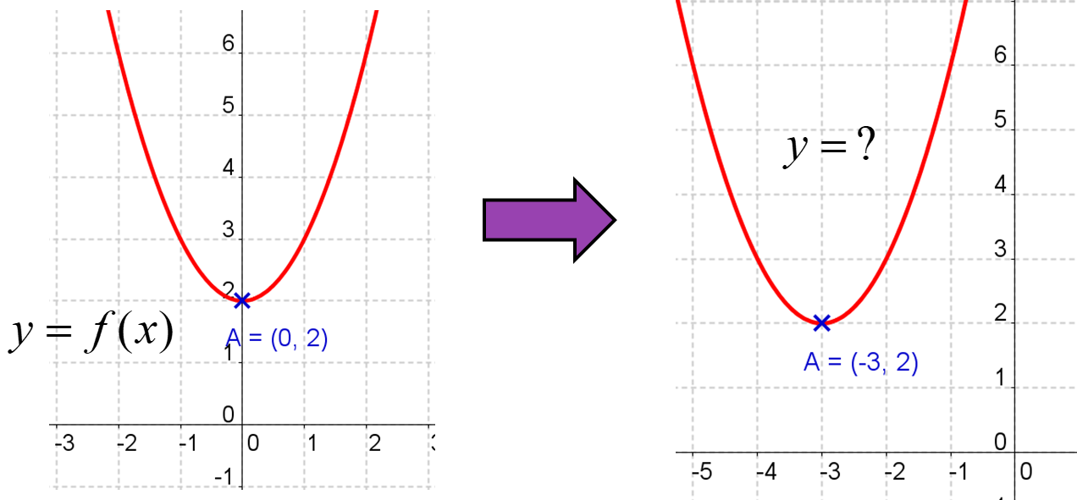
Factorise $2x^{2}+11x+12$
Describe the second function following the transformation.

Slide 29
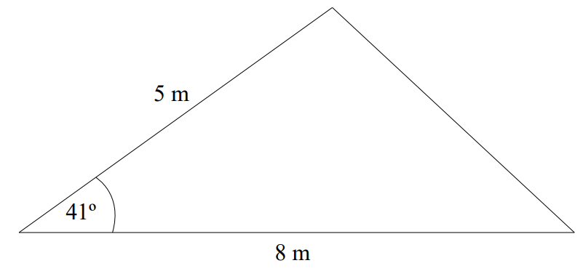
On a coordinate grid, shade the region that satisfies all three of these inequalities:
$y>–4$
$x<2$
$y<2x+1$
Work out the area of the triangle.

Slide 30
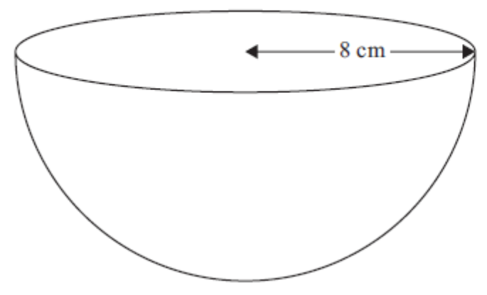
The diagram shows a sector of a circle, centre $O$, radius 10 cm. The arc length of the sector is 15 cm. Calculate the area of the sector.
The diagram shows a solid hemisphere of radius 8 cm. Work out the total surface area of the hemisphere. Give your answer correct to 3 significant figures
15 cm
10 cm
10 cm

Slide 31
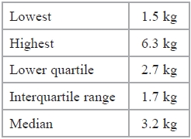
Expand and simplify ${(2+\sqrt{3})}^{2}−{(2−\sqrt{3})}^{2}$.
Make $a$ the subject of the formula $v^{2}=u^{2}+2as$
The table gives information about the weights of 60 parcels. Draw a box plot for this information.

Slide 32
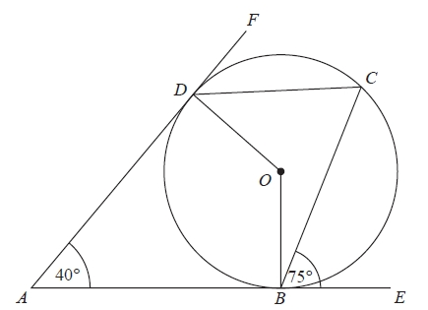
Sketch the graph of $y=x^{2}−4x−12$ and hence identify its turning point.
B, C and D are points on the circumference of a circle, centre O. ABE and ADF are tangents to the circle. Angle DAB = 40°. Angle CBE = 75°. Work out the size of angle ODC.

Slide 33
$a=\left(\begin{matrix}−4 \\ 1\end{matrix}\right)$ and $b=\left(\begin{matrix}2 \\ 6\end{matrix}\right)$. Calculate $a−b$.
A farmer wants to estimate the number of rabbits on his farm. On Monday he catches 120 rabbits. He puts a tag on each rabbit. He then lets the rabbits run away. On Tuesday the farmer catches 70 rabbits. 15 of these rabbits have a tag on them. Work out an estimate for the total number of rabbits on the farm. You must write down any assumptions you have made.

Slide 34
Describe the shape of a reciprocal graph, eg $y=\frac{1}{x}$
Simplify fully $\frac{x^{2}−x−12}{x^{2}−9x+20}$

Slide 35
Simplify $\sqrt{108}$.
Make $a$ the subject of the formula
$s=ut+\frac{1}{2}at^{2}$

Slide 36
Write $x²+10x+2$ in the form $(x+a)²+b$ where $a$ and $b$ are integers. Hence, or otherwise, solve $x^{2}+10x+2=0$.
There are 5 red counters and y blue counters in a bag. Imogen takes a counter from the bag at random. She puts the counter back into the bag. Imogen then takes another counter at random from the bag. The probability that the first counter Imogen takes is red and the second counter Imogen takes is red is $\frac{1}{9}$. Work how many blue counters are in the bag.

Slide 37
V=IR $I=5.92$ correct to 2 decimal places
$R=12.356$ correct to 3 decimal places
Work out the upper bound for V. Give your answer to 3 decimal places.
A straight line passes through the points (0, 5) and (3, 17). Find the equation of the straight line.
Solve $2x^{2}+x−14=0$. Give your answers correct to 1 decimal place.

Slide 38
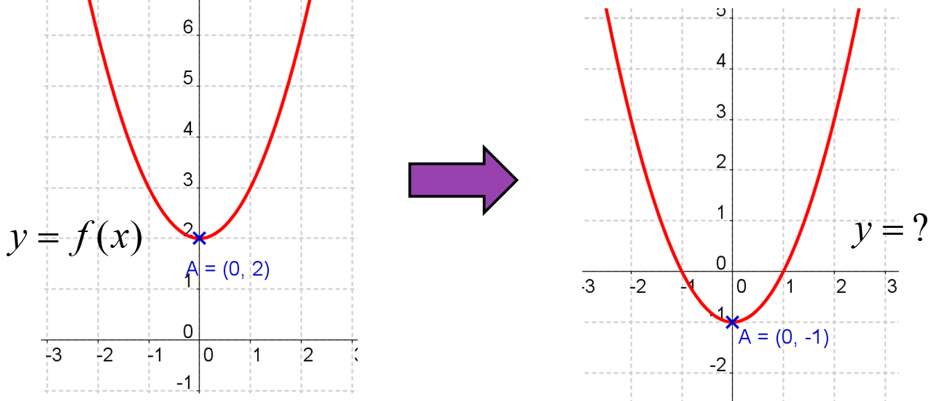
Write $0.2\dot{7}$ as a fraction in its simplest form.
Describe the second function following the transformation.

Slide 39
Accurately construct an equilateral triangle of side length 7 cm.
Tom recorded the times, in seconds, some boys took to complete an obstacle course. He drew this box plot for his results. Tom also recorded the times some girls took to complete the obstacle course. Here are the times, in seconds, for the girls. Compare the distribution of the times for the boys with the distribution of the times for the girls

Slide 40
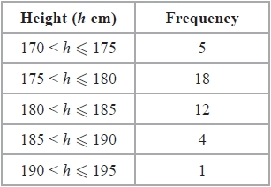
Rationalise the denominator $\frac{6}{\sqrt{3}}$
$OAB$ is a sector of a circle, centre $O$. Angle $AOB=60°$. $OA=OB=12 cm$. Work out the length of the arc $AB$. Give your answer in terms of $π$.
The table shows information about the heights of 40 plants. Draw a cumulative frequency graph to show this information.
$$B$$
$$A$$
$$12 cm$$
$$60°$$
$$12 cm$$
$$O$$

Slide 41
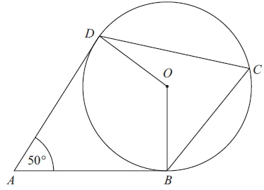
Calculate $(3.2×{10}^{9})÷(6.4×{10}^{−2})$. Give your answer in standard form.
B, C and D are points on the circumference of a circle, centre O. AB and AD are tangents to the circle. Angle DAB = 50°. Work out the size of angle BCD. Give a reason for each stage in your working.

Slide 42
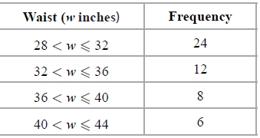
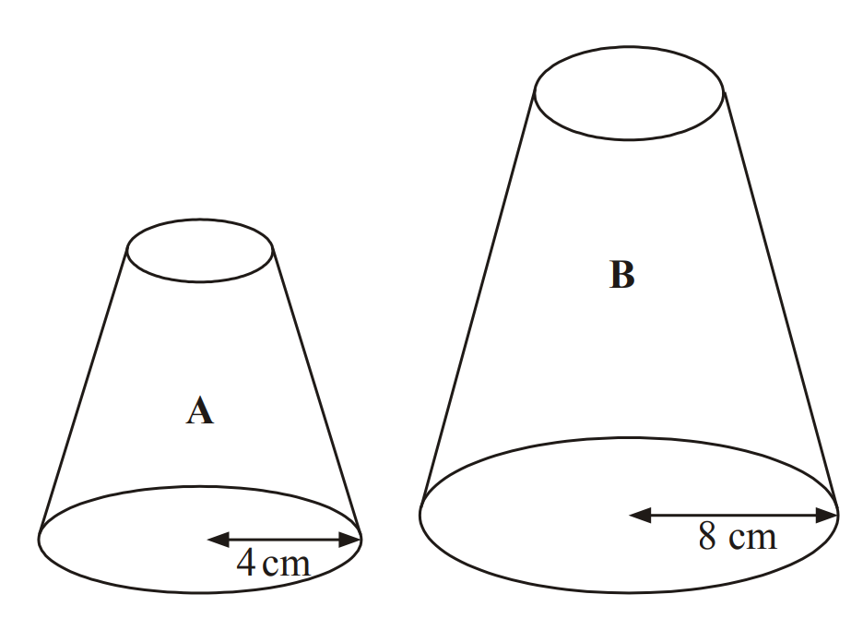
Jenny works in a shop that sells belts. The table shows information about the waist sizes of 50 customers who bought belts from the shop in May. Calculate an estimate for the mean waist size.
Two solid shapes, A and B, are mathematically similar. The surface area of shape A is 80 cm².Work out the surface area of shape B.

Slide 43
$x$ is inversely proportional to the square root of $y$. When $x=12$, $y=9$. Find the value of $x$ when $y=81$.
Starting with $x_{0}=3$, use the iteration formula $x_{n+1}=\frac{7}{{x_{n}}^{2}}+2$ three times to find an estimate for the solution to $x^{3}−2x^{2}=7$.

Slide 44
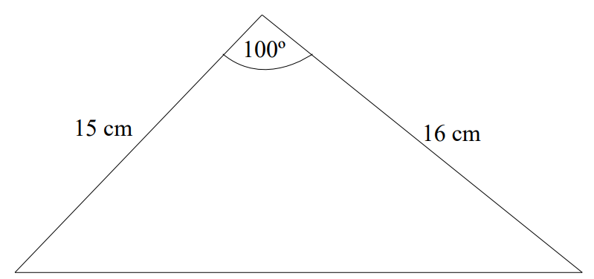
There are three different types of sandwiches on a shelf. There are 4 egg sandwiches, 5 cheese sandwiches and 2 ham sandwiches. Erin takes at random 2 of these sandwiches. Work out the probability that she takes 2 different types of sandwiches. (Hint: draw a tree diagram)
Work out the area of the triangle.

Slide 45
The region R satisfies the inequalities
$x≥2$
$y≥1$
$x+y≤6$
On a coordinate grid, draw straight lines and use shading to show the region R.
Work out the value of $x$. Give your answer to 3 significant figures.
$$15 cm$$
$$x°$$
$$16 cm$$
$$20 cm$$

Slide 46
$P=\frac{E}{t}$ $E=812$ correct to 3 significant figures
$T=9.2$ correct to 1 decimal place
By considering bounds, work out the value of $P$ to a suitable degree of accuracy. Give a reason for your answer.
Simplify fully $\frac{x+4}{x^{2}−16}$

Slide 47
The two cylinders, A and B, are mathematically similar. The height of cylinder B is twice the height of cylinder A. The total surface area of cylinder A is 180 cm². Calculate the total surface area of cylinder B.
The diagram shows a child’s toy. The toy is made from a cone on top of a hemisphere. Work out the volume of the toy. Give your answer correct to 3 significant figures.

Slide 48
Write $0.3\dot{9}\dot{4}$ as a fraction in its simplest form.
Make $v$ the subject of the formula $T=\frac{1}{2}mv^{2}$

Slide 49
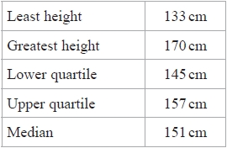
The table gives some information about the heights of 80 girls. Draw a box plot to represent this information.
Solve $\frac{8}{x+3}+\frac{3}{x+8}=1$

Slide 50
Write $x²–2x–1$ in the form $(x+a)²+b$ where $a$ and $b$ are integers. Hence, or otherwise, solve $x^{2}–2x–1=0$.
Factorise and solve $3x^{2}+17x+10=0$

Slide 51
There are $N$ beads in a jar. 40 of these beads are black. Julie takes at random a sample of 50 beads from the jar. 5 of the beads in her sample are black. Work out an estimate for the value of $N$.
Make $x$ the subject of the formula $2x+a=b(x–2)$

Slide 52
Show that line $3y=4x−14$ is perpendicular to line $4y=−3x+48$.
Write $\frac{{3x}^{2}+11x−4}{x^{2}+3x−4}$ in the form $\frac{ax+b}{x+c}$ where $a$, $b$ and $c$ are integers.

Slide 53
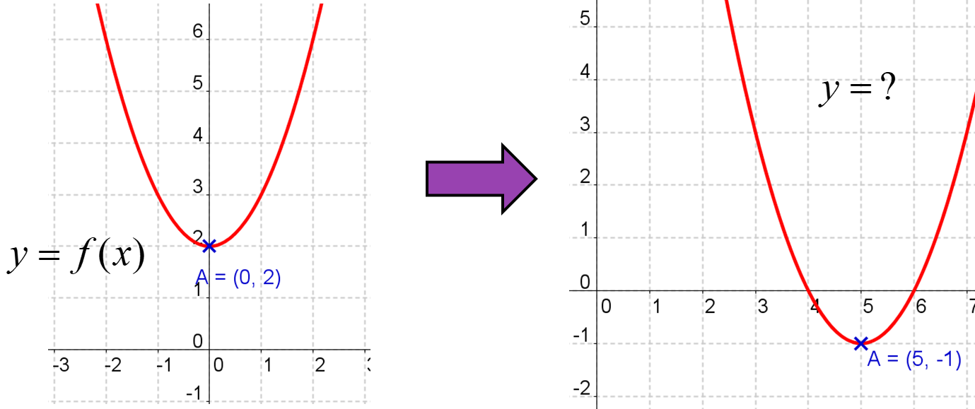
Solve ${2x}^{2}−6x−1=0$. Give your answers correct to 1 decimal place.
Describe the second function following the transformation.

Slide 54
$y$ is inversely proportional to the cube of $x$. When $y=250$, $x=0.2$. Find the value of $y$ when $x=0.5$.
The diagram shows an equilateral triangle $ABC$ with sides of length 6 cm. $P$ is the midpoint of $AB$. $Q$ is the midpoint of $AC$. $APQ$ is a sector of a circle, centre $A$. Calculate the area of the shaded region. Give your answer correct to 3 significant figures.
$$B$$
$$6 cm$$
$$6 cm$$
$$P$$
$$Q$$
$$A$$
$$C$$
$$6 cm$$

Slide 55
Simplify $\frac{3+\sqrt{6}}{\sqrt{3}}$
Describe the shape of an exponential graph, eg $y=2^{x}$
Accurately construct a triangle with sides 4 cm, 6.5 cm and 7 cm.

Slide 56
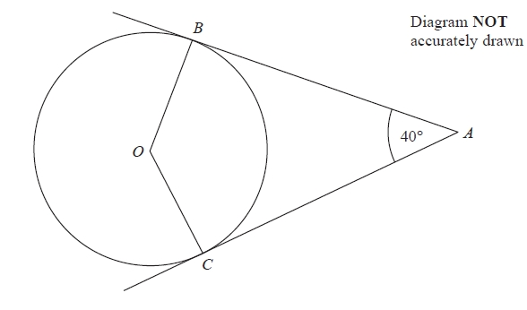
$f=\frac{\sqrt{g}}{h}$ $g=12.7$ correct to 3 significant figures
$h=9.294$ correct to 3 decimal places
By considering bounds, work out the value of $f$ to a suitable degree of accuracy.
B and C are points on the circumference of a circle, centre O. AB and AC are tangents to the circle. Angle BAC = 40°. Find the size of angle BCO.

Slide 57
Simplify $\sqrt{20}+\sqrt{80}$.
There are 4 red counters and $x$ blue counters in a bag. 2 counters are removed from the bag at random. The probability that both the counters taken are blue is $\frac{1}{3}$. Work out the value of $x$.

Slide 58
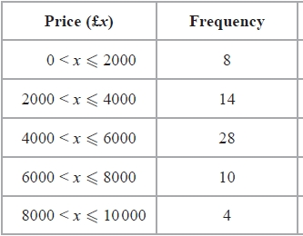
Clive wants to estimate the number of bees in a beehive. Clive catches 50 bees from the beehive. He marks each bee with a dye. He then lets the bees go. The next day, Clive catches 40 bees from the beehive. 8 of these bees have been marked with the dye. Work out an estimate for the number of bees in the beehive.
Make $x$ the subject of the formula $x\left(2+a\right)=b\left(x+3\right)$
The table shows some information about the prices of 64 secondhand cars that are for sale. Calculate an estimate for the mean price.

Slide 59
The table below shows information about the times, in minutes, a group of students took to answer 10 maths questions. Draw a box plot to show the information in the table.
Factorise $2x^{2}−x−1$
 | Least | Lower quartile | Median | Upper quartile | Greatest
Time in minutes | 14 | 18 | 20 | 25 | 30

Slide 60
Calculate $(1.6×{10}^{−3})÷(6.4×{10}^{−6})$. Give your answer in standard form.
Write $0.\dot{3}8\dot{6}$ as a fraction in its simplest form.
$a=\left(\begin{matrix}−2 \\ 4\end{matrix}\right)$ and $b=\left(\begin{matrix}3 \\ 2\end{matrix}\right)$. Calculate $a−2b$.

Slide 61
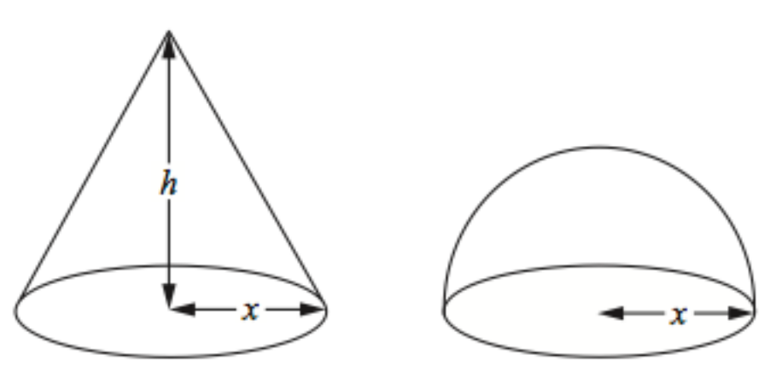
On a coordinate grid, show by shading, the region which satisfies all three of the inequalities
$x<3$ $y>–2$ $y<x$
Label the region R.
The diagram shows a cone and a hemisphere. The hemisphere has base radius $x$ cm. The cone has base radius $x$ cm and perpendicular height $h$ cm. The volume of the cone is equal to the volume of the hemisphere. The volume of a hemisphere is $⅔πr³$. Find an expression for $h$ in terms of $x$.

Slide 62
Work out the size of angle $BAC$. Give your answer to 3 significant figures.
The point $A$ has the coordinates (2, 5). The point $B$ has the coordinates (6, 7). Find the midpoint of $AB$.
Using $x_{n+1}=\frac{5}{{x_{n}}^{2}+3}$ with $x_{0}=1$, find the values of $x_{1}$, $x_{2}$ and $x_{3}$.
$$B$$
$$5.2 cm$$
$$6.9 cm$$
$$A$$
$$7.3 cm$$
$$C$$

Slide 63
Samantha has 10 black socks, 8 white socks and 2 blue socks. She picks two socks at random, without replacement. Calculate the probability she chooses two socks of the same colour. (Hint: draw a tree diagram)
The diagram shows a sector $OABC$ of a circle with centre $O$. $OA=OC=10.4 cm$. Angle $AOC=120°$. Calculate the area of the shaded segment $ABC$. Give your answer correct to 3 significant figures.
$$B$$
$$A$$
$$C$$
$$120°$$
$$10.4 cm$$
$$10.4 cm$$
$$O$$

Slide 64
Sketch the graph of $y=2x^{2}+2x−7$ and hence identify its turning point.
The box plot shows information about the number of countries competing in each Winter Olympic Games since 1948. The table below shows information about the number of countries competing in each Summer Olympic Games since 1948. Compare the distributions.

Slide 65
Solve $\frac{8}{3x−2}+\frac{6}{x+1}=2$
The grouped frequency table shows information about the weekly wages of 80 factory workers. Draw a cumulative frequency graph to show this information.
Weekly wage (£$x$) | Frequency
$$100 < x ≤ 200$$ | 8
$$200 < x ≤ 300$$ | 15
$$300 < x ≤ 400$$ | 30
$$400 < x ≤ 500$$ | 17
$$500 < x ≤ 600$$ | 7
$$600 < x ≤ 700$$ | 3

Slide 66
$P=\frac{F}{A}$ $F=25.14N$ correct 2 decimal places
$A=4.29m^{2}$ correct to 3 significant figures
By considering bounds, work out the value of $P$ to a suitable degree of accuracy. Give a reason for your answer.
Make $x$ the subject of the formula $a=\frac{x+4}{x+2}$

Slide 67
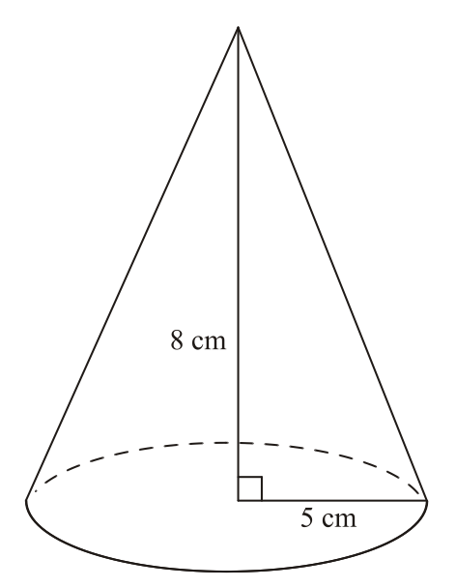
X and Y are two geometrically similar solid shapes. The total surface area of shape X is 450 cm². The total surface area of shape Y is 800 cm². The volume of shape X is 1350 cm³. Calculate the volume of shape Y.
A cone has a base radius of 5 cm and a vertical height of 8 cm. Calculate the volume of the cone. Give your answer correct to 3 significant figures.

Slide 68
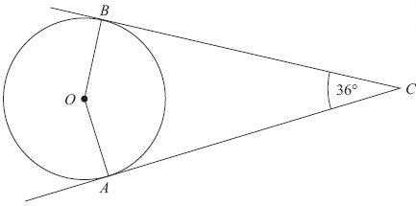
Simplify fully $\frac{(4+2\sqrt{3})(4−2\sqrt{3})}{\sqrt{11}}$
A and B are points on the circumference of a circle, centre O. AC and BC are tangents to the circle. Angle ACB = 36°. Find the size of angle OBA. Give reasons for your answer.

Slide 69
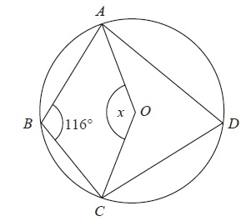
$x$ is directly proportional to the cube of $y$. When $x=32$, $y=0.4$. Find the value of $y$ when $x=256$.
A, B, C and D are points on the circumference of a circle with centre O. Angle ABC = 116°. Find the size of the angle marked $x$. Give reasons for your answer.

Slide 70
$–2<x≤1$ $y>–2$ $y<x+1$
$x$ and $y$ are integers. On a coordinate grid, mark with a cross (X), each of the six points which satisfies all these 3 inequalities.
There are $n$ counters in a bag. 4 of the counters are red and the rest are blue. Ross takes a counter from the bag at random and does not replace it. He then takes another counter at random from the bag. The probability that Ross takes two blue counters is $\frac{1}{3}$
Show that $n^{2}−13n+30=0$
Find the value of $n$.

Slide 71
There are 8 sweets in a bag. Three sweets are red, three sweets are blue and two sweets are green. Three sweets are selected at random without replacement. Calculate the probability that the sweets are not all the same colour. (Hint: draw a tree diagram)
The point $A$ has the coordinates (2, 5). The point $B$ has the coordinates (6, 7). Find the equation of the perpendicular bisector to $AB$.

Slide 72
Toga wants to estimate the number of termites in a nest. On Monday Toga catches 80 termites. He puts a mark on each termite. He then puts all 80 termites back in the nest. On Tuesday Toga catches 60 termites. 12 of these termites have a mark on them. Work out an estimate for the total number of termites in the nest. You must write down any assumptions you have made.
Write $\frac{x^{2}+7x−18}{{2x}^{2}−x−6}$ in the form $\frac{x+a}{bx+c}$ where $a$, $b$ and $c$ are integers.

Slide 73
Factorise $3x^{2}−11x+6$
Make $x$ the subject of the formula $a=\frac{x+c}{x−b}$
Accurately construct an equilateral triangle of side length 5.5 cm.

Slide 74
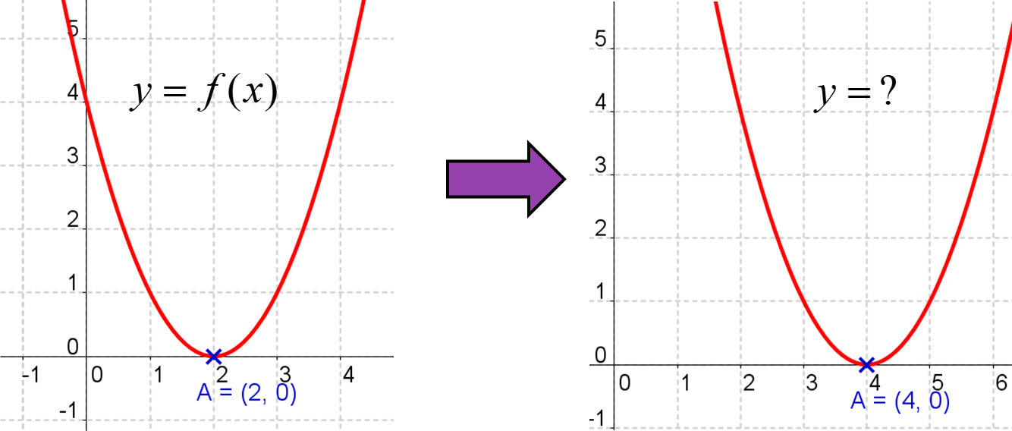
$a=\left(\begin{matrix}1 \\ −3\end{matrix}\right)$ and $b=\left(\begin{matrix}3 \\ −1\end{matrix}\right)$. Calculate $2a−3b$.
Describe the second function following the transformation.

Slide 75
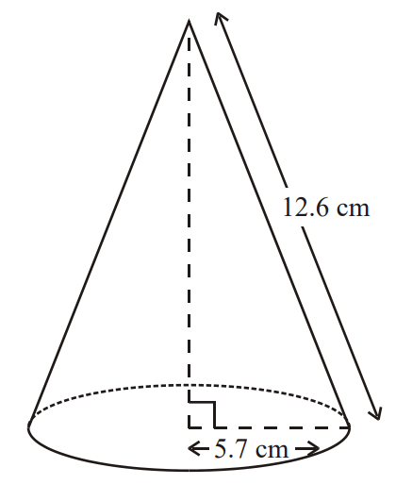
Calculate the volume of the cone. Give your answer correct to 3 significant figures.
Make $x$ the subject of the formula
$\frac{a}{b}=\frac{2x}{x+5}$

Slide 76
Calculate $(4.6×{10}^{4})×(5.1×{10}^{5})$. Give your answer in standard form.
Factorise and solve $4x^{2}−19x−5=0$

Slide 77
There are a large number of white beads in a bag. There are only white beads in the bag. Felicity wants to find an estimate for the number of beads in the bag. Felicity replaces 30 of the white beads in the bag with 30 black beads. She then takes 50 beads from the bag. 2 of the 50 beads are black. Felicity then puts the 50 beads back in the bag. Work out an estimate for the number of beads in the bag.
Sketch the graph of $y={3x}^{2}+4x−8$ and hence identify its turning point.

Slide 78
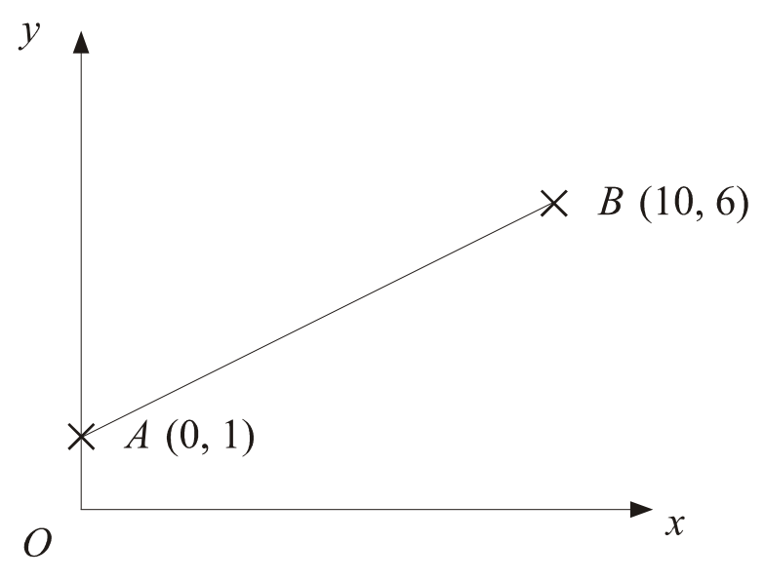
Write $2.3\dot{4}\dot{5}$ as a fraction in its simplest form.
$A$ is the point (0, 1). $B$ is the point (10, 6). Find the equation of the line perpendicular to $AB$ passing through $B$.

Slide 79
$v^{2}=u^{2}+2as$ $v=35.2$ correct to 1 decimal place
$a=9.8$ correct to 1 decimal place
$s=60.35$ correct to decimal places
Work out the upper bound for $u$. Give your answer to 3 significant figures.
Make $x$ the subject of the formula $a=\frac{4+2bx}{2x−3}$

Slide 80
The diagram shows a sector of a circle, centre $O$. The radius of the circle is 6 cm. Angle $AOB=120°$. Work out the perimeter of the sector. Give your answer in terms of $π$ in its simplest form.
Solve $\frac{7}{x+1}−\frac{4}{3x−2}=1$
$$A$$
$$B$$
$$120°$$
$$6 cm$$
$$6 cm$$
$$O$$

Slide 81
Simplify $\sqrt{72}−\sqrt{50}$
Jenny and Penny are identical twins. They are in the same mathematics class, which has a total of twenty students. The teacher selects two students at random to go on a trip. Calculate the probability that at least one twin will go on the trip. (Hint: draw a tree diagram)

Slide 82
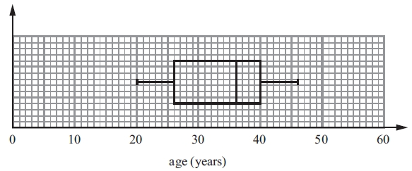
Describe the shape of a cubic graph.
Here are the ages, in years, of 15 women at West Ribble Tennis Club.
16, 18, 18, 20, 25, 25, 27, 28,
30, 35, 38, 42, 45, 46, 50
The box plot below shows the distribution of the ages of the men at
West Ribble Tennis Club. Use the box plots to compare the
distributions of the ages of these women and the distributions of the
ages of these men.

Slide 83
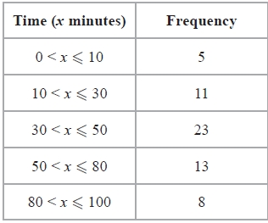
The table shows some information about the times, in minutes, 60 people took to get to work. Calculate an estimate for the mean.
Work out the value of $x$. Give your answer to 1 decimal place.
$$x cm$$
$$65°$$
$$13 cm$$
$$40°$$
$$5 cm$$

Slide 84
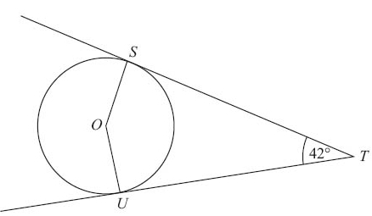
$a=\left(\begin{matrix}4 \\ 2\end{matrix}\right)$, $b=\left(\begin{matrix}3 \\ −1\end{matrix}\right)$ and $c=\left(\begin{matrix}2 \\ 5\end{matrix}\right)$. Calculate $a+b−c$.
S and U are points on the circumference of a circle, centre O. ST and UT are tangents to the circle. Angle STU = 42°. Work out the size of angle SOU. Give reasons for your answer.

Slide 85
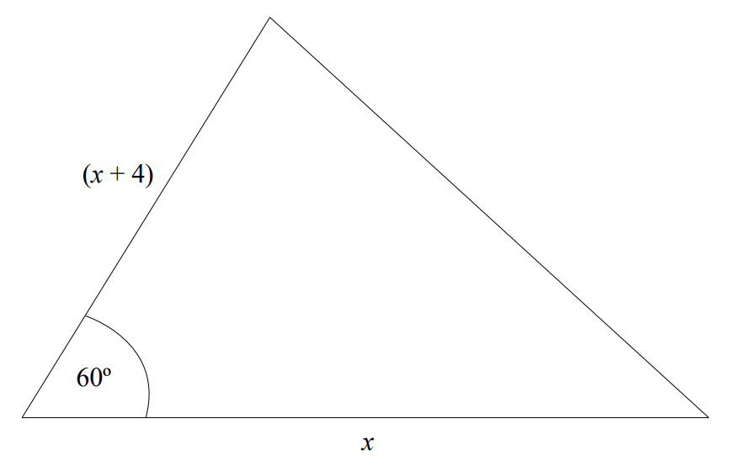
On a coordinate grid, draw straight lines and use shading to show the region R that satisfies the inequalities
$x>2$ $y≥x$ $x+y≤6$
The area of the triangle is $15\sqrt{3}$ cm². Work out the value of $x$.

Slide 86
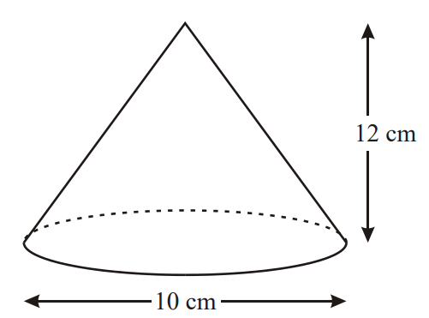
Calculate the curved surface area of the cone. Give your answer as a multiple of $π$.
Factorise and solve $5x^{2}+11x−12=0$

Slide 87
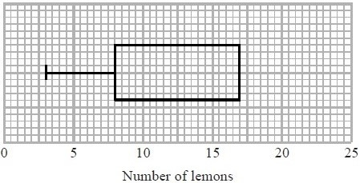
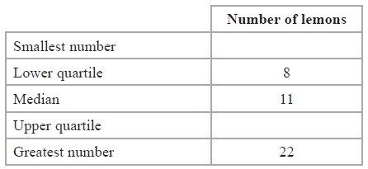
Prove algebraically that $0.\dot{9}=1$.
Presta recorded the number of lemons on each of 60 lemon trees. The incomplete table and box plot give information about her results. Complete the table and the box plot.

Slide 88
Two cylinders, P and Q, are mathematically similar. The total surface area of cylinder P is 90 cm². The total surface area of cylinder Q is 810 cm². The length of cylinder P is 4 cm. Work out the length of cylinder Q.
$P$ is the point (4, -9). $Q$ is the point (-2, 0). Find the equation of the perpendicular bisector of $PQ$.

