Slide 1

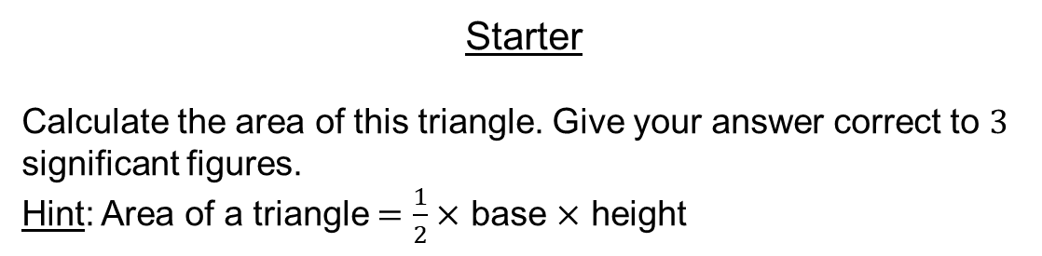
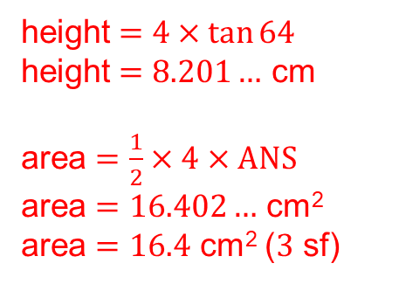

Starter
Calculate the area of this triangle. Give your answer correct to $3$ significant figures.
Hint: Area of a triangle $=\frac{1}{2}×$ base $×$ height
height $=4×\tan{64}$
height $=8.201…$ cm
area $=\frac{1}{2}×4×ANS$
area $=16.402…$ cm²
area $=16.4$ cm² ($3$ sf)
height
$$64°$$
$4$ cm

Slide 2



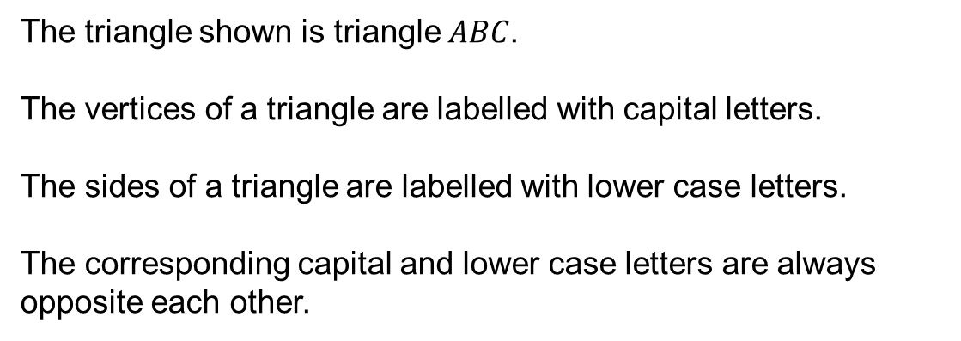



The triangle shown is triangle $ABC$.
The vertices of a triangle are labelled with capital letters.
The sides of a triangle are labelled with lower case letters.
The corresponding capital and lower case letters are always opposite each other.
$$A$$
$$c$$
$$b$$
$$B$$
$$a$$
$$C$$

Slide 3












Purposeful Practice
Label all of the vertices and sides in the diagrams below.
$$P$$
Triangle $KLM$
$$r$$
$$L$$
$$m$$
Triangle $PQR$
$$a$$
$$B$$
$$Z$$
$$x$$
Triangle $ABC$
Triangle $XYZ$

Slide 4
















Answers
$$P$$
$$M$$
$$k$$
Triangle $KLM$
$$q$$
$$r$$
$$L$$
$$l$$
$$m$$
$$X$$
$$R$$
$$p$$
$$Q$$
$$C$$
$$K$$
Triangle $PQR$
$$y$$
$$z$$
$$b$$
$$a$$
$$A$$
$$B$$
$$Z$$
$$Y$$
$$c$$
$$x$$
Triangle $ABC$
Triangle $XYZ$

Slide 5

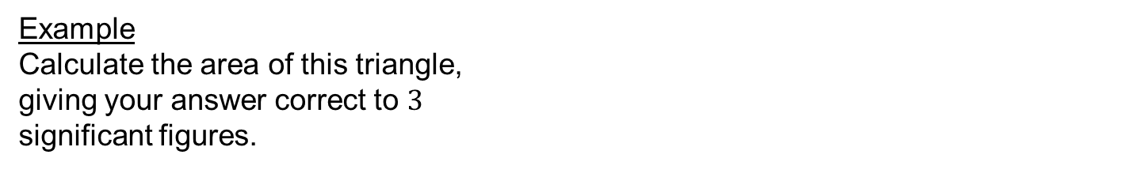


Example
Calculate the area of this triangle,
giving your answer correct to $3$
significant figures.
$7$ cm
$$37°$$
$11$ cm
Why is it difficult to find the area of this triangle?
Because we don’t know the height.

Slide 6



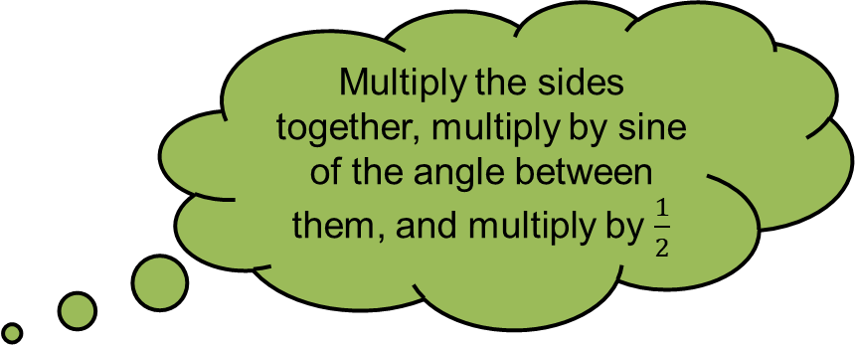




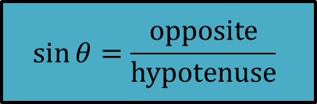

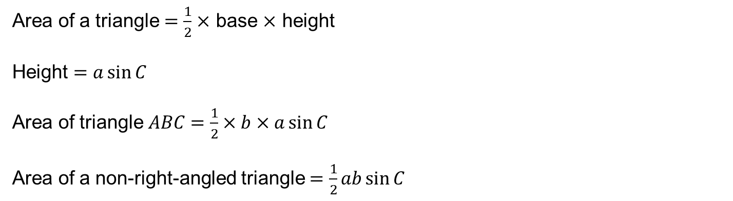
Area of a Non-Right-Angled Triangle
$$B$$
How can we calculate the height?
$$a$$
$$c$$
$$h$$
$$C$$
$$A$$
$$\sin{θ}=\frac{opposite}{hypotenuse}$$
$$b$$
Multiply the sides together, multiply by sine of the angle between them, and multiply by $\frac{1}{2}$
Area of a triangle $=\frac{1}{2}×$ base $×$ height
Height $=a\sin{C}$
Area of triangle $ABC=\frac{1}{2}×b×a\sin{C}$
Area of a non-right-angled triangle $=\frac{1}{2}ab\sin{C}$
$=\frac{1}{2}bc\sin{A}=\frac{1}{2}ac\sin{B}$

Slide 7
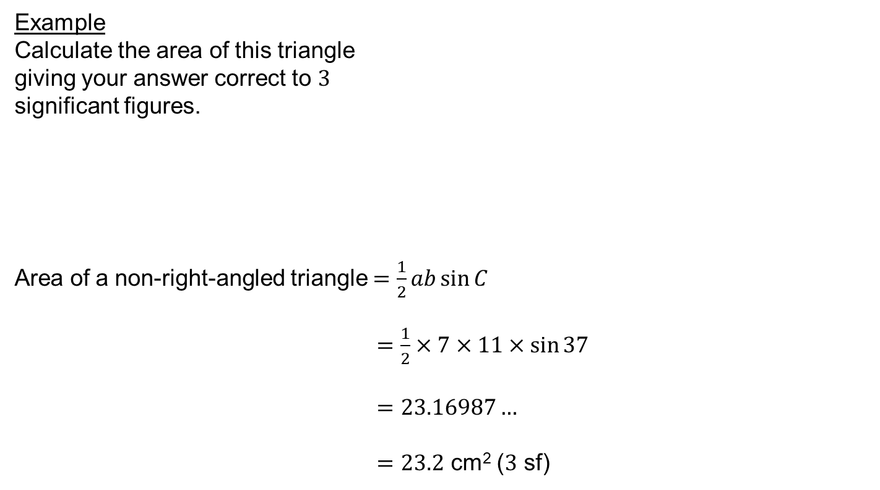
Example
Calculate the area of this triangle
giving your answer correct to $3$
significant figures.
Area of a non-right-angled triangle $=\frac{1}{2}ab\sin{C}$
$=\frac{1}{2}×7×11×\sin{37}$
$=23.16987…$
$=23.2$ cm² ($3$ sf)
$7$ cm
$$37°$$
$11$ cm

Slide 8

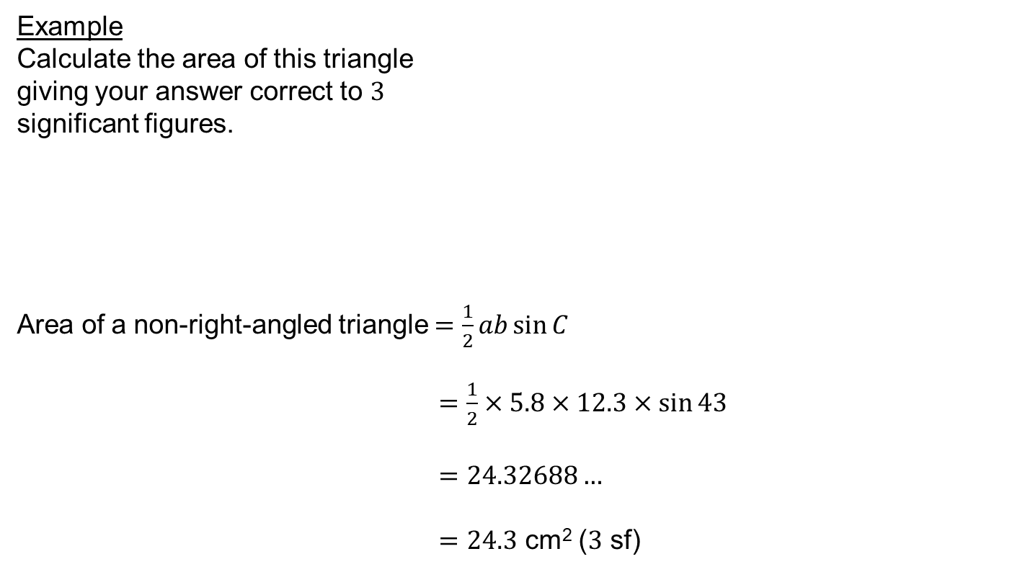


Example
Calculate the area of this triangle
giving your answer correct to $3$
significant figures.
Area of a non-right-angled triangle $=\frac{1}{2}ab\sin{C}$
$=\frac{1}{2}×5.8×12.3×\sin{43}$
$=24.32688…$
$=24.3$ cm² ($3$ sf)
$5.8$ cm
$$43°$$
$12.3$ cm

Slide 9


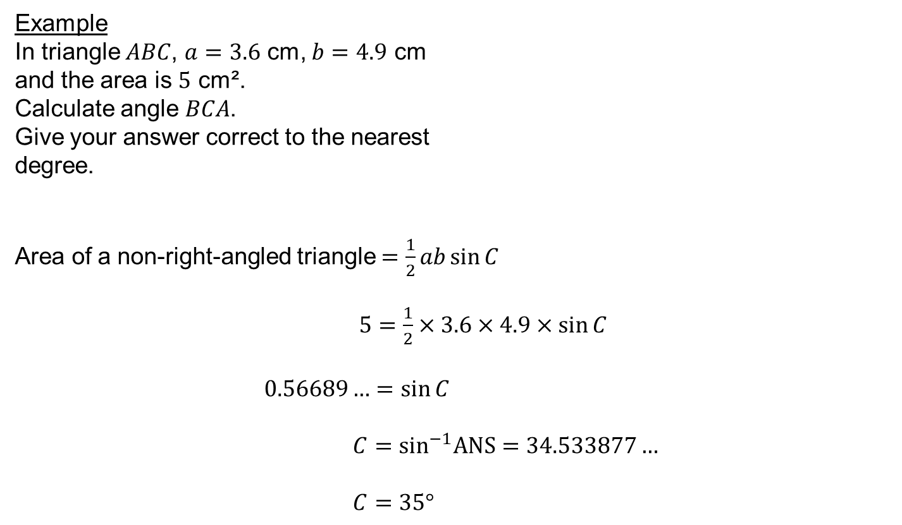



Hint: if it’s tricky, draw a piccy!
Example
In triangle $ABC$, $a=3.6$ cm, $b=4.9$ cm
and the area is $5$ cm².
Calculate angle $BCA$.
Give your answer correct to the nearest
degree.
Area of a non-right-angled triangle $=\frac{1}{2}ab\sin{C}$
$5=\frac{1}{2}×3.6×4.9×\sin{C}$
$0.56689…=\sin{C}$
$C=\sin^{−1}ANS=34.533877…$
$C=35°$
$$B$$
$3.6$ cm
$$C$$
$$A$$
$4.9$ cm

Slide 10
Extension: Question on next slide!

Slide 11



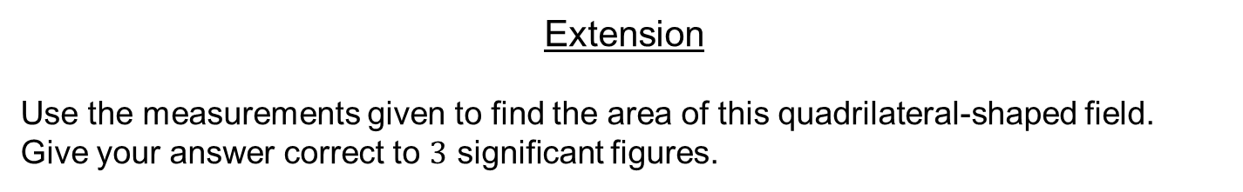



Extension
Use the measurements given to find the area of this quadrilateral-shaped field.
Give your answer correct to $3$ significant figures.
$50$ m
$45$ m
$$60°$$
$$70°$$
$25$ m
$60$ m
$\frac{1}{2}×45×25×\sin{70}+\frac{1}{2}×50×60×\sin{60}=1830$ m² (3 sf)

Slide 12
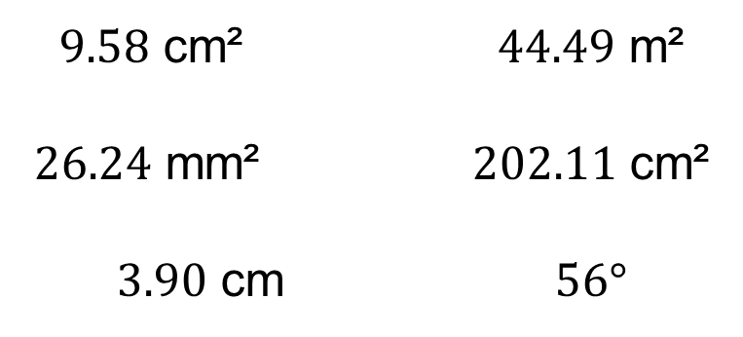
Answers
$9.58$ cm² $44.49$ m²
$26.24$ mm² $202.11$ cm²
$3.90$ cm $56°$

Slide 13
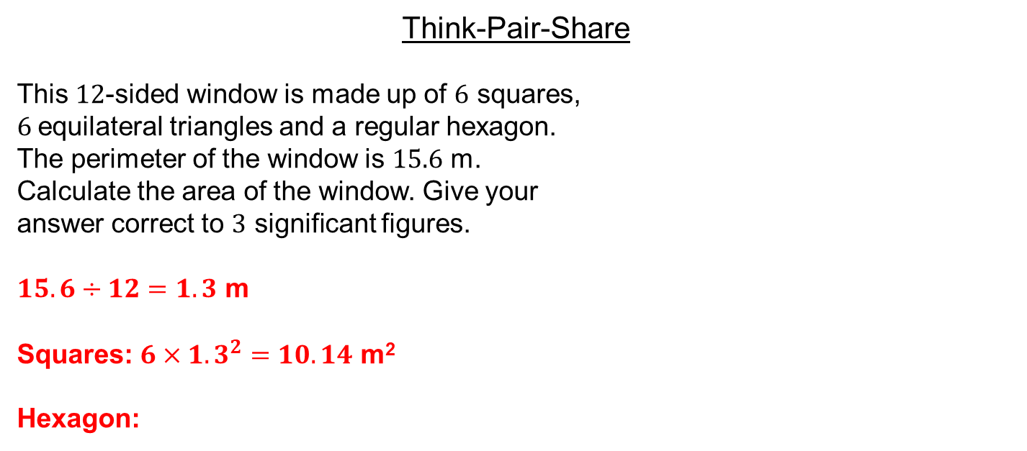
Think-Pair-Share
This $12$-sided window is made up of $6$ squares,
$6$equilateral triangles and a regular hexagon.
The perimeter of the window is $15.6$ m.
Calculate the area of the window. Give your
answer correct to $3$ significant figures.
$15.6÷12=1.3$ m
Squares: $6×{1.3}^{2}=10.14$ m²
Hexagon:

Slide 14
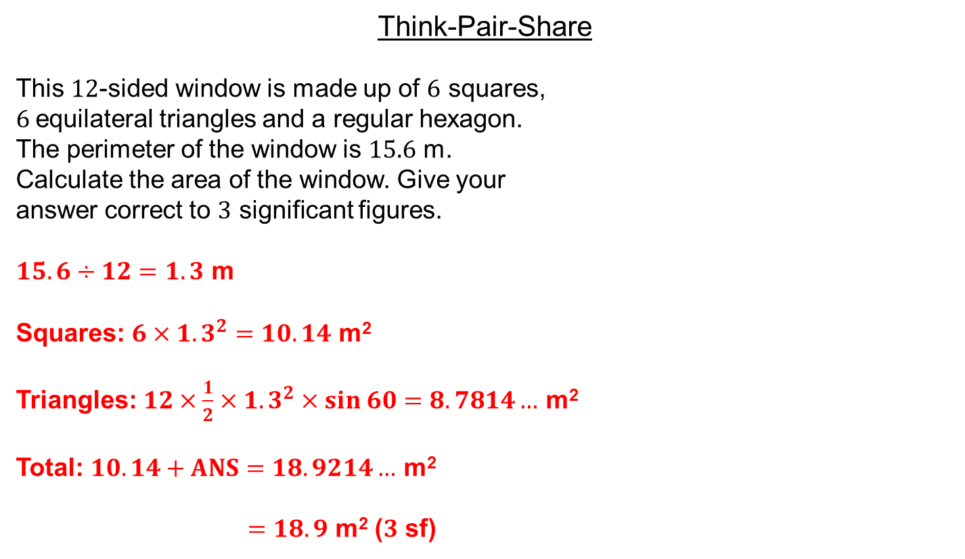
Think-Pair-Share
This $12$-sided window is made up of $6$ squares,
$6$equilateral triangles and a regular hexagon.
The perimeter of the window is $15.6$ m.
Calculate the area of the window. Give your
answer correct to $3$ significant figures.
$15.6÷12=1.3$ m
Squares: $6×{1.3}^{2}=10.14$ m²
Triangles: $12×\frac{1}{2}×{1.3}^{2}×sin 60=8.7814…$ m²
Total: $10.14+ANS=18.9214…$ m²
$=18.9$ m² ($3$ sf)

Slide 15
$$\frac{1}{2}ab\sin{C}=\frac{1}{2}bc\sin{A}=\frac{1}{2}ac\sin{B}$$
We can rearrange this to derive another useful equation: the sine rule

Slide 16


The Sine Rule
$$\frac{1}{2}ab\sin{C}=\frac{1}{2}bc\sin{A}=\frac{1}{2}ac\sin{B}$$
$$×2$$
$$ab\sin{C}=bc\sin{A}=ac\sin{B}$$
$$÷abc$$
$$\frac{ab\sin{C}}{abc}=\frac{bc\sin{A}}{abc}=\frac{ac\sin{B}}{abc}$$
Simplify
$$\frac{\sin{C}}{c}=\frac{\sin{A}}{a}=\frac{\sin{B}}{b}$$
$$\frac{a}{\sin{A}}=\frac{b}{\sin{B}}=\frac{c}{\sin{C}}$$
This works the other way up too

Slide 17

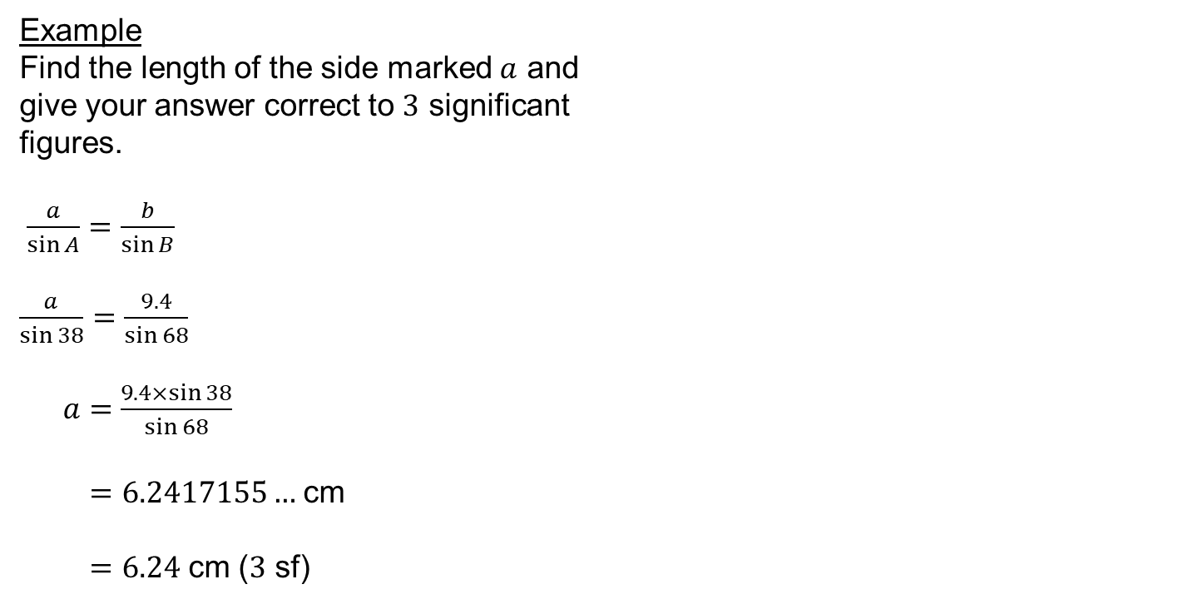



Example
Find the length of the side marked $a$ and
give your answer correct to $3$ significant
figures.
$\frac{a}{\sin{A}}=\frac{b}{\sin{B}}$
$\frac{a}{\sin{38}}=\frac{9.4}{\sin{68}}$
$a=\frac{9.4×\sin{38}}{\sin{68}}$
$=6.2417155…$ cm
$=6.24$ cm ($3$ sf)
$$68°$$
$a$ cm
$$38°$$
$9.4$ cm
Less rearranging required if the unknown is in the numerator

Slide 18

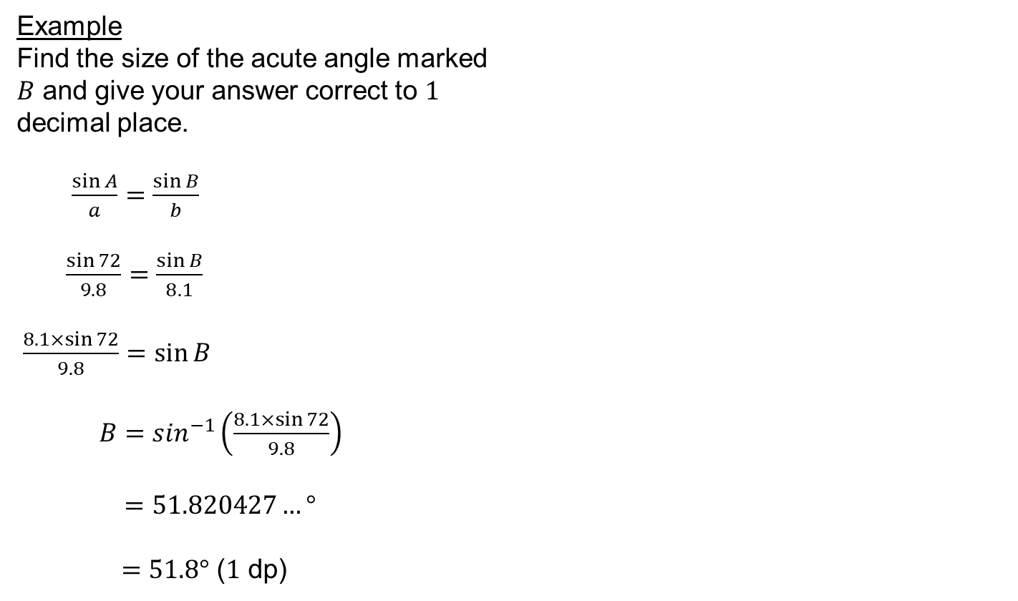



Example
Find the size of the acute angle marked
$B$ and give your answer correct to $1$
decimal place.
$\frac{\sin{A}}{a}=\frac{\sin{B}}{b}$
$\frac{\sin{72}}{9.8}=\frac{\sin{B}}{8.1}$
$\frac{8.1×\sin{72}}{9.8}=\sin{B}$
$B=\sin^{−1}\left(\frac{8.1×\sin{72}}{9.8}\right)$
$=51.820427…°$
$=51.8°$ ($1$ dp)
$$72°$$
$8.1$ cm
$$B°$$
$9.8$ cm
Other way up!

Slide 19
Extension: Question on next slide!

Slide 20
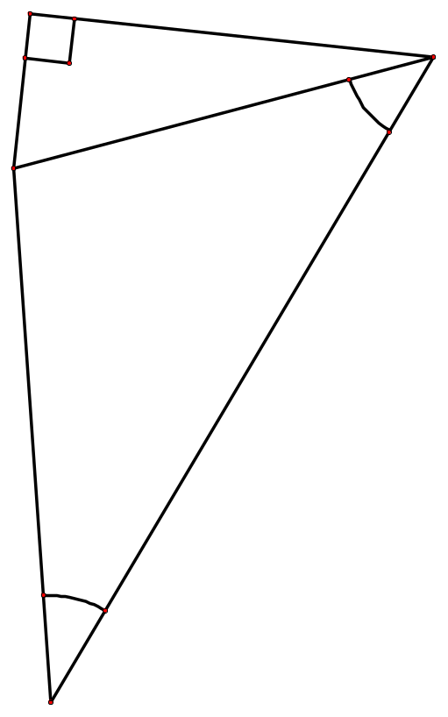



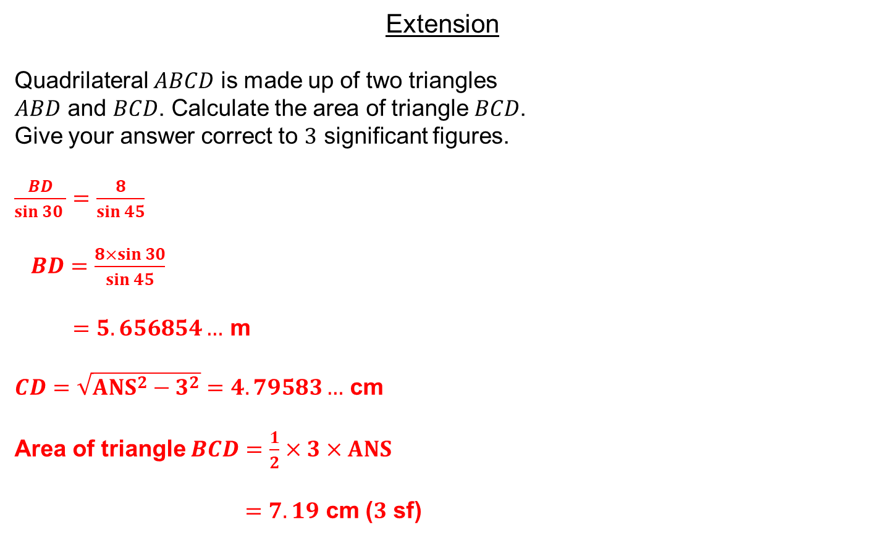





Extension
Quadrilateral $ABCD$ is made up of two triangles
$ABD$ and $BCD$. Calculate the area of triangle $BCD$.
Give your answer correct to $3$ significant figures.
$\frac{BD}{sin 30 }=\frac{8}{sin 45}$
$BD=\frac{8×sin 30}{sin 45}$
$=5.656854…$ m
$CD=\sqrt{{ANS}^{2}−3^{2}}=4.79583…$ cm
Area of triangle $BCD=\frac{1}{2}×3×ANS$
$=7.19$ cm ($3$ sf)
$$C$$
$$D$$
$3$ m
$$45°$$
$$B$$
$8$ m
$$30°$$
$$A$$

Slide 21
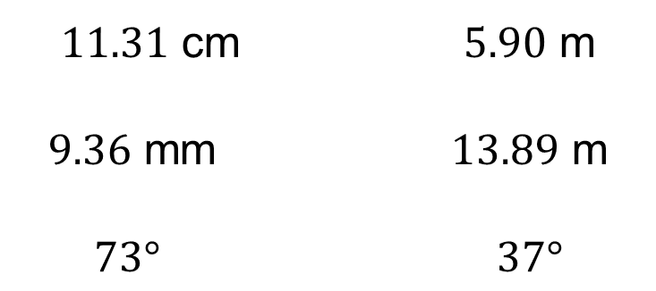
Answers
$11.31$ cm $5.90$ m
$9.36$ mm $13.89$ m
$73°$ $37°$

Slide 22


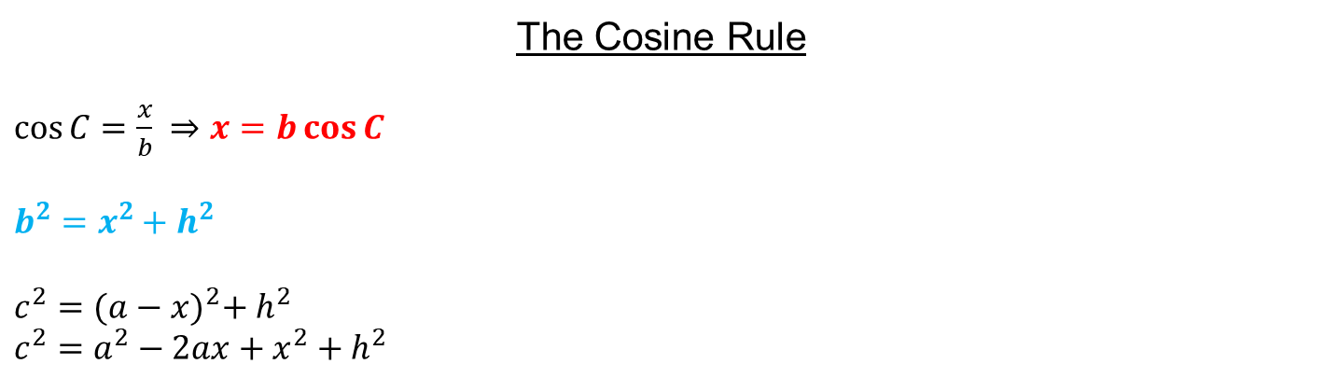






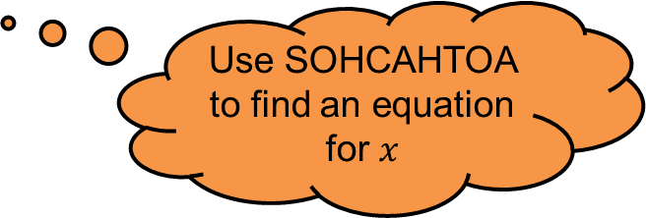

The Cosine Rule
$\cos{C}=\frac{x}{b} ⇒x=b\cos{C}$
$b^{2}=x^{2}+h^{2}$
$c^{2}={(a−x)}^{2}+ h^{2}$
$c^{2}=a^{2}−2ax+x^{2}+h^{2}$
$$A$$
$$b$$
$$c$$
$$h$$
$$C$$
$$a$$
$$B$$
$$x$$
$$a−x$$
Use SOHCAHTOA to find an equation for $x$
Apply Pythagoras’ Theorem to both right-angled triangles

Slide 23
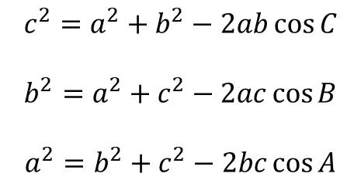
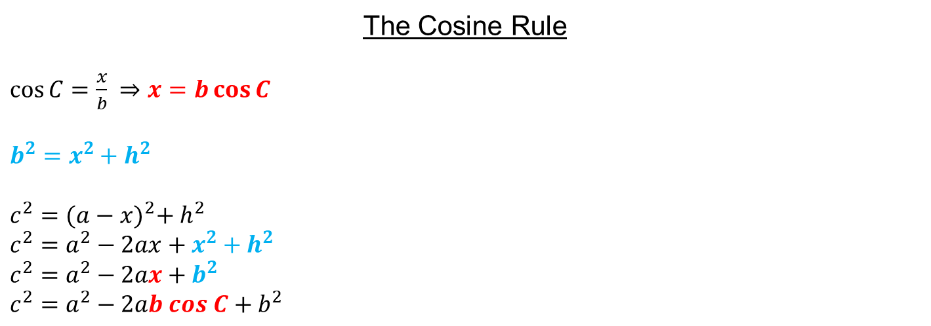
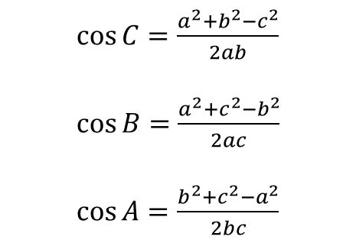
The Cosine Rule
$\cos{C}=\frac{x}{b} ⇒x=b\cos{C}$
$b^{2}=x^{2}+h^{2}$
$c^{2}={(a−x)}^{2}+ h^{2}$
$c^{2}=a^{2}−2ax+x^{2}+h^{2}$
$c^{2}=a^{2}−2ax+b^{2}$
$c^{2}=a^{2}−2ab cos C+b^{2}$
$$A$$
$$b$$
$$c$$
$$h$$
$$C$$
$$a$$
$$B$$
$$x$$
$$a−x$$
$\cos{C}=\frac{a^{2}+b^{2}−c^{2}}{2ab}$
$\cos{B}=\frac{a^{2}+c^{2}−b^{2}}{2ac}$
$\cos{A}=\frac{b^{2}+c^{2}−a^{2}}{2bc}$
$$c^{2}=a^{2}+b^{2}−2ab\cos{C}$$
$$b^{2}=a^{2}+c^{2}−2ac\cos{B}$$
$$a^{2}=b^{2}+c^{2}−2bc\cos{A}$$

Slide 24
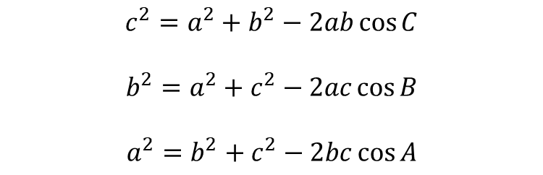
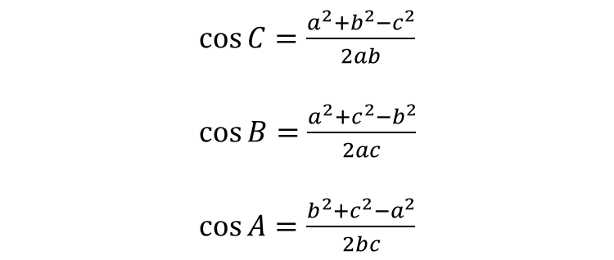
The Cosine Rule
Always uses two sides and the included angle
$\cos{C}=\frac{a^{2}+b^{2}−c^{2}}{2ab}$
$\cos{B}=\frac{a^{2}+c^{2}−b^{2}}{2ac}$
$\cos{A}=\frac{b^{2}+c^{2}−a^{2}}{2bc}$
$$c^{2}=a^{2}+b^{2}−2ab\cos{C}$$
$$b^{2}=a^{2}+c^{2}−2ac\cos{B}$$
$$a^{2}=b^{2}+c^{2}−2bc\cos{A}$$

Slide 25



























Think – Pair – Share
Which of these triangles can we apply the cosine rule to?
$$5.1$$
$$22$$
$$p$$
$$b°$$
$$95°$$
$$x$$
$$97°$$
$$100°$$
$$3.6$$
$$32°$$
$$21$$
$$9$$
$$16$$
$$28$$
$$a°$$
$$7$$
$$19$$
$$92°$$
$$28$$
$$5$$
$$b°$$
$$4$$
$$5$$
$$8$$
$$P°$$
$$41$$
$$x$$
Notes:
Thanks to TES user whidds

Slide 26








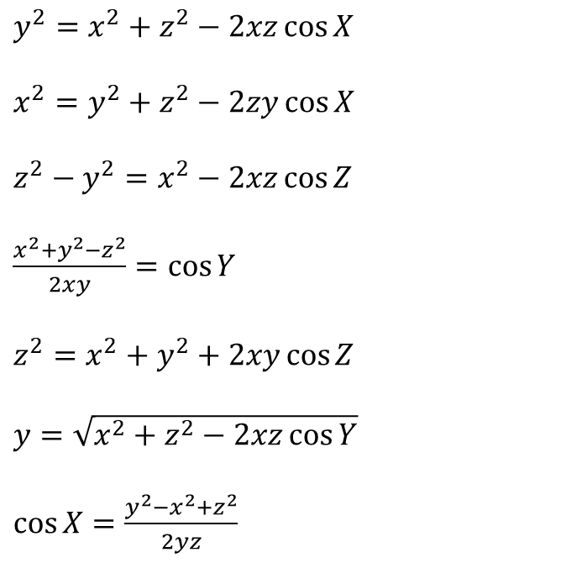
Think – Pair – Share
Which of these versions of the cosine rule can we apply to this triangle?
$y^{2}=x^{2}+z^{2}−2xz\cos{X}$
$x^{2}=y^{2}+z^{2}−2zy\cos{X}$
$z^{2}−y^{2}=x^{2}−2xz\cos{Z}$
$\frac{x^{2}+y^{2}−z^{2}}{2xy}=\cos{Y}$
$z^{2}=x^{2}+y^{2}+2xy\cos{Z}$
$y=\sqrt{x^{2}+z^{2}−2xz\cos{Y}}$
$\cos{X}=\frac{y^{2}−x^{2}+z^{2}}{2yz}$
$$X$$
$$z$$
$$y$$
$$Y$$
$$Z$$
$$x$$
Notes:
Thanks to @mrallanmaths

Slide 27

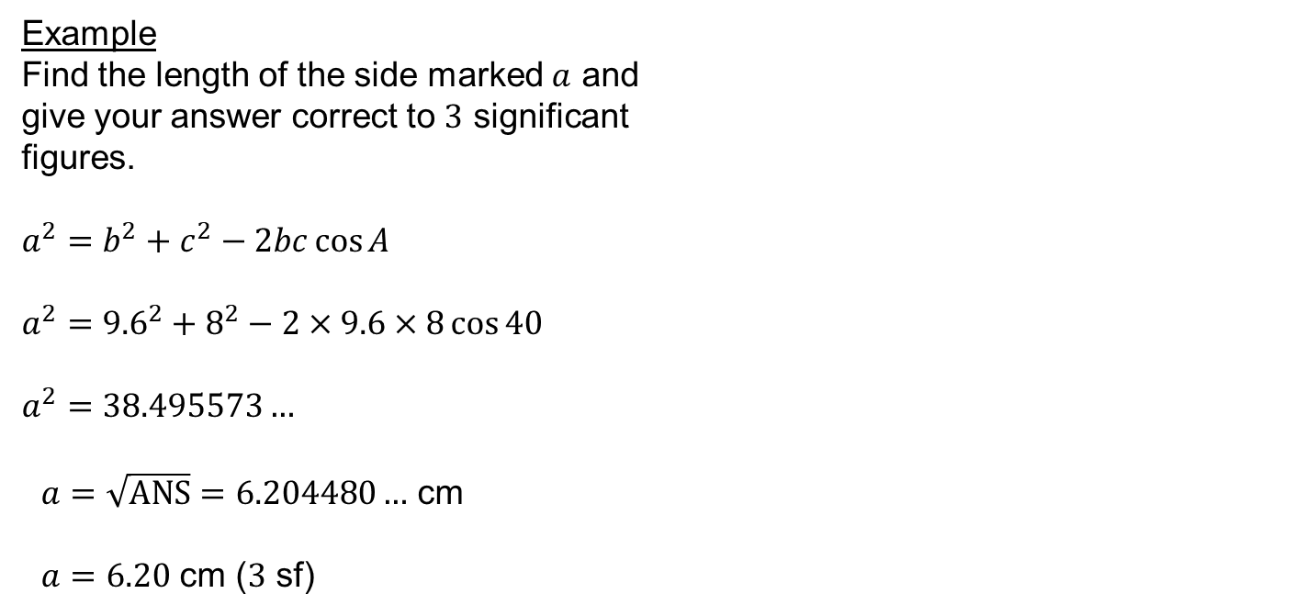



Example
Find the length of the side marked $a$ and
give your answer correct to $3$ significant
figures.
$a^{2}=b^{2}+c^{2}−2bc\cos{A}$
$a^{2}={9.6}^{2}+8^{2}−2×9.6×8\cos{40}$
$a^{2}=38.495573…$
$a=\sqrt{ANS}=6.204480…$ cm
$a=6.20$ cm ($3$ sf)
$9.6$ cm
$a$ cm
$$40°$$
$8$ cm

Slide 28

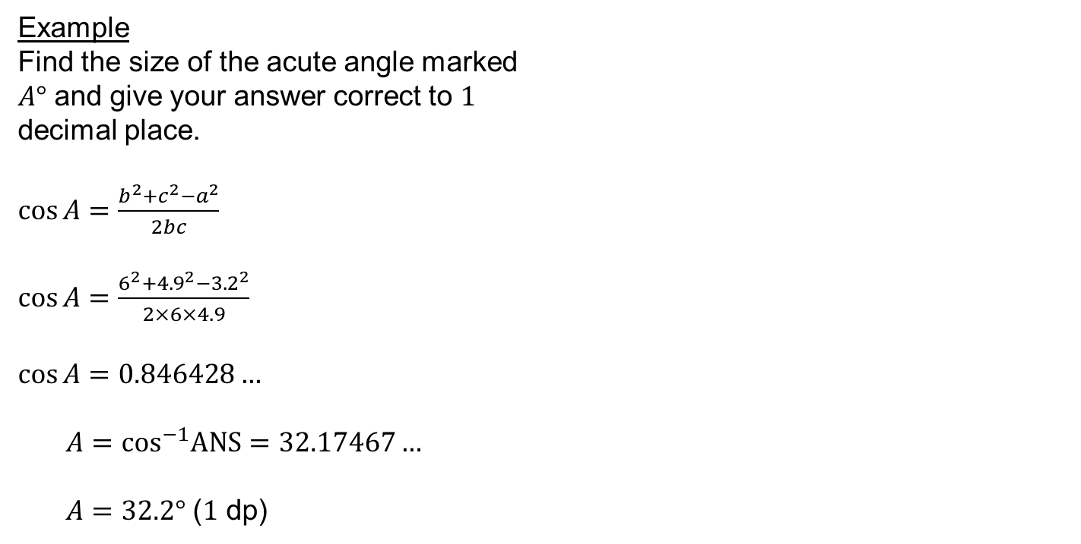



Example
Find the size of the acute angle marked
$A°$ and give your answer correct to $1$
decimal place.
$\cos{A}=\frac{b^{2}+c^{2}−a^{2}}{2bc}$
$\cos{A}=\frac{6^{2}+{4.9}^{2}−{3.2}^{2}}{2×6×4.9}$
$\cos{A}=0.846428…$
$A=\cos^{−1}ANS=32.17467…$
$A=32.2°$ ($1$ dp)
$6$ cm
$3.2$ cm
$$A°$$
$4.9$ cm

Slide 29
Extension: Question on next slide!

Slide 30
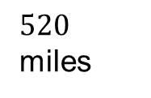


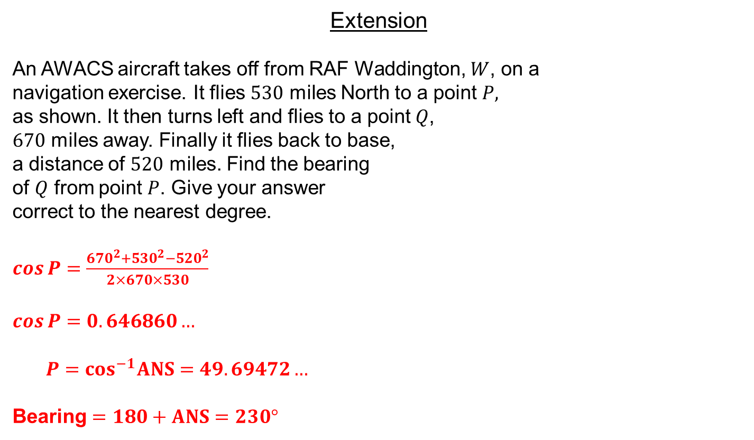



Extension
An AWACS aircraft takes off from RAF Waddington, $W$, on a
navigation exercise. It flies $530$ miles North to a point $P,$
as shown. It then turns left and flies to a point $Q$,
$670$ miles away. Finally it flies back to base,
a distance of $520$ miles. Find the bearing
of $Q$ from point $P$. Give your answer
correct to the nearest degree.
$\cos{P}=\frac{{670}^{2}+{530}^{2}−{520}^{2}}{2×670×530}$
$\cos{P}=0.646860…$
$P=\cos^{−1}ANS=49.69472…$
Bearing $=180+ANS=230°$
$$P$$
$670$ miles
$530$ miles
$$Q$$
$520$ miles
$$W$$

Slide 31
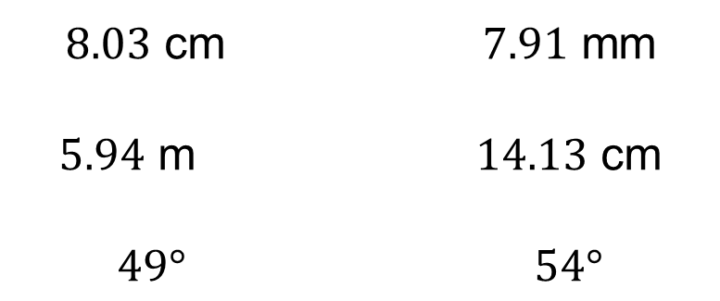
Answers
$8.03$ cm $7.91$ mm
$5.94$ m $14.13$ cm
$49°$ $54°$

