Slide 1
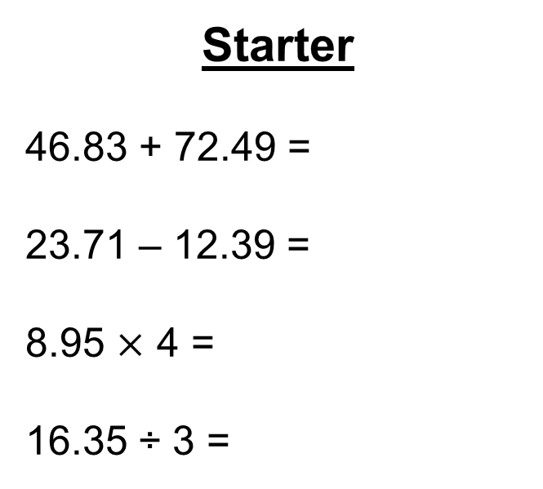
Starter
46.83 + 72.49 =
23.71 – 12.39 =
8.95 $×$ 4 =
16.35 ÷ 3 =
119.32
11.32
35.80
5.45

Slide 2
Things to look out for:
Have you used a highlighter or underlined key pieces of information?
Have you written units (pounds and/or pence) throughout your working?
Have you fully answered the question?

Slide 3
Here are the ticket prices for entry to a museum. Shamus takes his family to the museum. He gets tickets for
2 adults,
3 children,
1 senior.
Shamus pays the least possible amount of money for the tickets. He pays with three £20 notes. How much change should he get?
Ticket prices
Adult ticket £12
Child ticket £7
Senior ticket £8
Family ticket (2 adult tickets and 2 child tickets) £30
(Total 4 marks)
1 x family ticket = £30.00
1 x child ticket = £ 7.00
1 x senior ticket = £ 8.00
£60.00
£45.00
-
+
£ 15.00
£45.00
Shamus should receive £15.00 change.

Slide 4
The table gives information about the costs of posting parcels. Umar has to post some parcels.
He has to post:
3 parcels with a weight of 6 kg each
1 parcel with a weight of 10 kg
1 parcel with a weight of 3 kg
1 parcel with a weight of 1.2 kg
Umar has £55 to spend on posting the parcels. Can he post all the parcels?
Maximum weight of a parcel | Cost
2 kg | £4.41
4 kg | £7.06
6 kg | £9.58
8 kg | £11.74
10 kg | £12.61
20 kg | £14.69
(Total 4 marks)
3 x £9.58 = £28.74
1 x £12.61 = £12.61
1 x £7.06 = £ 7.06
1 x £4.41 = £ 4.41
+
£52.82
Umar does have enough money to post all the parcels.

Slide 5
Mr Jones uses 730 units of electricity. He pays:
24p per unit for the first 130 units of electricity he uses
13p per unit for the rest of the units of electricity he uses
Work out the total amount of money Mr Jones pays. You must show all your working.
(Total 4 marks)
130 x 24p =
3120p
= £32.20
730 units – 130 units =
600 units
600 x 13p =
7800p
= £78.00
£32.20
£78.00
The electricity will cost
£110.20 in total.
+
£110.20

Slide 6
Daniel buys
one loaf of bread costing £1.18
one tub of spread costing 94p
two jars of strawberry jam.
Daniel pays with a £5 note. He gets 30p change.
Work out the cost of one jar of strawberry jam.
£ . . . . . . . . . . . . . . . . . . . . . .
(Total for Question is 3 marks)
£1.18
£0.94
£2.12
£0.30
£5.00
£2.42
+
+
+
£2.12
£2.42
£2.58
£2.58 ÷ 3 =
£0.86
0.86

Slide 8
Answers
1. £3.25 change
2. £4.80 cheaper
3. Chris should chose Quick mix (£41.10 is cheaper than £44.00)
4. Joanna can save £4.45
5. Becky should buy from Fred’s Furniture (£312 is cheaper than £320 or £330)
6. Miss Martins gives £1400 to charity
7. Sandeep and friends should go on the tram (£14.00 is less that £14.20)
8. Jo has an overall loss of £10

