Slide 1
Starter
Convert the following fractions to percentages:
1) $\frac{1}{4}$
2) $\frac{2}{5}$
3) $\frac{3}{8}$
4) $\frac{7}{20}$

Slide 2

Answers
1) $\frac{1}{4}$ 25%
2) $\frac{2}{5}$ 20%
3) $\frac{3}{8}$ 37.5%
4) $\frac{7}{20}$ 35%

Slide 3
Example
There are $32$ sweets in a bag. Four of the sweets are orange flavour. What percentage of sweets are orange flavour?
$4$ out of $32$: $\frac{4}{32}$
$\frac{4}{32}×100$
Start by writing the proportion of orange sweets as a fraction.
$=12.5\%$
Then convert the fraction to a percentage.

Slide 4
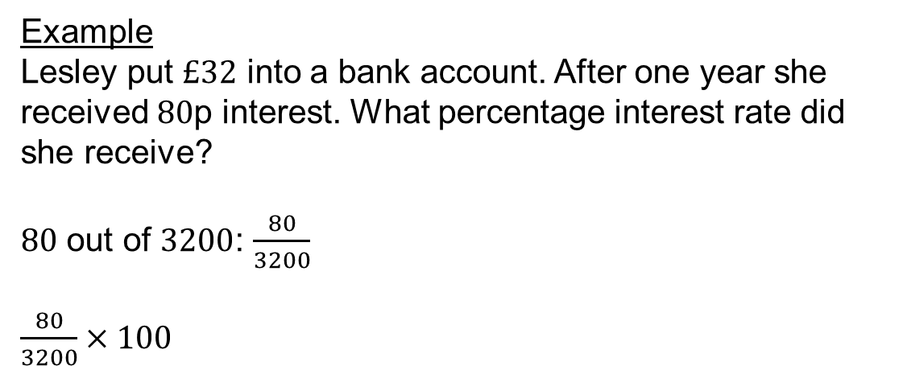
Example
Lesley put $£32$ into a bank account. After one year she received $80$p interest. What percentage interest rate did she receive?
$80$ out of $3200$: $\frac{80}{3200}$
$\frac{80}{3200}×100$
Start by writing the proportion of money as a fraction.
$=2.5\%$
Then convert the fraction to a percentage.

Slide 5
Task
Express the first quantity as a percentage of the second. Give your answers to 1 decimal place where appropriate:
£3 of £10
252 kg of 750 kg
24 minutes of 1 hour
2 weeks of a year
245 g of 5 kg
$\frac{3}{10}×100=30\%$
$\frac{252}{750}×100=33.6\%$
$\frac{24}{60}×100=40\%$
$\frac{2}{52}×100=3.8\%$
$\frac{245}{5000}×100=4.9\%$

Slide 6
Percentage change is where we discover what percentage an amount has increased or decreased by.
Percentage change $=\frac{\text{actual} \text{change} }{\text{original} \text{amount} }×100$

Slide 7
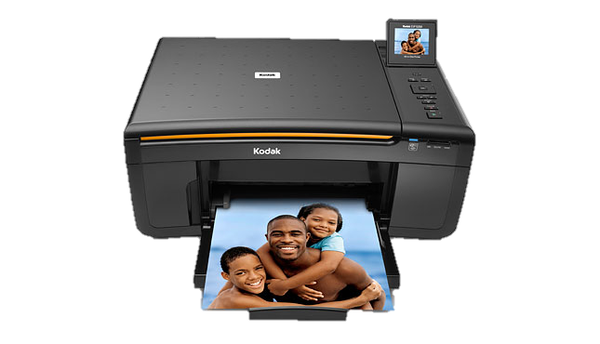
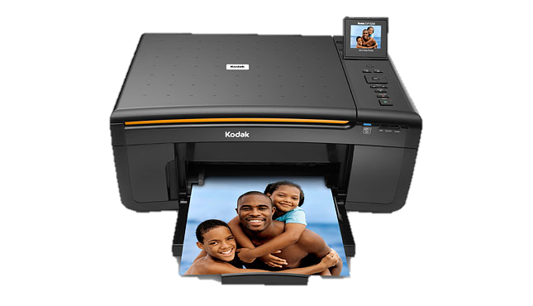
Percentage change $=\frac{\text{actual} \text{change} }{\text{original} \text{amount} }×100$
Example
A computer accessories shop increased the price of one of its printers from £80 to £100. Find the percentage increase in price.
Percentage change $=\frac{20}{80}×100$
£100
£80
Original price
New price
$=25\%$ increase

Slide 8
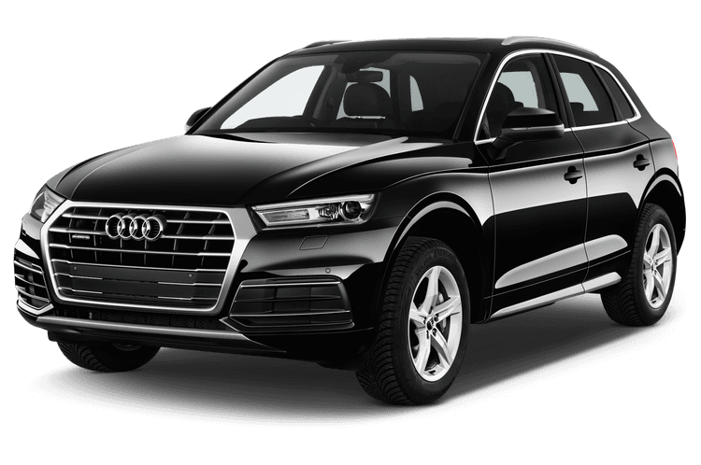

Percentage change $=\frac{\text{actual} \text{change} }{\text{original} \text{amount} }×100$
Example
Find the percentage decrease in the cost of the car in the sale. Give your answer correct to 1 decimal place.
Percentage change $=\frac{1500}{35500}×100$
£35500
£34000
Original price
Sale price
$=4.2\%$ decrease

Slide 9
Checkpoint
Original amount | New amount | Percentage change
£100 | £110
£250 | £300
£75 | £87.50

Slide 10
Answers
Original amount | New amount | Percentage change
£100 | £110 | 10% increase
£250 | £200 | 20% decrease
£75 | £87.50 | 16.7% increase

Slide 12
Answers
1) 20% decrease 2) 20% increase
3) 12% decrease 4) 10.8% decrease
5) 20% decrease 6) 25% increase
7) 16% increase 8) 7.5% decrease
9) 13% increase 10) 25% increase

Slide 13
Think – Pair – Share
A man in a shop decides to put his prices up by 10% as he needed more money.
However he found this didn’t work and reduced his prices back down by 10% .
Is the price of the items now the same as the original price?

