Slide 1
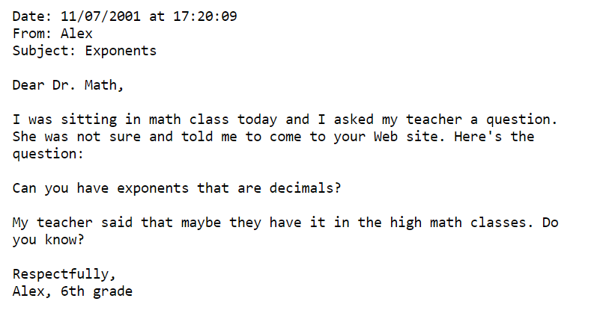
Try the problems on the sheet while you’re waiting for the workshop to start!

Slide 2
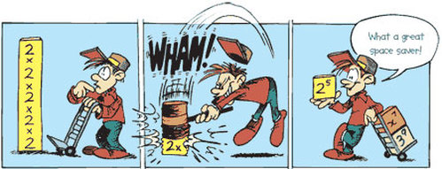
Indices In Depth
Resources, misconceptions
and approaches
Notes:
https://susanleesensei.weebly.com/index-laws.html

Slide 3
Teaching any topic: What to think about...
Topic progression: KS1 – 5 curriculum, prerequisites, links & next steps
Examples and explanation
Assessment
Misconceptions
Tasks and resources (fluency → challenge)
Enrichment and narrative
Depth not speed
Notes:
Indices are closely linked to a number of topics including standard form, highest common factor, algebraic fractions etc

Slide 4
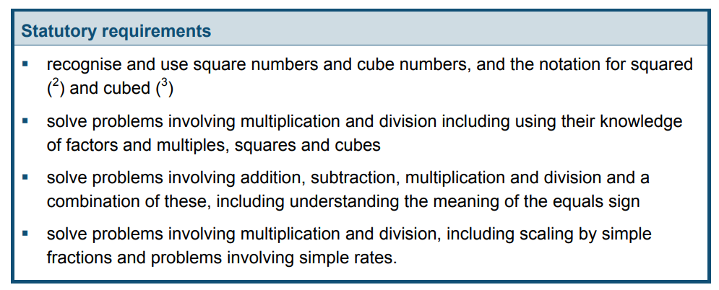
Year 5
Notes:
https://www.gov.uk/government/uploads/system/uploads/attachment_data/file/335158/PRIMARY_national_curriculum_-_Mathematics_220714.pdf

Slide 5
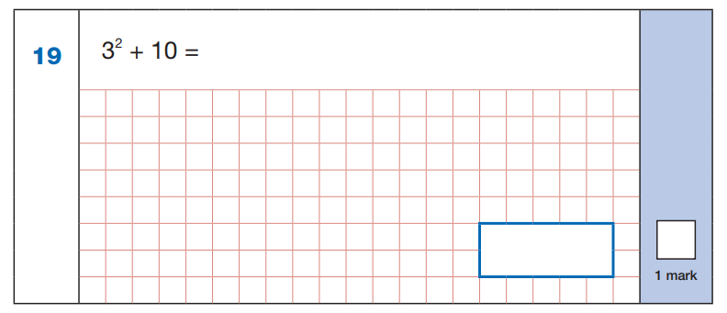
Notes:
Year 6 SATs 2016

Slide 6
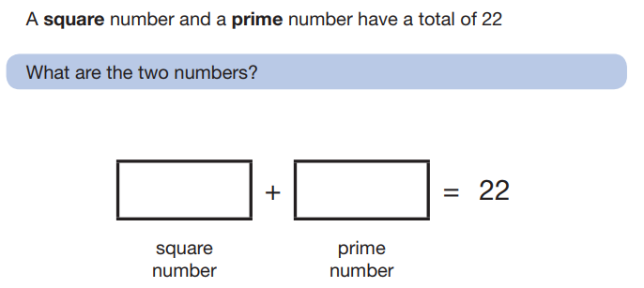
Notes:
Year 6 SATs 2017

Slide 7
Year 5
Notes:
https://www.gov.uk/government/uploads/system/uploads/attachment_data/file/335158/PRIMARY_national_curriculum_-_Mathematics_220714.pdf

Slide 8
Key Stage 3
Notes:
https://www.gov.uk/government/uploads/system/uploads/attachment_data/file/239058/SECONDARY_national_curriculum_-_Mathematics.pdf

Slide 9
GCSE
Notes:
https://www.gov.uk/government/uploads/system/uploads/attachment_data/file/254441/GCSE_mathematics_subject_content_and_assessment_objectives.pdf

Slide 10
Foundation GCSE 2017
Notes:
Plus standard form

Slide 11
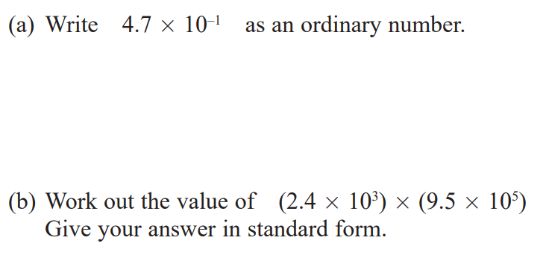
Notes:
More from Foundation

Slide 12
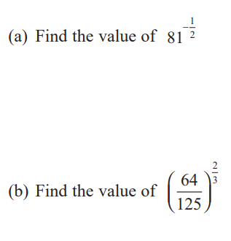
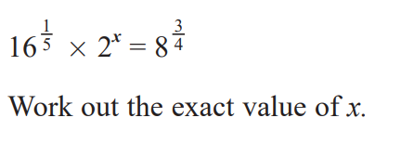
Higher GCSE 2017
Notes:
Plus standard form.
Possible to get a nine in GCSE with no fluency here

Slide 13
Higher GCSE 2017

Slide 14
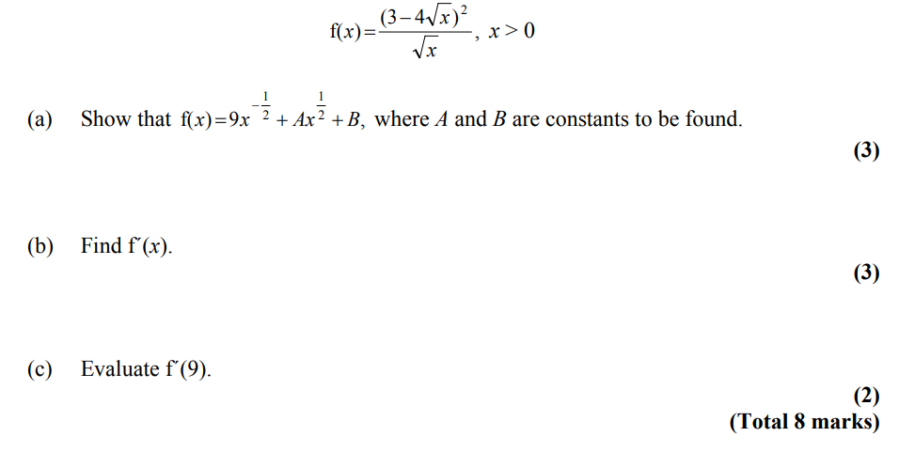
A level
Fluency in working with indices is absolutely essential to success at A level
Notes:
https://www.gov.uk/government/uploads/system/uploads/attachment_data/file/516949/GCE_AS_and_A_level_subject_content_for_mathematics_with_appendices.pdf
Logs, calculus

Slide 15
Back to Basics: Square Numbers

Slide 16
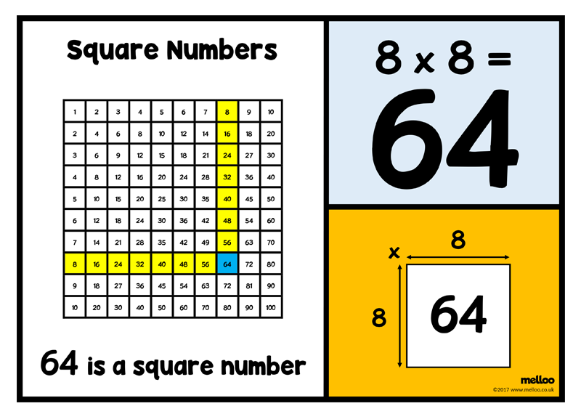
Exploring square numbers
Notes:
https://melloo.co.uk/square-numbers

Slide 17
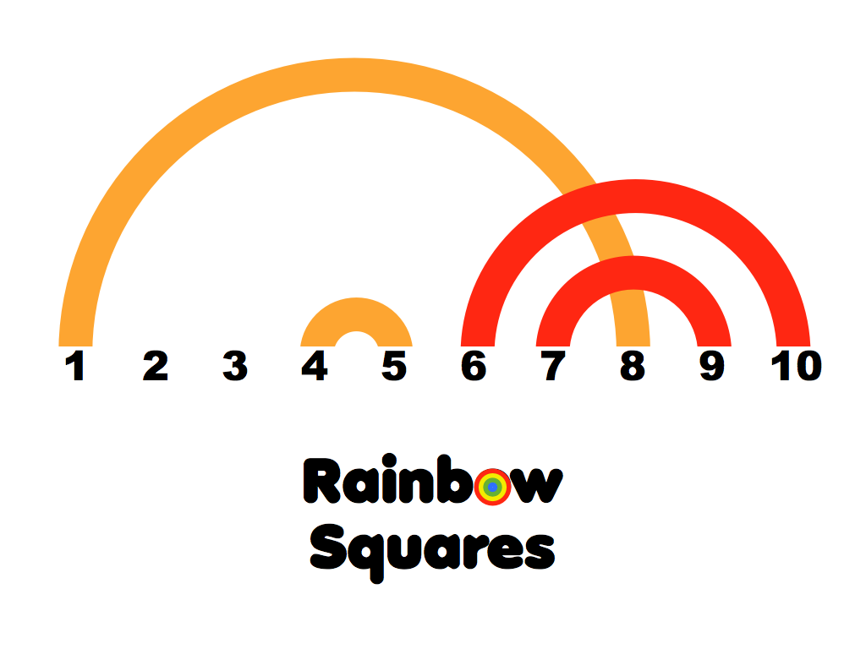
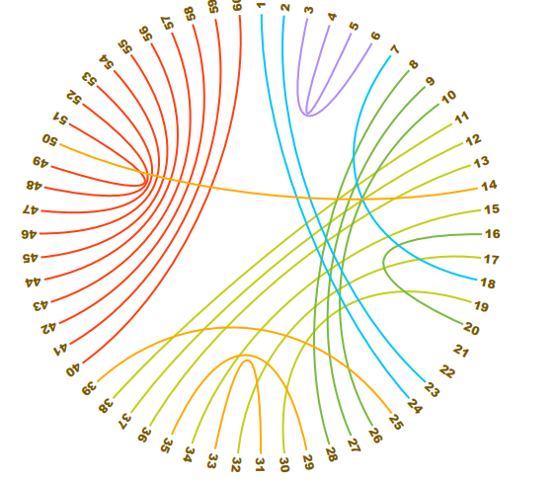
Notes:
http://mathpickle.com/wp-content/uploads/2015/07/Rainbow-Squares-2015.pdf

Slide 18
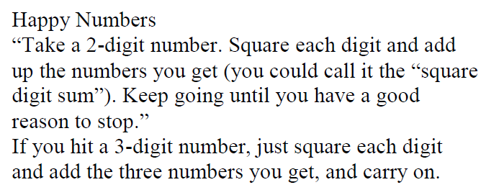
Notes:
There’s plenty to fill a lesson or two on square numbers – don’t rush ahead. Calculator use important too.
http://www.foster77.co.uk/1.14%20Indices.pdf

Slide 19
Back to Basics: Powers

Slide 20
A typical approach...
Done!
Notes:
A bit of whole class questioning is not enough here!

Slide 21
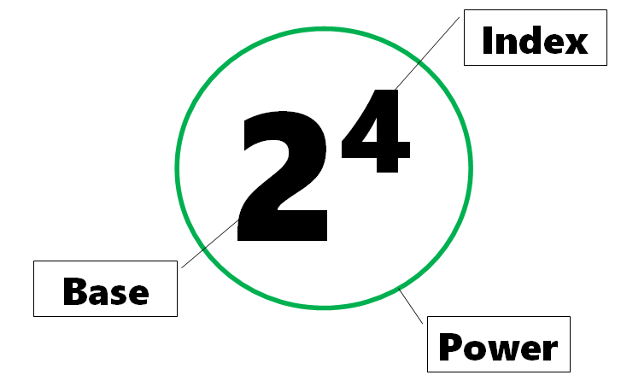
Explicit teaching of powers

Slide 22
The ‘powers of 2’
2¹ = 2
2² = 2 x 2
2³ = 2 x 2 x 2
2⁴ = 2 x 2 x 2 x 2
2⁵ = 2 x 2 x 2 x 2 x 2
2⁶ = 2 x 2 x 2 x 2 x 2 x 2
Let’s look more closely at the fourth power of two...
Notes:
Be clear about the term ‘powers of 2’.
‘2^4 is a power of 2’.
Let’s look more closely at 2^4

Slide 23
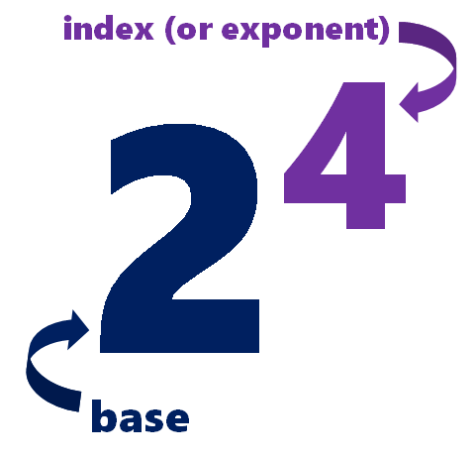
This is the fourth power of 2.
We say ...
two to the power of four
two to the power four
two to the fourth
two high four
two to the four
two fourth power
two to the fourth power
two raised to power four
two power four
two to the exponent of four
two at the power four
Notes:
“2 high 4” is actually what they say in Germany – “zwei hoch vier”
Consistently correct students to stop them saying “2 4”
Now look at powers of 3, powers of 4, powers of 5, powers of x etc

Slide 24
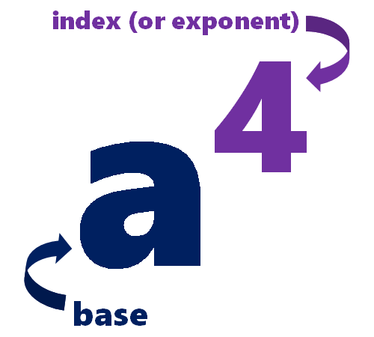
The ‘powers of a’
a¹ = a
a² = a x a
a³ = a x a x a
a⁴ = a x a x a x a
a⁵ = a x a x a x a x a
a⁶ = a x a x a x a x a x a

Slide 25
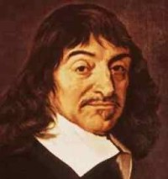
"Discours de la méthode" - René Descartes, 1637
“ ... and aa, or a², in order to multiply a by itself; and a³, in order to multiply it once more by a, and thus to infinity ; ... “
Notes:
http://gallica.bnf.fr/ark:/12148/btv1b86069594/f383.image
Wikipedia, Descartes: “One of Descartes' most enduring legacies was his development of Cartesian or analytic geometry, which uses algebra to describe geometry. He "invented the convention of representing unknowns in equations by x, y, and z, and knowns by a, b, and c". He also "pioneered the standard notation" that uses superscripts to show the powers or exponents; for example, the 4 used in x⁴ to indicate squaring of squaring.”
^{And}
In 1637, René Descartes published "Discours de la méthode" (the “Discourse on Method”). Following on from early movements towards the use of symbolic expressions in mathematics by Diophantus, Al-Khwarizmi and François Viète, "La Géométrie" introduced what has become known as the standard algebraic notation.
Fun fact: Descartes tended not to use 2 as an exponent, however, usually writing aa rather than a^2, perhaps because aa occupies no less space than a^2

Slide 26
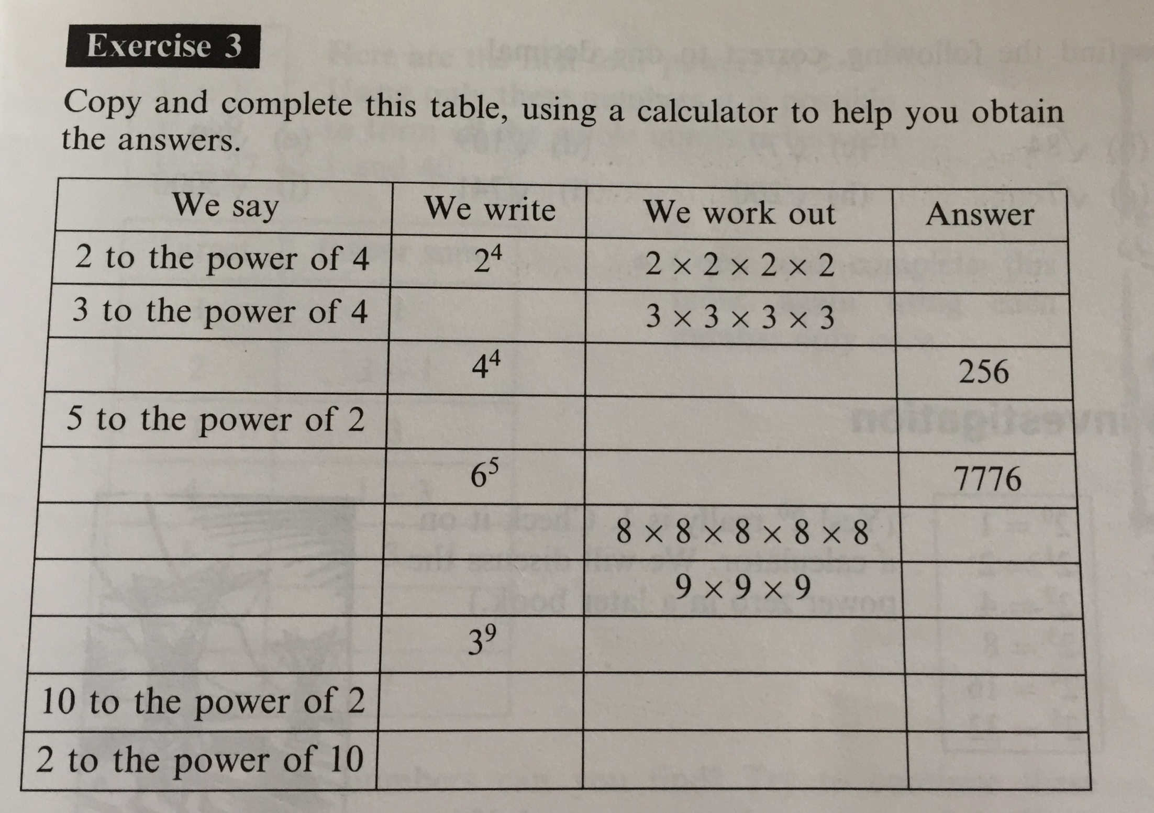
Notes:
Essential Mathematics (Rayner et al 1998)

Slide 27
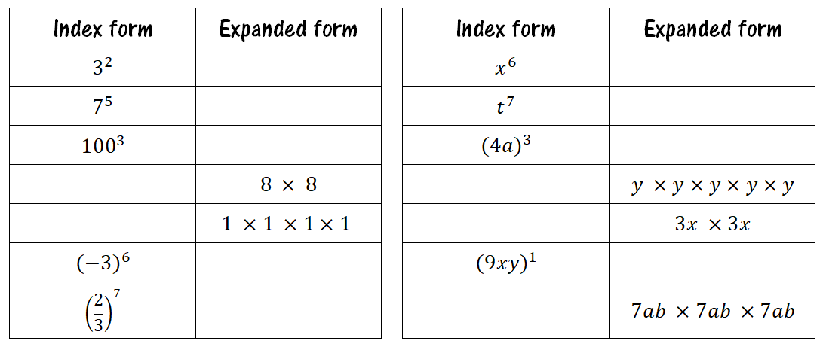

Slide 28
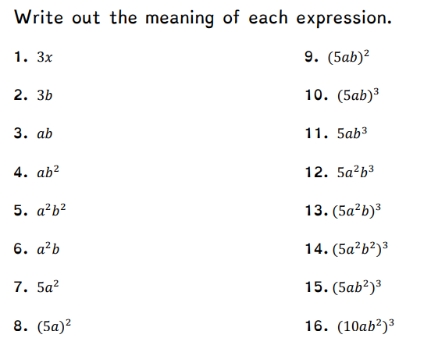
Notes:
https://minimallydifferent.files.wordpress.com/2018/04/algebraic-notation.pdf

Slide 29
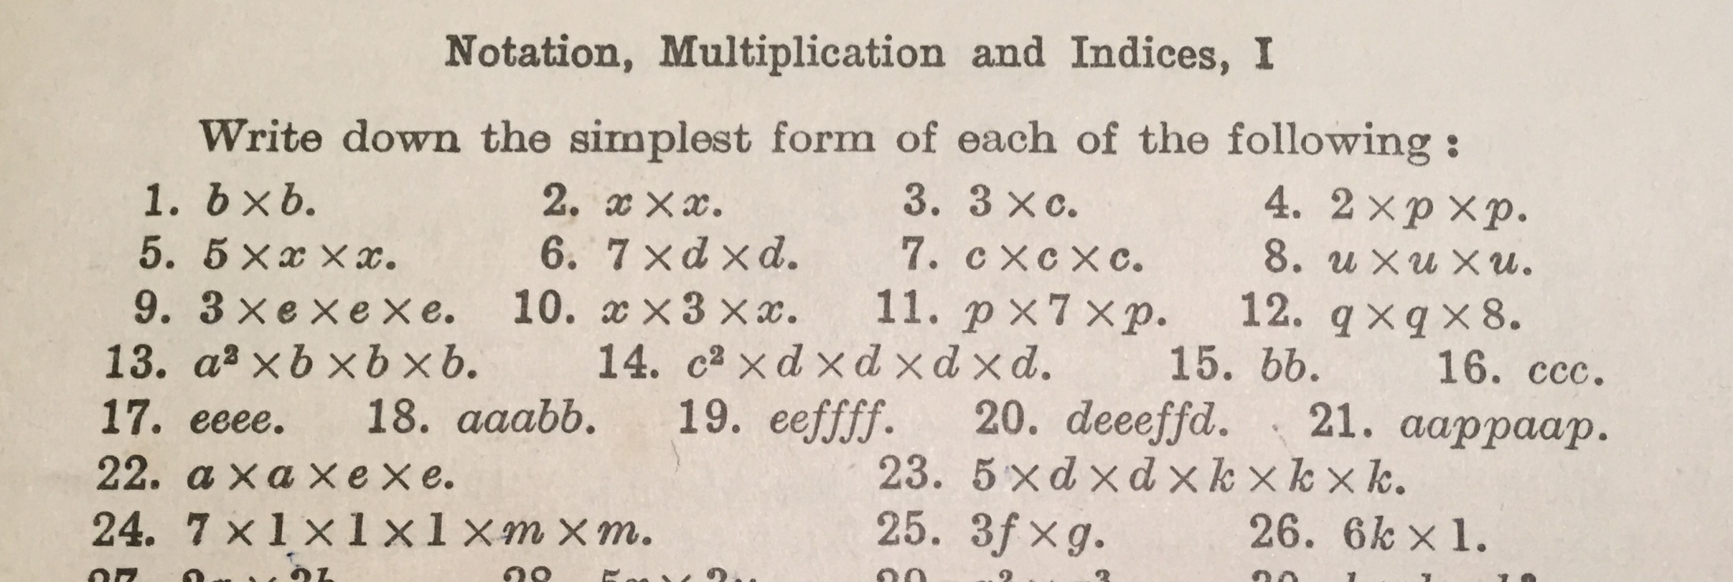
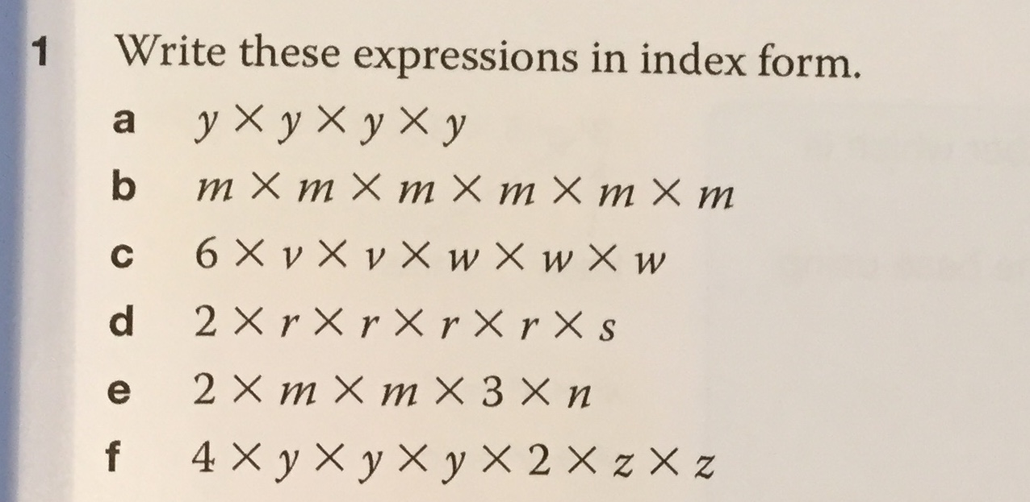
What a difference 66 years makes
Notes:
Trustam: first published 1949
Edexcel GCSE Maths (OUP for MyMaths): 2015

Slide 30
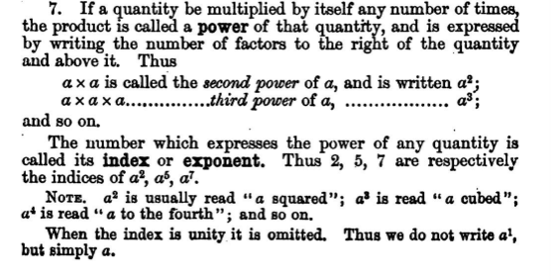
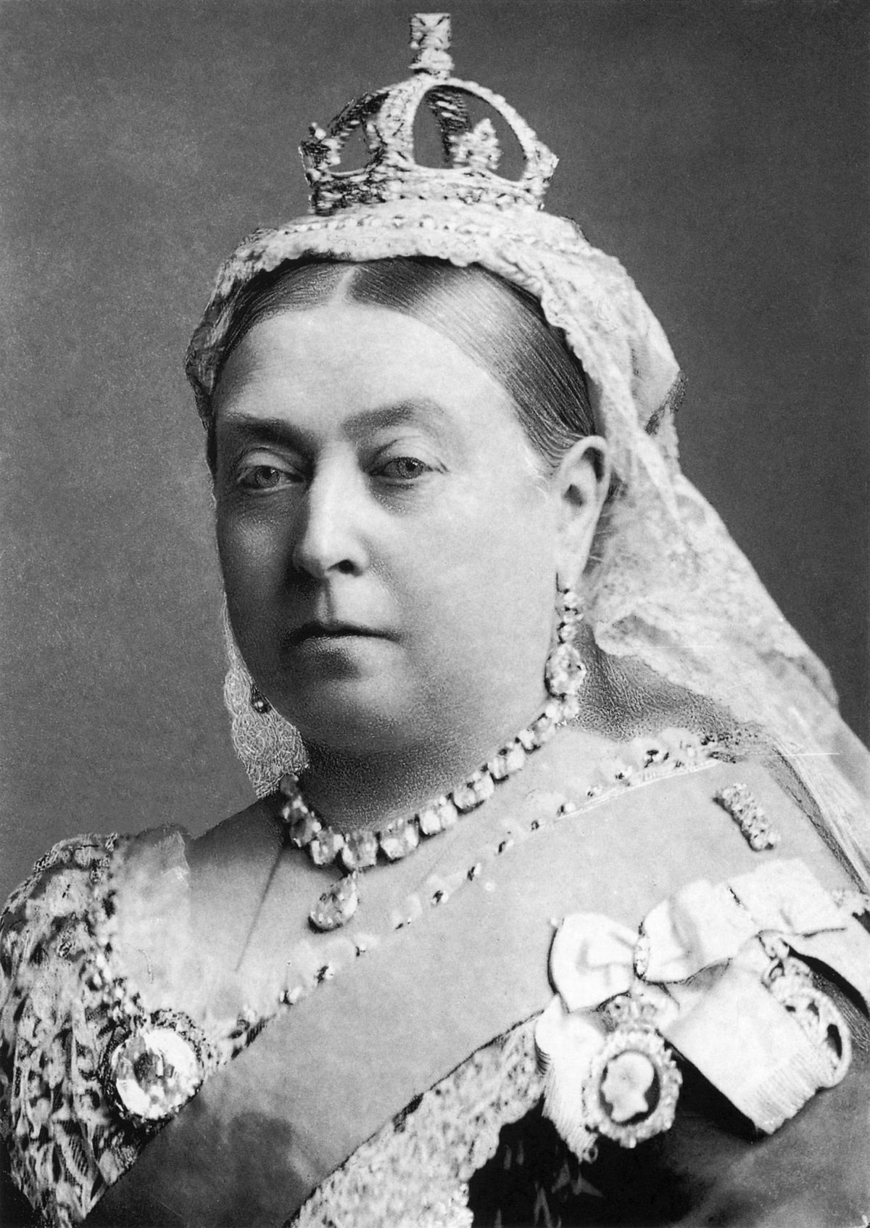
What did they do in Victorian times?

Slide 31
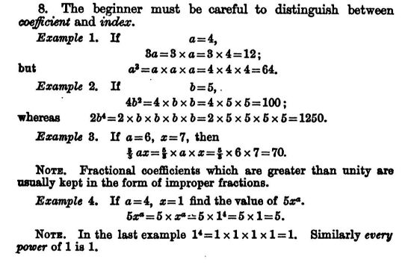
Misconceptions
3² = 6
r x r = 2r

Slide 32
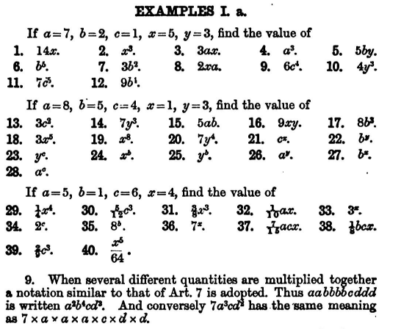
Notes:
Learning about powers using substitution

Slide 33
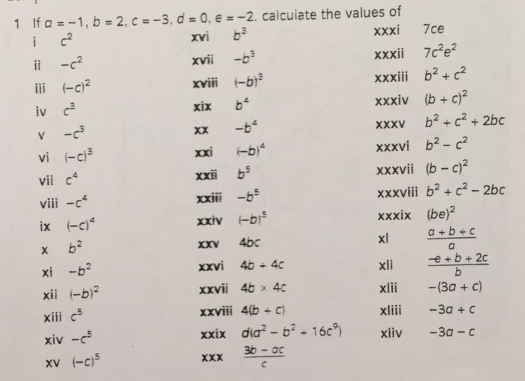
More substitution, but with careful thought to structure and variation
Notes:
Source: Anne Watson’s BCME 2018 presentation http://www.pmtheta.com/uploads/4/7/7/8/47787337/bcme_variation_slides.pptx
Strong negatives skills needed

Slide 34
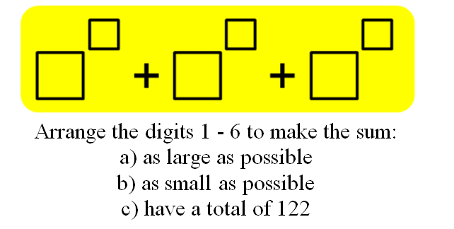
Binary!
Notes:
Colin Foster’s Instant Maths Ideas
What’s the last digit of 7^2011?
Lots of depth here. Also explore index buttons on calculators. Don’t rush ahead with index laws. Spend a whole lesson or two on index notation.
https://www.tes.co.uk/teaching-resource/powers-roots-and-index-laws-6446062

Slide 35
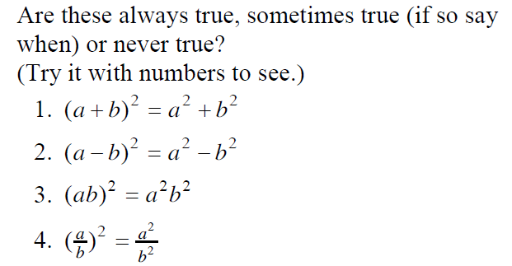
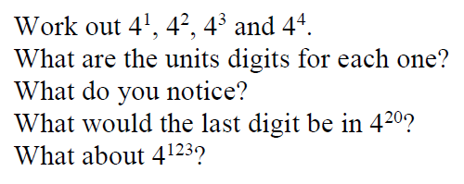

Slide 36
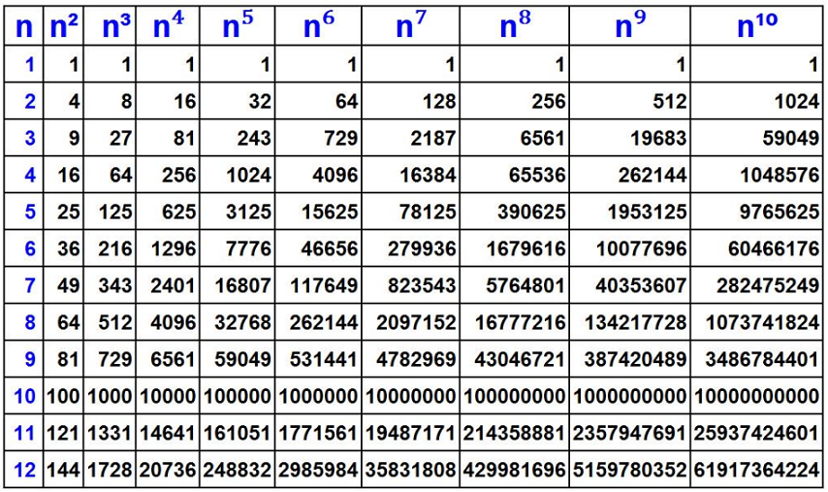
Image courtesy of Matt Dunbar @MathsDunbar
Notes:
Exploring the power of powers and roots. We’ll come back to this when we look at fractional and negative indices in my next session.

Slide 37
Index Laws

Slide 38
Common Misconceptions
3² x 3⁵ = 9⁷
y²(y³ + 7) = y⁶ +7y²

Slide 39
How I used to teach this in a single lesson...
Derive the multiplication law and show examples
2. Derive the division law and show examples
3. Derive the power law and show examples
4. Exercise on all three laws
5. Extension puzzles
Depth?
Notes:
One lesson, teach all three laws and then give them some practice

Slide 40
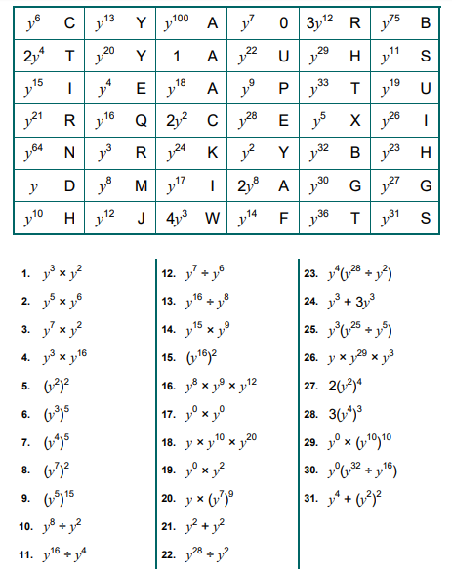
Notes:
https://www.teachitmaths.co.uk/resources/ks4/number/powers-of-y-eliminator/22255

Slide 41
Why did they struggle with these three questions?

Slide 42
1. Multiplication Law
a² x a³ = a x a x a x a x a
= a⁵
Notes:
Taking each law one at a time

Slide 43
Multiplication Law: ”Add the Indices”
Examples Non-Examples
b³ x b² b⁴ x g⁵
h^{1.5} x h^{2.5} a³ x A⁴
t x t¹⁰⁰ y² x t²
p⁴(p⁹) 5² + 5³
y⁻⁷ x y¹⁰ y⁵ + y⁵
4ª x 4^{b} 6³ x 7⁴
(3pq)⁶ x (3pq)¹⁰ (4pq)⁶ x (4pt)¹⁰
y⁵ x y⁸ x y² p³q² x 8p⁵
Notes:
The base is the same and we’re multiplying the terms. Say the rule and go through each example in turn.

Slide 44
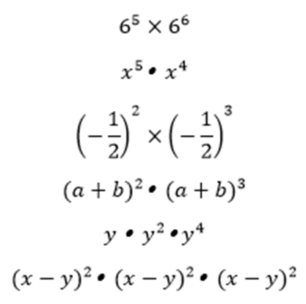
Examples observed by Clare Hill in Shanghai
Notes:
Choice of examples is key. These are from a lesson observed on Shanghai: http://www.trueorfalsemaths.com/index-laws-blog (website now removed). Clare Hill @chilledmaths

Slide 45
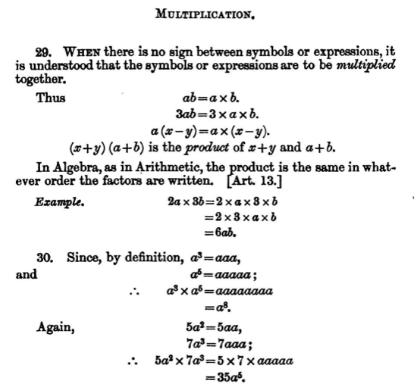
Introduce coefficients
Notes:
https://archive.org/stream/elementaryalgeb00kniggoog#page/n37/mode/2up/search/indice

Slide 46
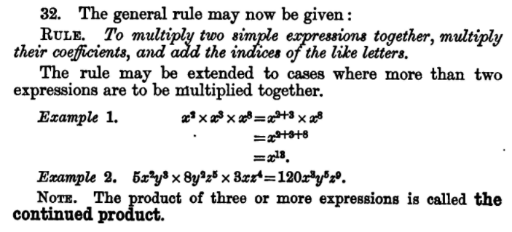
Introduce >2 terms

Slide 47
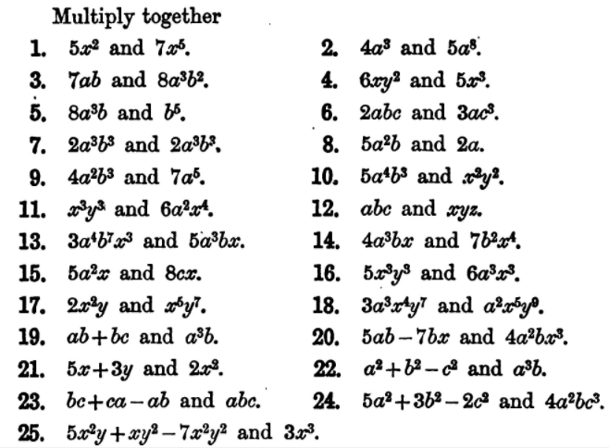
SLOP
(Shed Loads of Practice)
We could also add fractional and negative indices in at this stage

Slide 48
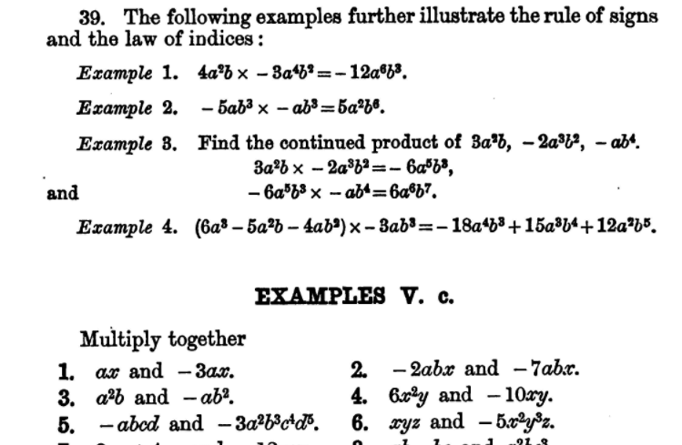
Take every opportunity to develop fluency with negatives

Slide 49
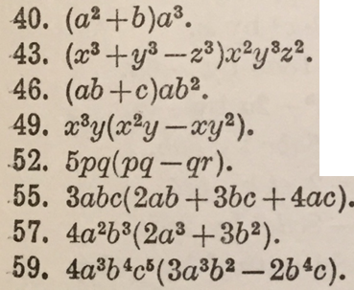
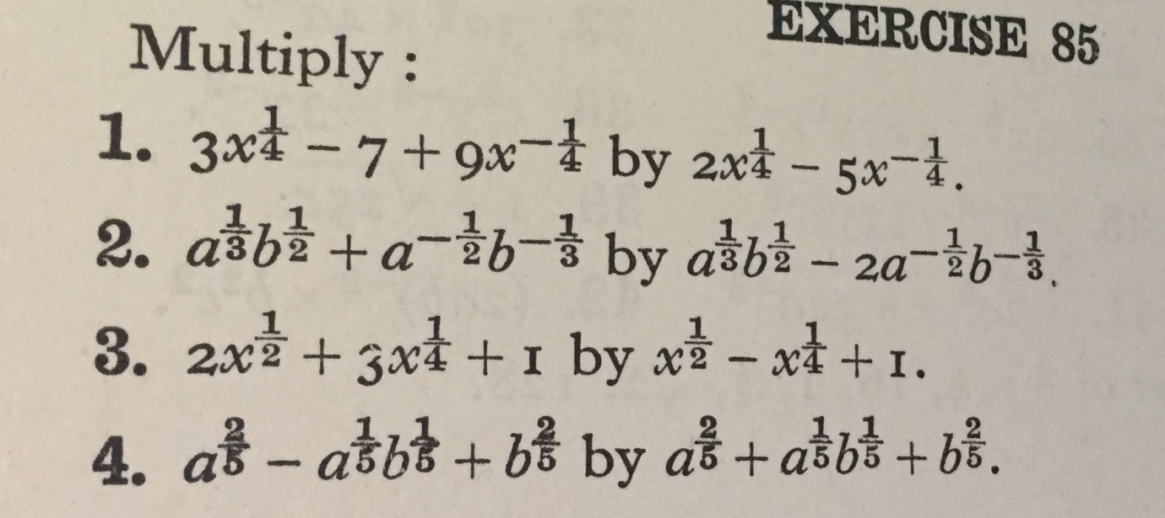
Notes:
Trustam, 1949. Practise the multiplication law by expanding brackets.
https://archive.org/stream/elementaryalgeb00kniggoog#page/n251/mode/2up
Ok to have fractions and negatives here because it’s just the multiplication law.

Slide 50
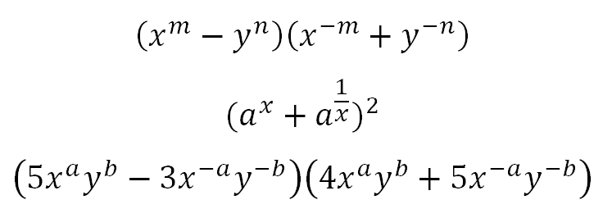
Notes:
Practise the multiplication law by expanding brackets.
Algebraic indices are worth including.
How many Year 8s are given questions like this?

Slide 51
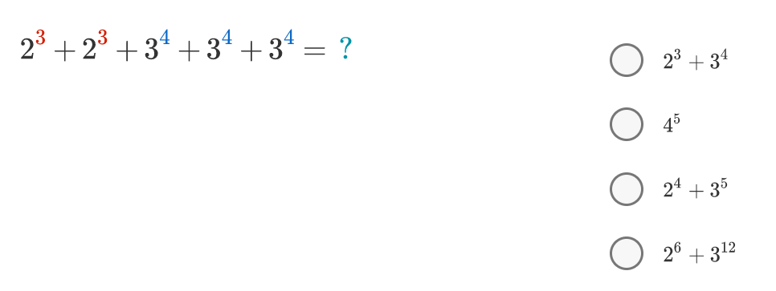
2(2³) + 3(3⁴) = 2⁴ + 3⁵
Notes:
Source: Brilliant.org
More: https://brilliant.org/wiki/simplify-exponents/

Slide 52
2. Power Law
An extension of the multiplication law
(a²)³ = a² x a² x a²
= a x a x a x a x a x a
= a⁶

Slide 53
What is the square of each of the following?
Notes:
Trustam – A Classbook of Algebra. First published 1949

Slide 54
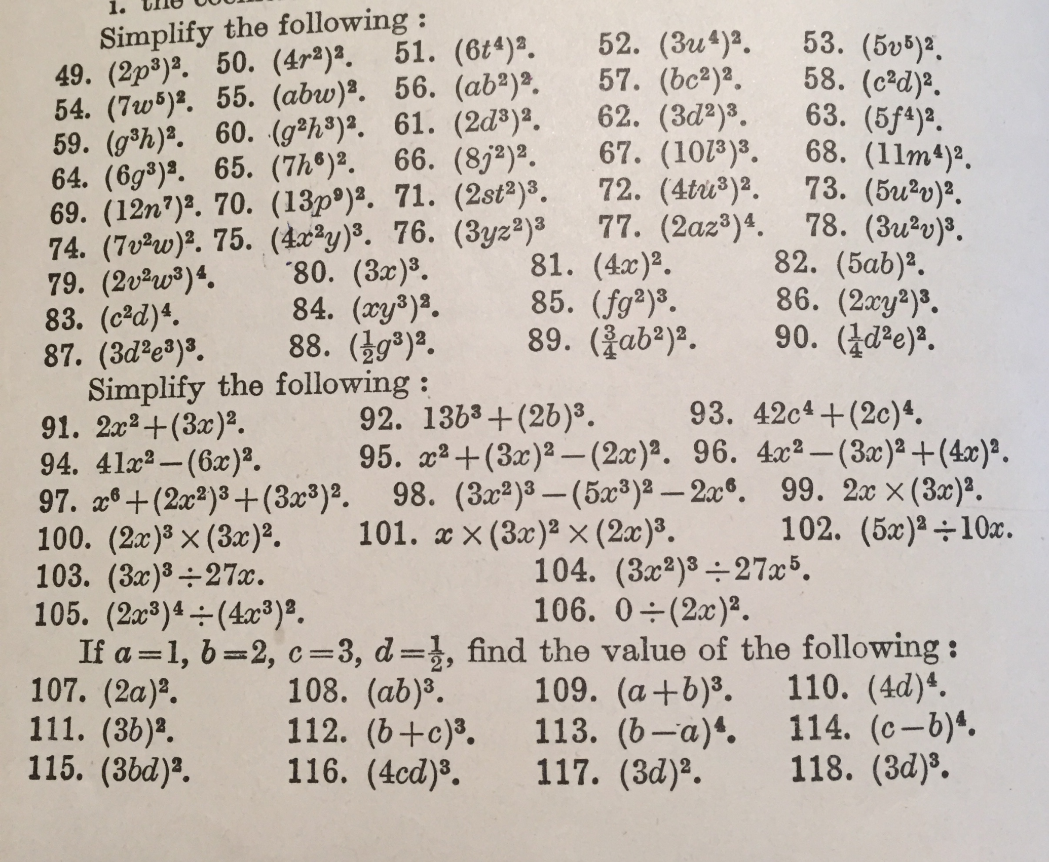
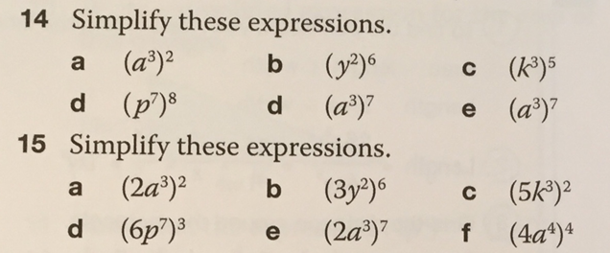
What a difference 66 years makes
Notes:
Trustam 1949 vs OUP 2015. Compare the number of questions.

Slide 55
The Power Law: Changing the Base
Write these numbers in ascending order
Notes:
Mathematics Assessment Project has good changing the base activities: http://map.mathshell.org/download.php?fileid=1668
Include exponential equations here
We’re need around three lessons just to cover the power law

Slide 56
Notes:
Don Steward

Slide 57
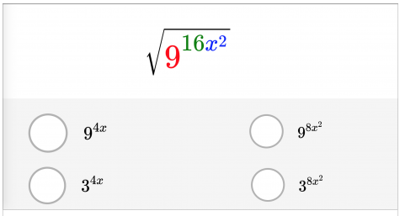
Notes:
Source: Brilliant.org
Only suitable for students once you’ve taught fractional indices

Slide 58
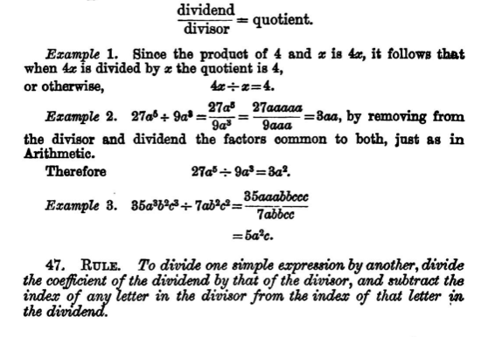
3. Division Law
Notes:
https://archive.org/stream/elementaryalgeb00kniggoog#page/n87/mode/2up/search/indice

Slide 60
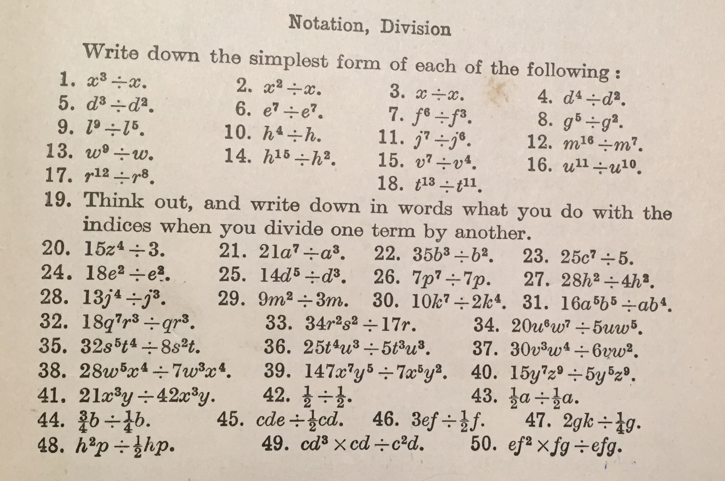
SLOP (Shed Loads of Practice)
Notes:
Page 15 trustam – all division symbols

Slide 61
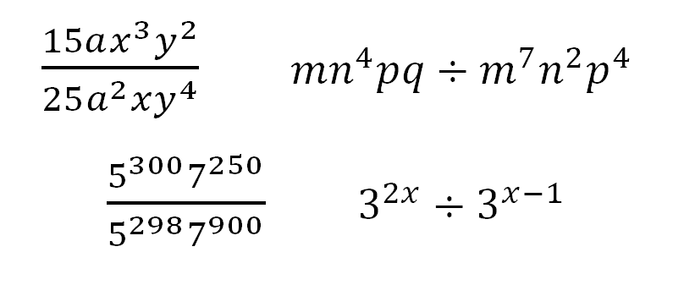
Practise with both division symbols and fractions...
Use both algebraic and numeric bases
Use both algebraic and numeric indices
Use fractions
Use negatives

Slide 62
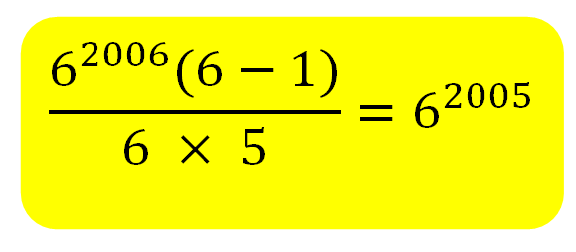
Notes:
Source: Brilliant.org
https://brilliant.org/courses/algebra-fundamentals/manipulating-exponents/

Slide 63
4. Zero Index
Notes:
https://bhs-methods10.wikispaces.com/01Aindex-3-4
Also read this: https://davidwees.com/content/what-does-mistake-mean/

Slide 65
Notes:
https://archive.org/stream/elementaryalgeb00kniggoog#page/n49/mode/2up

Slide 66
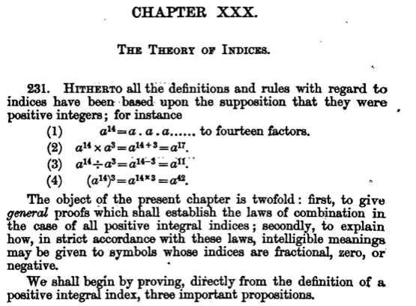
Notes:
https://archive.org/stream/elementaryalgeb00kniggoog#page/n241/mode/2up

Slide 67
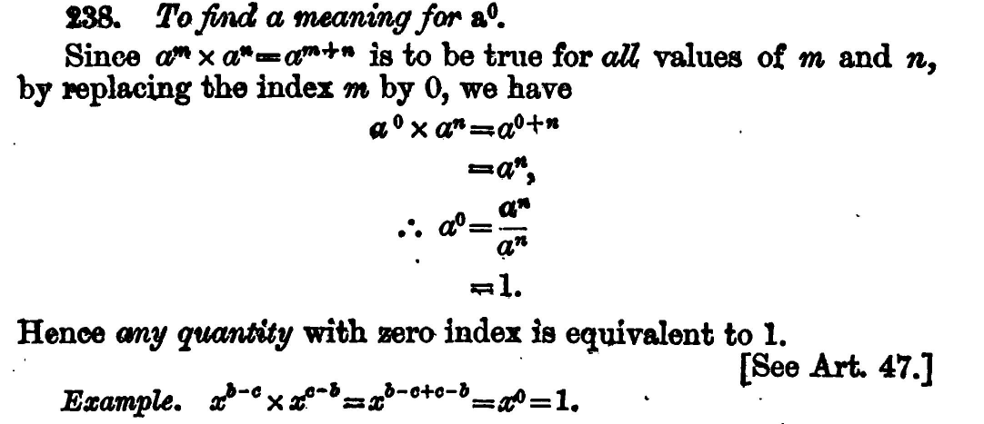
Notes:
https://medium.com/i-math/the-zero-power-rule-explai
Extension: what is zero to the power of zero?
ned-449b4bd6934d

Slide 68
Bringing it all together

Slide 69
Notation, multiplication law, power law, division law, zero index... Did I really used to cover all this in one lesson?
Notes:
We’re now on about 10 lessons and we haven’t even got to fractional and negative indices yet

Slide 70
And we haven’t even looked at this yet...
2³ x 5³
= 2 x 2 x 2 x 5 x 5 x 5
= 2 x 5 x 2 x 5 x 2 x 5
= 10 x 10 x 10
= 10³
= (2 x 5)³

Slide 71
Misconceptions

Slide 72
Notes:
https://www.epcc.edu/CollegeReadiness/Documents/CM_Exponents_0-40.pdf

Slide 74
Notes:
Common Misconceptions: http://map.mathshell.org/download.php?fileid=1668

Slide 76
Notes:
https://www.learnalberta.ca/content/mejhm/html/object_interactives/patterning_the_powers_of_10/flashHelp/pdf/Powersof10LearningStrategies.pdf

Slide 77
Resources and Activities

Slide 78
minimallydifferent.wordpress.com

Slide 79
Mathematics Assessment Project
Notes:
http://map.mathshell.org/lessons.php?unit=8110&collection=8&redir=1

Slide 80
MathsPad

Slide 81
OUP

Slide 83
Notes:
http://www.resourceaholic.com/p/problem-sets.html

Slide 84
Brilliant.org

Slide 85
We haven't even got to negative and fractional indices yet! How many lessons should we spend on index laws?
A lot!
Notes:
Perhaps around 10?

Slide 86
Even if you’ve learnt nothing new about indices today...
Think about a topic in depth before you teach it
Then teach it... in depth

