Slide 1
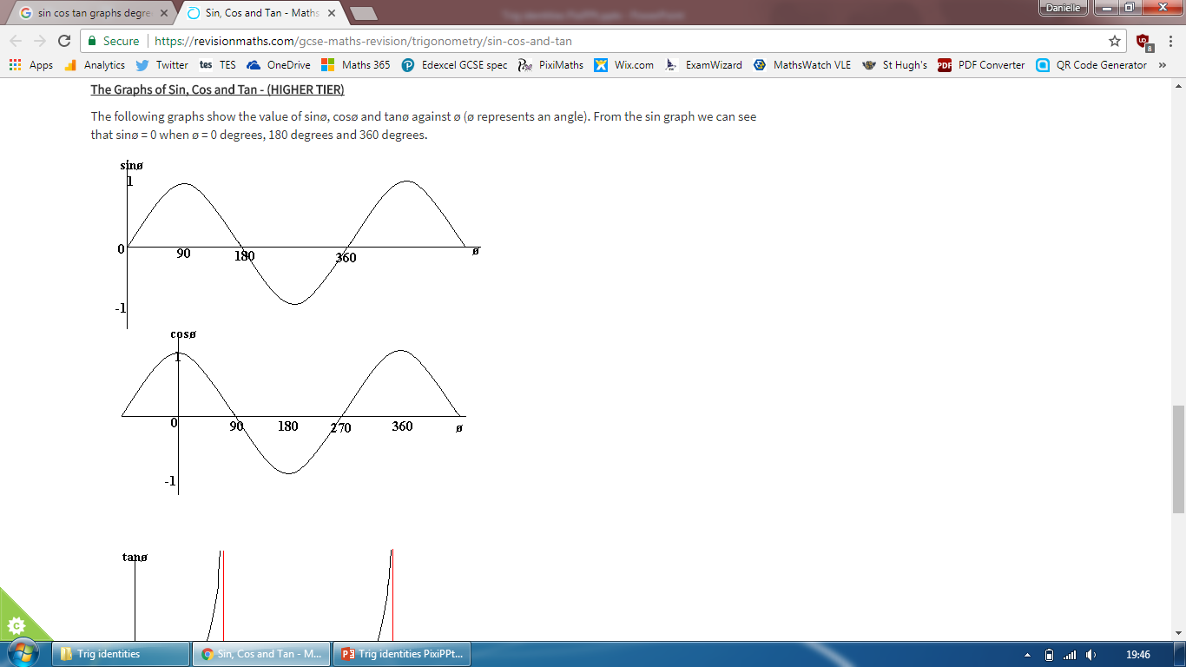
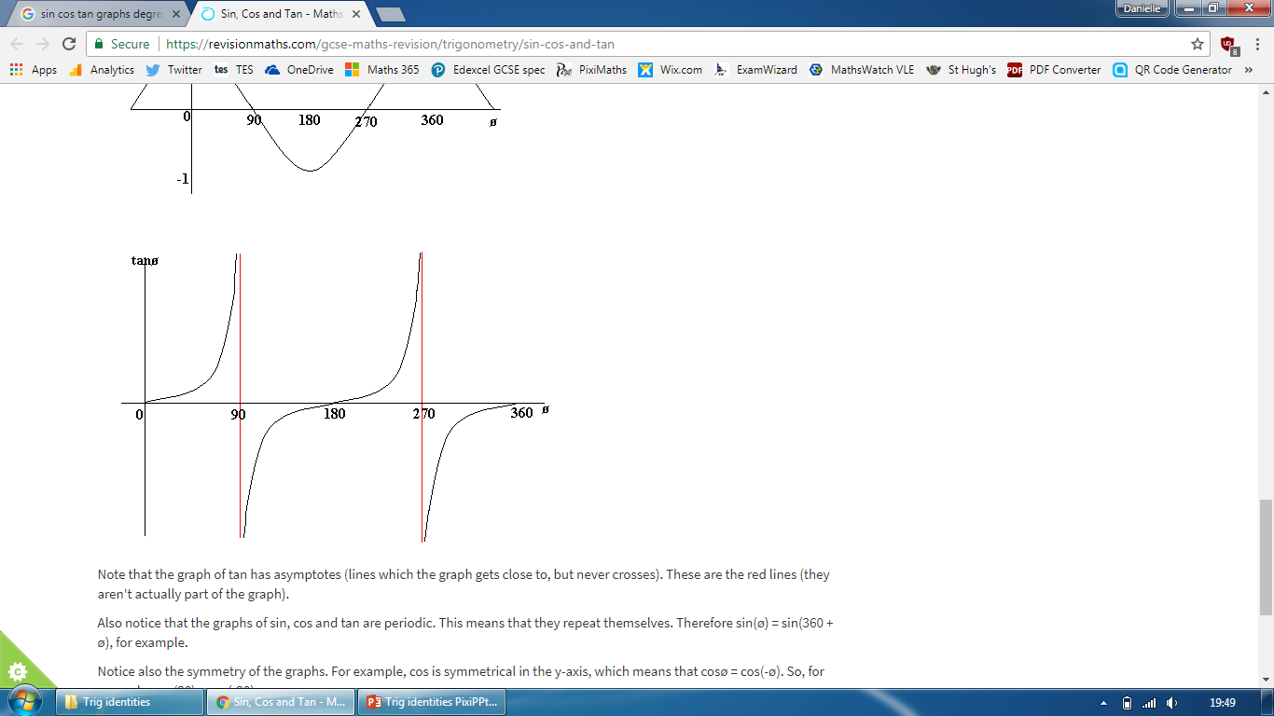
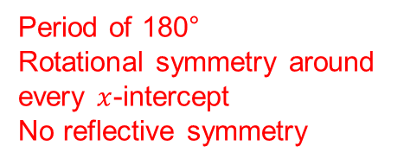
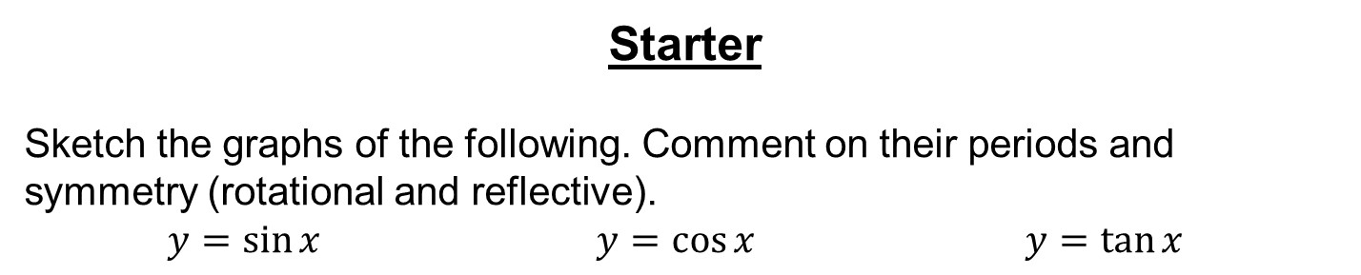
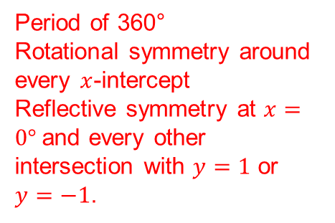
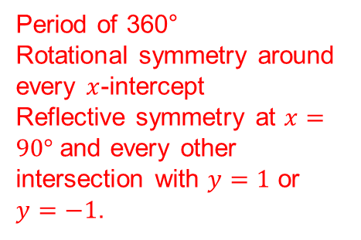
Starter
Sketch the graphs of the following. Comment on their periods and symmetry (rotational and reflective).
$y=\sin{x}$ $y=\cos{x}$ $y=\tan{x}$
Period of 360°
Rotational symmetry around every $x$-intercept
Reflective symmetry at $x=90°$and every other intersection with $y=1$ or $y=−1$.
Period of 360°
Rotational symmetry around every $x$-intercept
Reflective symmetry at $x=0°$and every other intersection with $y=1$ or $y=−1$.
Period of 180°
Rotational symmetry around every $x$-intercept
No reflective symmetry

Slide 2
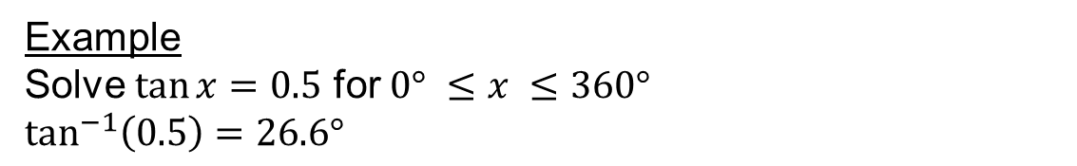

Are there any more solutions between 0° and 360°?
Example
Solve $\tan{x}=0.5$ for $0° ≤x ≤360°$
$\tan^{−1}\left(0.5\right)=26.6°$
and $206.6°$
26.6°
26.6° + 180° = 206.6°

Slide 3
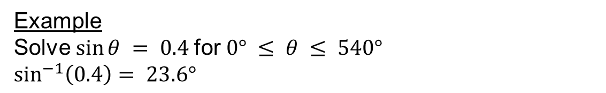



Example
Solve $sin⁡θ = 0.4$for $0° ≤ θ ≤ 540°$
$\sin^{−1}\left(0.4\right)= 23.6°$
, $156.4°$
Are there any more solutions between 0° and 540°?
, $383.6°$
and $516.4°$
23.6°
180° - 23.6° = 156.4°
23.6° - 360° = 383.6°
156.4° + 360° = 516.4°

Slide 5
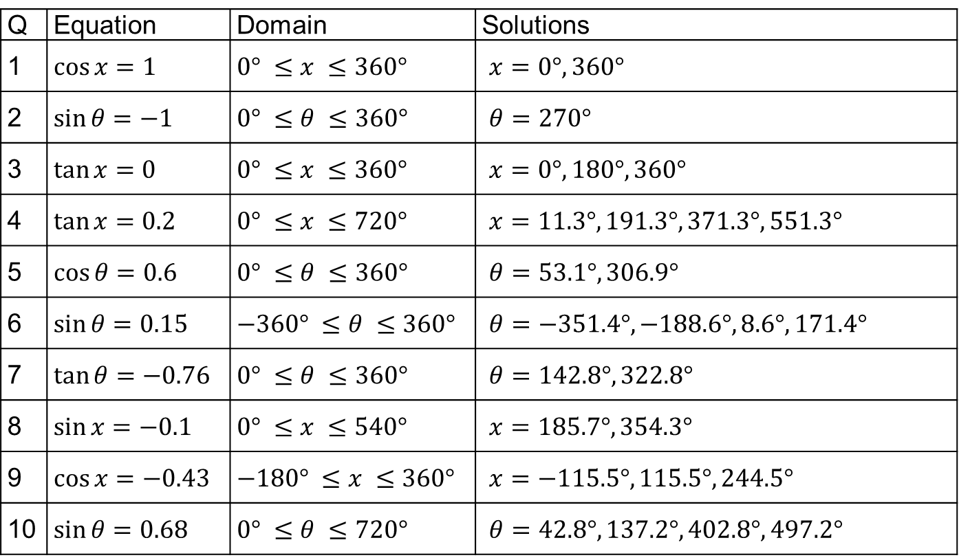
Answers
Q | Equation | Domain | Solutions
1 | $\cos{x}=1$ | $0° ≤x ≤360°$ | $x=0°, 360°$
2 | $\sin{θ}=−1$ | $0° ≤θ ≤360°$ | $θ=270°$
3 | $\tan{x}=0$ | $0° ≤x ≤360°$ | $x=0°, 180°, 360°$
4 | $\tan{x}=0.2$ | $0° ≤x ≤720°$ | $x=11.3°, 191.3°, 371.3°, 551.3°$
5 | $\cos{θ}=0.6$ | $0° ≤θ ≤360°$ | $θ=53.1°, 306.9°$
6 | $\sin{θ}=0.15$ | $−360° ≤θ ≤360°$ | $θ=−351.4°, −188.6°, 8.6°, 171.4°$
7 | $\tan{θ}=−0.76$ | $0° ≤θ ≤360°$ | $θ=142.8°, 322.8°$
8 | $\sin{x}=−0.1$ | $0° ≤x ≤540°$ | $x=185.7°, 354.3°$
9 | $\cos{x}=−0.43$ | $−180° ≤x ≤360°$ | $x=−115.5°,115.5°, 244.5°$
10 | $\sin{θ}=0.68$ | $0° ≤θ ≤720°$ | $θ=42.8°, 137.2°, 402.8°,497.2°$

Slide 6
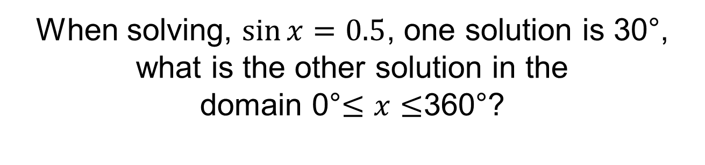
When solving, $\sin{x=0.5}$, one solution is 30°, what is the other solution in the
domain 0°$≤x≤$360°?
150°
170°
A
B
120°
330°
C
D

Slide 7
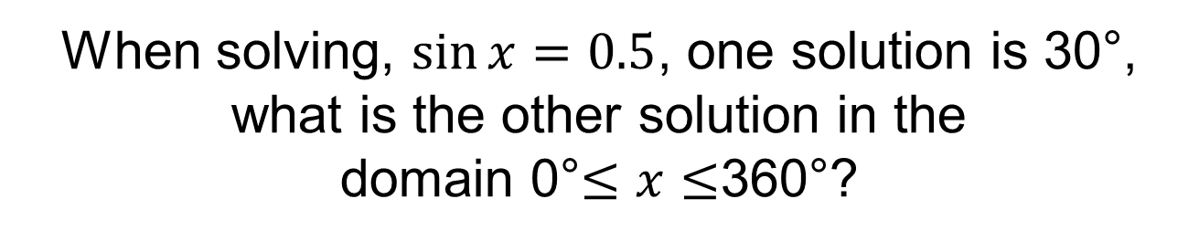
When solving, $\sin{x=0.5}$, one solution is 30°, what is the other solution in the
domain 0°$≤x≤$360°?
150°
170°
A
B
120°
330°
C
D

Slide 8
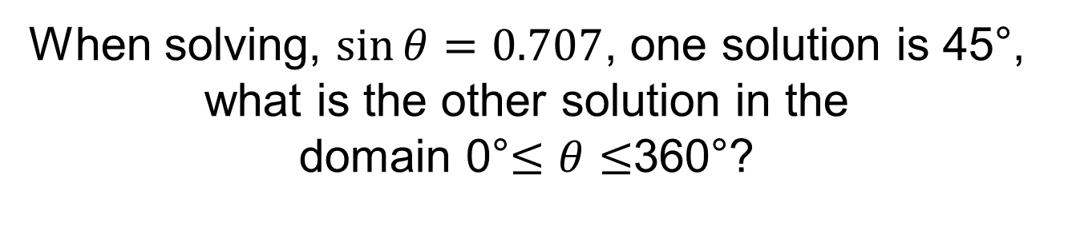
When solving, $\sin{θ=0.707}$, one solution is 45°, what is the other solution in the
domain 0°$≤θ≤$360°?
150°
125°
A
B
225°
135°
C
D

Slide 9
When solving, $\sin{θ=0.707}$, one solution is 45°, what is the other solution in the
domain 0°$≤θ≤$360°?
150°
125°
A
B
225°
135°
C
D

Slide 10
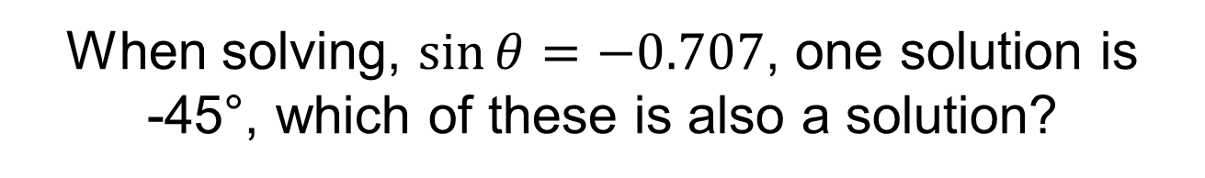
When solving, $\sin{θ=−0.707}$, one solution is
-45°, which of these is also a solution?
315°
45°
A
B
135°
145°
C
D

Slide 11
When solving, $\sin{θ=−0.707}$, one solution is
-45°, which of these is also a solution?
315°
45°
A
B
135°
145°
C
D

Slide 12
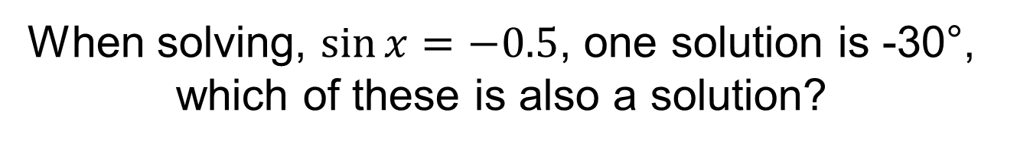
When solving, $\sin{x=−0.5}$, one solution is -30°, which of these is also a solution?
30°
210°
A
B
120°
230°
C
D

Slide 13
When solving, $\sin{x=−0.5}$, one solution is -30°, which of these is also a solution?
30°
210°
A
B
120°
230°
C
D

Slide 14

Without using a calculator decider whether this is true or false:
$$\cos{90}=1$$
False
Not sure
True

Slide 15
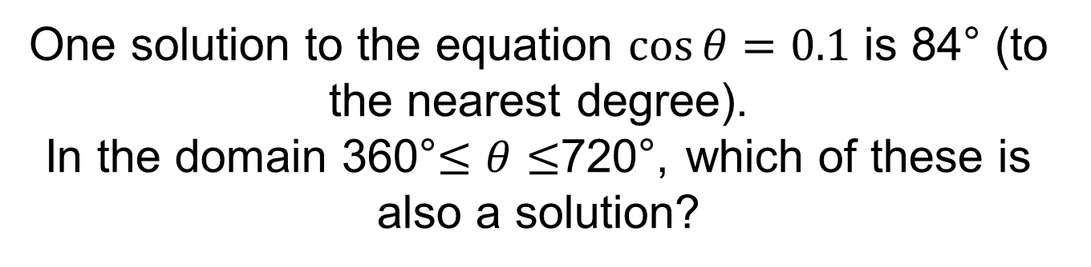
One solution to the equation $\cos{θ}=0.1$ is 84° (to the nearest degree).
In the domain 360°$≤θ≤$720°, which of these is also a solution?
714°
444°
A
B
366°
546°
C
D

Slide 16
One solution to the equation $\cos{θ}=0.1$ is 84° (to the nearest degree).
In the domain 360°$≤θ≤$720°, which of these is also a solution?
714°
444°
A
B
366°
546°
C
D

Slide 17
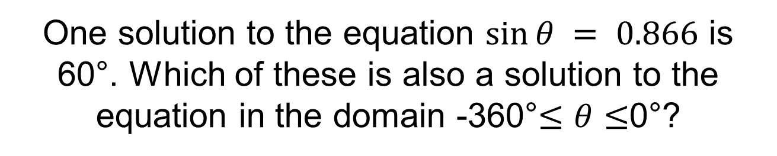
One solution to the equation $sin⁡θ = 0.866$ is 60°. Which of these is also a solution to the equation in the domain -360°$≤θ≤$0°?
-60°
60°
A
B
-120°
-240°
C
D

Slide 18
One solution to the equation $sin⁡θ = 0.866$ is 60°. Which of these is also a solution to the equation in the domain -360°$≤θ≤$0°?
-60°
60°
A
B
-120°
-240°
C
D

Slide 19
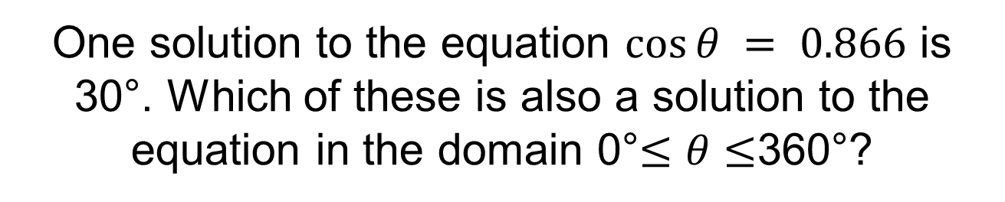
One solution to the equation $cos⁡θ = 0.866$ is 30°. Which of these is also a solution to the equation in the domain 0°$≤θ≤$360°?
300°
210°
A
B
150°
330°
C
D

Slide 20
One solution to the equation $cos⁡θ = 0.866$ is 30°. Which of these is also a solution to the equation in the domain 0°$≤θ≤$360°?
300°
210°
A
B
150°
330°
C
D

Slide 21



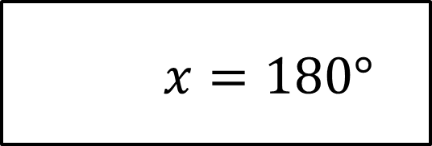
Which of these is an asymptote on the tangent graph?
$x=90°$
$x=180°$
A
B
$x=45°$
$x=360°$
C
D

Slide 22

Which of these is an asymptote on the tangent graph?
$x=90°$
$x=180°$
A
B
$x=45°$
$x=360°$
C
D

Slide 23
True or false:
If you translate the sine curve 90° to the right you get the cosine curve.
False
Not sure
True

Slide 24

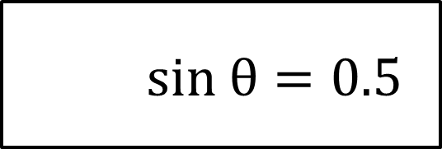
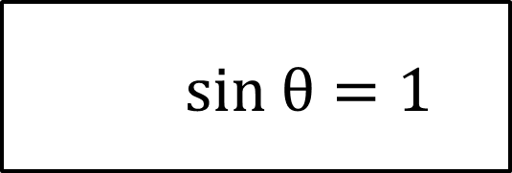
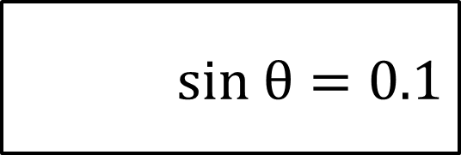
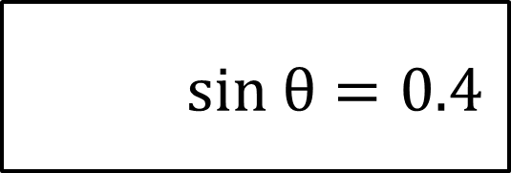
Without using a calculator, which of these will have the largest angle in the domain
0°$≤θ≤18$0°?
$sin θ=0.4$
$sin θ=0.1$
A
B
$sin θ=1$
$sin θ=0.5$
C
D

Slide 25

Without using a calculator, which of these will have the largest angle in the domain
0°$≤θ≤18$0°?
$sin θ=0.4$
$sin θ=0.1$
A
B
$sin θ=1$
$sin θ=0.5$
C
D

Slide 26
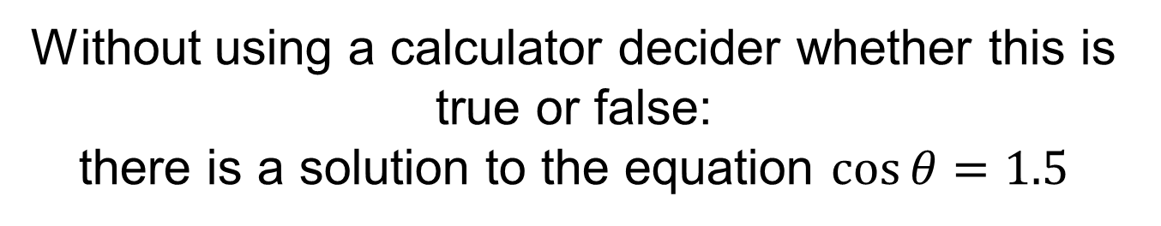
Without using a calculator decider whether this is true or false:
there is a solution to the equation $\cos{θ}=1.5$
False
Not sure
True

