Slide 1

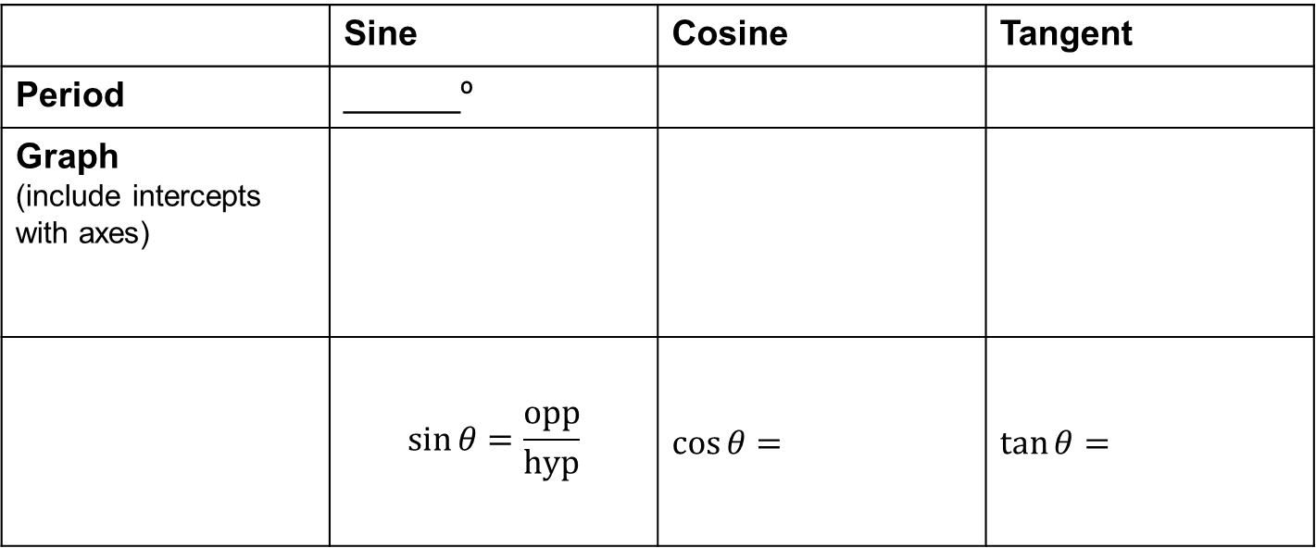
Starter
Complete this table to recap what you know about trig functions.
 | Sine | Cosine | Tangent
Period | ______º
Graph (include intercepts with axes)
 | $$\sin{θ}=\frac{opp}{hyp}$$ | $$\cos{θ=}$$ | $\tan{θ=}$
$$θ$$

Slide 2
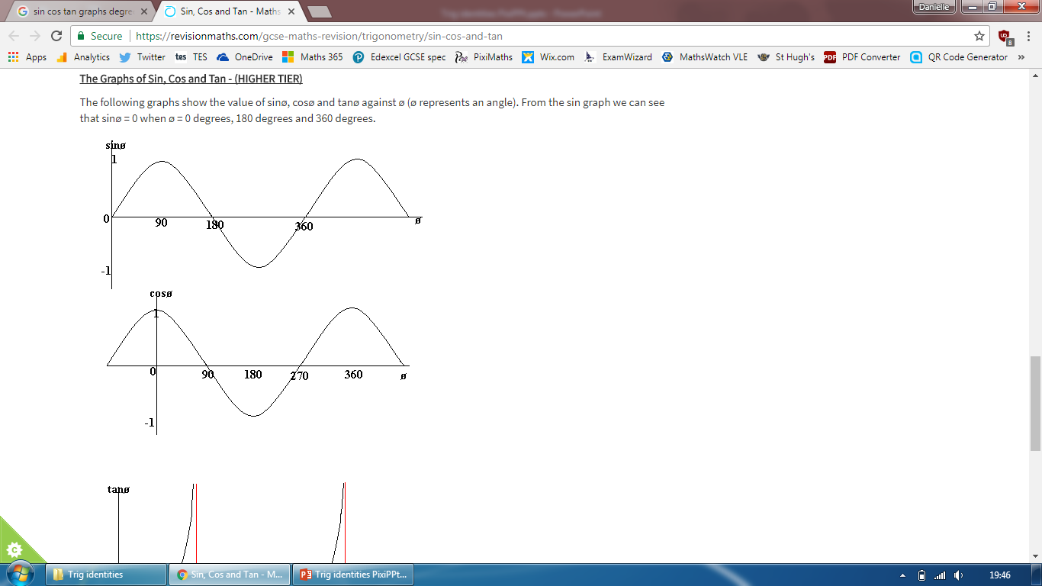
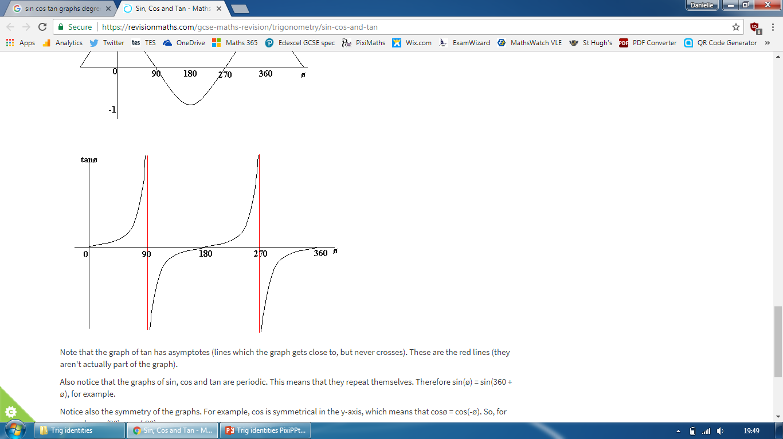
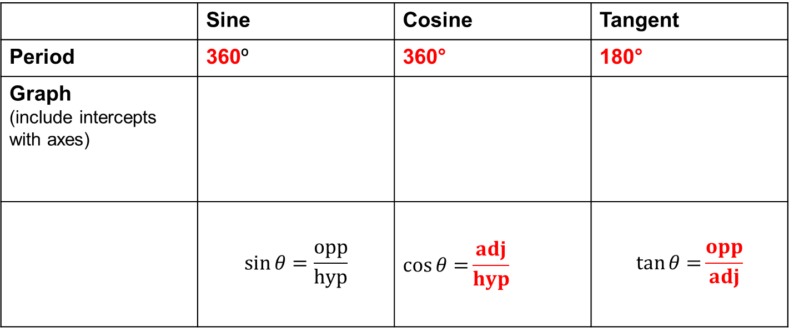
Answers
 | Sine | Cosine | Tangent
Period | 360º | 360° | 180°
Graph (include intercepts with axes)
 | $$\sin{θ}=\frac{opp}{hyp}$$ | $$\cos{θ=}\frac{adj}{hyp}$$ | $$\tan{θ=}\frac{opp}{adj}$$
$$θ$$

Slide 3

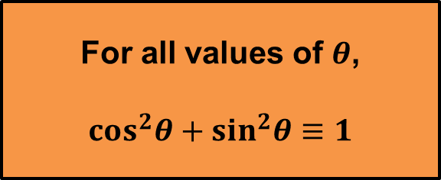

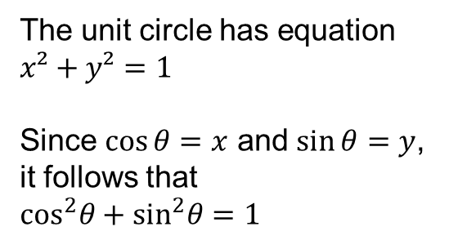


The Unit Circle
The unit circle has equation $x²+y²=1$
Since $\cos{θ}=x$ and $\sin{θ}=y$,
it follows that
$\cos^{2}θ+\sin^{2}θ=1$
$$y$$
Why?
$$P(x, y)$$
1
$$θ$$
$$x$$
For all values of $θ$,
$$\cos^{2}θ+\sin^{2}θ≡1$$

Slide 4

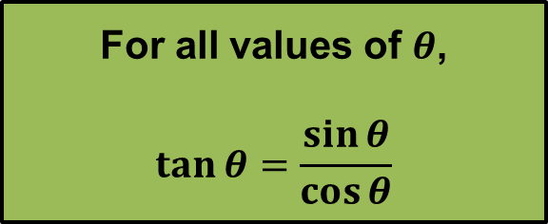
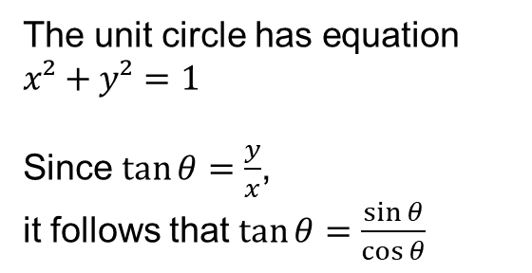
The Unit Circle
The unit circle has equation $x²+y²=1$
Since $\tan{θ}=\frac{y}{x}$,
it follows that $\tan{θ}=\frac{\sin{θ}}{\cos{θ}}$
$$y$$
Why?
$$P(x, y)$$
1
$$θ$$
$$x$$
For all values of $θ$,
$$\tan{θ}=\frac{\sin{θ}}{\cos{θ}}$$
$\tan{θ}$ is undefined when $\cos{θ}=0$. This occurs when $θ=±90, ±270, …$

Slide 5
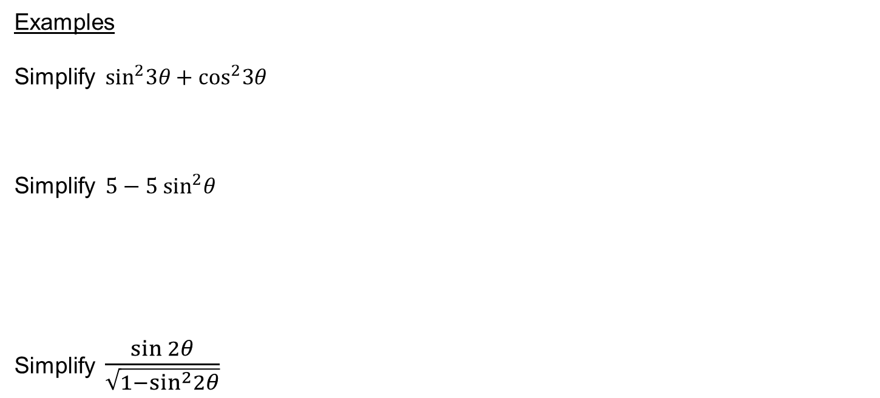
Examples
Simplify $\sin^{2}3θ+\cos^{2}3θ$
Simplify $5−5 \sin^{2}θ$
Simplify $\frac{\sin{2θ}}{\sqrt{1−\sin^{2}2θ}}$

Slide 6

Examples
Prove that $\frac{\cos^{4}θ−\sin^{4}θ}{\cos^{2}θ}$ $≡1−\tan^{2}θ$

Slide 7

Examples
Given that $\cos{θ=−\frac{3}{5}}$ and that $θ$ is reflex, find the value of $\sin{θ}$

Slide 9
Answers
1a. sin²½Θ
b. 5
c. tan x
d. 1
3a. cos Θ = ¹²/₁₃
b. sin Θ = ⁴/₅
c. tan Θ = ⁻⁷/₂₄

