Slide 1
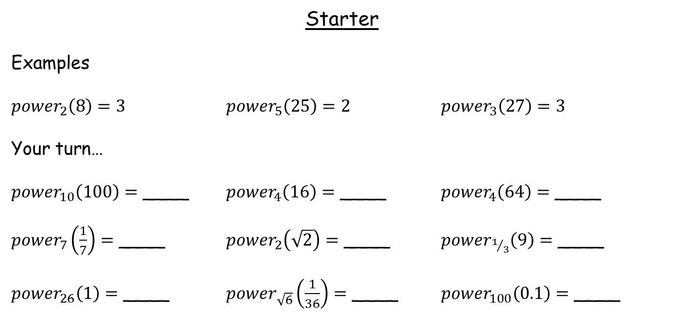
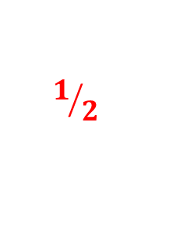
Starter
Examples
${power}_{2}\left(8\right)=3$ ${power}_{5}\left(25\right)=2$ ${power}_{3}\left(27\right)=3$
Your turn…
${power}_{10}\left(100\right)=$ ____ ${power}_{4}\left(16\right)=$ ____ ${power}_{4}\left(64\right)=$ ____
${power}_{7}\left(\frac{1}{7}\right)=$ ____ ${power}_{2}\left(\sqrt{2}\right)=$ ____ ${power}_{1/3}\left(9\right)=$ ____
${power}_{26}\left(1\right)=$ ____ ${power}_{\sqrt{6}}\left(\frac{1}{36}\right)=$ ____ ${power}_{100}\left(0.1\right)=$ ____
2
2
3
-1
$$1/2$$
-2
0
-4
-2
CONGRATULATIONS!
You have just taught yourselves logarithms ☺

Slide 2
Starter
Examples
${power}_{2}\left(8\right)=3$ ${power}_{5}\left(25\right)=2$ ${power}_{3}\left(27\right)=3$
Your turn…
${power}_{10}\left(100\right)=$ ____ ${power}_{4}\left(16\right)=$ ____ ${power}_{4}\left(64\right)=$ ____
${power}_{7}\left(\frac{1}{7}\right)=$ ____ ${power}_{2}\left(\sqrt{2}\right)=$ ____ ${power}_{1/3}\left(9\right)=$ ____
${power}_{26}\left(1\right)=$ ____ ${power}_{\sqrt{6}}\left(\frac{1}{36}\right)=$ ____ ${power}_{100}\left(0.1\right)=$ ____
log
log
log
log
2
log
2
log
3
log
-1
log
$$1/2$$
log
-2
log
0
log
-4
log
-2
Because of the Greek language, we don’t use the word power. We use the word logarithm instead, which we write as ‘log’ for short

Slide 3
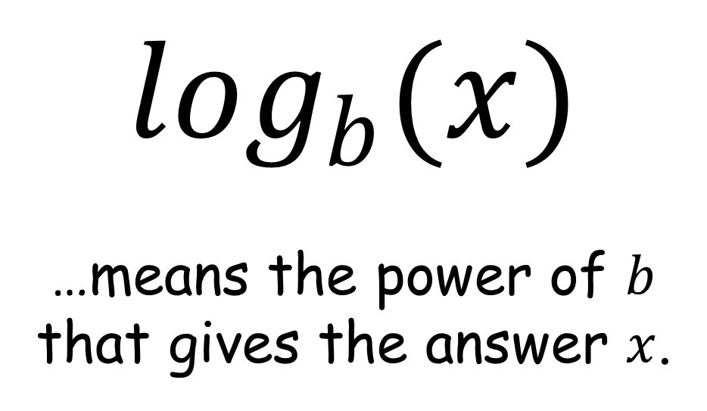
$\log_{b}(x)$
…means the power of $b$ that gives the answer $x$.

Slide 4
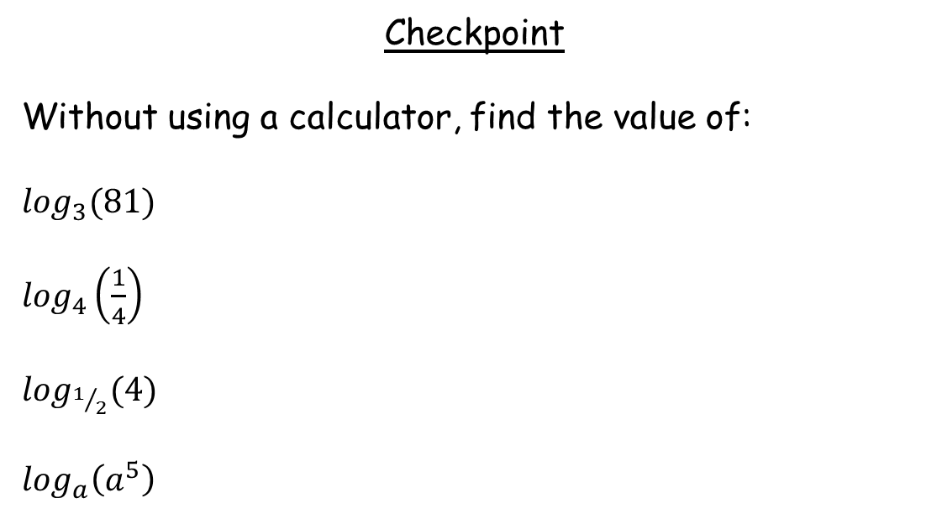
Checkpoint
Without using a calculator, find the value of:
$\log_{3}(81)$
$\log_{4}\left(\frac{1}{4}\right)$
$\log_{1/2}(4)$
$\log_{a}\left(a^{5}\right)$
= 4
= -1
= -2
= 5

Slide 5
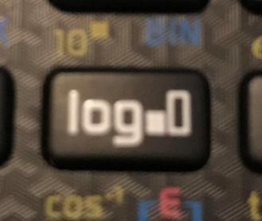
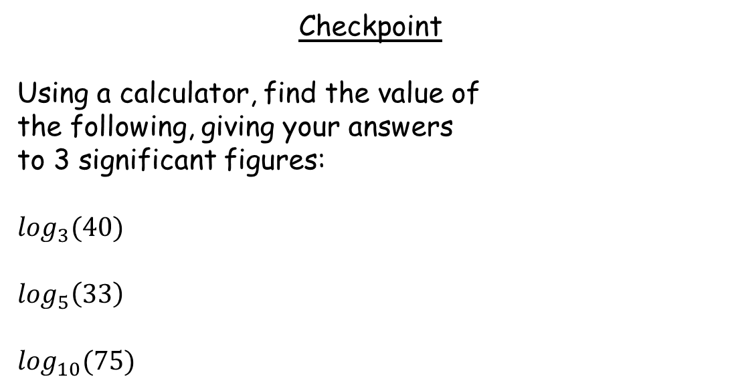
Checkpoint
Using a calculator, find the value of
the following, giving your answers
to 3 significant figures:
$\log_{3}(40)$
$\log_{5}\left(33\right)$
$\log_{10}(75)$
Use this button on your calculator
= 3.36
= 2.17
= 1.88

Slide 6

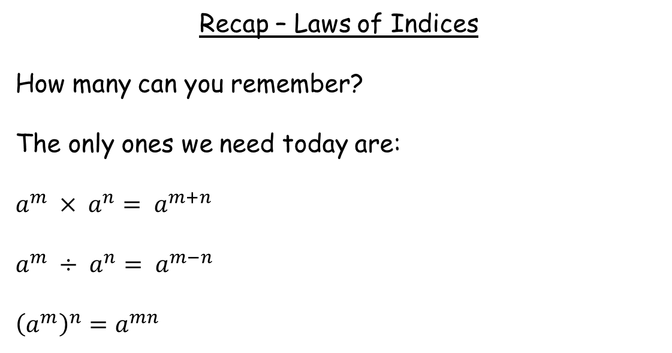


Recap – Laws of Indices
How many can you remember?
The only ones we need today are:
$a^{m} × a^{n}= a^{m+n}$
$a^{m} ÷ a^{n}= a^{m−n}$
${\left(a^{m}\right)}^{n}=a^{mn}$
→$\log_{a}(m)+\log_{a}(n)=\log_{a}(mn)$
→$\log_{a}(m)−\log_{a}(n)=\log_{a}\left(\frac{m}{n}\right)$
→$\log_{a}(m^{n})={n log}_{a}(m)$
Try re-writing these laws of indices using logarithms instead

Slide 7

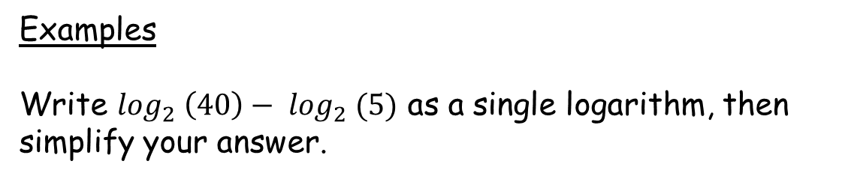


Examples
Write $\log_{2} \left(40\right)− \log_{2} (5)$ as a single logarithm, then simplify your answer.
$$=\log_{2} (40÷5)$$
$=\log_{2} (8)$
$$=3$$

Slide 8

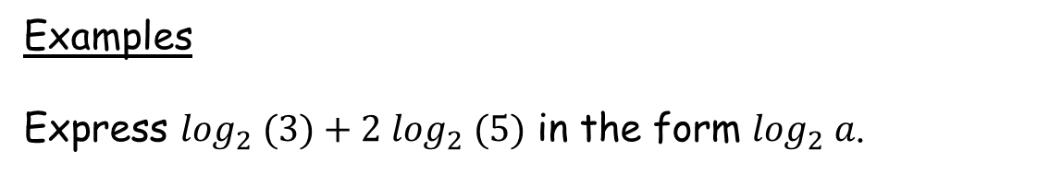


Examples
Express $\log_{2} (3)+2 \log_{2} (5)$ in the form $\log_{2} a$.
$=\log_{2} (3)+\log_{2} (5^{2})$
$=\log_{2} (3 × 5^{2})$
$$=\log_{2} (75)$$

Slide 9

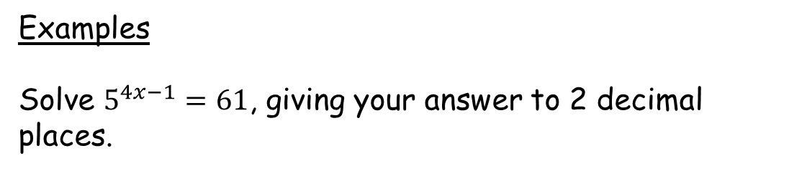



Examples
Solve $5^{4x−1}=61$, giving your answer to 2 decimal places.
$\log_{5} \left(61\right)=4x−1$
$\log_{5} \left(61\right)+1=4x$
Use your calculator
$\frac{\log_{5} \left(61\right)+1}{4}=x$
$0.89=x$

Slide 10



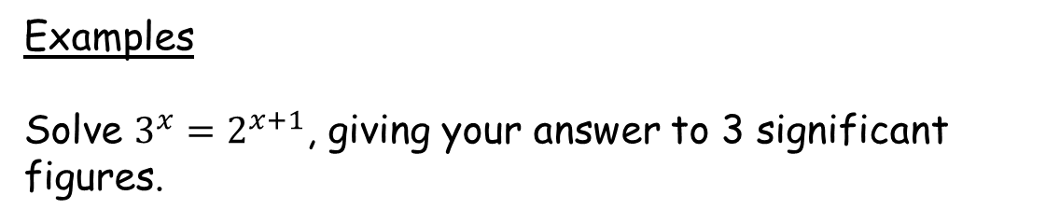




Examples
Solve $3^{x}=2^{x+1}$, giving your answer to 3 significant figures.
$log{(3}^{x})=log{(2}^{x+1})$
$x log 3=\left(x+1\right)log 2$
$x log 3=x log 2+log 2$
$x log 3−x log 2=log 2$
Use your calculator
$x (log 3− log 2)=log 2$
$x =\frac{log 2}{log 3 −log 2}$
$=1.71$

Slide 11
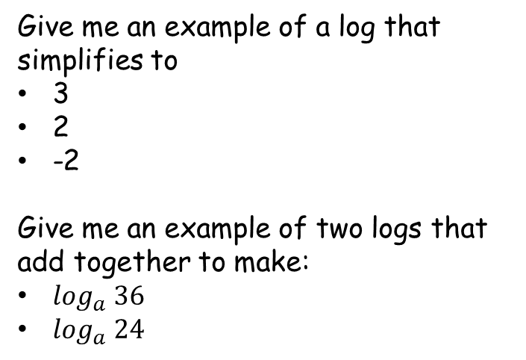
Give me an example of a log that simplifies to
3
2
-2
Give me an example of two logs that add together to make:
$\log_{a} 36$
$\log_{a} 24$

Slide 12
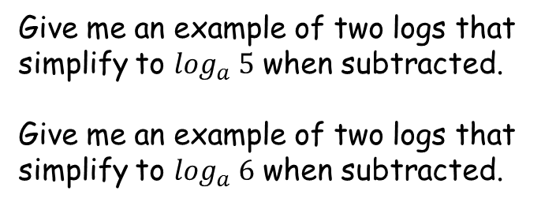
Give me an example of two logs that simplify to $\log_{a} 5$ when subtracted.
Give me an example of two logs that simplify to $\log_{a} 6$ when subtracted.

Slide 13
Odd One Out
Each set of three logarithms has an odd one out. You need to decide which statement is the odd one out.
Then, in the empty box, write a statement that matches the odd-one-out. Try to write a different statement to the person next to you.

Slide 14
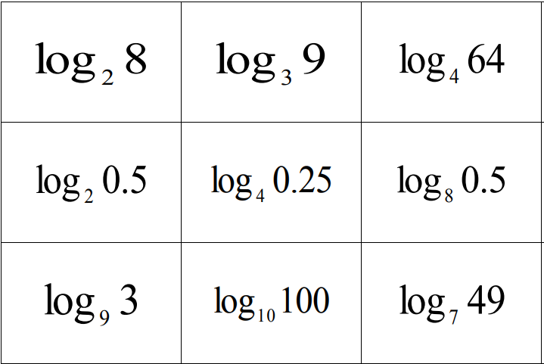
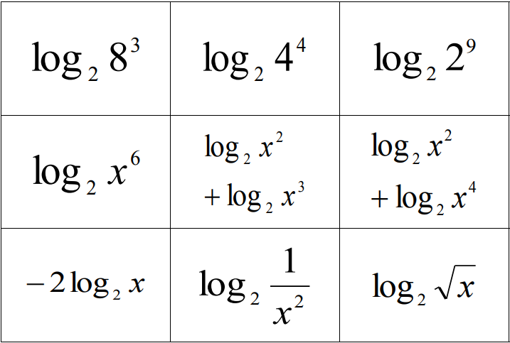
Answers

Slide 15
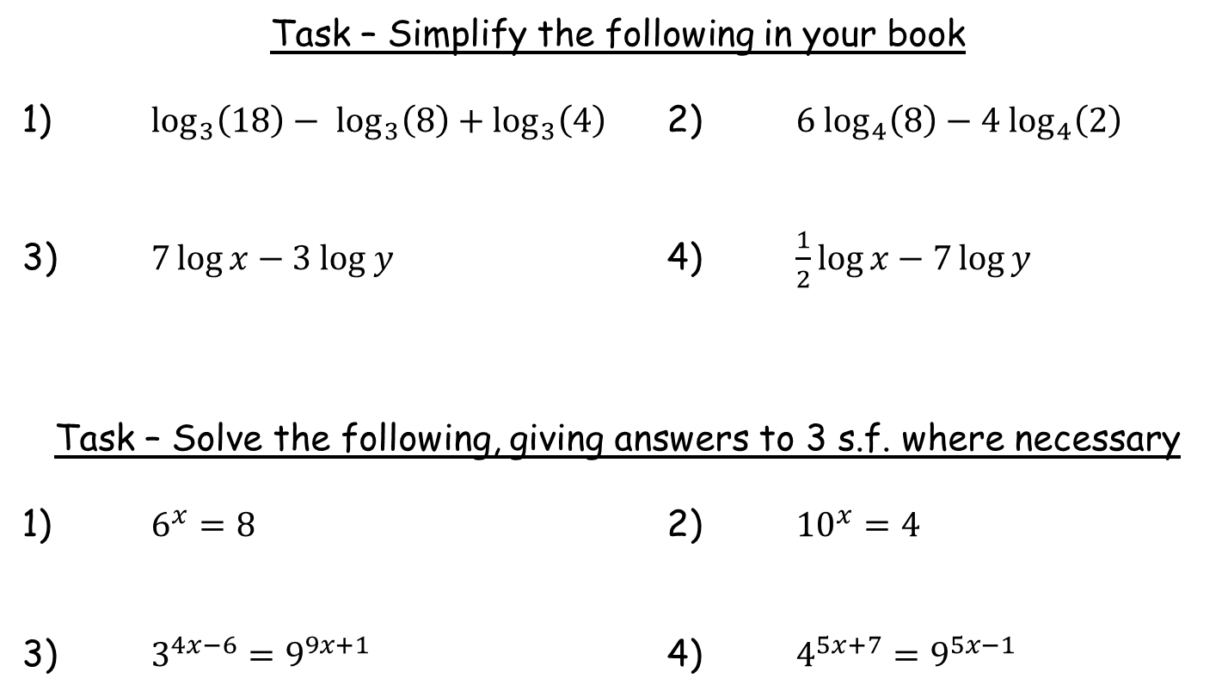
Task – Simplify the following in your book
1) $\log_{3}\left(18\right)− \log_{3}\left(8\right)+\log_{3}\left(4\right)$ 2) $6 \log_{4}\left(8\right)−4 \log_{4}\left(2\right)$
3) $7\log{x}−3 log y$ 4) $\frac{1}{2}\log{x}−7\log{y}$
Task – Solve the following, giving answers to 3 s.f. where necessary
1) $6^{x}=8$ 2) ${10}^{x}=4$
3) $3^{4x−6}=9^{9x+1}$ 4) $4^{5x+7}=9^{5x−1}$

Slide 16
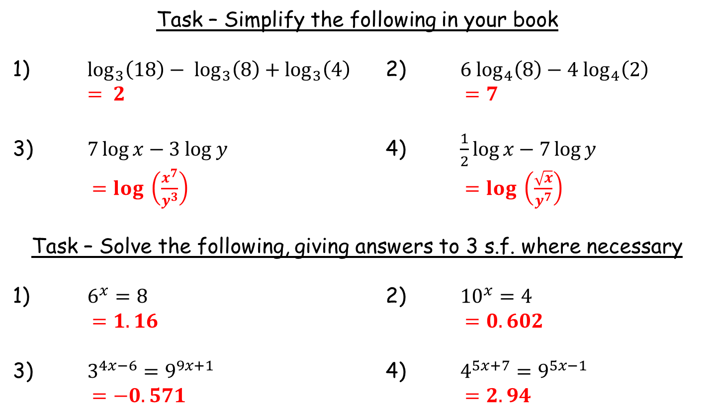
Task – Simplify the following in your book
1) $\log_{3}\left(18\right)− \log_{3}\left(8\right)+\log_{3}\left(4\right)$ 2) $6 \log_{4}\left(8\right)−4 \log_{4}\left(2\right)$
$= 2$ $=7$
3) $7\log{x}−3 log y$ 4) $\frac{1}{2}\log{x}−7\log{y}$
$=log \left(\frac{x^{7}}{y^{3}}\right)$ $=log \left(\frac{\sqrt{x}}{y^{7}}\right)$
Task – Solve the following, giving answers to 3 s.f. where necessary
1) $6^{x}=8$ 2) ${10}^{x}=4$
$=1.16$ $=0.602$
3) $3^{4x−6}=9^{9x+1}$ 4) $4^{5x+7}=9^{5x−1}$
$=−0.571$ $=2.94$

