Slide 1
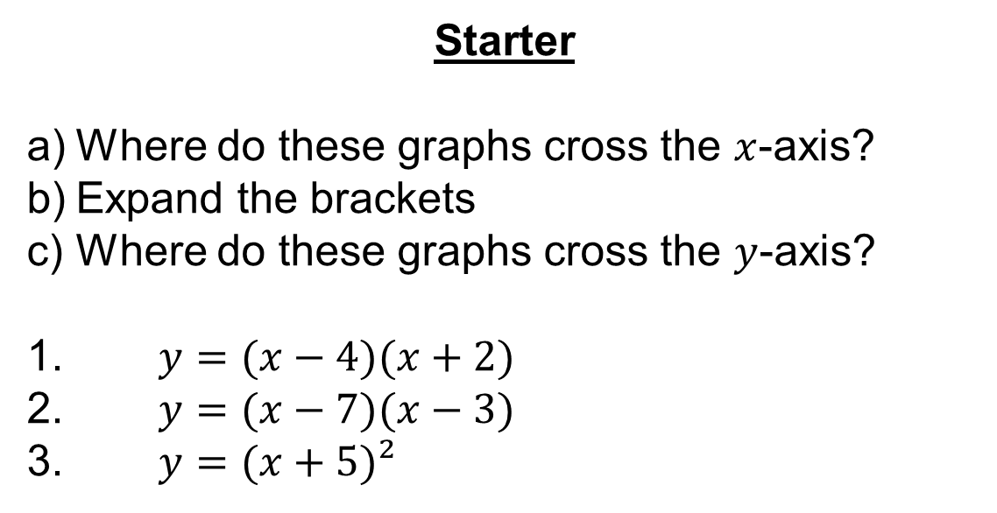
Starter
Where do these graphs cross the $x$-axis?
Expand the brackets
Where do these graphs cross the $y$-axis?
1. $y=(x−4)(x+2)$
2. $y=(x−7)(x−3)$
3. $y=(x+5)²$

Slide 2
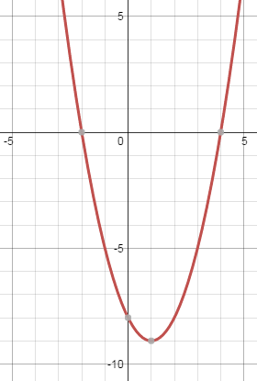




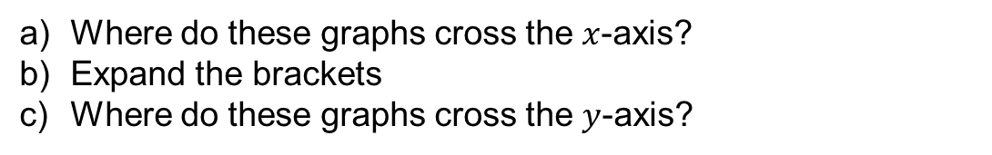
Where do these graphs cross the $x$-axis?
Expand the brackets
Where do these graphs cross the $y$-axis?
1. $y=(x−4)(x+2)$
$x=4$ or $−2$
$$y=x²−2x−8$$
$y$-intercept at $−8$

Slide 3
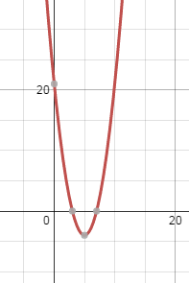




Where do these graphs cross the $x$-axis?
Expand the brackets
Where do these graphs cross the $y$-axis?
2. $y=(x−7)(x−3)$
$x=7$ or $3$
$$y=x²−10x+21$$
$y$-intercept at $+21$

Slide 4
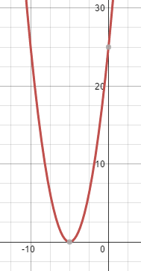




Where do these graphs cross the $x$-axis?
Expand the brackets
Where do these graphs cross the $y$-axis?
3. $y=(x+5)²$
$$x=−5$$
$$y=x²+10x+25$$
$y$-intercept at $+25$

Slide 5
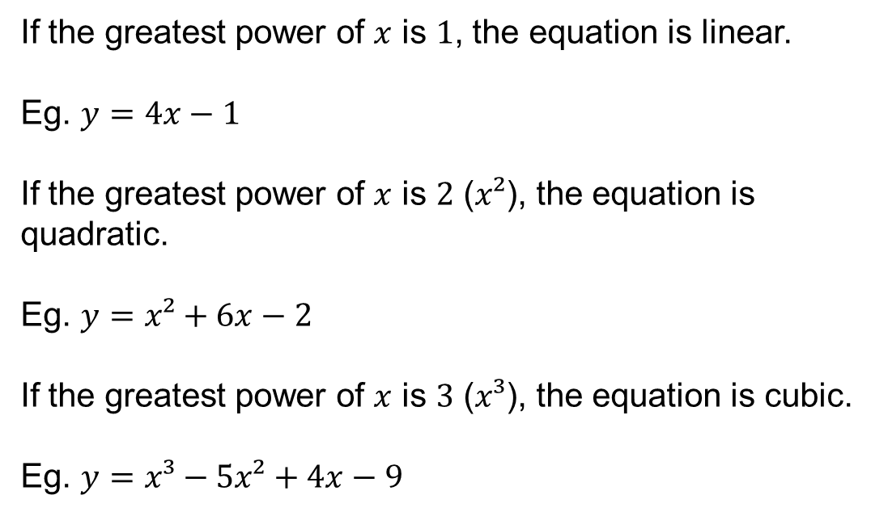
If the greatest power of $x$ is $1$, the equation is linear.
Eg. $y=4x−1$
If the greatest power of $x$ is $2$ ($x²$), the equation is quadratic.
Eg. $y=x²+6x−2$
If the greatest power of $x$ is $3$ ($x³$), the equation is cubic.
Eg. $y=x³−5x²+4x−9$

Slide 6
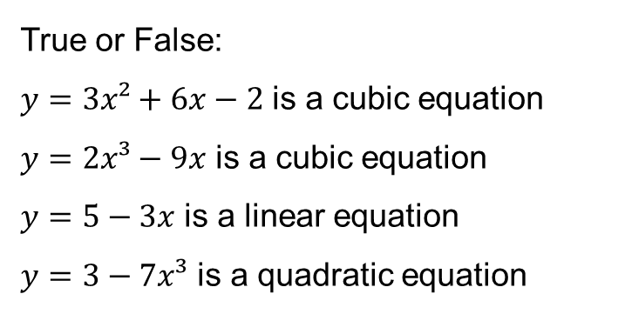
True or False:
$y=3x²+6x−2$ is a cubic equation
$y=2x³−9x$ is a cubic equation
$y=5−3x$ is a linear equation
$y=3−7x³$ is a quadratic equation

Slide 7
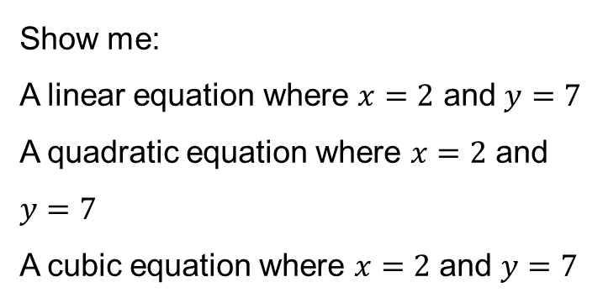
Show me:
A linear equation where $x=2$ and $y=7$
A quadratic equation where $x=2$ and $y=7$
A cubic equation where $x=2$ and $y=7$

Slide 8
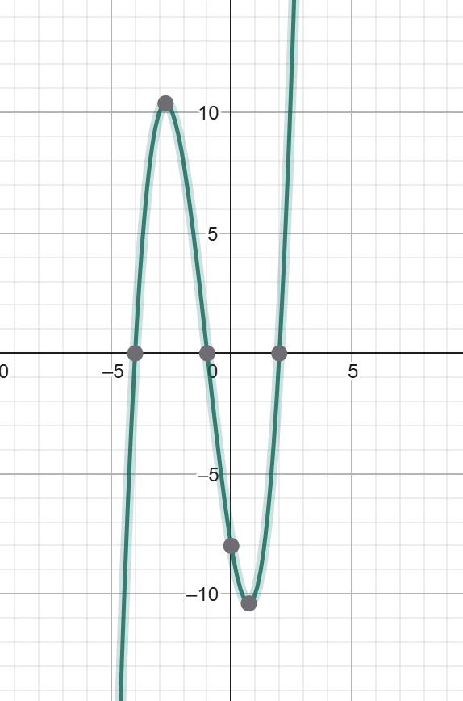
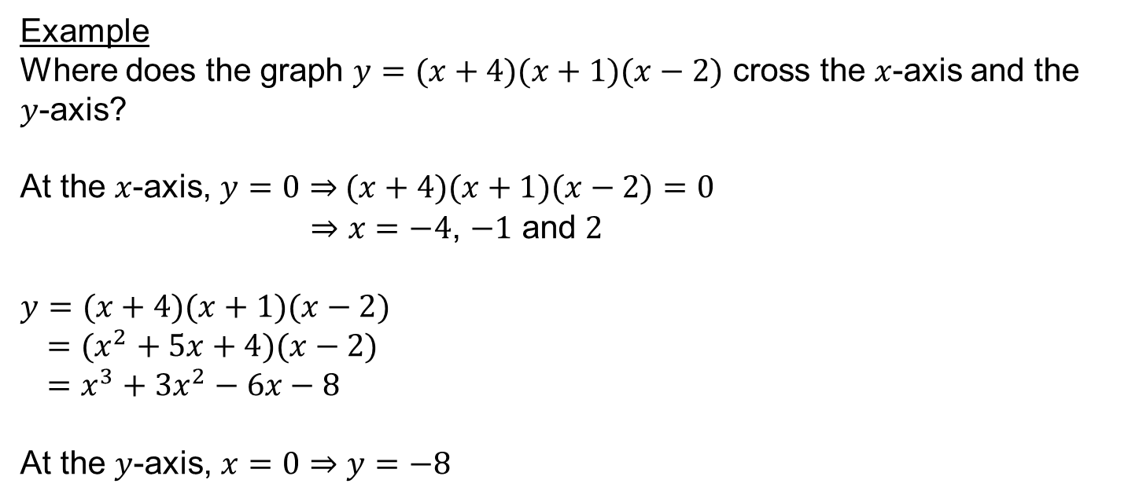
Example
Where does the graph $y=(x+4)(x+1)(x−2)$ cross the $x$-axis and the $y$-axis?
At the $x$-axis, $y=0⇒$ $(x+4)(x+1)(x−2)=0$
$⇒x=−4$, $−1$ and $2$
$y=(x+4)(x+1)(x−2)$
$=(x^{2}+5x+4)(x−2)$
$=x^{3}+3x^{2}−6x−8$
At the $y$-axis, $x=0⇒y=−8$

Slide 9
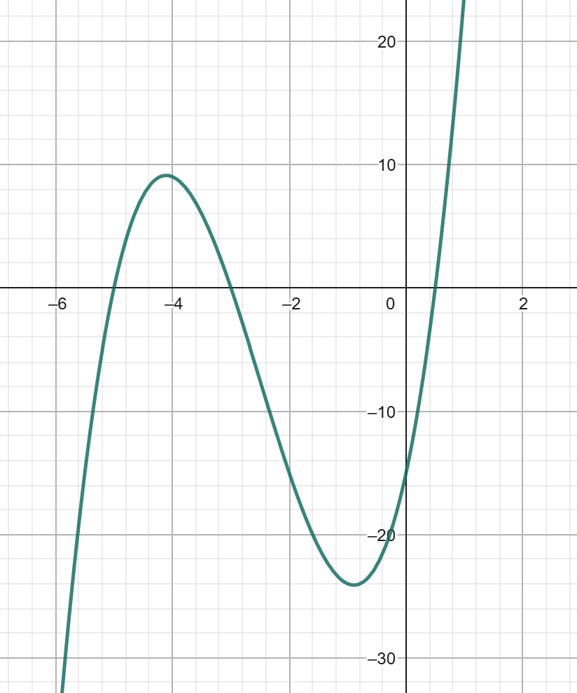
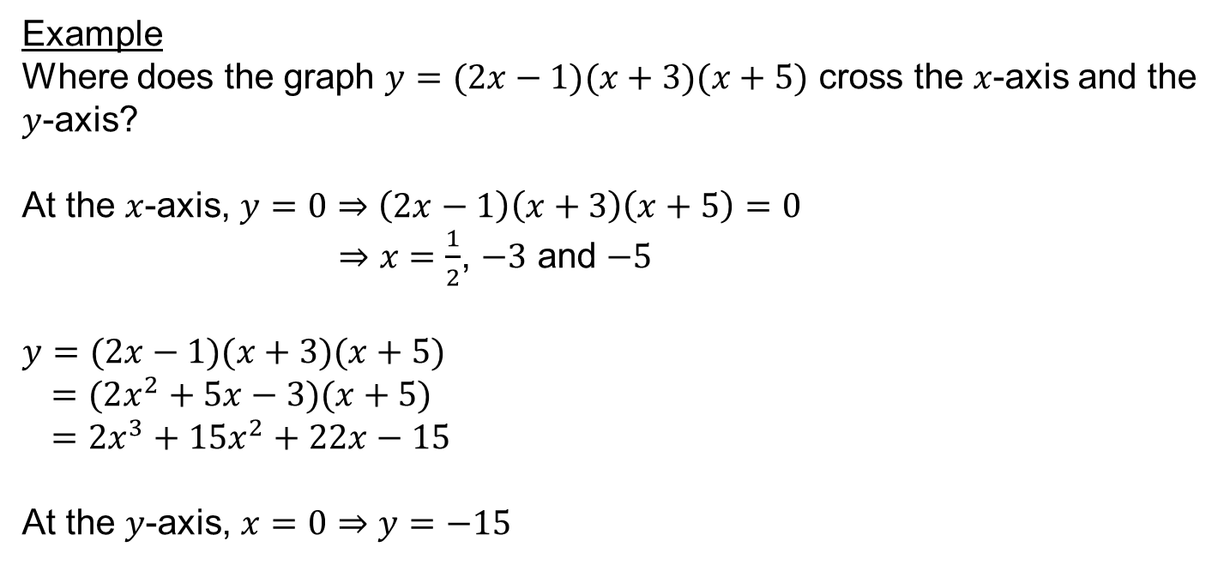
Example
Where does the graph $y=(2x−1)(x+3)(x+5)$ cross the $x$-axis and the $y$-axis?
At the $x$-axis, $y=0⇒\left(2x−1\right)\left(x+3\right)\left(x+5\right)=0$
$⇒x=\frac{1}{2}$, $−3$ and $−5$
$y=(2x−1)(x+3)(x+5)$
$=(2x^{2}+5x−3)(x+5)$
$=2x^{3}+15x^{2}+22x−15$
At the $y$-axis, $x=0⇒y=−15$
Notes:
Show expansion of brackets on whiteboard to model working

Slide 10
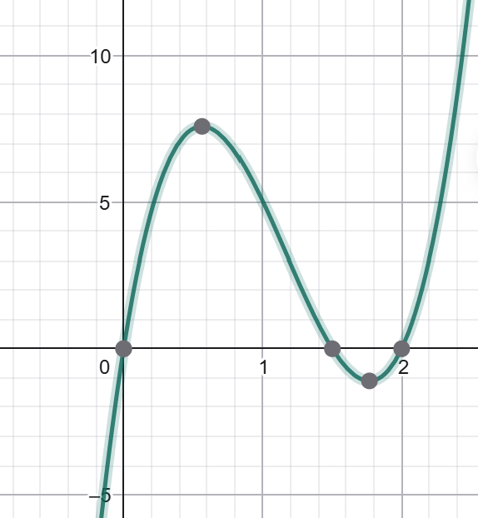
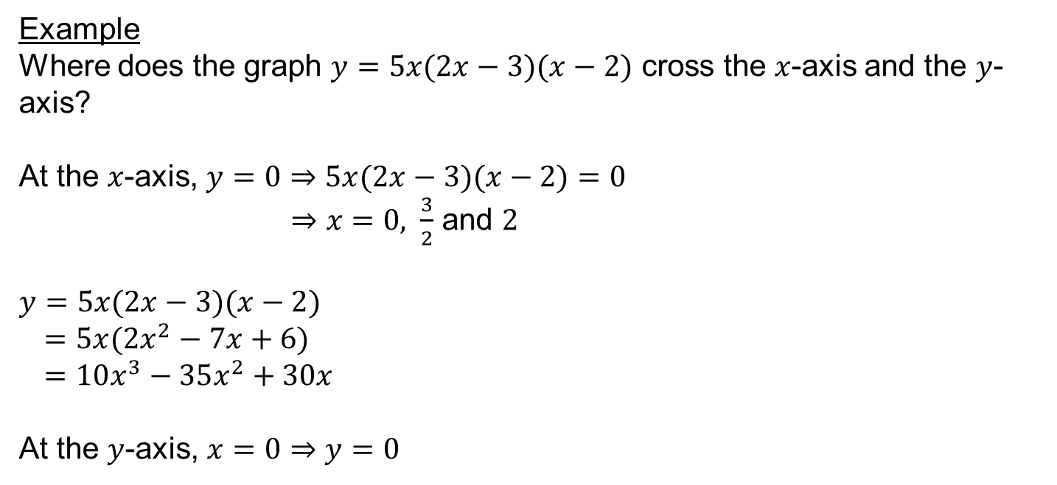
Example
Where does the graph $y=5x(2x−3)(x−2)$ cross the $x$-axis and the $y$-axis?
At the $x$-axis, $y=0⇒5x(2x−3)(x−2)=0$
$⇒x=0,$ $\frac{3}{2}$ and $2$
$y=5x(2x−3)(x−2)$
$=5x(2x^{2}−7x+6)$
$=10x^{3}−35x^{2}+30x$
At the $y$-axis, $x=0⇒y=0$
Notes:
Show expansion of brackets on whiteboard to model working

Slide 12
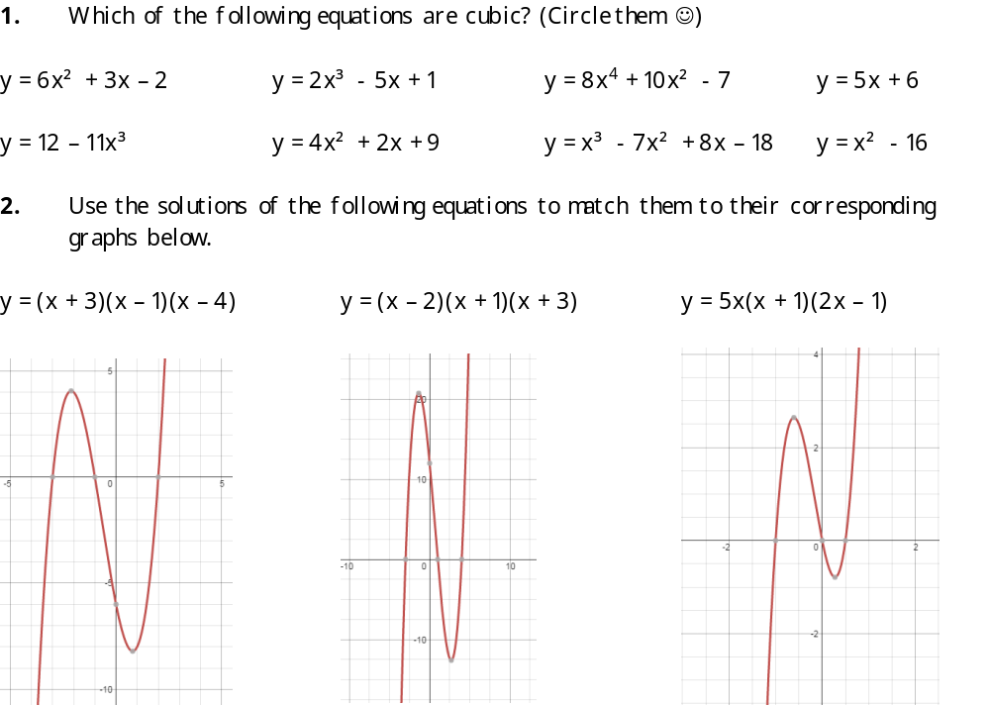
Answers

Slide 13
Answers
3. Expand the following expressions.
a. (x + 2)(x + 5)(x + 1) b. (x – 3)(x + 4)(x – 2)
= x³ + 8x² + 17x + 10 = x³ - x² - 14x + 24
c. x(x + 5)(x – 4) d. (x + 3)³
= x³ + x² - 20x = x³ + 9x² + 27x + 27
4. What equations do these graphs represent?
y = (x + 3)(x + 1)(x – 1), y = (x + 1)(x – 1)(x – 2), y = (x + 1)(x – 2)(x – 3)
5. How many solutions does each cubic equation have?
a. 3 b. 1
c. 3 d. 2
e. 3 f. 3

