Slide 1
Starter
Calculate the missing information below.
__ cm
__
cm
4.2 cm
Area =
15 cm²
9 cm
6 cm
Area = 21 cm²
Area =
__ cm²
Area = 24 cm²
__ cm
8 cm
1 cm
Area =
10 cm²
4 cm
3 cm
__ cm
__ cm
Area = 36 cm²

Slide 2
Answers
5 cm
4
cm
4.2 cm
Area =
15 cm²
9 cm
6 cm
Area = 21 cm²
Area =
9 cm²
Area = 24 cm²
5 cm
8 cm
1 cm
Area =
10 cm²
4 cm
3 cm
4.5 cm
2.5 cm
Area = 36 cm²

Slide 3
Notes
A histogram looks similar to a bar chart, but instead of the frequency being represented by the height of each bar, it’s represented by the area of each bar.
The vertical axis is labelled frequency density.
When working with histograms, we need to use this formula:
Frequency = class width $×$ frequency density
Like with all formulae, we can rearrange it to find other information too.

Slide 4
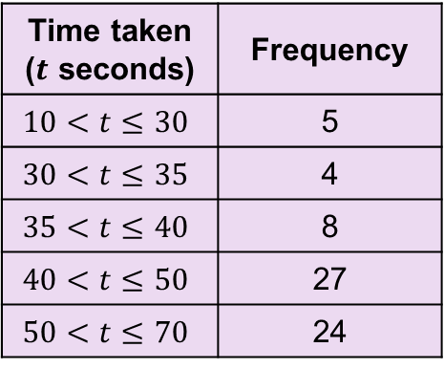
Example
Draw a histogram to show time taken to complete a task.
Time taken ($t$ seconds) | Frequency
$$10<t≤30$$ | 5
$$30<t≤35$$ | 4
$$35<t≤40$$ | 8
$$40<t≤50$$ | 27
$$50<t≤70$$ | 24

Slide 5
Example
Draw a histogram to show time taken to complete a task.
Time taken ($t$ seconds) | Frequency
$$10<t≤30$$ | 5
$$30<t≤35$$ | 4
$$35<t≤40$$ | 8
$$40<t≤50$$ | 27
$$50<t≤70$$ | 24
Class width | Frequency density
20
0.25
5
0.8
5
1.6
10
2.7
20
1.2

Slide 6
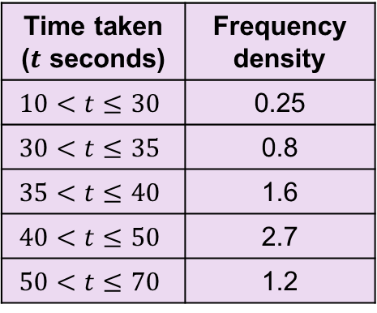
Example
Draw a histogram to show time taken to complete a task.
Time taken ($t$ seconds) | Frequency density
$$10<t≤30$$ | 0.25
$$30<t≤35$$ | 0.8
$$35<t≤40$$ | 1.6
$$40<t≤50$$ | 2.7
$$50<t≤70$$ | 1.2
3
Frequency density
2.5
2
1.5
Label both axes with continuous scales
1
0.5
0
0
10
20
30
40
50
60
70
Time taken ($t$ seconds)

Slide 7
Example
Draw a histogram to show time taken to complete a task.
Time taken ($t$ seconds) | Frequency density
$$10<t≤30$$ | 0.25
$$30<t≤35$$ | 0.8
$$35<t≤40$$ | 1.6
$$40<t≤50$$ | 2.7
$$50<t≤70$$ | 1.2
3
Frequency density
2.5
2
1.5
1
0.5
0
0
10
20
30
40
50
60
70
Time taken ($t$ seconds)

Slide 9
Answers – Q1

Slide 10
Answers – Q2

Slide 11
Answers – Q3

Slide 12
To interpret a histogram, just remember that the frequency is given by the area of each bar
3
$$2.7×10=27$$
Frequency density
2.5
2
1.5
$$1.6×5=8$$
$$1.2×20=24$$
1
$$0.8×50=4$$
0.5
$$0.25×20=5$$
0
0
10
20
30
40
50
60
70
Time taken ($t$ seconds)

Slide 14
Answers
Distance ($d$ metres) | Class width | Frequency density | Frequency
$$0<d≤10$$ | 10 | 1 | 10
$$10<d≤20$$ | 10 | 10 | 100
$$20<d≤30$$ | 10 | 7 | 70
$$30<d≤45$$ | 15 | 2 | 30
$$45<d≤70$$ | 25 | 1 | 25
Time ($t$ hours) | Class width | Frequency density | Frequency
$$0<t≤1$$ | 1 | 6 | 6
$$1<t≤2$$ | 1 | 30 | 30
$2<t≤2\frac{1}{2}$ | 0.5 | 60 | 30
$2\frac{1}{2}<t≤4$ | 1.5 | 24 | 36
$$4<t≤7$$ | 3 | 6 | 18

Slide 15
Group Task 1
Look at the answered exam question you have been given and identify the errors.
Can you calculate the correct answer?

Slide 16
Group Task 2
Match the histograms to their corresponding tables.
There will be one table and one histogram left over. You will need to draw their corresponding histogram and table.
Put key information on the poster.

Slide 17
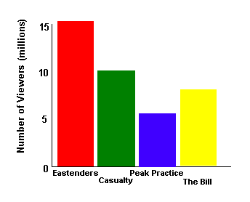
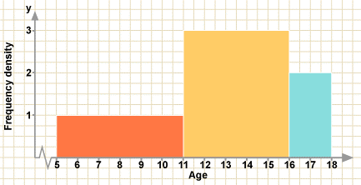
Plenary
What are the key differences between bar chart and histograms?

