Slide 1
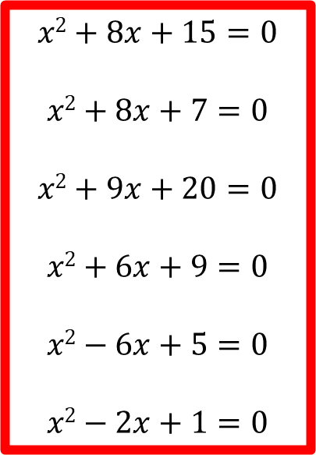
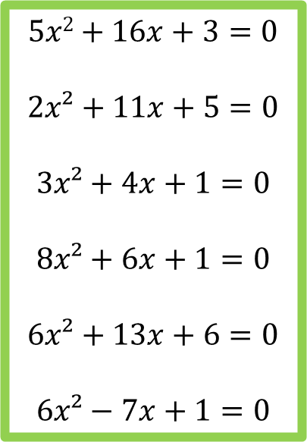
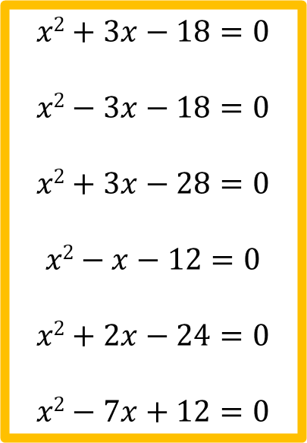
Starter
Factorise and solve the following:
$$x2+8x+15=0$$
$$x2+8x+7=0$$
$$x2+9x+20=0$$
$$x2+6x+9=0$$
$$x2−6x+5=0$$
$$x2−2x+1=0$$
$$x2+3x−18=0$$
$$x2−3x−18=0$$
$$x2+3x−28=0$$
$$x2−x−12=0$$
$$x2+2x−24=0$$
$$x2−7x+12=0$$
$$5x2+16x+3=0$$
$$2x²+11x+5=0$$
$$3x²+4x+1=0$$
$$8x²+6x+1=0$$
$$6x²+13x+6=0$$
$$6x²−7x+1=0$$

Slide 2
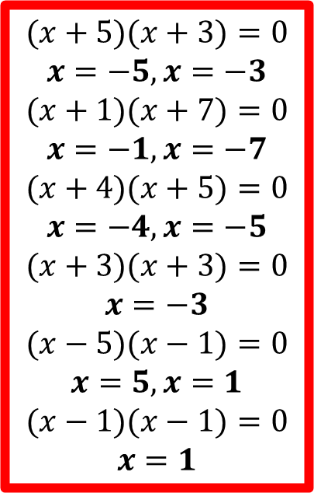
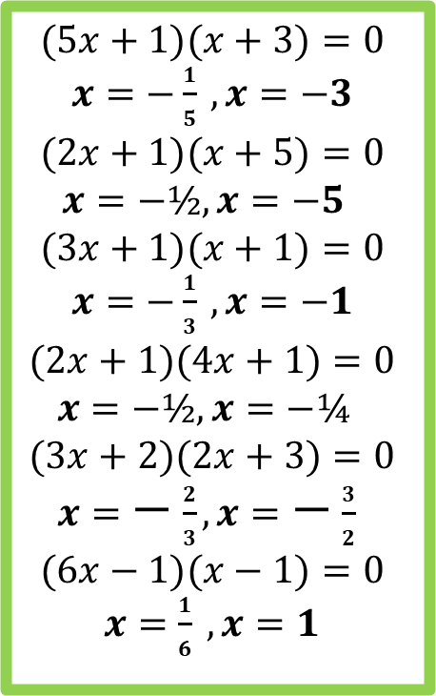
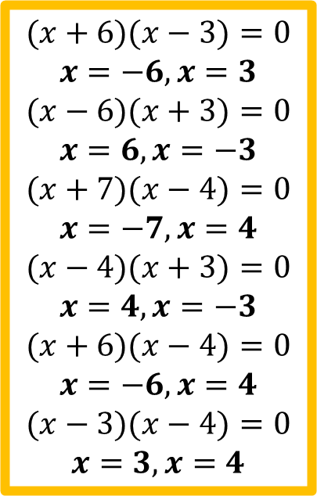
Answers
$$(5x+1)(x+3)=0$$
$x=−\frac{1}{5} , x=−3$
$$(2x+1)(x+5)=0$$
$$x=−½, x=−5$$
$$(3x+1)(x+1)=0$$
$x=−\frac{1}{3} , x=−1$
$$(2x+1)(4x+1)=0$$
$$x=−½, x=−¼$$
$$(3x+2)(2x+3)=0$$
$x=−\frac{2}{3}, x=−\frac{3}{2}$
$$(6x−1)(x−1)=0$$
$x=\frac{1}{6} , x=1$
$$(x+5)(x+3)=0$$
$$x=−5, x=−3$$
$$(x+1)(x+7)=0$$
$$x=−1, x=−7$$
$$(x+4)(x+5)=0$$
$$x=−4, x=−5$$
$$(x+3)(x+3)=0$$
$$x=−3$$
$$(x−5)(x−1)=0$$
$$x=5, x=1$$
$$(x−1)(x−1)=0$$
$$x=1$$
$$(x+6)(x−3)=0$$
$$x=−6, x=3$$
$$(x−6)(x+3)=0$$
$$x=6, x=−3$$
$$(x+7)(x−4)=0$$
$$x=−7, x=4$$
$$(x−4)(x+3)=0$$
$$x=4, x=−3$$
$$(x+6)(x−4)=0$$
$$x=−6, x=4$$
$$(x−3)(x−4)=0$$
$$x=3, x=4$$

Slide 3
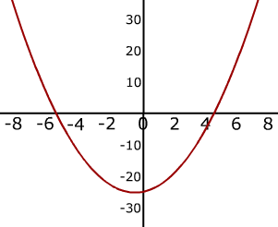




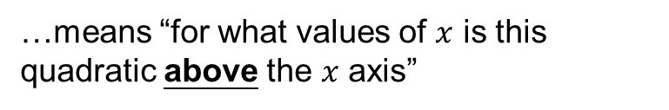
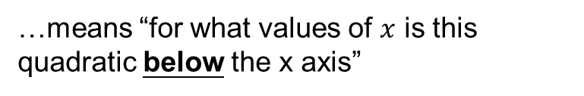
$$ax2+bx+c>0$$
…means “for what values of $x$ is this quadratic above the $x$ axis”
e.g. $x2+x−20>0$
$$ax2+bx+c<0$$
…means “for what values of $x$ is this quadratic below the x axis”
e.g. $x2+x−20<0$

Slide 4
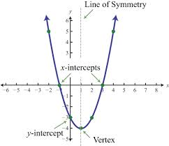
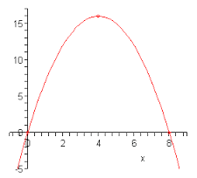
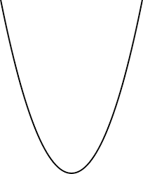
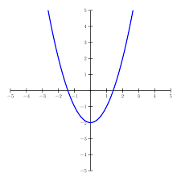
The shape of a quadratic graph is a parabola.
When we solve a quadratic equation, we are find the points where the graph intersects the x axis.

Slide 5
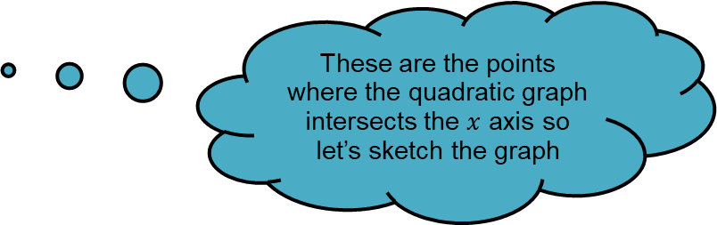
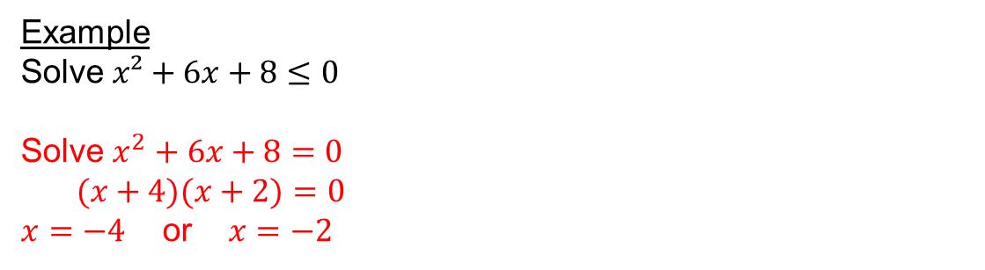

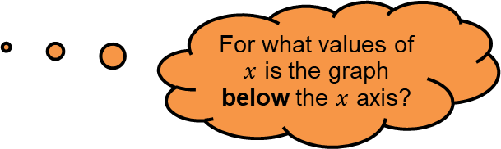
Example
Solve $x²+6x+8≤0$
Solve $x^{2}+6x+8=0$
$(x+4)(x+2)=0$
$x=−4$ or $x=−2$
Start by solving the inequality as an equation
For what values of $x$ is the graph below the $x$ axis?
These are the points where the quadratic graph intersects the $x$ axis so let’s sketch the graph
-4
-2
$$−4≤x≤−2$$

Slide 6



Example
Solve $x²+6x+8≥0$
Solve $x^{2}+6x+8=0$
$(x+4)(x+2)=0$
$x=−4$ or $x=−2$
Start by solving the inequality as an equation
For what values of $x$ is the graph above the $x$ axis?
These are the points where the quadratic graph intersects the $x$ axis so let’s sketch the graph
-4
-2
$x≤−4$, $x≥−2$

Slide 7
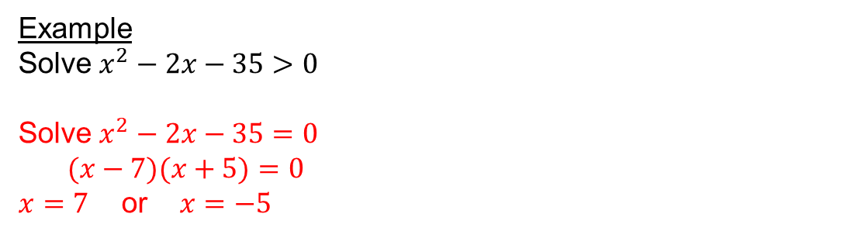

Example
Solve $x^{2}−2x−35>0$
Solve $x^{2}−2x−35=0$
$(x−7)(x+5)=0$
$x=7$ or $x=−5$
Start by solving the inequality as an equation
For what values of $x$ is the graph above the $x$ axis?
These are the points where the quadratic graph intersects the $x$ axis so let’s sketch the graph
-5
7
$x<−5$, $x>7$

Slide 8
How confident do you feel with this topic?
Write red, amber or green in your book!
Complete the corresponding activity ☺
You will need the blank grid along with:
Red: stick the solutions and working out into the right places on the grid.
Amber: stick the solutions and working out into the right places on the grid. Fill in the graph column as you go.
Green: fill in the columns with the correct working out and stick in the solutions as you go.

Slide 9
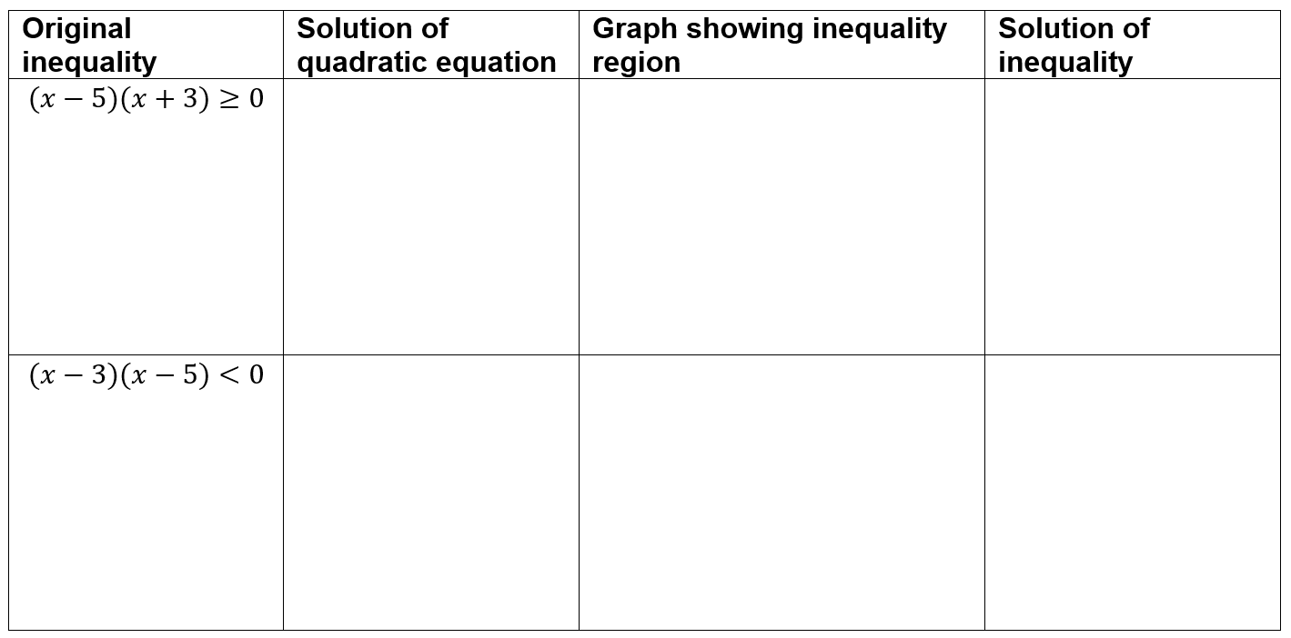





Solutions

Slide 10
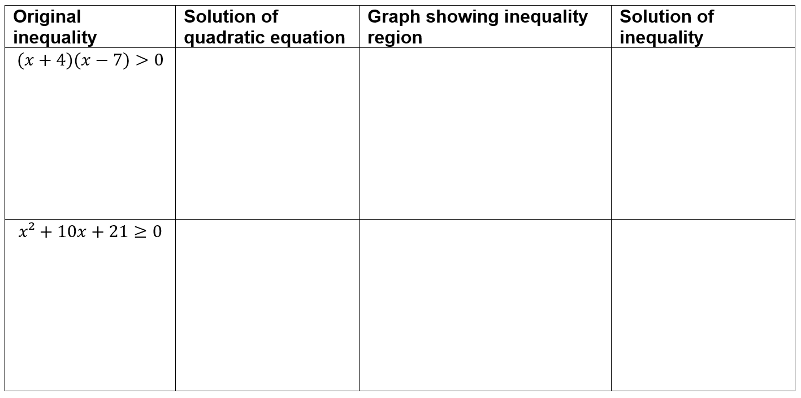






Solutions

Slide 11
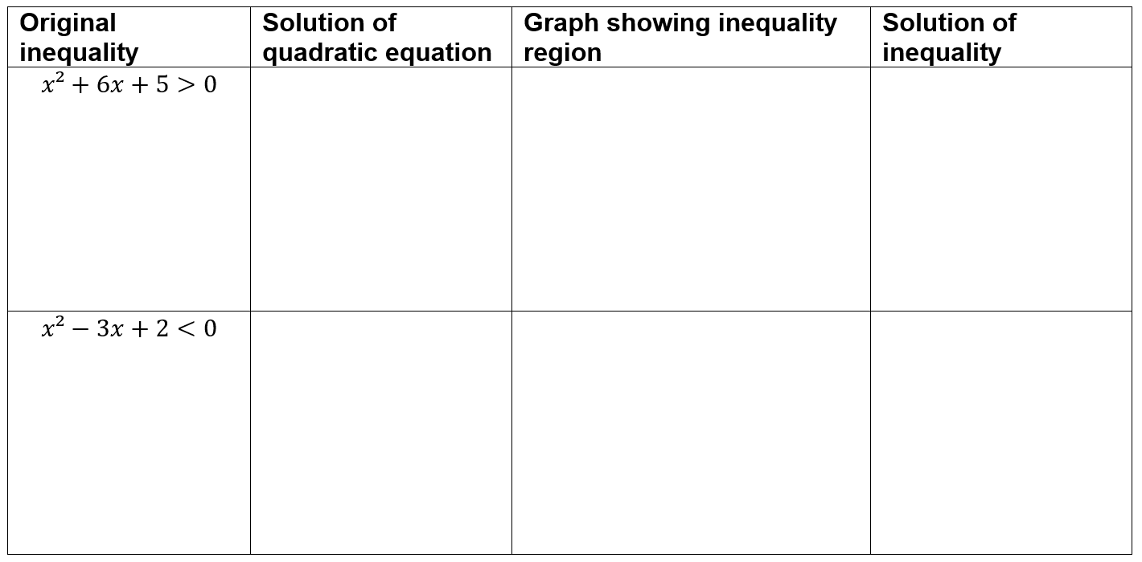
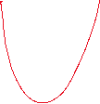


Solutions

Slide 12

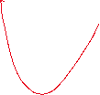
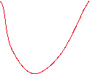


Solutions

Slide 13
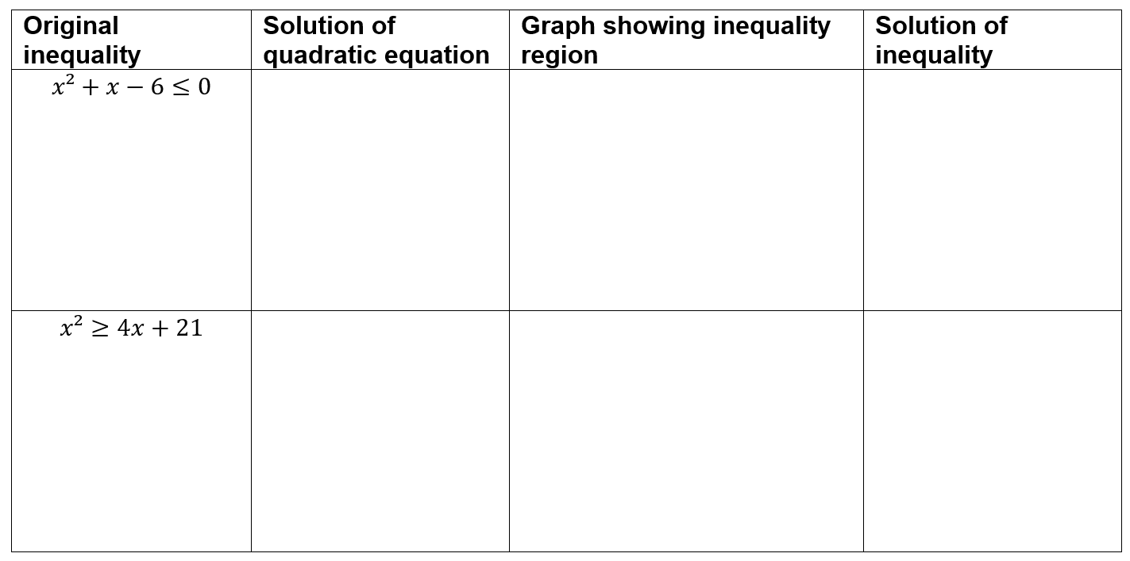


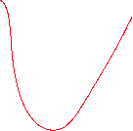


Solutions

Slide 14
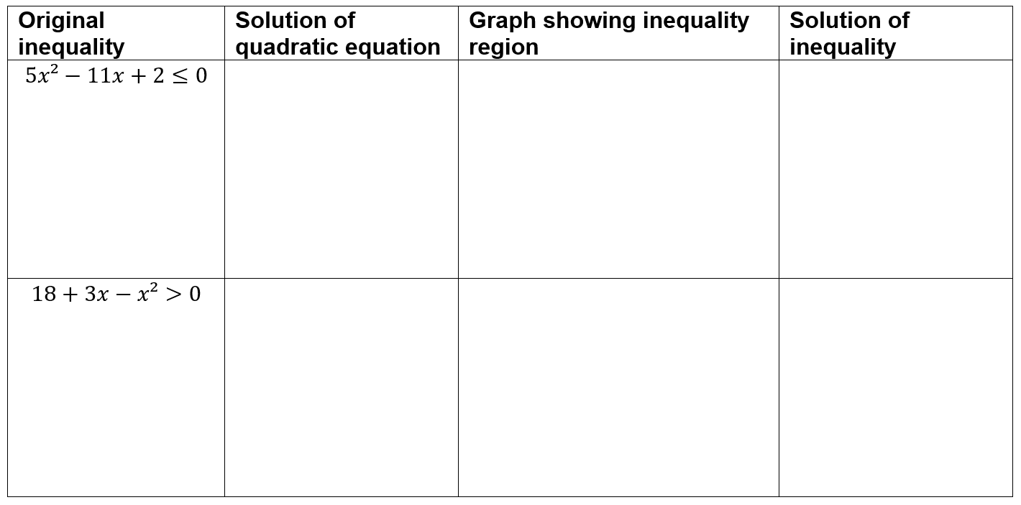



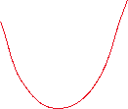
Solutions

