Slide 1
Starter
Copy and complete the table:
$$×$$
$$2a$$ | $$6a³$$ | $$8a²$$
 |  | $$12ab$$ | $$9b²$$

Slide 2
Starter
Copy and complete the table:
$$×$$ | $$3a²$$ | $$4a$$ | $$3b$$
$$2a$$ | $$6a³$$ | $$8a²$$ | $$6ab$$
$$3b$$ | $$9a^{2}b$$ | $$12ab$$ | $$9b²$$

Slide 3
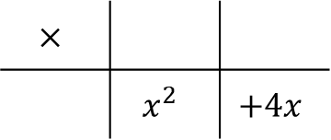
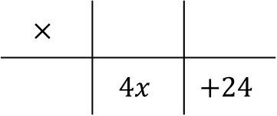
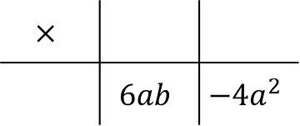
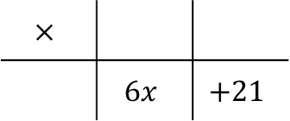
Factorising is the reverse process to expanding brackets. We are finding factors that multiply together to make the expression we have been given. Start each question by finding the highest common factor of the terms.
Examples
Factorise $6x+21$ Factorise $x²+4x$
Factorise fully $4x+24$ Factorise fully $6ab−4a²$
$=3$ $(2x+7)$
$=x$ $(x+4)$
$$×$$
 | $$6x$$ | $$+21$$
$$×$$
 | $$x^{2}$$ | $$+4x$$
$$2x$$
$$+7$$
$$x$$
$$+4$$
$$3$$
$$x$$
$=4$ $(x+6)$
$=2a$ $(3b−2a)$
$$×$$
 | $$4x$$ | $$+24$$
$$×$$
 | $$6ab$$ | $$−4a^{2}$$
$$x$$
$$+6$$
$$3b$$
$$−2a$$
$$4$$
$$2a$$

Slide 5
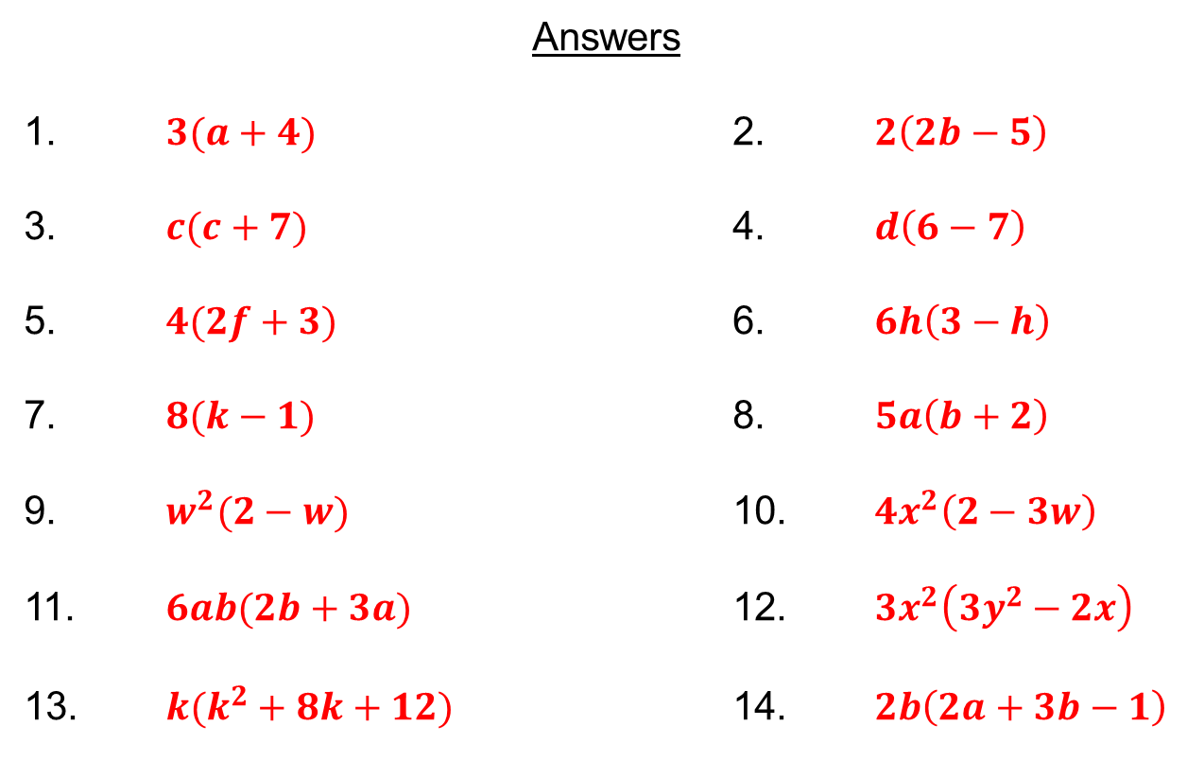
Answers
1. $3(a+4)$ 2. $2\left(2b−5\right)$
3. $c(c+7)$ 4. $d\left(6−7\right)$
5. $4(2f+3)$ 6. $6h\left(3−h\right)$
7. $8(k−1)$ 8. $5a\left(b+2\right)$
9. $w^{2}(2−w)$ 10. $4x^{2}\left(2−3w\right)$
11. $6ab(2b+3a)$ 12. $3x^{2}\left(3y^{2}−2x\right)$
13. $k(k^{2}+8k+12)$ 14. $2b\left(2a+3b−1\right)$

Slide 6
Factorise:
$3+6x$
$6x−30$
$8x−22$
Show me an expression which has a factor of:
$(x+3)$
$(4−x)$
$(7+2x)$
$(x2−5)$

