Slide 1
Starter
1. If $X\sim B(8,0.4)$ find:
(a) $P(X≤2)$ (b) $P(X=4)$
2. If $X\sim B(10,\frac{1}{4})$ find:
(a) $P(X<5)$ (b) $P\left(X>4\right)$
3. If $X\sim B(6,0.225)$ find $P(X=5)$
4. In a factory producing light bulbs, the probability of one being faulty is 0.15. A batch of 20 is tested. Find the probability that:
(a) 5 are faulty
(b) More than 5 are faulty
(c) At least 5 are faulty
= 0.315
= 0.232
= 0.922
= 0.078
= 0.003
= 0.103
= 0.067
= 0.170

Slide 2
Task
Complete the multiple choice quiz.
No cheating!
(No conferring or looking up answers ☺)
(You are unlikely to know the answers and so will be guessing!)

Slide 3
Discuss
What would you EXPECT someone to score?
What would be a fair pass mark for this test which would mean that guessers are unlikely to pass?
(You don’t have to agree at this point – in fact it would be better if you disagree!)

Slide 4
Answers
A
C
A
B
A
D
C
D

Slide 5
Discuss
What was your score?
What did everyone else score?
Work out the probability that someone who guesses all the answers will pass the test, using the pass mark that you have chosen.

Slide 6
Pass Mark | Working out | Probability of passing
8
7
6
5
4
3
2
1
0

Slide 7
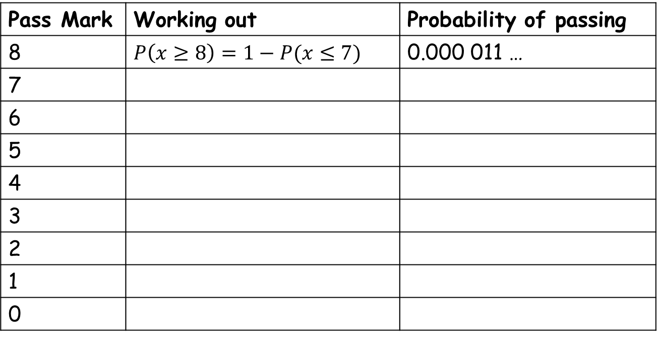
Pass Mark | Working out | Probability of passing
8 | $P\left(x≥8\right)=1−P(x≤7)$ | 0.000 011 …
7
6
5
4
3
2
1
0

Slide 8
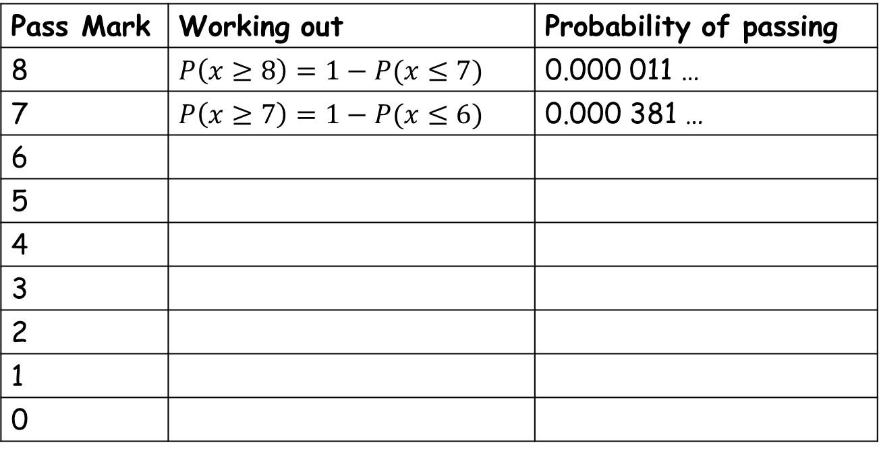
Pass Mark | Working out | Probability of passing
8 | $P\left(x≥8\right)=1−P(x≤7)$ | 0.000 011 …
7 | $P\left(x≥7\right)=1−P(x≤6)$ | 0.000 381 …
6
5
4
3
2
1
0

Slide 9
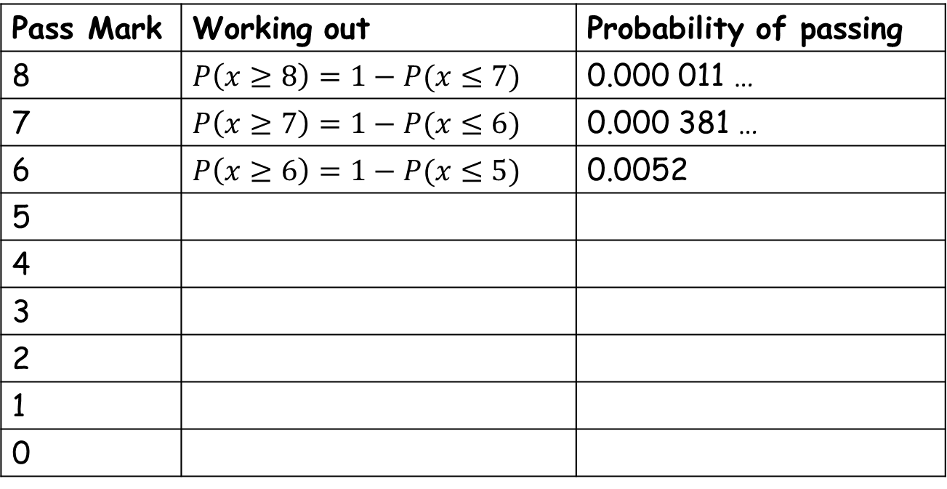
Pass Mark | Working out | Probability of passing
8 | $P\left(x≥8\right)=1−P(x≤7)$ | 0.000 011 …
7 | $P\left(x≥7\right)=1−P(x≤6)$ | 0.000 381 …
6 | $P\left(x≥6\right)=1−P(x≤5)$ | 0.0052
5
4
3
2
1
0

Slide 10
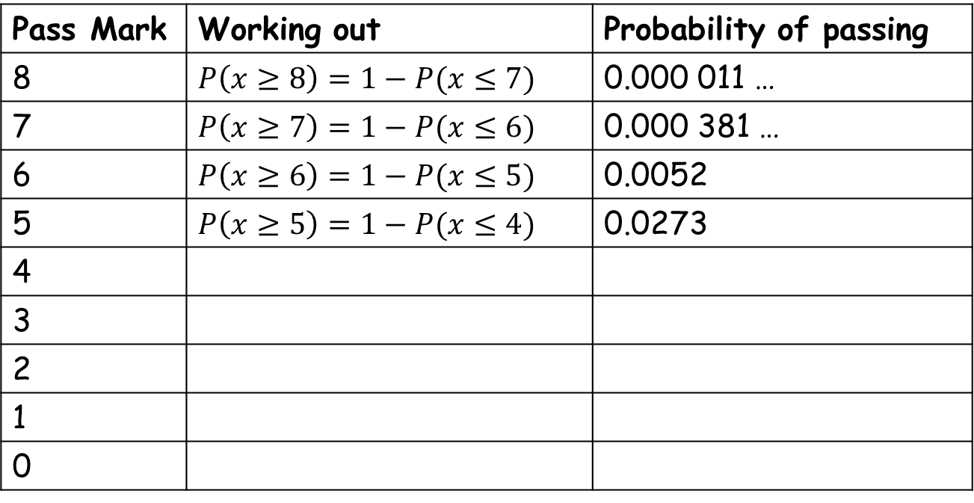
Pass Mark | Working out | Probability of passing
8 | $P\left(x≥8\right)=1−P(x≤7)$ | 0.000 011 …
7 | $P\left(x≥7\right)=1−P(x≤6)$ | 0.000 381 …
6 | $P\left(x≥6\right)=1−P(x≤5)$ | 0.0052
5 | $P\left(x≥5\right)=1−P(x≤4)$ | 0.0273
4
3
2
1
0

Slide 11
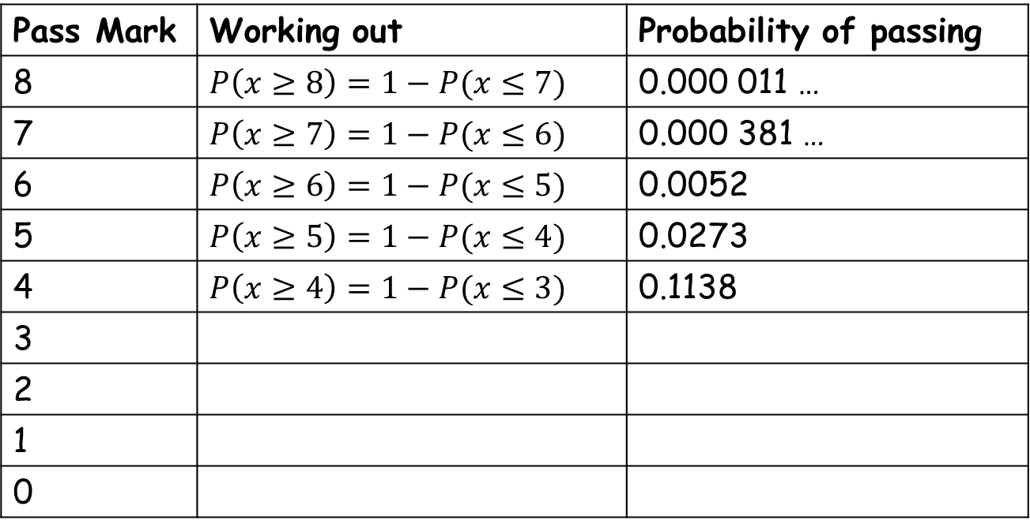
Pass Mark | Working out | Probability of passing
8 | $P\left(x≥8\right)=1−P(x≤7)$ | 0.000 011 …
7 | $P\left(x≥7\right)=1−P(x≤6)$ | 0.000 381 …
6 | $P\left(x≥6\right)=1−P(x≤5)$ | 0.0052
5 | $P\left(x≥5\right)=1−P(x≤4)$ | 0.0273
4 | $P\left(x≥4\right)=1−P(x≤3)$ | 0.1138
3
2
1
0

Slide 12
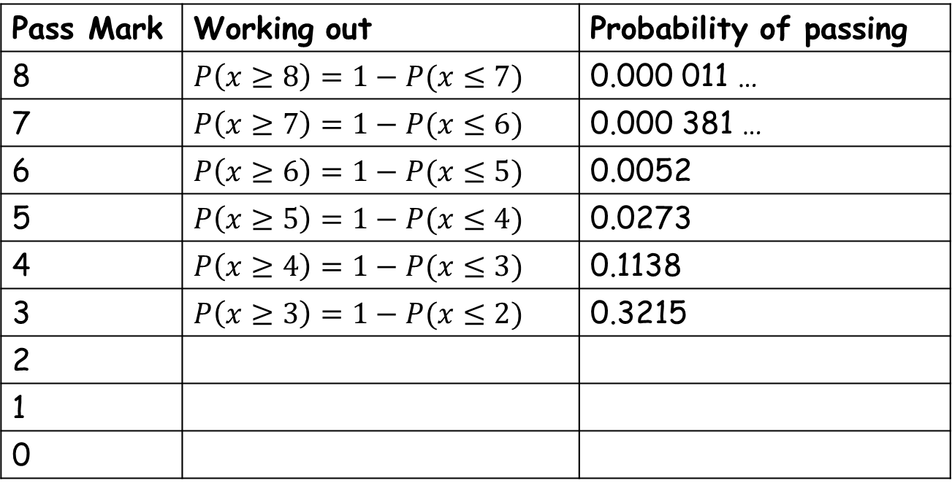
Pass Mark | Working out | Probability of passing
8 | $P\left(x≥8\right)=1−P(x≤7)$ | 0.000 011 …
7 | $P\left(x≥7\right)=1−P(x≤6)$ | 0.000 381 …
6 | $P\left(x≥6\right)=1−P(x≤5)$ | 0.0052
5 | $P\left(x≥5\right)=1−P(x≤4)$ | 0.0273
4 | $P\left(x≥4\right)=1−P(x≤3)$ | 0.1138
3 | $P\left(x≥3\right)=1−P(x≤2)$ | 0.3215
2
1
0

Slide 13
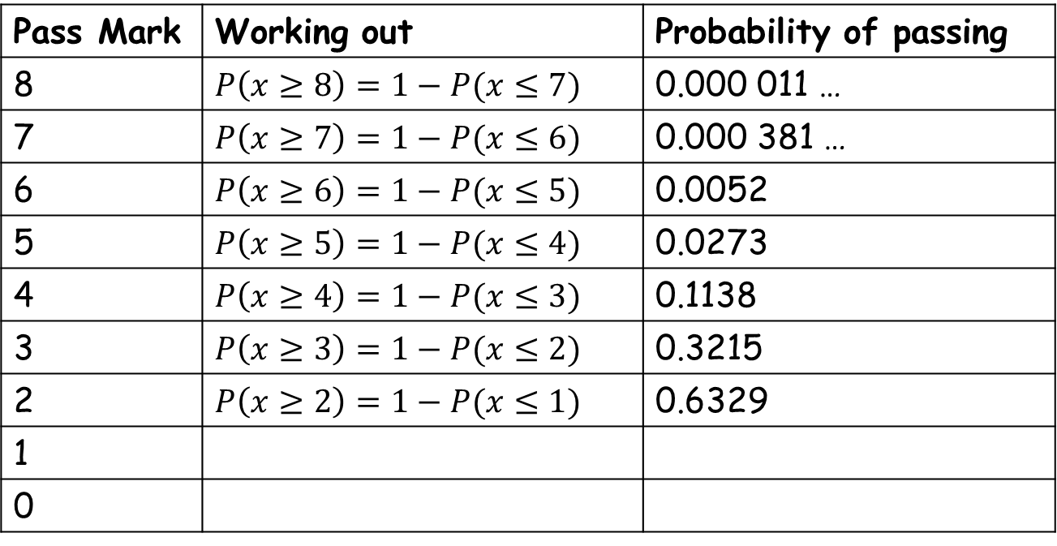
Pass Mark | Working out | Probability of passing
8 | $P\left(x≥8\right)=1−P(x≤7)$ | 0.000 011 …
7 | $P\left(x≥7\right)=1−P(x≤6)$ | 0.000 381 …
6 | $P\left(x≥6\right)=1−P(x≤5)$ | 0.0052
5 | $P\left(x≥5\right)=1−P(x≤4)$ | 0.0273
4 | $P\left(x≥4\right)=1−P(x≤3)$ | 0.1138
3 | $P\left(x≥3\right)=1−P(x≤2)$ | 0.3215
2 | $P\left(x≥2\right)=1−P(x≤1)$ | 0.6329
1
0

Slide 14
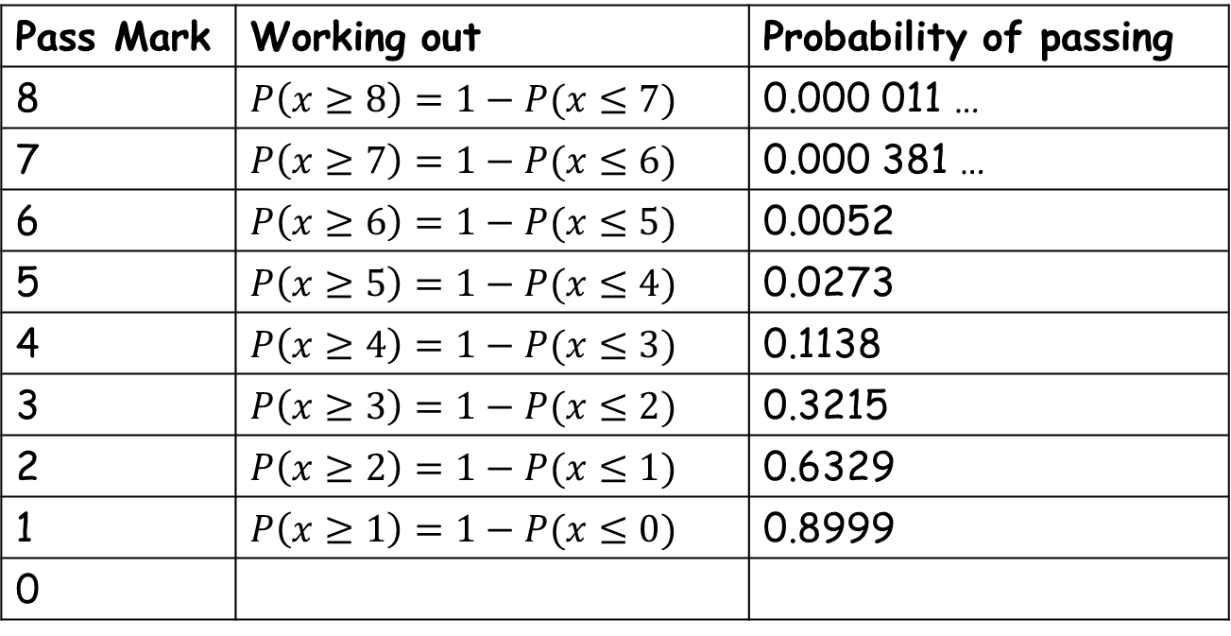
Pass Mark | Working out | Probability of passing
8 | $P\left(x≥8\right)=1−P(x≤7)$ | 0.000 011 …
7 | $P\left(x≥7\right)=1−P(x≤6)$ | 0.000 381 …
6 | $P\left(x≥6\right)=1−P(x≤5)$ | 0.0052
5 | $P\left(x≥5\right)=1−P(x≤4)$ | 0.0273
4 | $P\left(x≥4\right)=1−P(x≤3)$ | 0.1138
3 | $P\left(x≥3\right)=1−P(x≤2)$ | 0.3215
2 | $P\left(x≥2\right)=1−P(x≤1)$ | 0.6329
1 | $P\left(x≥1\right)=1−P(x≤0)$ | 0.8999
0

Slide 15
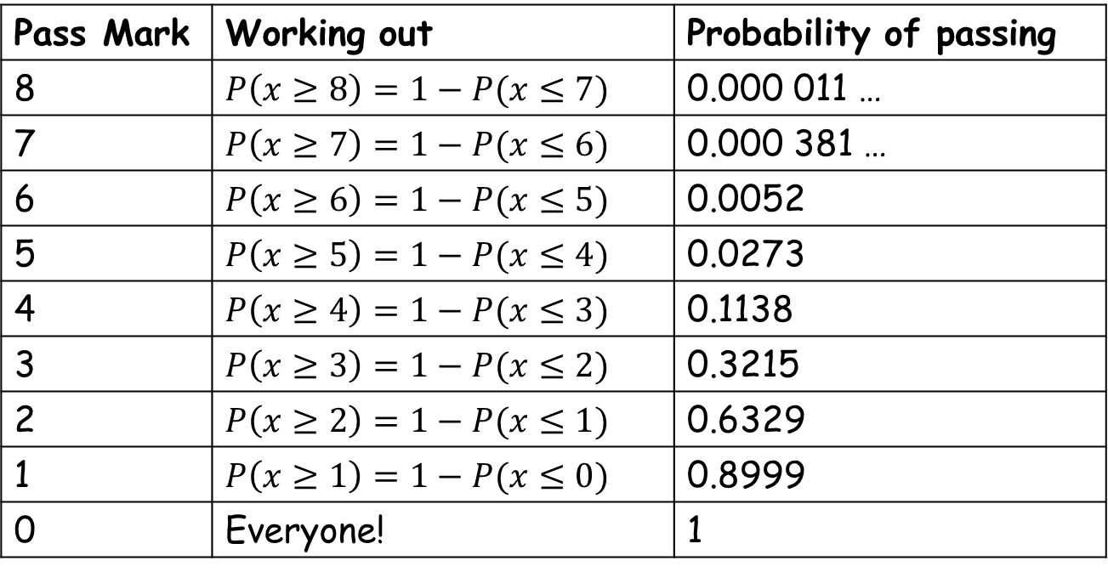
Pass Mark | Working out | Probability of passing
8 | $P\left(x≥8\right)=1−P(x≤7)$ | 0.000 011 …
7 | $P\left(x≥7\right)=1−P(x≤6)$ | 0.000 381 …
6 | $P\left(x≥6\right)=1−P(x≤5)$ | 0.0052
5 | $P\left(x≥5\right)=1−P(x≤4)$ | 0.0273
4 | $P\left(x≥4\right)=1−P(x≤3)$ | 0.1138
3 | $P\left(x≥3\right)=1−P(x≤2)$ | 0.3215
2 | $P\left(x≥2\right)=1−P(x≤1)$ | 0.6329
1 | $P\left(x≥1\right)=1−P(x≤0)$ | 0.8999
0 | Everyone! | 1

Slide 16
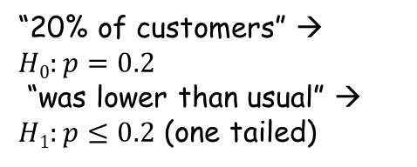

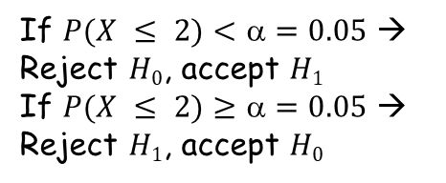
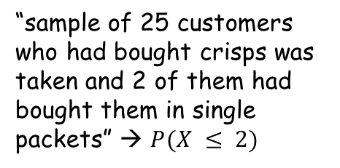
Example 1
Past records show that 20% of customers who buy crisps from a large supermarket buy them in single packets.
During a particular day a random sample of 25 customers who had bought crisps was taken and 2 of them had bought them in single packets.
Use these data to test, at the 5% level of significance, whether or not the percentage of customers who bought crisps in single packets that day was lower than usual. State your hypotheses clearly.
1) Type of distribution
5) Decide on which hypothesis to choose
“20% of customers...” → $X\sim B(n,p)$ where $p = 0.2$
“...25 customers” → $n = 25$
If $P(X ≤ 2)<=0.05$ → Reject $H0$, accept $H1$
If $P(X ≤ 2)≥=0.05$ → Reject $H1$, accept $H0$
2) Test statistic and choose hypothesis
At 5% significance level, there is significant evidence that this is lower than usual
“20% of customers” → $H0:p=0.2$
“was lower than usual” → $H1:p≤0.2$ (one tailed)
At 5% significance level, there is not significant evidence that this is lower than usual
6) Final calculation
$X\sim B(25,0.20)$
$H0:p=0.2$
$H1:p≤0.2$ (one tailed)
$P(X≤2)=0.0982$ (from calculator) $>5\%$, so not significant
At 5% significance level, there is not significant evidence that this is lower than usual → accept $H0$
3) Significance level
“5% level of significance” → $=0.05$
If the P-value is less than (or equal to) α, reject the null hypothesis in favour of the alternative hypothesis.
If the P-value is greater than α, do not reject the null hypothesis.
4) Predicted probability (check critical region)
“sample of 25 customers who had bought crisps was taken and 2 of them had bought them in single packets” → $P(X ≤ 2)$

Slide 17
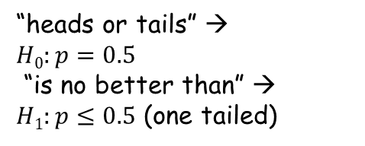

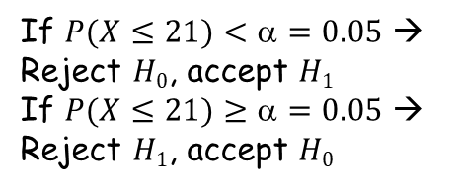
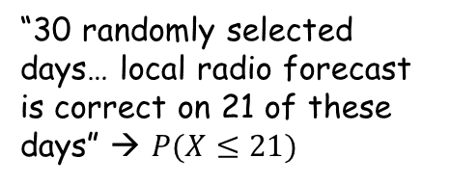
Example 2
Sami claims that the weather forecasts produced by local radio are no better than those achieved by tossing a fair coin and predicting rain if a head is obtained or no rain if a tail is obtained. He records the weather for 30 randomly selected days. The local radio forecast is correct on 21 of these days.
Test Sami’s claim at the 5% level of significance.
State your hypotheses clearly.
1) Type of distribution
5) Decide on which hypothesis to choose
“heads or tails...” → $X\sim B(n,p)$ where $p=0.5$
“...30 days” → $n=30$
If $P(X≤21)<=0.05$ → Reject $H0$, accept $H1$
If $P(X≤21)≥=0.05$ → Reject $H1$, accept $H0$
2) Test statistic and choose hypothesis
“heads or tails” → $H0:p=0.5$
“is no better than” → $H1:p≤0.5$ (one tailed)
6) Final calculation
$X\sim B(30,0.5)$
$H0:p=0.5$
$H1:p≤0.5$ (one tailed)
$P(X≤21)=0.9919$ (from calculator) $>5\%$, so not significant
At 5% significance level, there is not significant evidence that this is lower than usual → accept $H0$
3) Significance level
“5% level of significance” → $=0.05$
If the P-value is less than (or equal to) α, reject the null hypothesis in favour of the alternative hypothesis.
If the P-value is greater than α, do not reject the null hypothesis.
4) Predicted probability (check critical region)
“30 randomly selected days… local radio forecast is correct on 21 of these days” → $P(X≤21)$

Slide 18
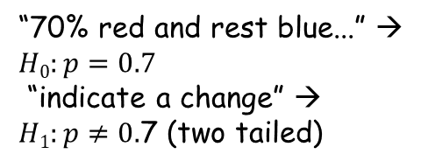

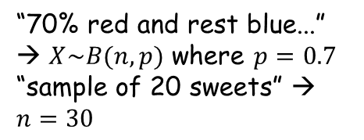
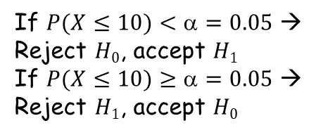
Example 3
A company has mixed sweets delivered with 70% red and rest blue. The company wishes to test whether there has been a change in the ratio of blue to red sweets. To do this, they take a sample of 20 sweets of which 10 are red.
Does this indicate a change at 10% significance?
Do a hypothesis test to find out whether there has been a change or not. State your hypotheses clearly.
1) Type of distribution
5) Decide on which hypothesis to choose
“70% red and rest blue...” → $X\sim B(n,p)$ where $p=0.7$
“sample of 20 sweets” → $n=30$
If $P(X≤10)<=0.05$ → Reject $H0$, accept $H1$
If $P(X≤10)≥=0.05$ → Reject $H1$, accept $H0$
2) Test statistic and choose hypothesis
6) Final calculation
“70% red and rest blue...” → $H0:p=0.7$
“indicate a change” → $H1:p≠0.$7 (two tailed)
$X\sim B(20,0.7)$
$H0:p=0.7$
$H1:p≠0.7$ (two tailed)
$P(X≤10)=0.048$ (from calculator) $<5\%$, so significant
At 10% significance level, there is significant evidence that this is lower than usual → reject $H0$
3) Significance level
If the P-value is less than (or equal to) α, reject the null hypothesis in favour of the alternative hypothesis.
If the P-value is greater than α, do not reject the null hypothesis.
“10% level of significance” → $=0.10÷2=0.05$
4) Predicted probability (check critical region)
“a sample of 20 sweets of which 10 are red…” → $P(X≤10)$

