Slide 1
Starter
If
$2^{2}=2×2$
and
$2^{3}=2×2×2$
What else can you deduce?
Have you made any assumptions?

Slide 2

Power
Index
$$2^{3}$$
Base

Slide 3
“Two to the three”
“Two cubed”
$$2^{3}$$
“The third power of two”
“Two to the power of three”

Slide 4
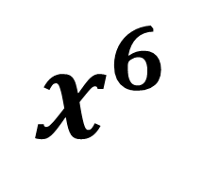
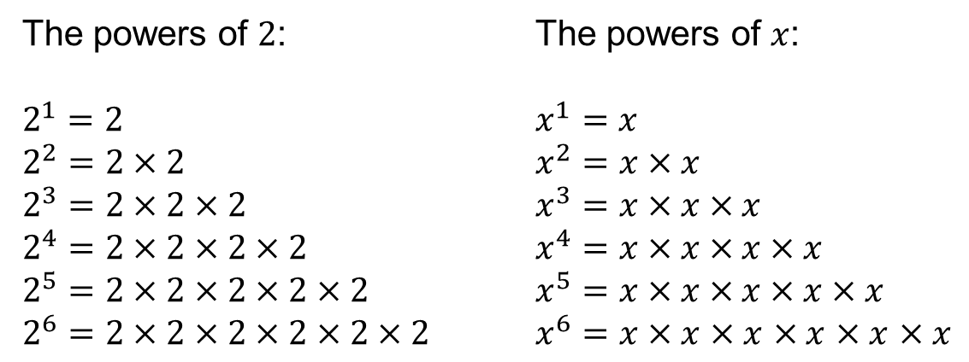
The powers of $2$: The powers of $x$:
$2^{1}=2$ $x^{1}=x$
$2^{2}=2×2$ $x^{2}=x×x$
$2^{3}=2×2×2$ $x^{3}=x×x×x$
$2^{4}=2×2×2×2$ $x^{4}=x×x×x×x$
$2^{5}=2×2×2×2×2$ $x^{5}=x×x×x×x×x$
$2^{6}=2×2×2×2×2×2$ $x^{6}=x×x$ $×x$ $×x$ $×x$ $×x$
Index
$$x^{6}$$
Base

Slide 5
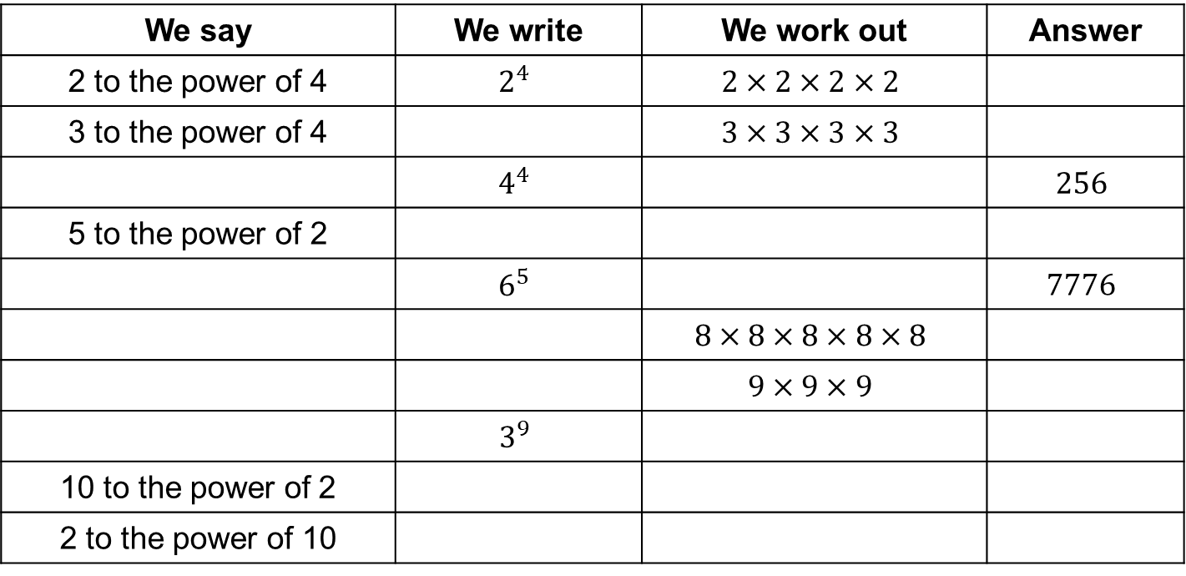
Task
Copy and complete the table.
Use a calculator to help you obtain your answers.
We say | We write | We work out | Answer
2 to the power of 4 | $$2^{4}$$ | $$2×2×2×2$$
3 to the power of 4 |  | $$3×3×3×3$$
 | $$4^{4}$$ |  | $$256$$
5 to the power of 2
 | $$6^{5}$$ |  | $$7776$$
 |  | $$8×8×8×8×8$$
 |  | $$9×9×9$$
 | $$3^{9}$$
10 to the power of 2
2 to the power of 10
Notes:
Essential Mathematics (Rayner et al 1998)

Slide 6
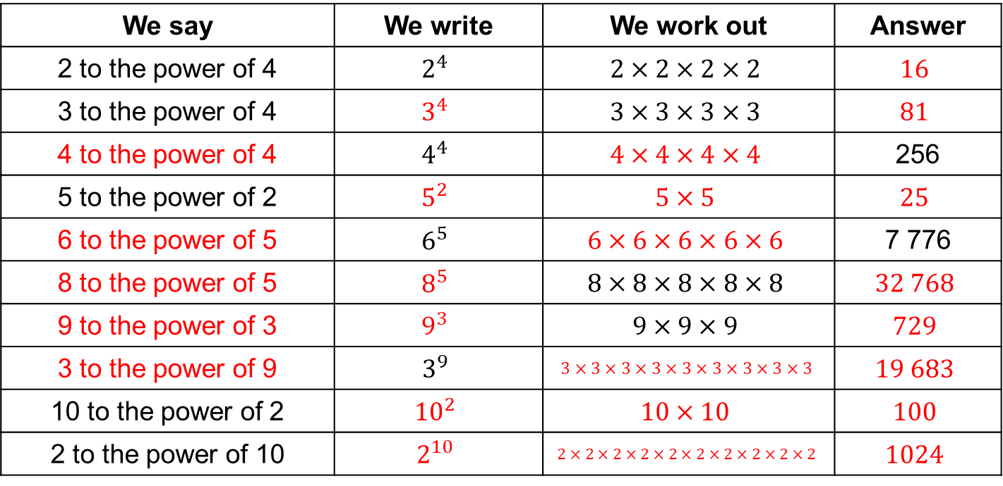
Answers
We say | We write | We work out | Answer
2 to the power of 4 | $$2^{4}$$ | $$2×2×2×2$$ | $$16$$
3 to the power of 4 | $$3^{4}$$ | $$3×3×3×3$$ | $$81$$
4 to the power of 4 | $$4^{4}$$ | $$4×4×4×4$$ | 256
5 to the power of 2 | $$5^{2}$$ | $$5×5$$ | $$25$$
6 to the power of 5 | $$6^{5}$$ | $$6×6×6×6×6$$ | 7 776
8 to the power of 5 | $$8^{5}$$ | $$8×8×8×8×8$$ | $$32 768$$
9 to the power of 3 | $$9^{3}$$ | $$9×9×9$$ | $$729$$
3 to the power of 9 | $$3^{9}$$ | $$3×3×3×3×3×3×3×3×3$$ | $$19 683$$
10 to the power of 2 | $${10}^{2}$$ | $$10×10$$ | $$100$$
2 to the power of 10 | $$2^{10}$$ | $$2×2×2×2×2×2×2×2×2×2$$ | $$1024$$
Notes:
Essential Mathematics (Rayner et al 1998)

Slide 7
The same applies to negative numbers, fractions and algebra.
What does ${(−4)}^{5}$ look like in expanded form?
$−4×−4×−4×−4×−4$
What does $\frac{1}{4}×\frac{1}{4}×\frac{1}{4}×\frac{1}{4}$ look like in index form?
${\left(\frac{1}{4}\right)}^{4}$
What does ${(3m)}^{2}$ mean?
$3m×3m$

Slide 8
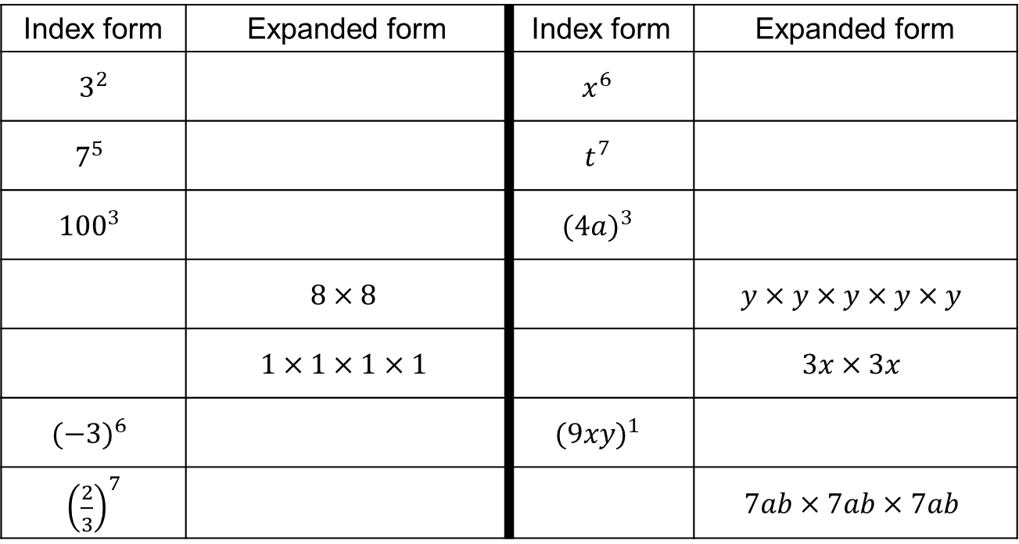
Task
Copy and complete the table.
Index form | Expanded form | Index form | Expanded form
$3^{2}$ |  | $$x^{6}$$
$$7^{5}$$ |  | $$t^{7}$$
$${100}^{3}$$ |  | $${(4a)}^{3}$$
 | $$8×8$$ |  | $$y×y×y×y×y$$
 | $$1×1×1×1$$ |  | $$3x×3x$$
$${(−3)}^{6}$$ |  | $${(9xy)}^{1}$$
${\left(\frac{2}{3}\right)}^{7}$ |  |  | $$7ab×7ab×7ab$$
Notes:
Jo Morgan @mathsjem www.resourceaholic.com

Slide 9
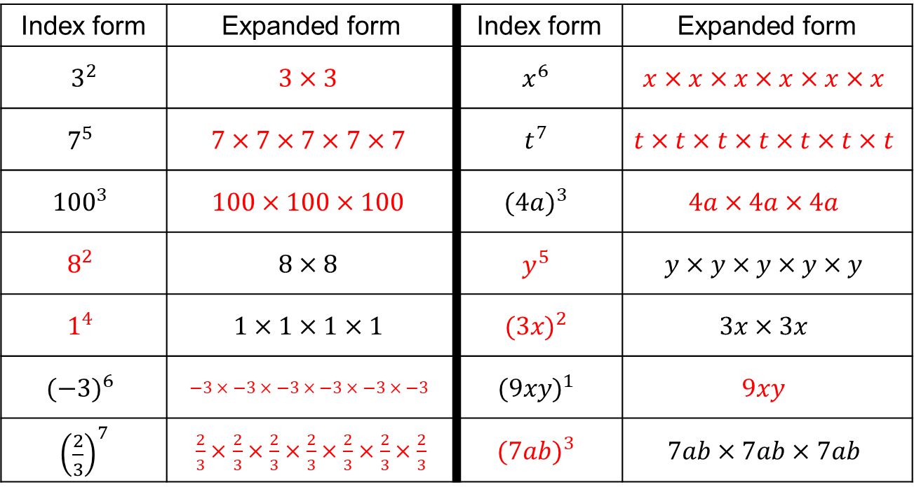
Answers
Index form | Expanded form | Index form | Expanded form
$3^{2}$ | $$3×3$$ | $$x^{6}$$ | $$x×x×x×x×x×x$$
$$7^{5}$$ | $$7×7×7×7×7$$ | $$t^{7}$$ | $$t×t×t×t×t×t×t$$
$${100}^{3}$$ | $$100×100×100$$ | $${(4a)}^{3}$$ | $$4a×4a×4a$$
$$8^{2}$$ | $$8×8$$ | $$y^{5}$$ | $$y×y×y×y×y$$
$$1^{4}$$ | $$1×1×1×1$$ | $${(3x)}^{2}$$ | $$3x×3x$$
$${(−3)}^{6}$$ | $$−3×−3×−3×−3×−3×−3$$ | $${(9xy)}^{1}$$ | $$9xy$$
${\left(\frac{2}{3}\right)}^{7}$ | $\frac{2}{3}×\frac{2}{3}×\frac{2}{3}×\frac{2}{3}×\frac{2}{3}×\frac{2}{3}×\frac{2}{3}$ | $${(7ab)}^{3}$$ | $$7ab×7ab×7ab$$
Notes:
Jo Morgan @mathsjem www.resourceaholic.com

Slide 10
Always true, sometimes true or never true?
${(a+b)}^{2}=a^{2}+b^{2}$
${(a−b)}^{2}=a^{2}−b^{2}$
${(ab)}^{2}=a^{2}b^{2}$
${\left(\frac{a}{b}\right)}^{2}=\frac{a^{2}}{b^{2}}$

Slide 11
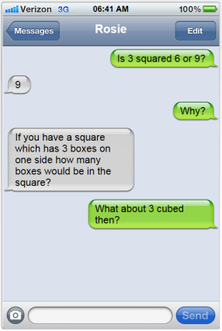
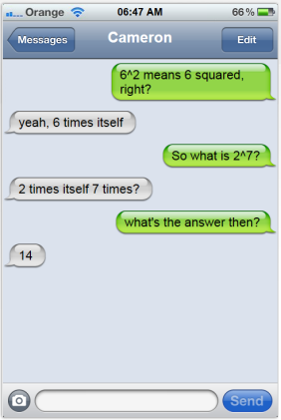
Plenary
Discuss within your group.
How would you help Rosie, Colin and Cameron out?
What common misconceptions can you spot?
Any other observations about the conversations?

