Slide 1
Starter
Match the cards together.
Hint 1: There are 3 in each group.
Hint 2: Start by putting the objects in order of size.

Slide 2
Answers
Nucleus of an atom | 0.00000000000001 m | 1 × 10⁻¹⁴ m
Length of a virus | 0.0000002 m | 2 × 10⁻⁷ m
Diameter of the eye of a fly | 0.0008 m | 8 × 10⁻⁴ m
Diameter of a 1p coin | 0.02 m | 2 × 10⁻² m
Height of a door | 2 m | 2 x 10⁰ m
Height of a tall skyscraper | 400 m | 4 × 10² m
Height of a mountain | 8 000 m | 8 × 10³ m
Distance between two furthest places on earth | 20 000 000 m | 2 × 10⁷ m
Distance from earth to moon | 400 000 000 m | 4 × 10⁸ m
Size of a galaxy | 800 000 000 000 000 000 000 m | 8 × 10²⁰ m

Slide 3
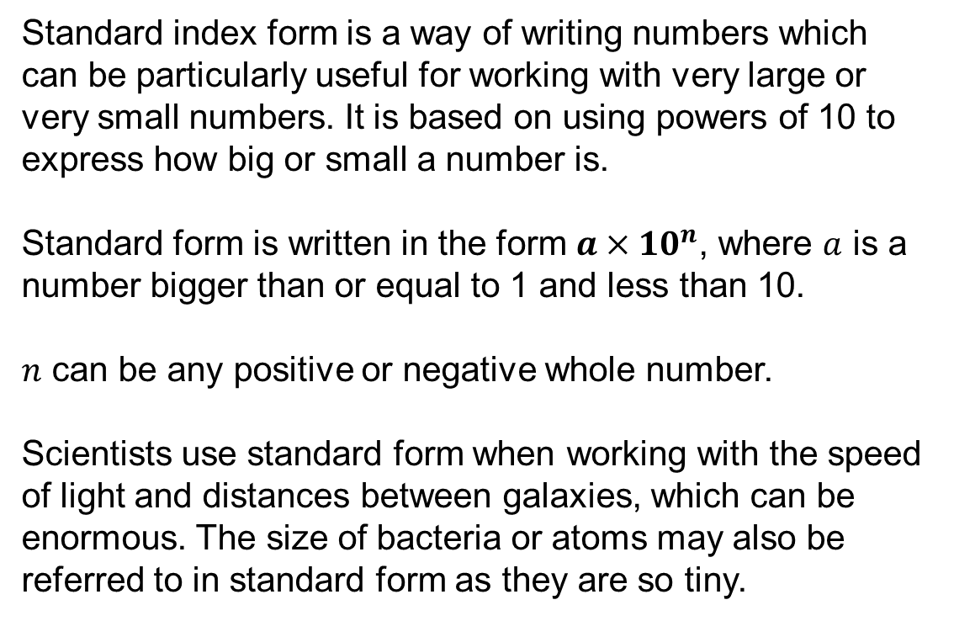
Standard index form is a way of writing numbers which can be particularly useful for working with very large or very small numbers. It is based on using powers of 10 to express how big or small a number is.
Standard form is written in the form $a×{10}^{n}$, where $a$ is a number bigger than or equal to 1 and less than 10.
$n$ can be any positive or negative whole number.
Scientists use standard form when working with the speed of light and distances between galaxies, which can be enormous. The size of bacteria or atoms may also be referred to in standard form as they are so tiny.

Slide 4
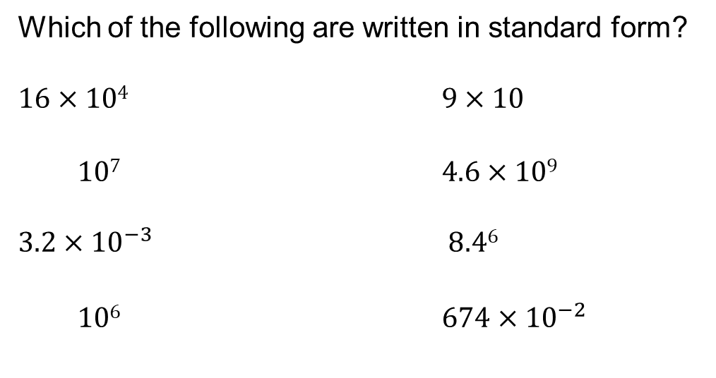
Which of the following are written in standard form?
$16×104$ $9×10$
$107$ $4.6×109$
$3.2×{10}^{−3}$ $8.46$
$106$ $674×{10}^{−2}$
$$1$$
$1×$
$1×$

Slide 5
Remember:
10³ = 1000
10² = 100
10¹ = 10
10⁰ = 1
10⁻¹ = 0.1
10⁻² = 0.01
10⁻³ = 0.001

Slide 6
Examples
Write the following in standard index form:
$32 000 000$ $0.000 005 74$
$$a×{10}^{n}$$
$=3.2×10 000 000$
$=5.74×0.000 001$
For $a$ to be between 1 and 10, the decimal point needs to be here!
For $a$ to be between 1 and 10, the decimal point needs to be here!
$=3.2×{10}^{7}$
$=5.74×{10}^{−6}$

Slide 7
Examples
Write the following as ordinary numbers:
$8.35×{10}^{−3}$ $2.9×{10}^{6}$
$$a×{10}^{n}$$
$=8.35×0.001$
$=2.9×1 000 000$
$=0.008 35$
$=2 900 000$

Slide 8
Examples
Work out the value of $(6.4×{10}^{7})×(2×{10}^{−3})$
Give your answer in standard index form.
$=6.4×2×{10}^{7}×{10}^{−3}$
$=12.8×{10}^{4}$
$=1.28×10×{10}^{4}$
$=1.28×{10}^{5}$
$$a×{10}^{n}$$
Multiplication is commutative
Multiply normally
Law of indices
(can be done in any order)

Slide 9
Examples
Work out the value of $(6.9×{10}^{−2})÷(3×{10}^{4})$
Give your answer in standard index form.
$=$ $\frac{6.9×{10}^{−2}}{3×{10}^{4}}$
$=2.3×{10}^{−6}$
$$a×{10}^{n}$$
Law of indices
Divide normally

Slide 10
Extension: Complete the jigsaw activity on standard form calculations

Slide 11
Answers
Question 1
Yes Yes No No
Yes Yes Yes No
Question 2
9 920 000 7 700 000 525.5
Question 3
3.2006 x 10⁴ 4.55 x 10 2.3 x 10³ 1.775 x 10⁵
Question 4
0.3 0.000 029 82 0.0079 0.000 009 528
Question 5
2 x 10⁻² 5.4287 x 10⁻⁴ 6.56 x 10⁻⁵ 8.9 x 10⁻⁶

Slide 12
Answers
Question 6
0.008 5.286 2 100 000 0.0214
Question 7
2.508 x 10⁻⁴ 3.3 x 10⁴ 7.77 x 10 2.5799 x 10⁻¹
Question 8
2.8 x 10⁻¹⁶ 5 x 10⁹
6.677 x 10⁻⁶ 4.62 x 10⁻⁹

