Slide 1
Starter
Sort the digits 1, 2, 3, 4, 5, 6, 7, 8, 9 into the grid so that they obey the row and column headings.
 | Odd | Even | Multiple of 3
Prime
Square
Factors of 168
5
2
3
1
4
9
7
8
6

Slide 2
The highest common factor (HCF) of two numbers is the highest whole number which divides into both.
The lowest common multiple (LCM) of two numbers is the smallest number that is a multiple of both.

Slide 3
Example: Find the HCF and the LCM of 12 and 18
Factors of 12:
Factors of 18:
HCF = 6
1
2
3
4
6
12
1
2
3
6
9
18
Multiples of 12: 12, 24, 36, 48, 60, 72, 84, 96, 108, 120…
Identify the common factors
Multiples of 18: 18, 36, 54, 72, 90, 108, 126, 144, 162, 180…
LCM = 36
Which is the highest?
Identify the common multiples
Which is the lowest?

Slide 4
Your Turn
Calculate the HCF and LCM of the following pairs of small numbers by listing factors and multiples.
8 and 10
12 and 15
16 and 24
15 and 18
8 and 12
18 and 24
Challenge: Calculate the HCF and LCM of 12, 15 and 18.

Slide 5
Answers
Calculate the HCF and LCM of the following pairs of small numbers by listing factors and multiples.
8 and 10 HCF = 2, LCM = 40
12 and 15 HCF = 3, LCM = 60
16 and 24 HCF = 8, LCM = 48
15 and 18 HCF = 3, LCM = 90
8 and 12 HCF = 4, LCM = 24
18 and 24 HCF = 6, LCM = 72
Challenge: Calculate the HCF and LCM of 12, 15 and 18.
HCF = 3, LCM = 360

Slide 6
Prime Factor Trees
36
Split the number into 2 factors that multiply to make the starting number.
Circle any factors that are prime numbers.
Continue to split any numbers that are not prime.
2
18
2
9
3
3
36 = 2 × 2 × 3 × 3
= 2² × 3²

Slide 7
Prime Factor Trees
36
42
2
18
2
21
2
9
3
7
3
3
36 = 2 × 2 × 3 × 3
42 = 2 × 3 × 7
= 2² × 3²

Slide 8
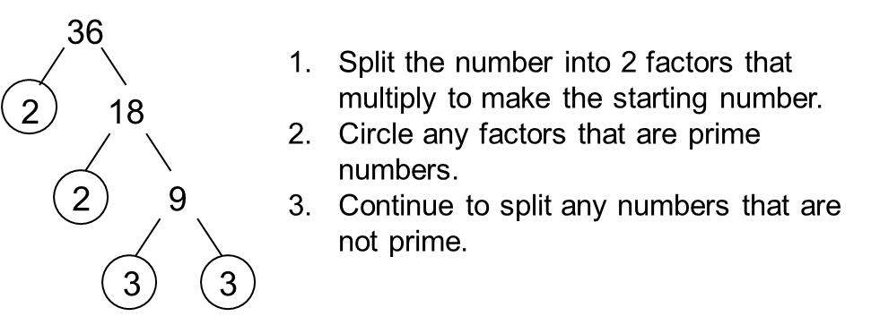
Express the numbers on the worksheet as products of their prime factors.
Reflect – what do you already know?
Expect – what do you think the answer could be? Why?
Check – show your working here!
Ask your teacher for the Challenge Task: Each of the numbers have 4 prime factors. Place each of the prime factors in the white boxes around the larger numbers.
Notes:
Variation worksheet: https://variationtheory.com/2018/02/26/product-of-prime-factors/
Challenge task: https://www.tes.com/teaching-resource/prime-factor-decomposition-logical-puzzle-11367345

Slide 9
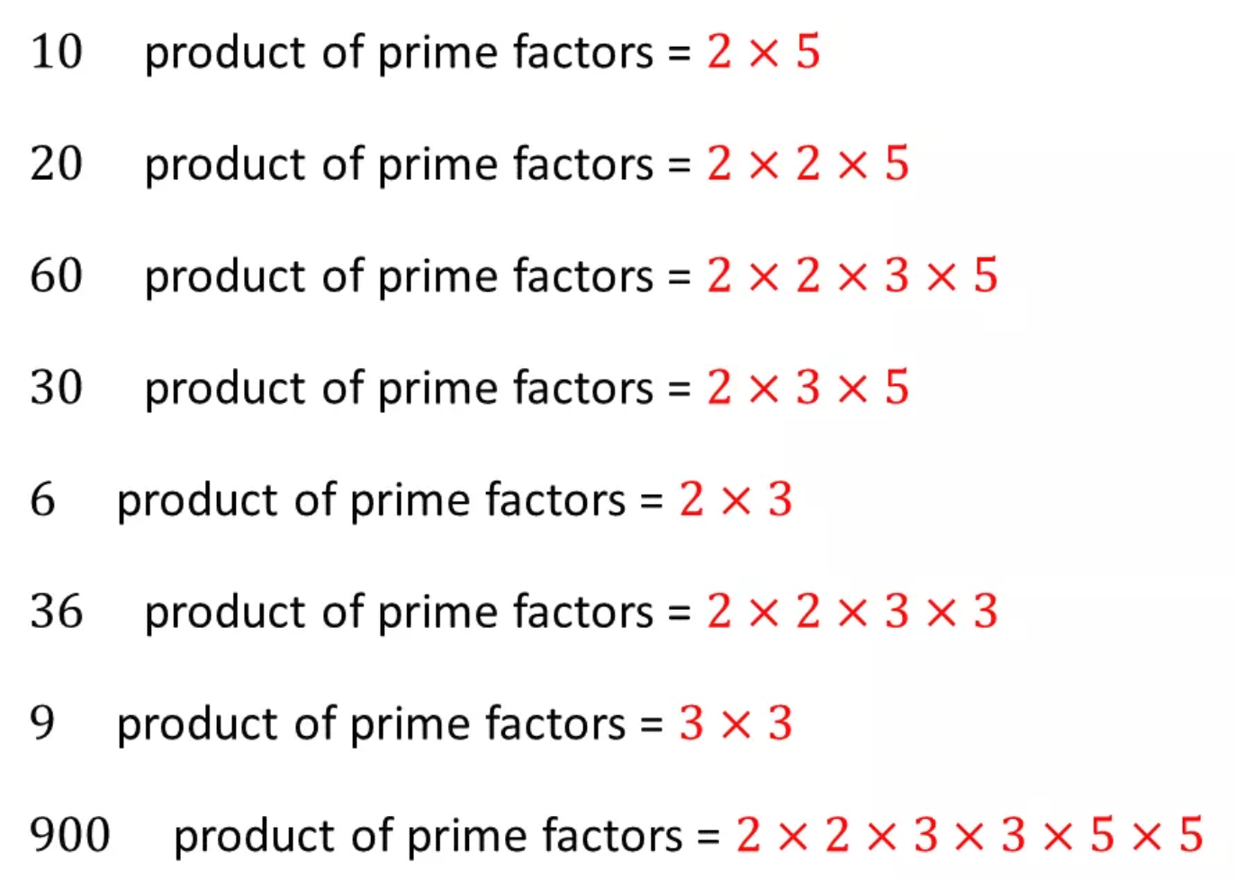
Answers

Slide 10
Calculate the HCF and LCM of 18 and 24.
24
18
2
12
2
9
2
6
3
3
2
3
Factors of 18
Factors of 24
3
2
3
2
2
HCF = 2 x 3
= 6
LCM = 3 x 2 x 3 x 2 x 2
= 72
Factors of both

Slide 11
We can use the factors of a number to find the HCF and LCM of larger numbers.
Example: Find the HCF and the LCM of 84 and 294
84
294
2
42
147
3
14
49
7
2
7
Think of a common factor and divide both numbers by it
HCF = 2 x 3 x 7 = 42
Repeat until there are no common factors greater than 1
LCM = 2 x 3 x 7 x 2 x 7 = 588

Slide 12
We can use the factors of a number to find the HCF and LCM of larger numbers.
Example: Find the HCF and the LCM of 96 and 72
96
72
2
48
36
6
8
6
2
4
3
Think of a common factor and divide both numbers by it
HCF = 2 x 6 x 2 = 24
Repeat until there are no common factors greater than 1
LCM = 2 x 6 x 2 x 4 x 3 = 288

Slide 13
Your Turn
Calculate the HCF and LCM of the following pairs of larger numbers using the ladder method.
48 and 60
72 and 90
81 and 108
54 and 135
112 and 168
104 and 156
Challenge: Calculate the HCF and LCM of 140, 168 and 196.

Slide 14
Answers
Calculate the HCF and LCM of the following pairs of larger numbers using the ladder method.
48 and 60 HCF = 12, LCM = 240
72 and 90 HCF = 18, LCM = 360
81 and 108 HCF = 27, LCM = 324
54 and 135 HCF = 27, LCM = 270
112 and 168 HCF = 56, LCM = 336
104 and 156 HCF = 52, LCM = 312
Challenge: Calculate the HCF and LCM of 140, 168 and 196.
HCF = 28, LCM = 5880

Slide 15
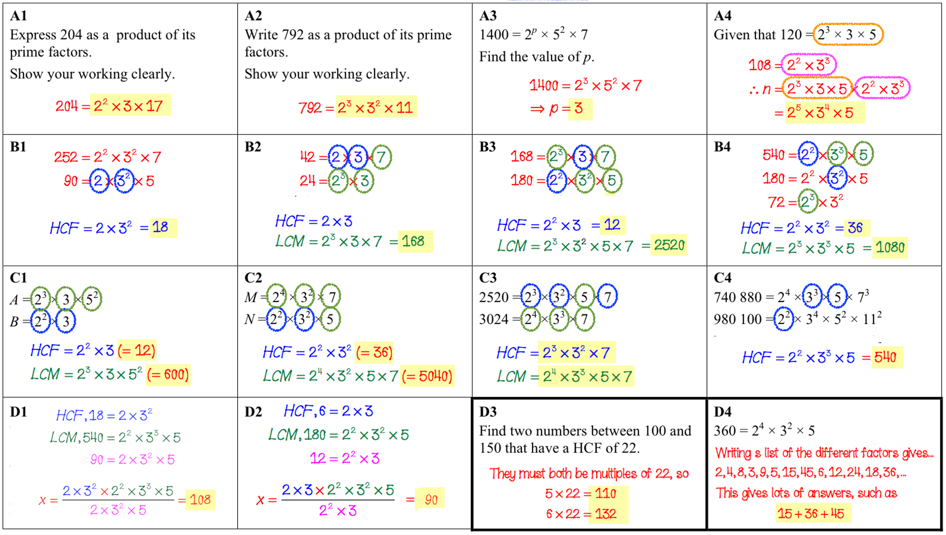
Notes:
https://www.tes.com/teaching-resource/hcf-and-lcm-gcse-topic-review-11819395

