Slide 1
Starter
What does it mean for two things to be ‘in proportion’?
Two quantities are said to be in direct proportion if they increase and decrease at the same rate. That is, if the ratio between the two quantities is always the same.
Two quantities are said to be inversely proportional if, as one quantity increases, the other quantity decreases at the same rate.

Slide 2
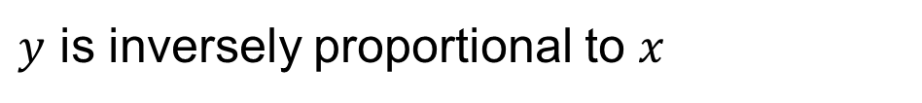

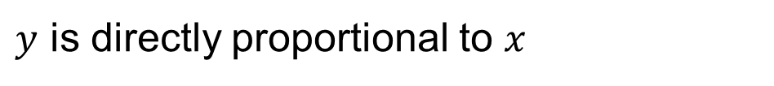
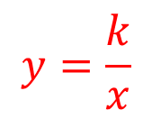


directly
$y$ is directly proportional to $x$
$k$ is multiplied by $x$
$$y=kx$$
k stands for constant
$y$ is inversely proportional to $x$
inversely
$k$ is divided by $x$
$$y=\frac{k}{x}$$

Slide 3
Group Task
Match the word descriptions to mathematical proportion formulae
Hint: start by grouping the direct proportion equations together and the inverse proportion equations together.

Slide 4
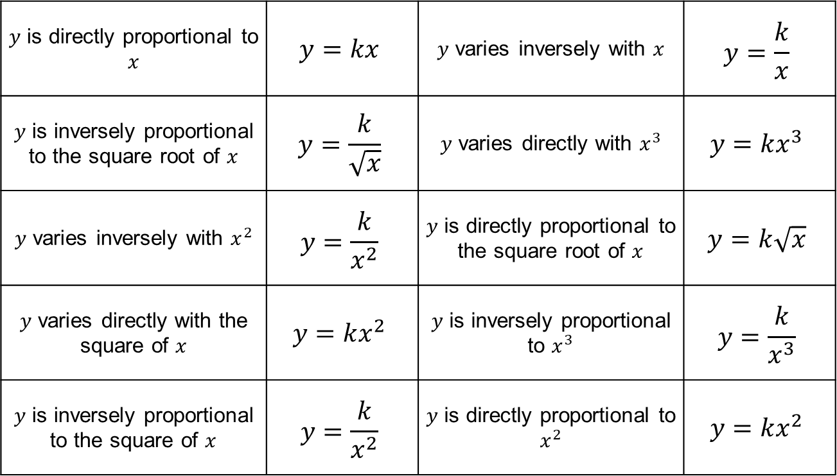
Answers
$y$ is directly proportional to $x$ | $$y=kx$$ | $y$ varies inversely with $x$ | $$y=\frac{k}{x}$$
$y$ is inversely proportional to the square root of $x$ | $$y=\frac{k}{\sqrt{x}}$$ | $y$ varies directly with $x^{3}$ | $$y=kx^{3}$$
$y$ varies inversely with $x^{2}$ | $$y=\frac{k}{x^{2}}$$ | $y$ is directly proportional to the square root of $x$ | $$y=k\sqrt{x}$$
$y$ varies directly with the square of $x$ | $$y=kx^{2}$$ | $y$ is inversely proportional to $x^{3}$ | $$y=\frac{k}{x^{3}}$$
$y$ is inversely proportional to the square of $x$ | $$y=\frac{k}{x^{2}}$$ | $y$ is directly proportional to $x^{2}$ | $$y=kx^{2}$$

Slide 5
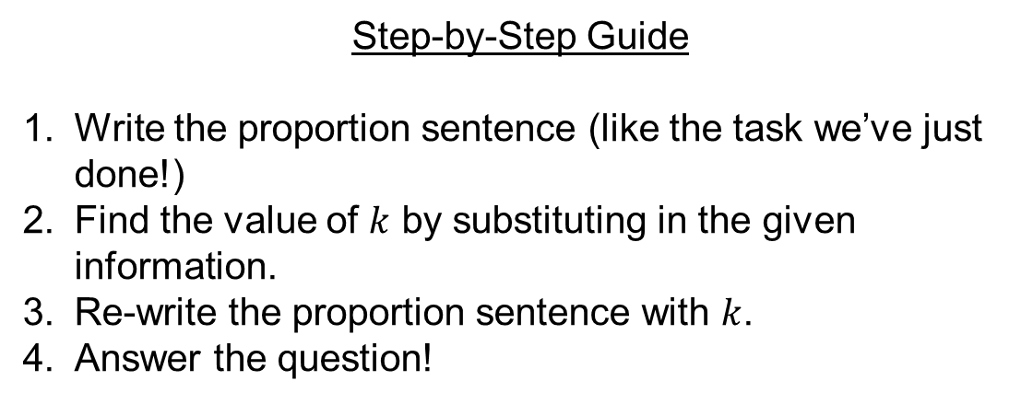
Step-by-Step Guide
Write the proportion sentence (like the task we’ve just done!)
Find the value of $k$ by substituting in the given information.
Re-write the proportion sentence with $k$.
Answer the question!

Slide 6



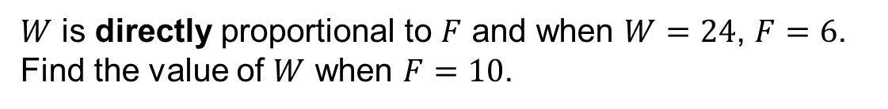




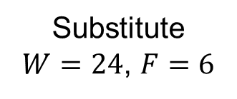

$W$ is directly proportional to $F$ and when $W=24$, $F=6$.
Find the value of $W$ when $F=10$.
$$W=kF$$
$$W=4F$$
Substitute
$W=24$, $F=6$
When $F=10$,
$$W=4×10$$
$$24=6k$$
$$W=40$$
$$4=k$$
$$W=4F$$

Slide 7

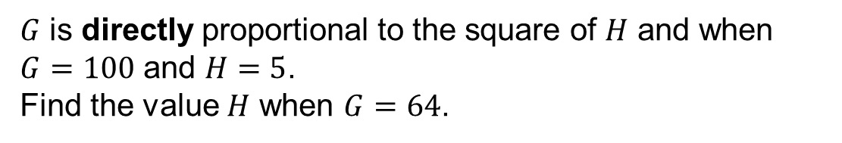
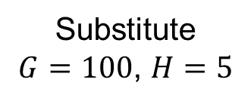









$G$ is directly proportional to the square of $H$ and when $G=100$ and $H=5$.
Find the value $H$ when $G=64$.
$$G=kH²$$
$$G=4H²$$
Substitute
$G=100$, $H=5$
When $G=64$,
$$64=4H²$$
$$100=k×5²$$
$$16=H²$$
$$100=25k$$
$$4=H$$
$$4=k$$
$$G=4H²$$

Slide 9
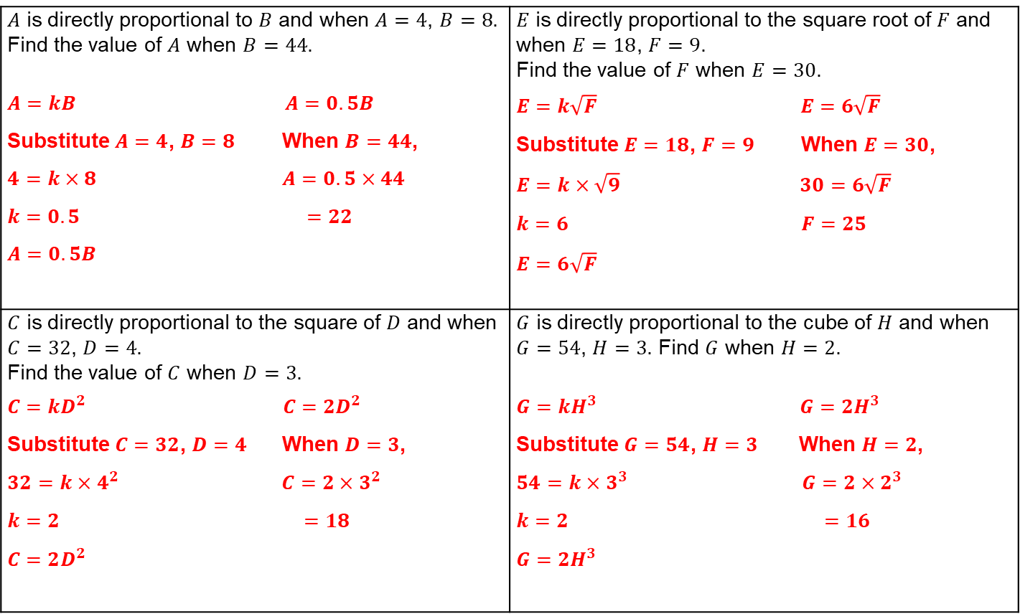
Answers
$A$ is directly proportional to $B$ and when $A=4$, $B=8$. Find the value of $A$ when $B=44$. $A=kB$ $A=0.5B$ Substitute $A=4$, $B=8$ When $B=44$, $4=k×8$ $A=0.5×44$ $k=0.5$ $=22$ $A=0.5B$ | $E$ is directly proportional to the square root of $F$ and when $E=18$, $F=9$. Find the value of $F$ when $E=30$. $E=k\sqrt{F}$ $E=6\sqrt{F}$ Substitute $E=18$, $F=9$ When $E=30$, $E=k×\sqrt{9}$ $30=6\sqrt{F}$ $k=6$ $F=25$ $E=6\sqrt{F}$
$C$ is directly proportional to the square of $D$ and when $C=32$, $D=4$. Find the value of $C$ when $D=3$. $C=kD^{2}$ $C=2D^{2}$ Substitute $C=32$, $D=4$ When $D=3$, $32=k×4^{2}$ $C=2×3^{2}$ $k=2$ $=18$ $C=2D^{2}$ | $G$ is directly proportional to the cube of $H$ and when $G=54$, $H=3$. Find $G$ when $H=2$. $G=kH^{3}$ $G=2H^{3}$ Substitute $G=54$, $H=3$ When $H=2$, $54=k×3^{3}$ $G=2×2^{3}$ $k=2$ $=16$ $G=2H^{3}$

Slide 10
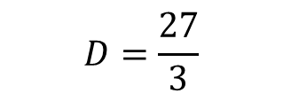
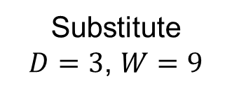
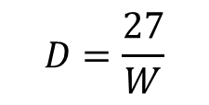
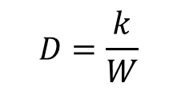
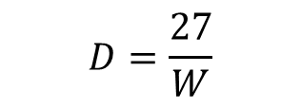
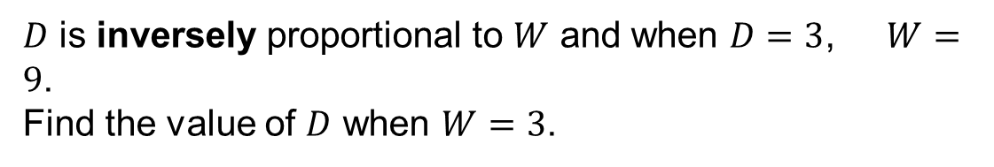


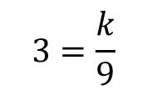

$D$ is inversely proportional to $W$ and when $D=3$, $W=9$.
Find the value of $D$ when $W=3$.
$$D=\frac{k}{W}$$
$$D=\frac{27}{W}$$
Substitute
$D=3$, $W=9$
When $W=3$,
$$D=\frac{27}{3}$$
$$3=\frac{k}{9}$$
$$D=9$$
$$27=k$$
$$D=\frac{27}{W}$$

Slide 11
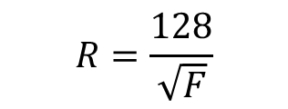

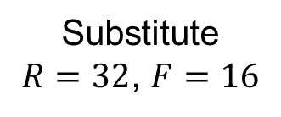
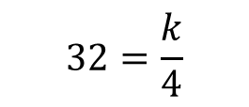

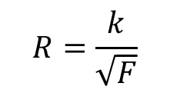
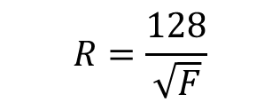


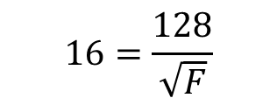
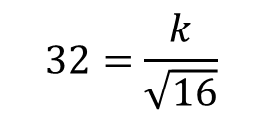

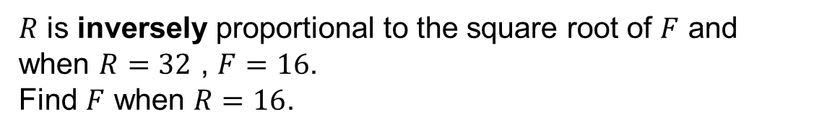
$R$ is inversely proportional to the square root of $F$ and when $R=32$ , $F=16$.
Find $F$ when $R=16$.
$$R=\frac{k}{\sqrt{F}}$$
$$R=\frac{128}{\sqrt{F}}$$
Substitute
$R=32$, $F=16$
When $R=16$,
$$16=\frac{128}{\sqrt{F}}$$
$$32=\frac{k}{\sqrt{16}}$$
$$32=\frac{k}{4}$$
$$16×\sqrt{F}=128$$
$$\sqrt{F}=8$$
$$128=k$$
$$F=64$$
$$R=\frac{128}{\sqrt{F}}$$

Slide 13
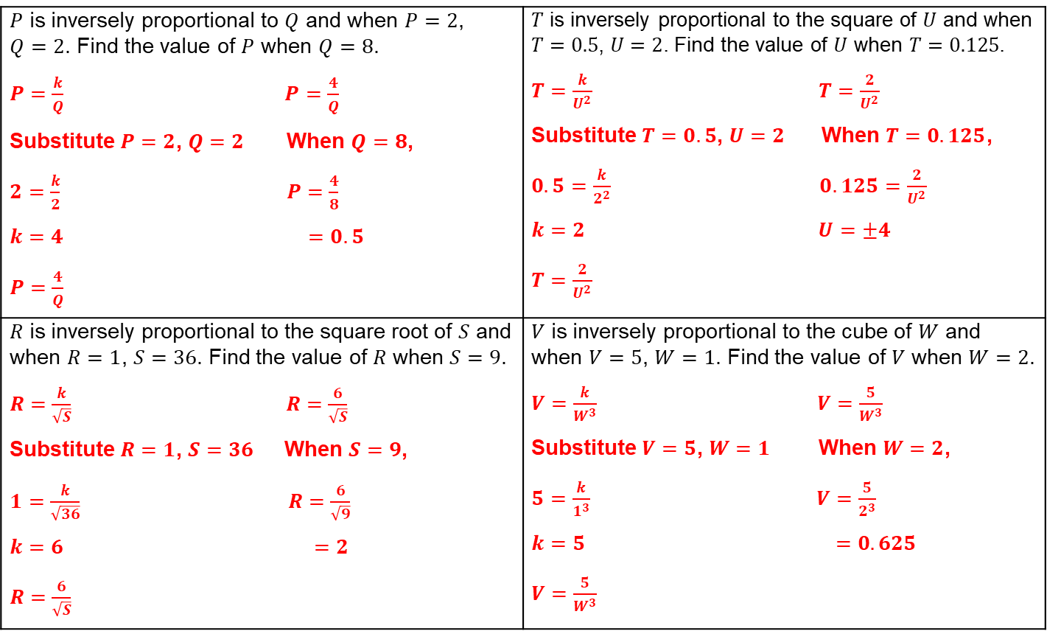
Answers
$P$ is inversely proportional to $Q$ and when $P=2$, $Q=2$. Find the value of $P$ when $Q=8$. $P=\frac{k}{Q}$ $P=\frac{4}{Q}$ Substitute $P=2$, $Q=2$ When $Q=8$, $2=\frac{k}{2}$ $P=\frac{4}{8}$ $k=4$ $=0.5$ $P=\frac{4}{Q}$ | $T$ is inversely proportional to the square of $U$ and when $T=0.5$, $U=2$. Find the value of $U$ when $T=0.125$. $T=\frac{k}{U^{2}}$ $T=\frac{2}{U^{2}}$ Substitute $T=0.5$, $U=2$ When $T=0.125$, $0.5=\frac{k}{2^{2}}$ $0.125=\frac{2}{U^{2}}$ $k=2$ $U=±4$ $T=\frac{2}{U^{2}}$
$R$ is inversely proportional to the square root of $S$ and when $R=1$, $S=36$. Find the value of $R$ when $S=9$. $R=\frac{k}{\sqrt{S}}$ $R=\frac{6}{\sqrt{S}}$ Substitute $R=1$, $S=36$ When $S=9$, $1=\frac{k}{\sqrt{36}}$ $R=\frac{6}{\sqrt{9}}$ $k=6$ $=2$ $R=\frac{6}{\sqrt{S}}$ | $V$ is inversely proportional to the cube of $W$ and when $V=5$, $W=1$. Find the value of $V$ when $W=2$. $V=\frac{k}{W^{3}}$ $V=\frac{5}{W^{3}}$ Substitute $V=5$, $W=1$ When $W=2$, $5=\frac{k}{1^{3}}$ $V=\frac{5}{2^{3}}$ $k=5$ $=0.625$ $V=\frac{5}{W^{3}}$

