Slide 1
Next Term Bingo Use any 9 of these numbers NO REPEATS
13 0.25 -8 39
36 16 1.7 30
-5 12.5 48 26
62 31 15 49

Slide 2
4, 7, 10, 13, ?

Slide 3
25, 31, 37, 43, ?

Slide 4
1, 4, 9, 16, 25, ?

Slide 5
7, 15, 23, 31, ?

Slide 6
200, 100, 50, 25, ?

Slide 7
1, 3, 6, 10, ?

Slide 8
4, 1, -2, -5, ?

Slide 9
64, 16, 4, 1, ?

Slide 10
3, 6, 12, 24, ?

Slide 11
10, 14, 18, 22, ?

Slide 12
0.5, 0.8, 1.1, 1.4, ?

Slide 13
18, 29, 40, 51, ?

Slide 14
7, 10, 15, 22, ?

Slide 15
42, 39, 36, 33, ?

Slide 16
19, 13, 7, 1, ?

Slide 17
1, 1, 2, 3, 5, 8, ?

Slide 18
Starter
Write the term-to-term rule for the following sequences:
1. 3, 5, 7, 9, … 2. 4, 8, 12, 16, …
3. 14, 11, 8, 5, … 4. 2, 15, 28, 41, …
5. 2, 7, 12, 17, … 6. 9, -8, -25, -42, …
Challenge: What rule do you think the following sequence uses? How far can you continue the sequence on for?
1 , 1 , 2 , 3 , 5 , 8 , 13 , ...
Add 2 Add 4
Subtract 3 Add 13
Add 5 Subtract 17
21, 34, 55, 89, 144, 233, 377, 610, 987, ...
Rule: Add the previous two terms to get the next.
This sequence is called the Fibonacci sequence.

Slide 19
Find the $nth$ term of the sequence
1, 3, 5, 7, 9 , ...
The 2 times table goes up in 2s!
+2
+2
+2
+2
$$T$$ | 1 | 3 | 5 | 7 | 9
$$2n$$ | 2 | 4 | 6 | 8 | 10
$$T−2n$$ | -1 | -1 | -1 | -1 | -1
$n^{th}$ term = $2n−1$

Slide 20
Find the $nth$ term of the sequence
4, 7, 10, 13, 16 , ...
The 3 times table goes up in 3s!
+3
+3
+3
+3
$$T$$ | 4 | 7 | 10 | 13 | 16
$$3n$$ | 3 | 6 | 9 | 12 | 15
$$T−3n$$ | +1 | +1 | +1 | +1 | +1
$n^{th}$ term = $3n+1$

Slide 21
Find the $nth$ term of the sequence
9, 4, -1, -6, -11 , ...
The 5 times table goes up in 5s!
-5
-5
-5
-5
$$T$$ | 9 | 4 | -1 | -6 | -11
$$−5n$$ | -5 | -10 | -15 | -20 | -25
$$T+5n$$ | 14 | 14 | 14 | 14 | 14
$n^{th}$ term = $−5n+14$

Slide 23

Answers
$4n+1$ $−2n+15$
$4n−1$ $4n+2$
$5n+2$ $5n−1$
$−4n+12$ $−6n+20$
$10n−3$ $−4n+13$

Slide 24
Find the first 5 terms of $3n+4$
1st term = $3×1+4=7$
2nd term = $3×2+4=10$
3rd term = $3×3+4=13$
4th term = $3×4+4=16$
5th term = $3×5+4=19$
7, 10, 13, 16, 19

Slide 25
Find the first 5 terms of $−4n+10$
1st term = $−4×1+10=6$
2nd term = $−4×2+10=2$
3rd term = $−4×3+10=−2$
4th term = $−4×4+10=−6$
5th term = $−4×5+10=−10$
6, 2, -2, -6, -10

Slide 27
Answers
5, 8, 11, 14, 17 0, -2, -4, -6, -8
3, 9, 15, 21, 27 3, 0, -3, -6, -9
-5, -3, -1, 1, 3 6, 16, 26, 36, 46

Slide 28
What would the 4th and 5th patterns look like?
Pattern 1:
Pattern 2:
Pattern 3:

Slide 29
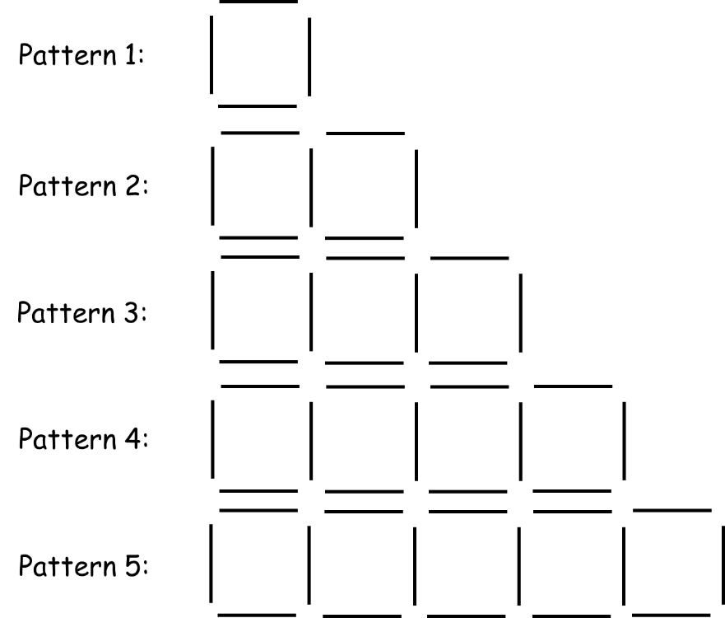
Pattern 1:
Pattern 2:
4
How many sticks are in each pattern?
Can you use this to work out the $n^{th}$ term?
7
Pattern 3:
10
Pattern 4:
13
$3n+1$
16
Pattern 5:

Slide 30
Pattern 1:
Pattern 2:
$$3n+1$$
How many sticks would be in the 10th pattern?
How many sticks would be in the 25th pattern?
Pattern 3:
$$3 × 10+1=31$$
Pattern 4:
$$3 × 25+1=76$$
Pattern 5:

Slide 31
In pairs, follow the instructions on the sheet and display your answers on a poster.

Slide 32
Answers
1) 3, 5, 7, 9 2) 8, 10, 12, 14 3) 4, 8, 12, 16
b) $2n+1$ b) $2n+6$ b) $4n$
c) 21 c) 26 c) 40
d) 51 d) 56 d) 100
4) 6, 9, 12, 15 5) 3, 5, 7, 9 6) 2, 4, 6, 8
b) $3n+3$ b) $2n+1$ b) $2n$
c) 33 c) 21 c) 20
d) 78 d) 51 d) 50
7) 4, 6, 8, 10 8) 8, 12, 16, 20 9) 1, 5, 9, 13
b) $2n+2$ b) $4n+4$ b) $4n−3$
c) 22 c) 44 c) 37
d) 52 d) 104 d) 97
10) 1, 3, 5, 7
b) $2n−1$
c) 19
d) 49

