Slide 1
Starter
Without using a calculator, work out:
30% of 90 65% of 30 46% of 15
27 19.5 6.9

Slide 2

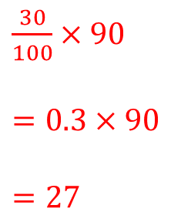
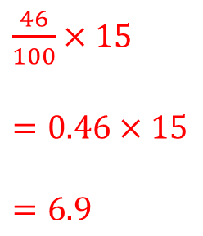
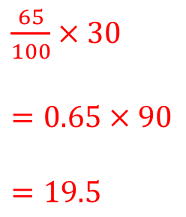
‘Per cent’ means ‘out of 100’
Examples
Use a calculator to work out:
30% of 90 65% of 30 46% of 15
‘Of’ means ‘$×$’
$\frac{30}{100}×90$
$=0.3×90$
$=27$
$\frac{65}{100}×30$
$=0.65×90$
$=19.5$
$\frac{46}{100}×15$
$=0.46×15$
$=6.9$

Slide 3
Checkpoint
Use a calculator to work out:
15% of 30
45% of 70
63% of 120
34% of 32
72% of 92
99% of 56
86% of 34
64.5% of 48
4.5
31.5
75.6
10.88
66.24
55.44
29.24
30.96

Slide 4
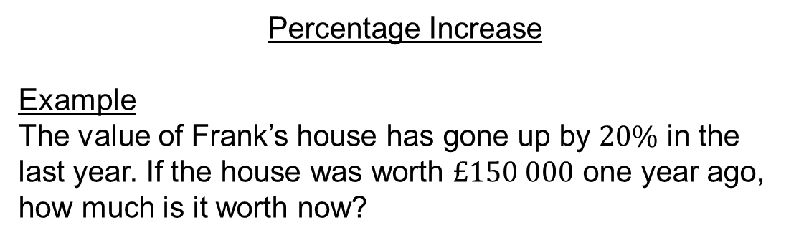






Percentage Increase
Example
The value of Frank’s house has gone up by $20\%$ in the last year. If the house was worth $£150 000$ one year ago, how much is it worth now?
The original amount is $100\%$:
$$100\%$$
$$20\%$$
Now we add $20\%$
We now have $120\%$
$\frac{120}{100}×150 000$
$=1.2×150 000$
$=£180 000$

Slide 5

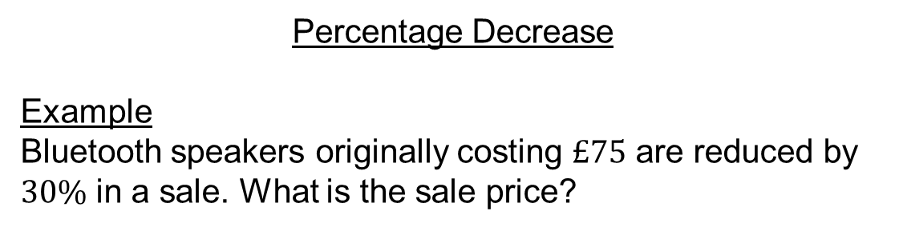







Percentage Decrease
Example
Bluetooth speakers originally costing $£75$ are reduced by $30\%$ in a sale. What is the sale price?
The original amount is $100\%$ like this:
$$70\%$$
100%
$$30\%$$
Now we subtract $30\%$
We now have $70\%$ of the original amount.
$\frac{70}{100}×75$
$=0.7×75$
$=£52.50$

Slide 6
Task
Increase 50 by 40%
Decrease 75 by 20%
Increase 45 by 63%
Decrease 67 by 37%
Decrease 82 by 14%
Increase 136 by 24%
Decrease 49 by 19%
Increase 88 by 56%
= 70
= 60
= 73.35
= 42.21
= 70.52
= 168.64
= 39.69
= 137.28
= 140%
100%
20%
40%
= 80%
100%

Slide 7
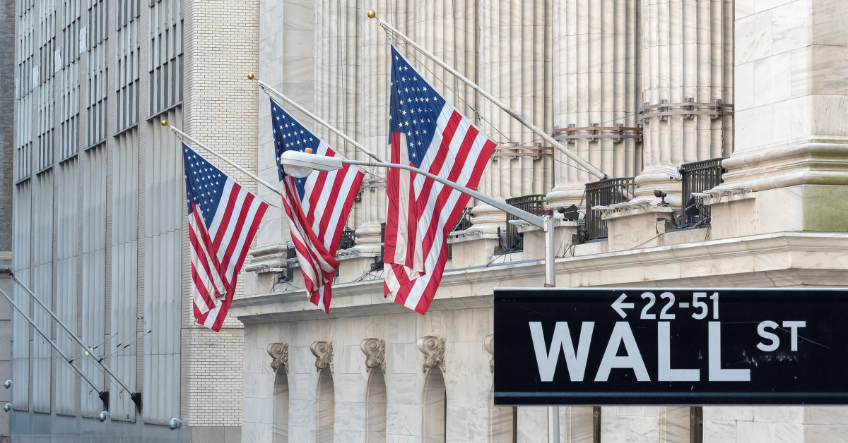
Stock Exchange Game
Make millions £££ or go bust!

Slide 8
Choose your stocks, you have £100,000 to invest. Pick wisely!
Mrs Moosajee’s stationery shop
McDonalds
MC Wise and DJ Luck’s album
MathsWatch
webuyanycar.com
You can choose up to 3 stocks.
You can choose to save some in the bank to gain a guaranteed 5% increase per year.
Three series of events are going to happen and each will have an impact on the value of your stocks.
Will you win?!

Slide 9
Event 1
Stock | Event | Effect
Mrs Moosajee’ stationery shop | The library starts selling cheap pencil cases | Share price drops by 25%
McDonalds | Burger King goes bust | Share price rises by 35%
MC Wise and DJ Luck’s album | Fraction Knight gets to number 1 in the maths charts! | Share price rises by 100%
MathsWatch | MathWatch crashes so students can’t do their homework | Share price drops by 10%
webuyanycar.com | webuyanycar.com starts buying vans too | Share price increases by 12%

Slide 10
Event 2
Stock | Event | Effect
Mrs Moosajee’ stationery shop | Mrs Moosajee designs amazing last-forever pencils! | Share price rises by 65%
McDonalds | McDonalds start selling pizza. | Share price rises by 33%
MC Wise and DJ Luck’s album | MC Wise gets a cold so recording can’t take place | Share price drops by 17%
MathsWatch | MathsWatch creates videos for primary school age children | Share price rises by 45%
webuyanycar.com | People begin to get annoyed by the webuyanycar.com song | Share price drops by 18%

Slide 11
Event 3
Stock | Event | Effect
Mrs Moosajee’ stationery shop | Mrs Moosajee starts selling her products at WHSmiths | Share price rises by 38%
McDonalds | McDonalds merges with Coca Cola | Share price rises by 110%
MC Wise and DJ Luck’s album | Mrs Moosajee joins the song-writing team | Share price rises by 45%
MathsWatch | MathsWatch is updated so it works on phones too! | Share price rises by 77%
webuyanycar.com | British Parliament ban the webuyanycar.com song | Share price crashes to 0

Slide 12
Stock Exchange Game
Are you a millionaire?

