Slide 1
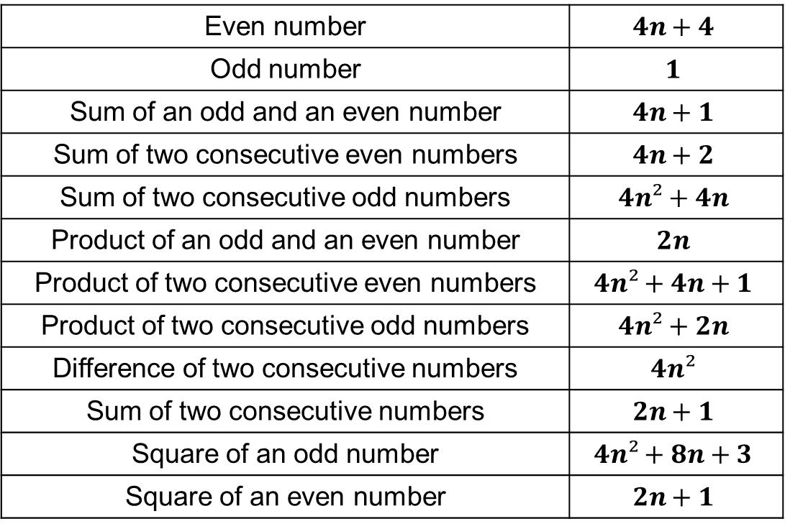
Starter
Match the statements to the algebraic expressions.
Even number | $$4n+4$$
Odd number | $$1$$
Sum of an odd and an even number | $$4n+1$$
Sum of two consecutive even numbers | $$4n+2$$
Sum of two consecutive odd numbers | $$4n²+4n$$
Product of an odd and an even number | $$2n$$
Product of two consecutive even numbers | $$4n²+4n+1$$
Product of two consecutive odd numbers | $$4n²+2n$$
Difference of two consecutive numbers | $$4n²$$
Sum of two consecutive numbers | $$2n+1$$
Square of an odd number | $$4n²+8n+3$$
Square of an even number | $$2n+1$$

Slide 2
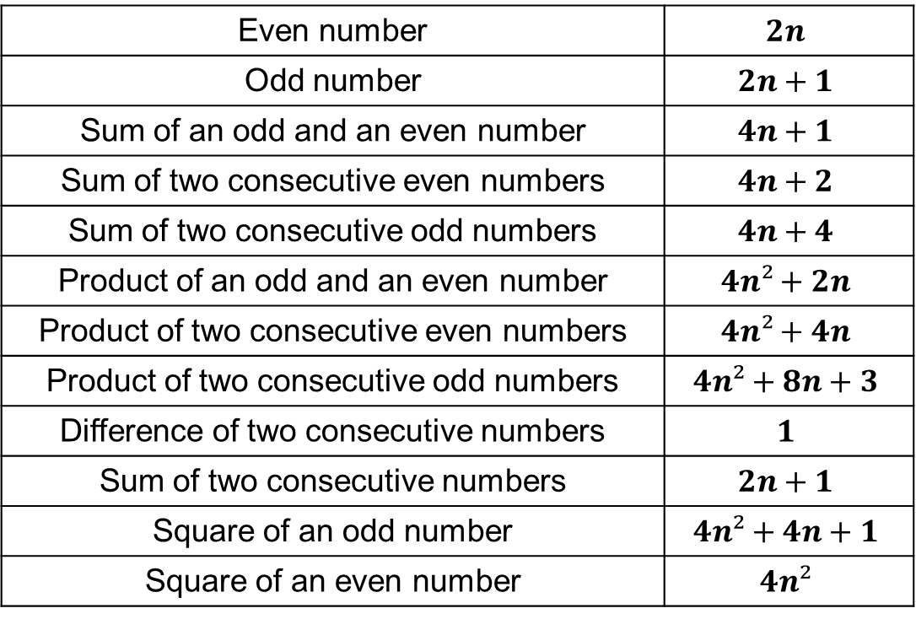
Answers
Even number | $$2n$$
Odd number | $$2n+1$$
Sum of an odd and an even number | $$4n+1$$
Sum of two consecutive even numbers | $$4n+2$$
Sum of two consecutive odd numbers | $$4n+4$$
Product of an odd and an even number | $$4n²+2n$$
Product of two consecutive even numbers | $$4n²+4n$$
Product of two consecutive odd numbers | $$4n²+8n+3$$
Difference of two consecutive numbers | $$1$$
Sum of two consecutive numbers | $$2n+1$$
Square of an odd number | $$4n²+4n+1$$
Square of an even number | $$4n²$$

Slide 3
Expanding, Simplifying and Factorising
Use your knowledge of algebra to prove that these pairs of statements are equal to each other.
1. Prove that ${(n+4)}^{2}−\left(3n+4\right)≡\left(n+1\right)\left(n+4\right)+8$
2. Prove that ${(n+4)}^{2}−\left(3n+4\right)≡\left(n+2\right)\left(n+3\right)+6$
3. Prove that ${(n+3)}^{2}−\left(3n+5\right)≡\left(n+1\right)\left(n+2\right)+2$
4. Prove that ${(n−5)}^{2}−\left(2n−1\right)≡\left(n−3\right)\left(n−9\right)−1$
5. Prove that ${(n−3)}^{2}−\left(n−5\right)≡\left(n−3\right)\left(n−4\right)+2$
6. Prove that $\frac{1}{2}\left(n+1\right)\left(n+2\right)−\frac{1}{2}n\left(n+1\right)≡n+1$
7. Prove that $\frac{1}{4}\left(2n+1\right)\left(n+4\right)−\frac{1}{4}n\left(2n+1\right)≡2n+1$

Slide 4

Solutions
1. LHS $={(n+4)}^{2}−\left(3n+4\right)$
$=n^{2}+8n+16−3n−4$
$=n^{2}+5n+4+8$
$=\left(n+1\right)\left(n+4\right)+8$
$=$ RHS
2. LHS $={(n+4)}^{2}−\left(3n+4\right)$
$=n^{2}+8n+16−3n−4$
$=n^{2}+5n+6+6$
$=\left(n+2\right)\left(n+3\right)+6$
$=$ RHS

Slide 5

Solutions
3. LHS $={(n+3)}^{2}−\left(3n+5\right)$
$=n^{2}+6n+9−3n−5$
$=n^{2}+3n+2+2$
$=\left(n+1\right)\left(n+2\right)+2$
$=$ RHS
4. LHS $={(n−5)}^{2}−\left(2n−1\right)$
$=n^{2}−10n+25−2n+1$
$=n^{2}−12n+27−1$
$=\left(n−3\right)\left(n−9\right)−1$
$=$ RHS

Slide 6

Solutions
5. LHS $={(n−3)}^{2}−\left(n−5\right)$
$=n^{2}−6n+9−n+5$
$=n^{2}−7n+12+2$
$=\left(n−3\right)\left(n−4\right)+2$
$=$ RHS
6. LHS $=\frac{1}{2}\left(n+1\right)\left(n+2\right)−\frac{1}{2}n\left(n+1\right)$
$=\frac{1}{2}(n^{2}+3n+2)−\frac{1}{2}(n^{2}+n)$
$=\frac{1}{2}n^{2}+\frac{3}{2}n+1−\frac{1}{2}n^{2}−\frac{1}{2}n$
$=n+1$
$=$ RHS

Slide 7
Solutions
7. LHS $=\frac{1}{4}\left(2n+1\right)\left(n+4\right)−\frac{1}{4}n\left(2n+1\right)$
$=\frac{1}{4}(2n^{2}+9n+4)−\frac{1}{4}(2n^{2}+n)$
$=\frac{1}{2}n^{2}+\frac{9}{4}n+1−\frac{1}{2}n^{2}−\frac{1}{4}n$
$=2n+1$
$=$ RHS

Slide 8
Prove that the difference between the squares of any two consecutive even numbers is always a multiple of 4.
$$( )²$$
$$( )²$$
$$2n$$
$$2n+2$$
$$−$$
Expand: $4n^{2}+8n+4−4n²$
Simplify: $8n+4$
Factorise: $4(2n+1)$
← 4 is a factor □

Slide 10
Solutions
1. $2n+2n+1=4n+1$
$4n$ is even $∴$ $4n+1$ is odd
2. $\frac{1}{2}\left(n+n+1+n+2+n+3\right)=\frac{1}{2}\left(4n+6\right)=2n+3$
$2n$ is even $∴$ $2n+3$ is odd
3. $n+n+1+n+2=3n+3=3(n+1)$
3 is a factor, $∴$ sum of three consecutive numbers is a multiple of 3
4. $2n\left(2m+1\right)=4mn+2n=2(2mn+n)$
2 is a factor, $∴$ product of any odd and even number is even
5. $\left(2n+1\right)\left(2m+1\right)=4mn+2m+2n+1=2\left(2mn+n+m\right)+1$
2 is a factor of $4mn+2m+2n$, $∴$ product of any two odd numbers is odd

Slide 11
Solutions
6. $2m×2n=4mn=2(2mn)$
2 is a factor, $∴$ product of any two even numbers is even
7. $\left(n−m\right)\left(n+m\right)≡n^{2}−m^{2}$
LHS $=n^{2}+mn−mn−m^{2}=n^{2}−m^{2}=$ RHS
8. ${(n+4)}^{2}−n^{2}=n^{2}+8n+16−n^{2}=8n+16=8(n+2)$
8 is a factor, $∴$ difference of squares is a multiple of 8
9. $2n+2n+2+2n+4=6n+6=6(n+1)$
6 is a factor, $∴$ sum of three consecutive even numbers is a multiple of 6
10. $2n+1+2n+3=4n+4=4(n+1)$
4 is a factor, $∴$ sum of 2 consecutive odd numbers is a multiple of 4

