Slide 1
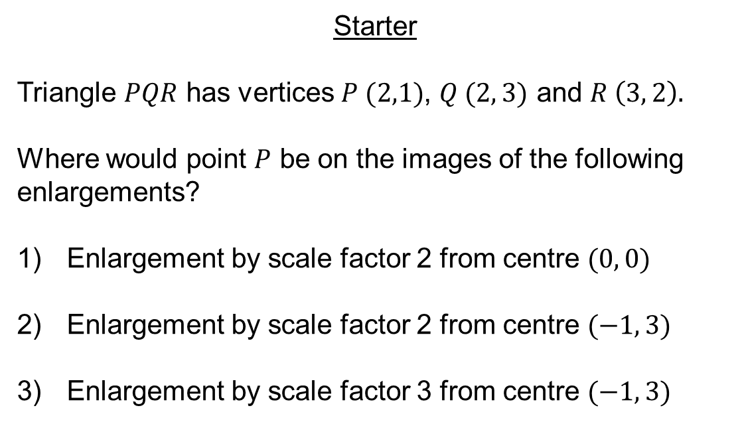
Starter
Triangle $PQR$ has vertices $P (2,1)$, $Q (2, 3)$ and $R \left(3, 2\right).$
Where would point $P$ be on the images of the following enlargements?
Enlargement by scale factor 2 from centre $(0, 0)$
Enlargement by scale factor 2 from centre $(−1, 3)$
Enlargement by scale factor 3 from centre $(−1, 3)$

Slide 2
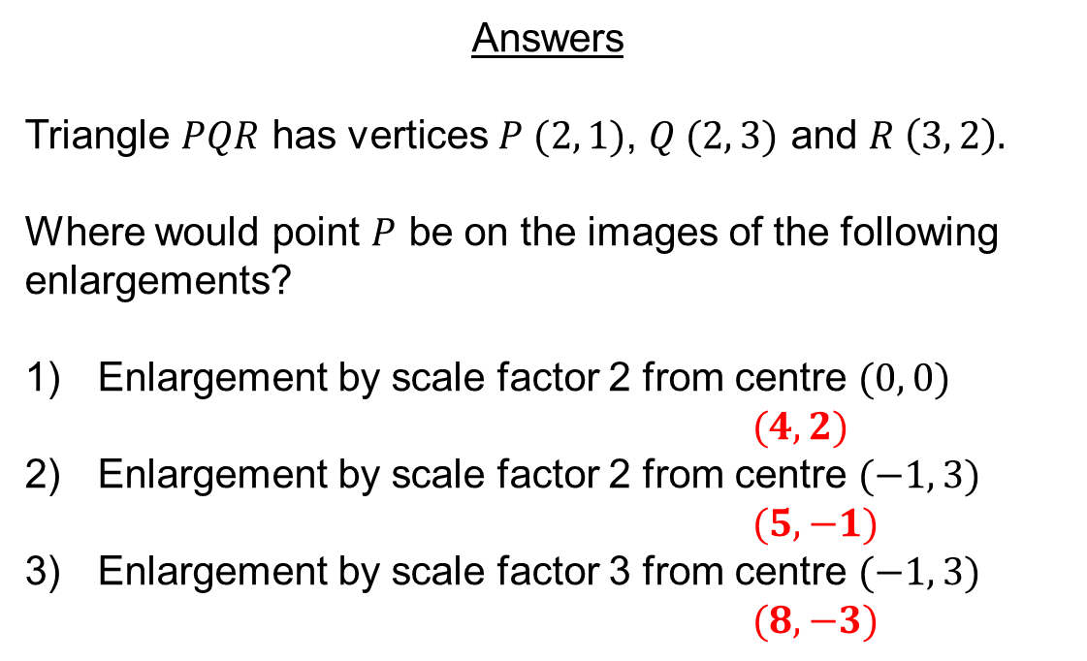
Answers
Triangle $PQR$ has vertices $P (2, 1)$, $Q (2, 3)$ and $R \left(3, 2\right).$
Where would point $P$ be on the images of the following enlargements?
Enlargement by scale factor 2 from centre $(0, 0)$
$(4, 2)$
Enlargement by scale factor 2 from centre $(−1, 3)$
$(5, −1)$
Enlargement by scale factor 3 from centre $(−1, 3)$
$(8, −3)$

Slide 3
Enlargement is a type of transformation.
An enlargement changes the size of an object. The shape stays exactly the same but the size changes.
Enlargements are described using two pieces of information:
Scale factor – the size of the enlargement
Centre of enlargement – the position from which the shape is enlarged

Slide 4
10
Transform this triangle by the enlargement:
Scale factor ½ from centre (0, 0)
9
Identify the centre of enlargement.
8
7
6
5
4
3
2
1
0
0
1
2
3
4
5
6
7
8
9
10

Slide 5
10
Transform this triangle by the enlargement:
Scale factor ½ from centre (0, 0)
9
Calculate the distance from the centre to the shape.
8
7
6
5
4
3
2
1
Four right, two up
0
0
1
2
3
4
5
6
7
8
9
10

Slide 6
10
Transform this triangle by the enlargement:
Scale factor ½ from centre (0, 0)
9
Multiply this distance by the scale factor.
8
7
This is the bottom left vertex of the new shape.
6
5
4
3
2
1
Two right, one up
0
0
1
2
3
4
5
6
7
8
9
10

Slide 7
10
Transform this triangle by the enlargement:
Scale factor ½ from centre (0, 0)
Multiply every side length by the scale factor and draw in the new shape.
9
8
7
6
5
4
3
2
1
0
0
1
2
3
4
5
6
7
8
9
10

Slide 8
10
Transform this triangle by the enlargement:
Scale factor -2 from centre (6, 6)
9
Identify the centre of enlargement.
8
7
6
5
4
3
2
1
0
0
1
2
3
4
5
6
7
8
9
10

Slide 9
10
Transform this triangle by the enlargement:
Scale factor -2 from centre (6, 6)
9
Calculate the distance from the centre to the shape.
8
7
6
One right, one up
5
4
3
2
1
0
0
1
2
3
4
5
6
7
8
9
10

Slide 10
10
Transform this triangle by the enlargement:
Scale factor -2 from centre (6, 6)
9
Multiply this distance by the scale factor.
8
7
6
Two left, two down
5
4
This is the bottom left vertex of the new shape.
3
2
1
0
0
1
2
3
4
5
6
7
8
9
10

Slide 11
10
Transform this triangle by the enlargement:
Scale factor -2 from centre (6, 6)
Multiply every side length by the scale factor and draw in the new shape.
9
8
7
6
5
4
3
2
1
0
0
1
2
3
4
5
6
7
8
9
10

Slide 12
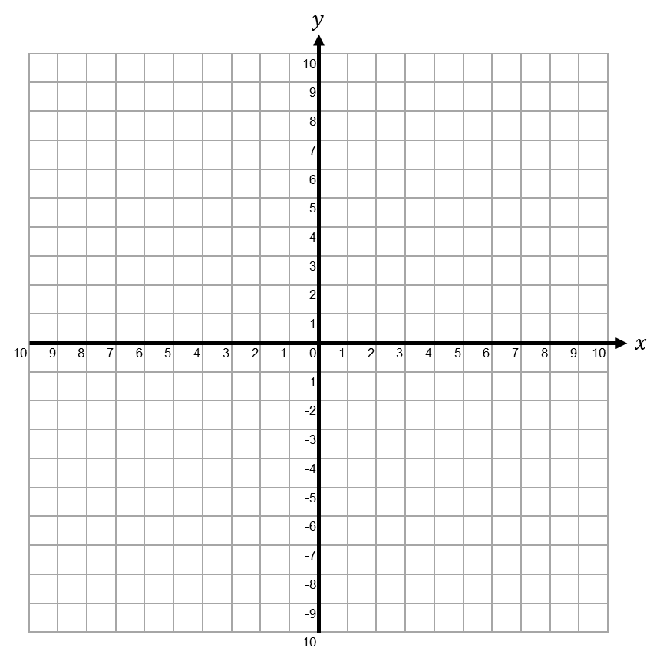
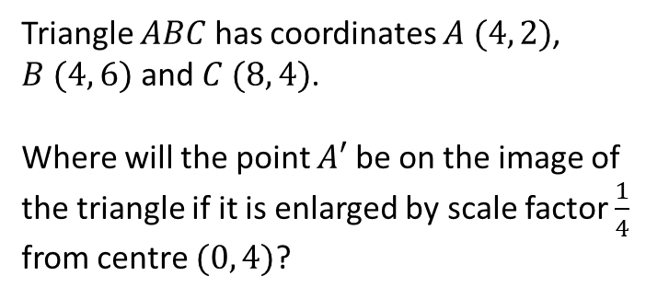
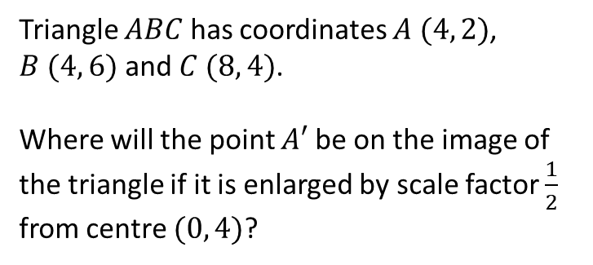
Worked Example
Your Turn
Triangle $ABC$ has coordinates $A (4, 2)$, $B (4, 6)$ and $C (8, 4)$.
Where will the point $A′$ be on the image of the triangle if it is enlarged by scale factor $\frac{1}{2}$ from centre $(0, 4)$?
Triangle $ABC$ has coordinates $A (4, 2)$, $B (4, 6)$ and $C (8, 4)$.
Where will the point $A′$ be on the image of the triangle if it is enlarged by scale factor $\frac{1}{4}$ from centre $(0, 4)$?
@PixiMaths

Slide 13
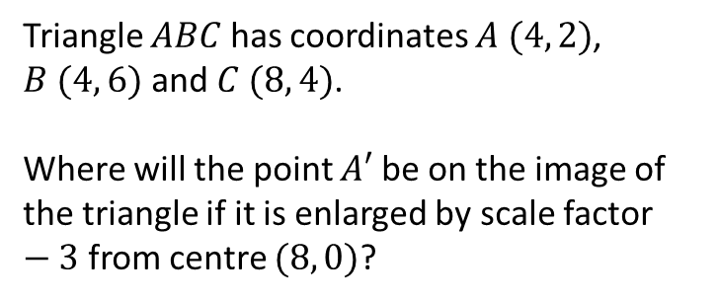
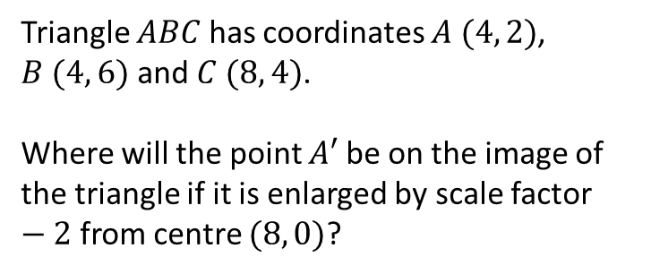
Worked Example
Your Turn
Triangle $ABC$ has coordinates $A (4, 2)$, $B (4, 6)$ and $C (8, 4)$.
Where will the point $A′$ be on the image of the triangle if it is enlarged by scale factor $−2$ from centre $(8, 0)$?
Triangle $ABC$ has coordinates $A (4, 2)$, $B (4, 6)$ and $C (8, 4)$.
Where will the point $A′$ be on the image of the triangle if it is enlarged by scale factor $−3$ from centre $(8, 0)$?
@PixiMaths

Slide 14
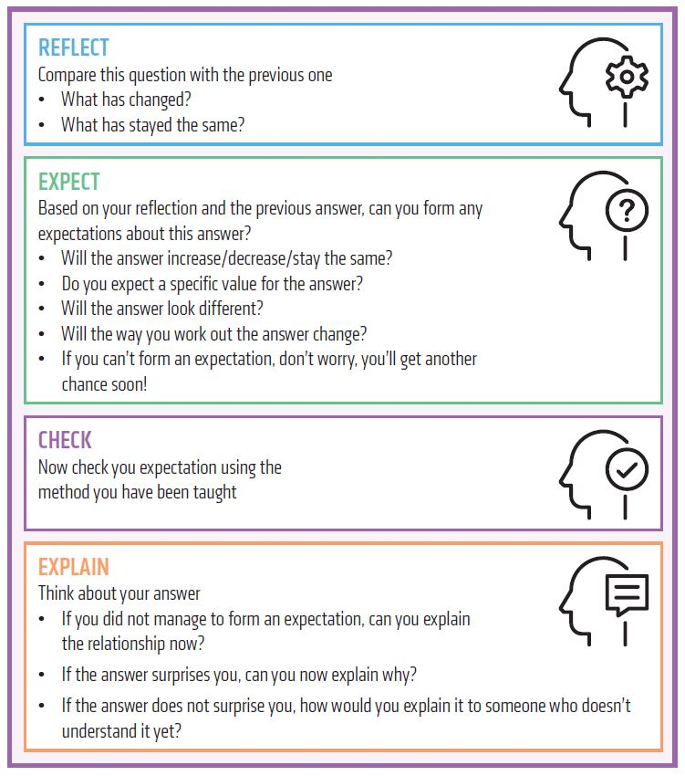

Slide 15
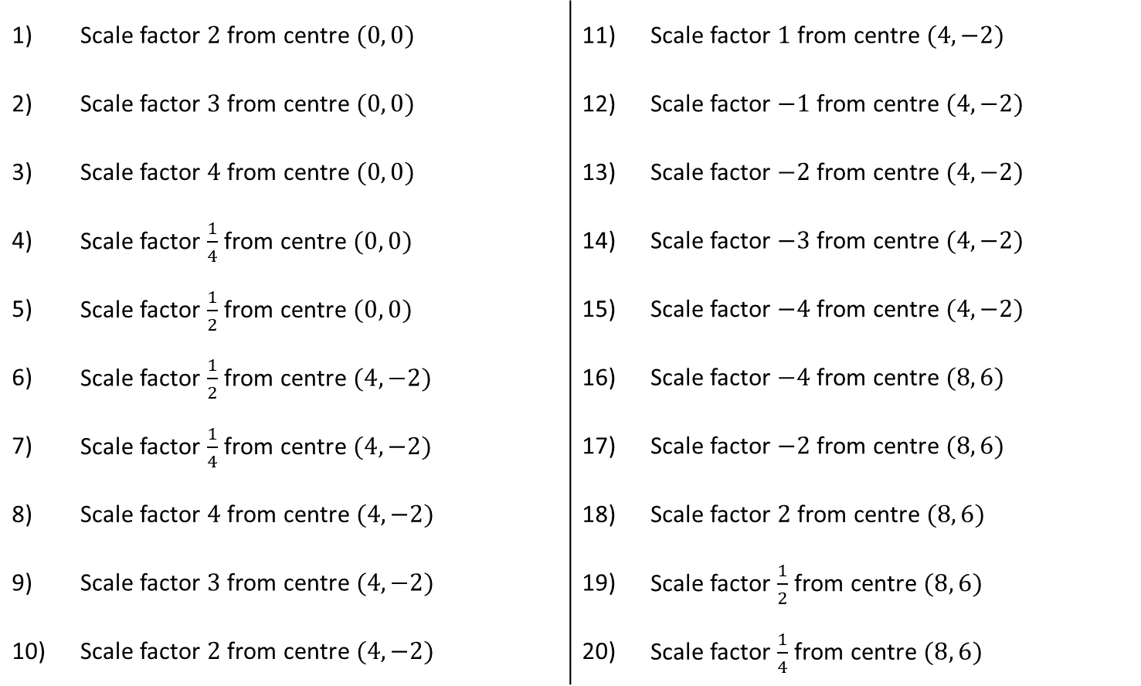
Triangle $ABC$ has coordinates $A (4, 2)$, $B (4, 6)$ and $C (8, 4)$.
Where will the point $A′$ be on the image of the triangle if it is enlarged by:
1) | Scale factor $2$ from centre $(0, 0)$ |  | 11) | Scale factor $1$ from centre $(4, −2)$
2) | Scale factor $3$ from centre $(0, 0)$ |  | 12) | Scale factor $−1$ from centre $(4, −2)$
3) | Scale factor $4$ from centre $(0, 0)$ |  | 13) | Scale factor $−2$ from centre $(4, −2)$
4) | Scale factor $\frac{1}{4}$ from centre $(0, 0)$ |  | 14) | Scale factor $−3$ from centre $(4, −2)$
5) | Scale factor $\frac{1}{2}$ from centre $(0, 0)$ |  | 15) | Scale factor $−4$ from centre $(4, −2)$
6) | Scale factor $\frac{1}{2}$ from centre $(4, −2)$ |  | 16) | Scale factor $−4$ from centre $(8, 6)$
7) | Scale factor $\frac{1}{4}$ from centre $(4, −2)$ |  | 17) | Scale factor $−2$ from centre $(8, 6)$
8) | Scale factor $4$ from centre $(4, −2)$ |  | 18) | Scale factor $2$ from centre $(8, 6)$
9) | Scale factor $3$ from centre $(4, −2)$ |  | 19) | Scale factor $\frac{1}{2}$ from centre $(8, 6)$
10) | Scale factor $2$ from centre $(4, −2)$ |  | 20) | Scale factor $\frac{1}{4}$ from centre $(8, 6)$
@PixiMaths

Slide 16
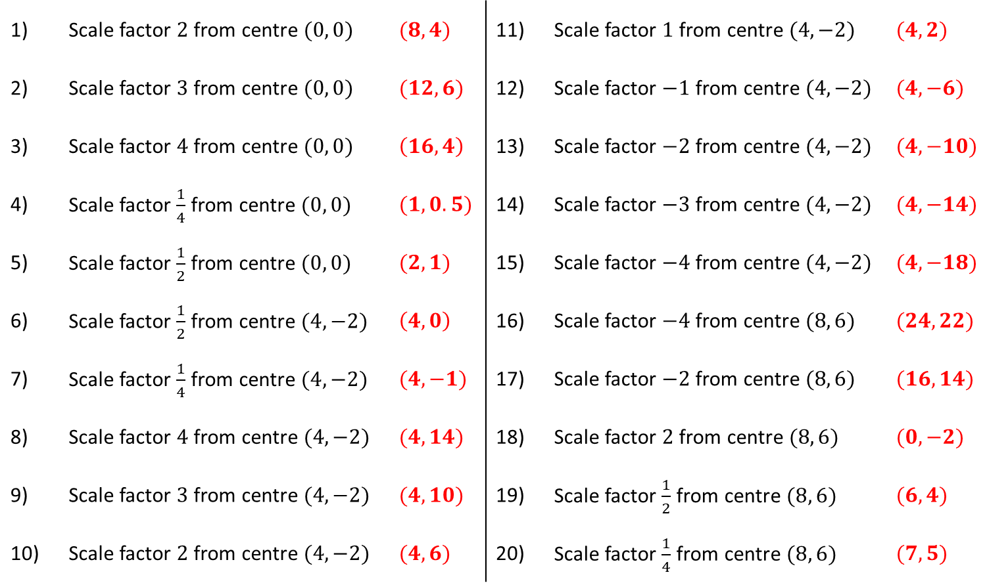
Triangle $ABC$ has coordinates $A (4, 2)$, $B (4, 6)$ and $C (8, 4)$.
Where will the point $A′$ be on the image of the triangle if it is enlarged by:
1) | Scale factor $2$ from centre $(0, 0)$ | $(8, 4)$ | 11) | Scale factor $1$ from centre $(4, −2)$ | $(4,2)$
2) | Scale factor $3$ from centre $(0, 0)$ | $(12, 6)$ | 12) | Scale factor $−1$ from centre $(4, −2)$ | $(4, −6)$
3) | Scale factor $4$ from centre $(0, 0)$ | $\left(16, 4\right)$ | 13) | Scale factor $−2$ from centre $(4, −2)$ | $(4, −10)$
4) | Scale factor $\frac{1}{4}$ from centre $(0, 0)$ | $(1, 0.5)$ | 14) | Scale factor $−3$ from centre $(4, −2)$ | $(4, −14)$
5) | Scale factor $\frac{1}{2}$ from centre $(0, 0)$ | $(2, 1)$ | 15) | Scale factor $−4$ from centre $(4, −2)$ | $(4, −18)$
6) | Scale factor $\frac{1}{2}$ from centre $(4, −2)$ | $\left(4, 0\right)$ | 16) | Scale factor $−4$ from centre $(8, 6)$ | $(24, 22)$
7) | Scale factor $\frac{1}{4}$ from centre $(4, −2)$ | $(4, −1)$ | 17) | Scale factor $−2$ from centre $(8, 6)$ | $(16, 14)$
8) | Scale factor $4$ from centre $(4, −2)$ | $(4, 14)$ | 18) | Scale factor $2$ from centre $(8, 6)$ | $(0, −2)$
9) | Scale factor $3$ from centre $(4, −2)$ | $(4, 10)$ | 19) | Scale factor $\frac{1}{2}$ from centre $(8, 6)$ | $(6, 4)$
10) | Scale factor $2$ from centre $(4, −2)$ | $(4, 6)$ | 20) | Scale factor $\frac{1}{4}$ from centre $(8, 6)$ | $(7, 5)$
@PixiMaths

Slide 17
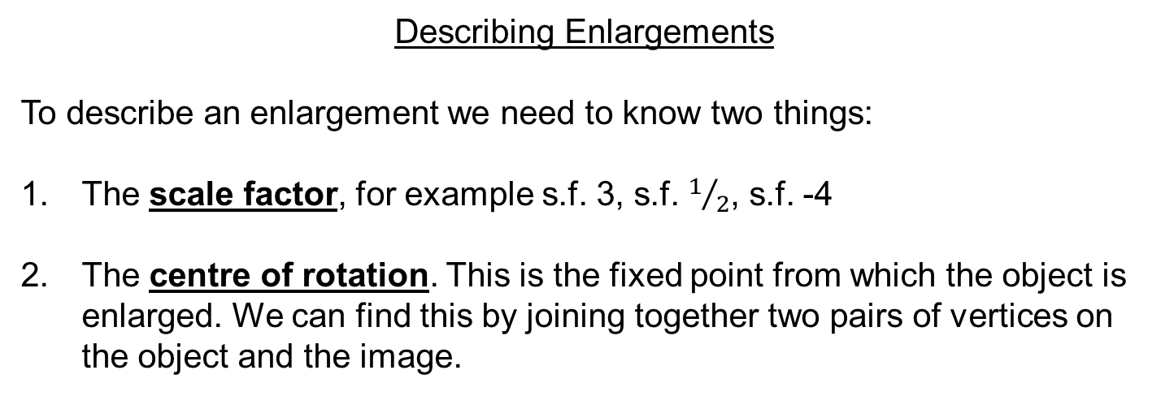
Describing Enlargements
To describe an enlargement we need to know two things:
The scale factor, for example s.f. 3, s.f. $1/2$, s.f. -4
The centre of rotation. This is the fixed point from which the object is enlarged. We can find this by joining together two pairs of vertices on the object and the image.

Slide 18
10
Describe the transformation that maps A onto B.
9
8
7
6
B
5
4
3
A
2
1
0
0
1
2
3
4
5
6
7
8
9
10

Slide 19
10
Describe the transformation that maps A onto B.
9
Compare the same side on the object and the image to find the scale factor.
8
7
Scale factor 2
6
B
5
4
4
3
A
2
s.f. 2
1
2
0
0
1
2
3
4
5
6
7
8
9
10

Slide 20
10
Describe the transformation that maps A onto B.
9
Identify a vertex on the object and its partner on the image.
8
7
Scale factor 2
6
B
5
4
3
A
2
1
0
0
1
2
3
4
5
6
7
8
9
10

Slide 21
10
Describe the transformation that maps A onto B.
9
Draw a line all the way through these points.
8
7
Scale factor 2
6
B
5
4
3
A
2
1
0
0
1
2
3
4
5
6
7
8
9
10

Slide 22
10
Describe the transformation that maps A onto B.
9
Repeat with another pair of vertices.
8
7
Scale factor 2
6
B
5
4
3
A
2
1
0
0
1
2
3
4
5
6
7
8
9
10

Slide 23
10
Describe the transformation that maps A onto B.
9
The point where the lines cross is the centre of enlargement.
8
7
Scale factor 2
6
Centre (1, 0)
B
5
4
3
A
2
1
0
0
1
2
3
4
5
6
7
8
9
10

Slide 24
Pair Activity
Match the scale factors and centres of enlargement to their corresponding objects and images.
Object
Image

