Slide 1
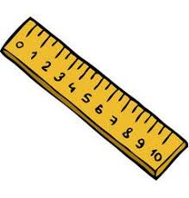
Starter
Convert the following to the units in brackets:
4 cm (mm)
55 cm (m)
90 minutes (hours)
2.5 minutes (seconds)
1.5 kg (g)
1 m³ (cm³)
40 mm
0.55 m
1.5 hours
150 seconds
1500 g
1 000 000 cm³

Slide 2
Commonly used compound measures include:
Density | $$\frac{\text{mass}}{\text{volume}}$$ | Measured in g/cm³ or kg/L
Speed | $$\frac{\text{distance}}{\text{time}}$$ | Measured in m/s, km/h or mph
Pressure | $$\frac{\text{force}}{\text{surface} \text{area}}$$ | Measured in N/m² or N/cm²
Fuel consumption | $$\frac{\text{distance}}{\text{volume}}$$ | Measured in km/L or mpg

Slide 3
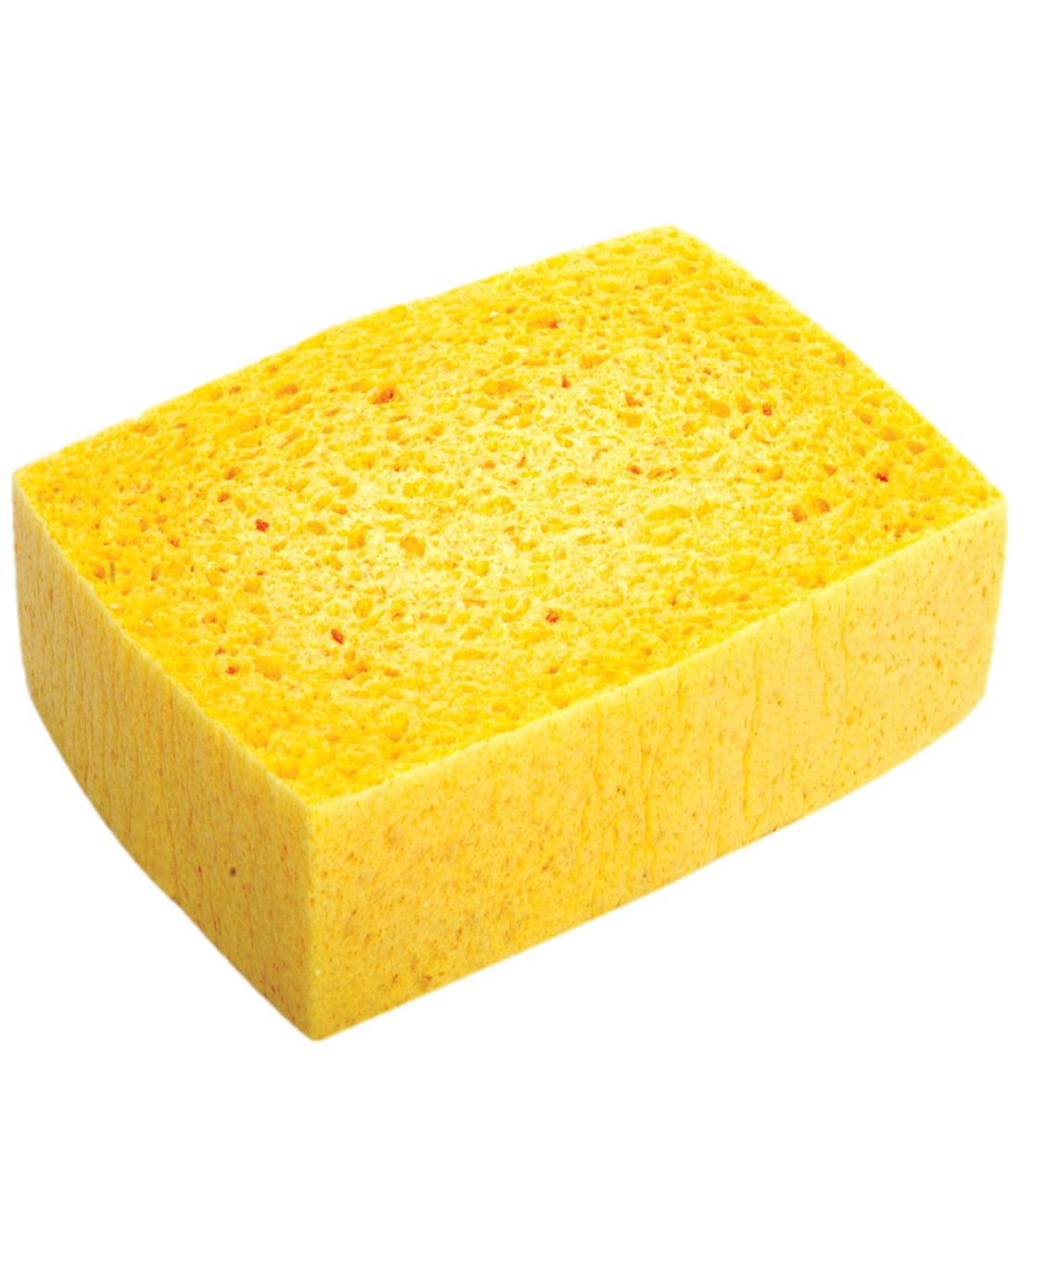
Converting between compound measures needs to be done in multiple steps because they are a compound of units.
Example
Convert 800 kg/m³ to g/cm³
800 $\frac{\text{kg}}{{\text{m}}^{\text{3}}}$
Rewrite the unit as a fraction

Slide 4
Converting between compound measures needs to be done in multiple steps because they are a compound of units.
Example
Convert 800 kg/m³ to g/cm³
800 $\frac{\text{kg}}{{\text{m}}^{\text{3}}}$ = 800 $\frac{\text{1000 }\text{g}}{{\text{1 000 000 }\text{cm}}^{\text{3}}}$
Convert both units

Slide 5
Converting between compound measures needs to be done in multiple steps because they are a compound of units.
Example
Convert 800 kg/m³ to g/cm³
800 $\frac{\text{kg}}{{\text{m}}^{\text{3}}}$ = 800 $\frac{\text{1000 }\text{g}}{{\text{1 000 000 }\text{cm}}^{\text{3}}}$ = $\frac{\text{800 000}}{\text{1 000 000}}$ g/cm³
Simplify

Slide 6
Converting between compound measures needs to be done in multiple steps because they are a compound of units.
Example
Convert 800 kg/m³ to g/cm³
800 $\frac{\text{kg}}{{\text{m}}^{\text{3}}}$ = 800 $\frac{\text{1000 }\text{g}}{{\text{1 000 000 }\text{cm}}^{\text{3}}}$ = $\frac{\text{800 000}}{\text{1 000 000}}$ g/cm³
= 0.8 g/cm³
Simplify

Slide 7
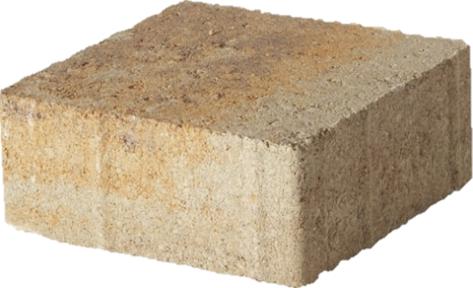
Converting between compound measures needs to be done in multiple steps because they are a compound of units.
Example
Convert 130 g/cm³ to kg/m³
130 $\frac{\text{g}}{{\text{cm}}^{\text{3}}}$

Slide 8
Converting between compound measures needs to be done in multiple steps because they are a compound of units.
Example
Convert 130 g/cm³ to kg/m³
130 $\frac{\text{g}}{{\text{cm}}^{\text{3}}}$ = 130 $\frac{\text{0.001 }\text{kg}}{{\text{0.000 001 }\text{m}}^{\text{3}}}$

Slide 9
Converting between compound measures needs to be done in multiple steps because they are a compound of units.
Example
Convert 130 g/cm³ to kg/m³
130 $\frac{\text{g}}{{\text{cm}}^{\text{3}}}$ = 130 $\frac{\text{0.001 }\text{kg}}{{\text{0.000 001 }\text{m}}^{\text{3}}}$ = $\frac{\text{0.13}}{\text{0.000 001}}$ kg/m³

Slide 10
Converting between compound measures needs to be done in multiple steps because they are a compound of units.
Example
Convert 130 g/cm³ to kg/m³
130 $\frac{\text{g}}{{\text{cm}}^{\text{3}}}$ = 130 $\frac{\text{0.001 }\text{kg}}{{\text{0.000 001 }\text{m}}^{\text{3}}}$ = $\frac{\text{0.13}}{\text{0.000 001}}$ kg/m³
= 130 000 kg/m³

Slide 11
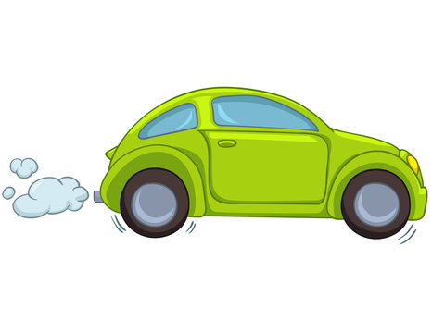
Converting between compound measures needs to be done in multiple steps because they are a compound of units.
Example
Convert 40 km/h to m/s
40 $\frac{\text{km}}{\text{h}}$

Slide 12
Converting between compound measures needs to be done in multiple steps because they are a compound of units.
Example
Convert 40 km/h to m/s
40 $\frac{\text{km}}{\text{h}}$ = 40 $\frac{\text{1000 }\text{m}}{\text{3}\text{600 }\text{s}}$

Slide 13
Converting between compound measures needs to be done in multiple steps because they are a compound of units.
Example
Convert 40 km/h to m/s
40 $\frac{\text{km}}{\text{h}}$ = 40 $\frac{\text{1000 }\text{m}}{\text{3}\text{600 }\text{s}}$ = $\frac{\text{40 000}}{\text{3600}}$ m/s

Slide 14
Converting between compound measures needs to be done in multiple steps because they are a compound of units.
Example
Convert 40 km/h to m/s
40 $\frac{\text{km}}{\text{h}}$ = 40 $\frac{\text{1000 }\text{m}}{\text{3}\text{600 }\text{s}}$ = $\frac{\text{40 000}}{\text{3600}}$ m/s = 11.11 m/s

Slide 15
Your Turn
Convert the following to the units in brackets:
12300 kg/m³ (g/cm³)
90 km/h (m/s)
640 kg/m³ (g/cm³)
21 g/cm³ (kg/m³)
150 m/s (km/h)
110 km/h (m/s)
12.3 g/cm³
25 m/s
0.64 g/cm³
21 000 kg/m³
540 km/h
30.55 m/s (2 d.p.)

Slide 16
Codebreaker
Convert the speeds to the units requested; link your answers to the table above and unjumble the letters to reveal which brand of car a Jedi prefers.
https://www.tes.com/teaching-resource/converting-compound-measures-codebreaker-12178018
“Toyoda”

Slide 17
Combining Compound Measures
Sometimes we need to calculate the average speed of a journey comprising of different speeds…
Or the overall density of a mixed liquid or alloy…
We can’t just calculate the average because the proportions are usually different.
We can use a table to help us organise our working out.

Slide 18
We cannot just calculate the average because the quantities are different!
Example
Liquid A has a density of 0.8 g/cm³.
Liquid B has a density of 1.5 g/cm³.
240 g of liquid A and 150 g of liquid B are mixed to make liquid C.
Work out the density of liquid C.
 | Liquid A | Liquid B | Liquid C
Mass
Volume
Density
Next example
Notes:
Use arrow button to skip the animations if you prefer to model the working out on the IWB

Slide 19
Example
Liquid A has a density of 0.8 g/cm³.
Liquid B has a density of 1.5 g/cm³.
240 g of liquid A and 150 g of liquid B are mixed to make liquid C.
Work out the density of liquid C.
 | Liquid A | Liquid B | Liquid C
Mass
Volume
Density | 0.8 g/cm³ | 1.5 g/cm³

Slide 20
Example
Liquid A has a density of 0.8 g/cm³.
Liquid B has a density of 1.5 g/cm³.
240 g of liquid A and 150 g of liquid B are mixed to make liquid C.
Work out the density of liquid C.
Liquid A: V = $\frac{\text{M}}{\text{D}}$
 | Liquid A | Liquid B | Liquid C
Mass | 240 g | 150 g
Volume
Density | 0.8 g/cm³ | 1.5 g/cm³

Slide 21
Example
Liquid A has a density of 0.8 g/cm³.
Liquid B has a density of 1.5 g/cm³.
240 g of liquid A and 150 g of liquid B are mixed to make liquid C.
Work out the density of liquid C.
Liquid A: V = $\frac{\text{M}}{\text{D}}$ = $\frac{\text{240}}{\text{0.8}}$
 | Liquid A | Liquid B | Liquid C
Mass | 240 g | 150 g
Volume
Density | 0.8 g/cm³ | 1.5 g/cm³

Slide 22
Example
Liquid A has a density of 0.8 g/cm³.
Liquid B has a density of 1.5 g/cm³.
240 g of liquid A and 150 g of liquid B are mixed to make liquid C.
Work out the density of liquid C.
Liquid A: V = $\frac{\text{M}}{\text{D}}$ = $\frac{\text{240}}{\text{0.8}}$ = 300 cm³
 | Liquid A | Liquid B | Liquid C
Mass | 240 g | 150 g
Volume
Density | 0.8 g/cm³ | 1.5 g/cm³

Slide 23
Example
Liquid A has a density of 0.8 g/cm³.
Liquid B has a density of 1.5 g/cm³.
240 g of liquid A and 150 g of liquid B are mixed to make liquid C.
Work out the density of liquid C.
Liquid A: V = $\frac{\text{M}}{\text{D}}$ = $\frac{\text{240}}{\text{0.8}}$ = 300 cm³
 | Liquid A | Liquid B | Liquid C
Mass | 240 g | 150 g
Volume | 300 cm³
Density | 0.8 g/cm³ | 1.5 g/cm³

Slide 24
Example
Liquid A has a density of 0.8 g/cm³.
Liquid B has a density of 1.5 g/cm³.
240 g of liquid A and 150 g of liquid B are mixed to make liquid C.
Work out the density of liquid C.
Liquid B: V = $\frac{\text{M}}{\text{D}}$
 | Liquid A | Liquid B | Liquid C
Mass | 240 g | 150 g
Volume | 300 cm³
Density | 0.8 g/cm³ | 1.5 g/cm³

Slide 25
Example
Liquid A has a density of 0.8 g/cm³.
Liquid B has a density of 1.5 g/cm³.
240 g of liquid A and 150 g of liquid B are mixed to make liquid C.
Work out the density of liquid C.
Liquid B: V = $\frac{\text{M}}{\text{D}}$ = $\frac{\text{150}}{\text{1.5}}$
 | Liquid A | Liquid B | Liquid C
Mass | 240 g | 150 g
Volume | 300 cm³
Density | 0.8 g/cm³ | 1.5 g/cm³

Slide 26
Example
Liquid A has a density of 0.8 g/cm³.
Liquid B has a density of 1.5 g/cm³.
240 g of liquid A and 150 g of liquid B are mixed to make liquid C.
Work out the density of liquid C.
Liquid B: V = $\frac{\text{M}}{\text{D}}$ = $\frac{\text{150}}{\text{1.5}}$ = 100 cm³
 | Liquid A | Liquid B | Liquid C
Mass | 240 g | 150 g
Volume | 300 cm³
Density | 0.8 g/cm³ | 1.5 g/cm³

Slide 27
Example
Liquid A has a density of 0.8 g/cm³.
Liquid B has a density of 1.5 g/cm³.
240 g of liquid A and 150 g of liquid B are mixed to make liquid C.
Work out the density of liquid C.
Liquid B: V = $\frac{\text{M}}{\text{D}}$ = $\frac{\text{150}}{\text{1.5}}$ = 100 cm³
 | Liquid A | Liquid B | Liquid C
Mass | 240 g | 150 g
Volume | 300 cm³ | 100 cm³
Density | 0.8 g/cm³ | 1.5 g/cm³

Slide 28
Example
Liquid A has a density of 0.8 g/cm³.
Liquid B has a density of 1.5 g/cm³.
240 g of liquid A and 150 g of liquid B are mixed to make liquid C.
Work out the density of liquid C.
 | Liquid A | Liquid B | Liquid C
Mass | 240 g | 150 g
Volume | 300 cm³ | 100 cm³
Density | 0.8 g/cm³ | 1.5 g/cm³
We cannot add compound units but we can add the others

Slide 29
Example
Liquid A has a density of 0.8 g/cm³.
Liquid B has a density of 1.5 g/cm³.
240 g of liquid A and 150 g of liquid B are mixed to make liquid C.
Work out the density of liquid C.
 | Liquid A | Liquid B | Liquid C
Mass | 240 g | 150 g | 390 g
Volume | 300 cm³ | 100 cm³
Density | 0.8 g/cm³ | 1.5 g/cm³

Slide 30
Example
Liquid A has a density of 0.8 g/cm³.
Liquid B has a density of 1.5 g/cm³.
240 g of liquid A and 150 g of liquid B are mixed to make liquid C.
Work out the density of liquid C.
 | Liquid A | Liquid B | Liquid C
Mass | 240 g | 150 g | 390 g
Volume | 300 cm³ | 100 cm³ | 400 cm³
Density | 0.8 g/cm³ | 1.5 g/cm³

Slide 31
Example
Liquid A has a density of 0.8 g/cm³.
Liquid B has a density of 1.5 g/cm³.
240 g of liquid A and 150 g of liquid B are mixed to make liquid C.
Work out the density of liquid C.
Liquid C: D = $\frac{\text{M}}{\text{V}}$
 | Liquid A | Liquid B | Liquid C
Mass | 240 g | 150 g | 390 g
Volume | 300 cm³ | 100 cm³ | 400 cm³
Density | 0.8 g/cm³ | 1.5 g/cm³

Slide 32
Example
Liquid A has a density of 0.8 g/cm³.
Liquid B has a density of 1.5 g/cm³.
240 g of liquid A and 150 g of liquid B are mixed to make liquid C.
Work out the density of liquid C.
Liquid C: D = $\frac{\text{M}}{\text{V}}$ = $\frac{\text{390}}{\text{400}}$
 | Liquid A | Liquid B | Liquid C
Mass | 240 g | 150 g | 390 g
Volume | 300 cm³ | 100 cm³ | 400 cm³
Density | 0.8 g/cm³ | 1.5 g/cm³

Slide 33
Example
Liquid A has a density of 0.8 g/cm³.
Liquid B has a density of 1.5 g/cm³.
240 g of liquid A and 150 g of liquid B are mixed to make liquid C.
Work out the density of liquid C.
Liquid C: D = $\frac{\text{M}}{\text{V}}$ = $\frac{\text{390}}{\text{400}}$ = 0.975 g/cm³
 | Liquid A | Liquid B | Liquid C
Mass | 240 g | 150 g | 390 g
Volume | 300 cm³ | 100 cm³ | 400 cm³
Density | 0.8 g/cm³ | 1.5 g/cm³

Slide 34
Example
Liquid A has a density of 0.8 g/cm³.
Liquid B has a density of 1.5 g/cm³.
240 g of liquid A and 150 g of liquid B are mixed to make liquid C.
Work out the density of liquid C.
Liquid C: D = $\frac{\text{M}}{\text{V}}$ = $\frac{\text{390}}{\text{400}}$ = 0.975 g/cm³
 | Liquid A | Liquid B | Liquid C
Mass | 240 g | 150 g | 390 g
Volume | 300 cm³ | 100 cm³ | 400 cm³
Density | 0.8 g/cm³ | 1.5 g/cm³ | 0.975 g/cm³

Slide 35
Example
Melanie drives 60 km from Oakham to Northampton.
She drives the first 10 km at an average speed of 40 km/h.
She drives the next 30 km at an average speed of 60 km/h.
The last 20 km takes her 24 minutes.
What was the average speed of the whole journey?
 | 1st leg | 2nd leg | 3rd leg | Total
Distance
Time
Speed
Skip to task
Notes:
Use arrow button to skip the animations if you prefer to model the working out on the IWB

Slide 36
Example
Melanie drives 60 km from Oakham to Northampton.
She drives the first 10 km at an average speed of 40 km/h.
She drives the next 30 km at an average speed of 60 km/h.
The last 20 km takes her 24 minutes.
What was the average speed of the whole journey?
 | 1st leg | 2nd leg | 3rd leg | Total
Distance |  |  |  | 60 km
Time
Speed

Slide 37
Example
Melanie drives 60 km from Oakham to Northampton.
She drives the first 10 km at an average speed of 40 km/h.
She drives the next 30 km at an average speed of 60 km/h.
The last 20 km takes her 24 minutes.
What was the average speed of the whole journey?
 | 1st leg | 2nd leg | 3rd leg | Total
Distance | 10 km |  |  | 60 km
Time
Speed | 40 km/h

Slide 38
Example
Melanie drives 60 km from Oakham to Northampton.
She drives the first 10 km at an average speed of 40 km/h.
She drives the next 30 km at an average speed of 60 km/h.
The last 20 km takes her 24 minutes.
What was the average speed of the whole journey?
 | 1st leg | 2nd leg | 3rd leg | Total
Distance | 10 km | 30 km |  | 60 km
Time
Speed | 40 km/h | 60 km/h

Slide 39
Example
Melanie drives 60 km from Oakham to Northampton.
She drives the first 10 km at an average speed of 40 km/h.
She drives the next 30 km at an average speed of 60 km/h.
The last 20 km takes her 24 minutes.
What was the average speed of the whole journey?
 | 1st leg | 2nd leg | 3rd leg | Total
Distance | 10 km | 30 km | 20 km | 60 km
Time |  |  | 0.4 hr
Speed | 40 km/h | 60 km/h

Slide 40
Example
Melanie drives 60 km from Oakham to Northampton.
She drives the first 10 km at an average speed of 40 km/h.
She drives the next 30 km at an average speed of 60 km/h.
The last 20 km takes her 24 minutes.
What was the average speed of the whole journey?
1st leg: T = $\frac{\text{D}}{\text{S}}$
 | 1st leg | 2nd leg | 3rd leg | Total
Distance | 10 km | 30 km | 20 km | 60 km
Time |  |  | 0.4 hr
Speed | 40 km/h | 60 km/h

Slide 41
Example
Melanie drives 60 km from Oakham to Northampton.
She drives the first 10 km at an average speed of 40 km/h.
She drives the next 30 km at an average speed of 60 km/h.
The last 20 km takes her 24 minutes.
What was the average speed of the whole journey?
1st leg: T = $\frac{\text{D}}{\text{S}}$ = $\frac{\text{10}}{\text{40}}$
 | 1st leg | 2nd leg | 3rd leg | Total
Distance | 10 km | 30 km | 20 km | 60 km
Time |  |  | 0.4 hr
Speed | 40 km/h | 60 km/h

Slide 42
Example
Melanie drives 60 km from Oakham to Northampton.
She drives the first 10 km at an average speed of 40 km/h.
She drives the next 30 km at an average speed of 60 km/h.
The last 20 km takes her 24 minutes.
What was the average speed of the whole journey?
1st leg: T = $\frac{\text{D}}{\text{S}}$ = $\frac{\text{10}}{\text{40}}$ = 0.25 hours
 | 1st leg | 2nd leg | 3rd leg | Total
Distance | 10 km | 30 km | 20 km | 60 km
Time |  |  | 0.4 hr
Speed | 40 km/h | 60 km/h

Slide 43
Example
Melanie drives 60 km from Oakham to Northampton.
She drives the first 10 km at an average speed of 40 km/h.
She drives the next 30 km at an average speed of 60 km/h.
The last 20 km takes her 24 minutes.
What was the average speed of the whole journey?
1st leg: T = $\frac{\text{D}}{\text{S}}$ = $\frac{\text{10}}{\text{40}}$ = 0.25 hours
 | 1st leg | 2nd leg | 3rd leg | Total
Distance | 10 km | 30 km | 20 km | 60 km
Time | 0.25 hr |  | 0.4 hr
Speed | 40 km/h | 60 km/h

Slide 44
Example
Melanie drives 60 km from Oakham to Northampton.
She drives the first 10 km at an average speed of 40 km/h.
She drives the next 30 km at an average speed of 60 km/h.
The last 20 km takes her 24 minutes.
What was the average speed of the whole journey?
2nd leg: T = $\frac{\text{D}}{\text{S}}$
 | 1st leg | 2nd leg | 3rd leg | Total
Distance | 10 km | 30 km | 20 km | 60 km
Time | 0.25 hr |  | 0.4 hr
Speed | 40 km/h | 60 km/h

Slide 45
Example
Melanie drives 60 km from Oakham to Northampton.
She drives the first 10 km at an average speed of 40 km/h.
She drives the next 30 km at an average speed of 60 km/h.
The last 20 km takes her 24 minutes.
What was the average speed of the whole journey?
2nd leg: T = $\frac{\text{D}}{\text{S}}$ = $\frac{\text{30}}{\text{60}}$
 | 1st leg | 2nd leg | 3rd leg | Total
Distance | 10 km | 30 km | 20 km | 60 km
Time | 0.25 hr |  | 0.4 hr
Speed | 40 km/h | 60 km/h

Slide 46
Example
Melanie drives 60 km from Oakham to Northampton.
She drives the first 10 km at an average speed of 40 km/h.
She drives the next 30 km at an average speed of 60 km/h.
The last 20 km takes her 24 minutes.
What was the average speed of the whole journey?
2nd leg: T = $\frac{\text{D}}{\text{S}}$ = $\frac{\text{30}}{\text{60}}$ = 0.5 hours
 | 1st leg | 2nd leg | 3rd leg | Total
Distance | 10 km | 30 km | 20 km | 60 km
Time | 0.25 hr |  | 0.4 hr
Speed | 40 km/h | 60 km/h

Slide 47
Example
Melanie drives 60 km from Oakham to Northampton.
She drives the first 10 km at an average speed of 40 km/h.
She drives the next 30 km at an average speed of 60 km/h.
The last 20 km takes her 24 minutes.
What was the average speed of the whole journey?
2nd leg: T = $\frac{\text{D}}{\text{S}}$ = $\frac{\text{30}}{\text{60}}$ = 0.5 hours
 | 1st leg | 2nd leg | 3rd leg | Total
Distance | 10 km | 30 km | 20 km | 60 km
Time | 0.25 hr | 0.5 hr | 0.4 hr
Speed | 40 km/h | 60 km/h

Slide 48
Example
Melanie drives 60 km from Oakham to Northampton.
She drives the first 10 km at an average speed of 40 km/h.
She drives the next 30 km at an average speed of 60 km/h.
The last 20 km takes her 24 minutes.
What was the average speed of the whole journey?
3rd leg: S = $\frac{\text{D}}{\text{T}}$
 | 1st leg | 2nd leg | 3rd leg | Total
Distance | 10 km | 30 km | 20 km | 60 km
Time | 0.25 hr | 0.5 hr | 0.4 hr | 1.15 hr
Speed | 40 km/h | 60 km/h

Slide 49
Example
Melanie drives 60 km from Oakham to Northampton.
She drives the first 10 km at an average speed of 40 km/h.
She drives the next 30 km at an average speed of 60 km/h.
The last 20 km takes her 24 minutes.
What was the average speed of the whole journey?
3rd leg: S = $\frac{\text{D}}{\text{T}}$ = $\frac{\text{20}}{\text{0.4}}$
 | 1st leg | 2nd leg | 3rd leg | Total
Distance | 10 km | 30 km | 20 km | 60 km
Time | 0.25 hr | 0.5 hr | 0.4 hr | 1.15 hr
Speed | 40 km/h | 60 km/h

Slide 50
Example
Melanie drives 60 km from Oakham to Northampton.
She drives the first 10 km at an average speed of 40 km/h.
She drives the next 30 km at an average speed of 60 km/h.
The last 20 km takes her 24 minutes.
What was the average speed of the whole journey?
3rd leg: S = $\frac{\text{D}}{\text{T}}$ = $\frac{\text{20}}{\text{0.4}}$ = 50 km/h
 | 1st leg | 2nd leg | 3rd leg | Total
Distance | 10 km | 30 km | 20 km | 60 km
Time | 0.25 hr | 0.5 hr | 0.4 hr | 1.15 hr
Speed | 40 km/h | 60 km/h

Slide 51
Example
Melanie drives 60 km from Oakham to Northampton.
She drives the first 10 km at an average speed of 40 km/h.
She drives the next 30 km at an average speed of 60 km/h.
The last 20 km takes her 24 minutes.
What was the average speed of the whole journey?
3rd leg: S = $\frac{\text{D}}{\text{T}}$ = $\frac{\text{20}}{\text{0.4}}$ = 50 km/h
 | 1st leg | 2nd leg | 3rd leg | Total
Distance | 10 km | 30 km | 20 km | 60 km
Time | 0.25 hr | 0.5 hr | 0.4 hr | 1.15 hr
Speed | 40 km/h | 60 km/h | 50 km/h

Slide 52
Example
Melanie drives 60 km from Oakham to Northampton.
She drives the first 10 km at an average speed of 40 km/h.
She drives the next 30 km at an average speed of 60 km/h.
The last 20 km takes her 24 minutes.
What was the average speed of the whole journey?
Total: S = $\frac{\text{D}}{\text{T}}$
 | 1st leg | 2nd leg | 3rd leg | Total
Distance | 10 km | 30 km | 20 km | 60 km
Time | 0.25 hr | 0.5 hr | 0.4 hr | 1.15 hr
Speed | 40 km/h | 60 km/h | 50 km/h

Slide 53
Example
Melanie drives 60 km from Oakham to Northampton.
She drives the first 10 km at an average speed of 40 km/h.
She drives the next 30 km at an average speed of 60 km/h.
The last 20 km takes her 24 minutes.
What was the average speed of the whole journey?
Total: S = $\frac{\text{D}}{\text{T}}$ = $\frac{\text{60}}{\text{1.15}}$
 | 1st leg | 2nd leg | 3rd leg | Total
Distance | 10 km | 30 km | 20 km | 60 km
Time | 0.25 hr | 0.5 hr | 0.4 hr | 1.15 hr
Speed | 40 km/h | 60 km/h | 50 km/h

Slide 54
Example
Melanie drives 60 km from Oakham to Northampton.
She drives the first 10 km at an average speed of 40 km/h.
She drives the next 30 km at an average speed of 60 km/h.
The last 20 km takes her 24 minutes.
What was the average speed of the whole journey?
Total: S = $\frac{\text{D}}{\text{T}}$ = $\frac{\text{60}}{\text{1.15}}$ = 52.17 km/h (2 d.p.)
 | 1st leg | 2nd leg | 3rd leg | Total
Distance | 10 km | 30 km | 20 km | 60 km
Time | 0.25 hr | 0.5 hr | 0.4 hr | 1.15 hr
Speed | 40 km/h | 60 km/h | 50 km/h

Slide 55
Example
Melanie drives 60 km from Oakham to Northampton.
She drives the first 10 km at an average speed of 40 km/h.
She drives the next 30 km at an average speed of 60 km/h.
The last 20 km takes her 24 minutes.
What was the average speed of the whole journey?
Total: S = $\frac{\text{D}}{\text{T}}$ = $\frac{\text{60}}{\text{1.15}}$ = 52.17 km/h (2 d.p.)
 | 1st leg | 2nd leg | 3rd leg | Total
Distance | 10 km | 30 km | 20 km | 60 km
Time | 0.25 hr | 0.5 hr | 0.4 hr | 1.15 hr
Speed | 40 km/h | 60 km/h | 50 km/h | 52.17 km/h

Slide 57
Answers
8.0 g/cm³
1.05 g/cm³
56.25 km/h
8.8 g/cm³
52.17 km/h
3.52 g/cm³

