Slide 1
Starter
Use your calculator to answer the following questions. Where appropriate, give your answers correct to 2 decimal places.
${18}^{2}$
$\sqrt{352}$
${3.4}^{2}$
${14.2}^{2}$
$\sqrt{105}$
$\sqrt{13.2}$
= 324
= 18.76
= 11.56
= 201.64
= 10.25
= 3.63

Slide 2
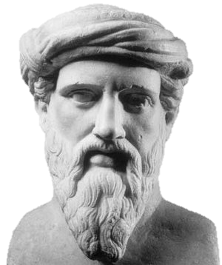
I was born at Samos in Greece and lived from 580 to 500 B.C. I was a mathematician who became famous for discovering something interesting about right-angled triangles.

Slide 3
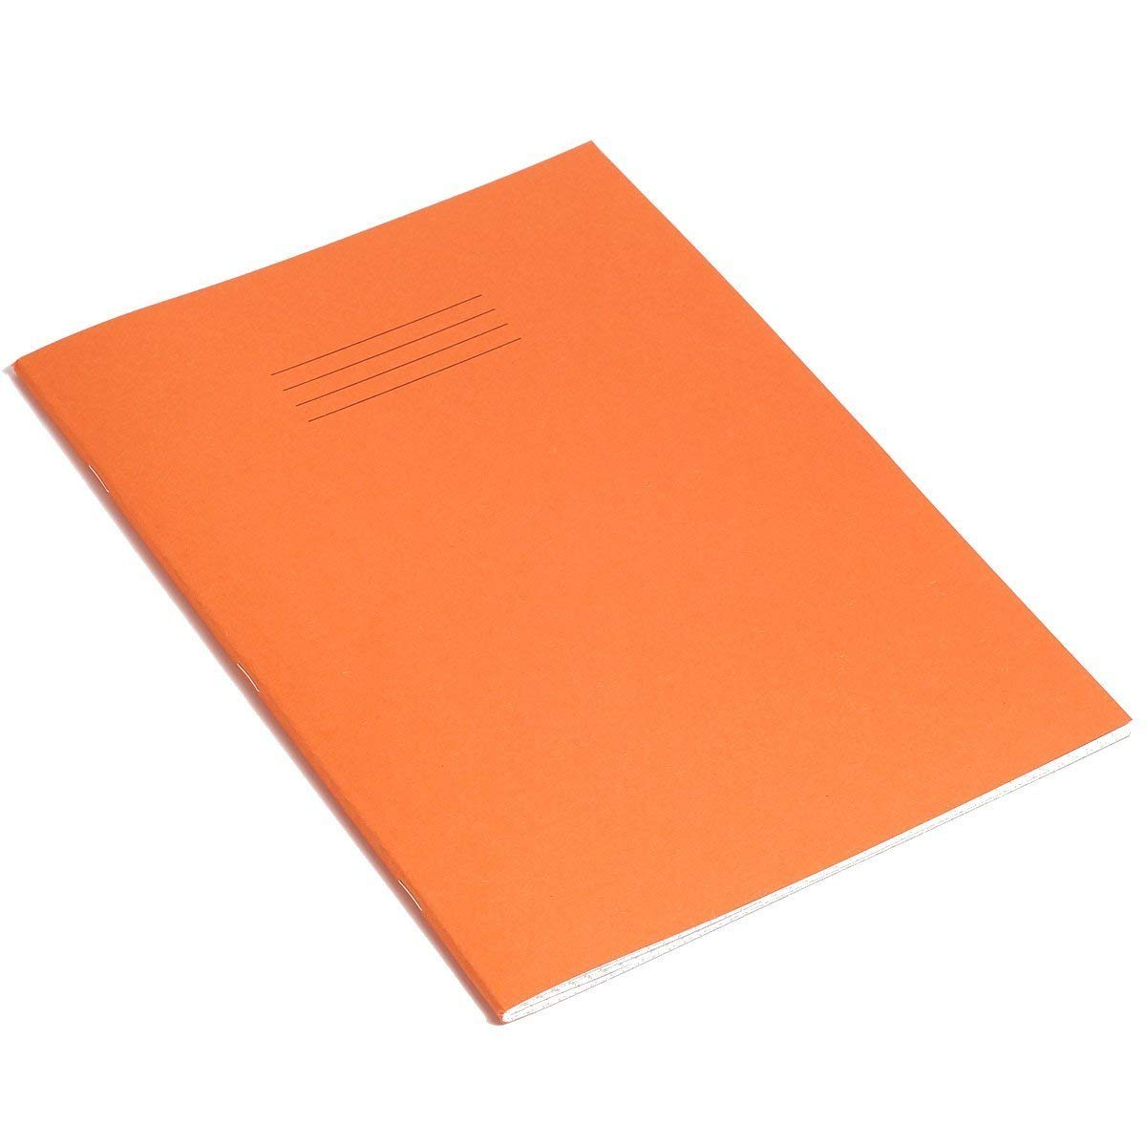
What will I be able to do by the end of the lesson?
Find out the diagonal length of your exercise book without measuring it.

Slide 4
Pythagoras discovered that for any right angled triangle, the area of the square drawn on the hypotenuse (the longest side, opposite the right angle) is equal to the sum of the areas of the squares drawn on the other two sides…

Slide 5
5cm
?cm
3cm
4cm
Area of + area of = area of
+ =
9 + 16 = 25

Slide 6
Copy this into your exercise book:
$$a²+b²=c²$$
$$c$$
$$a$$
$$b$$

Slide 7
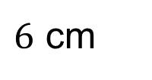
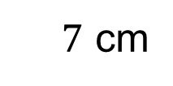
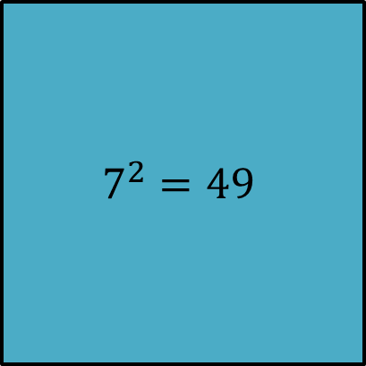
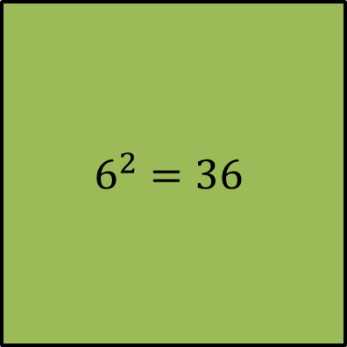
$$a²+b²=c²$$
$\sqrt{85}=9.22$ ($2$ d.p.)
$$85$$
$$7^{2}=49$$
?
$7$ cm
$$6^{2}=36$$
$6$ cm

Slide 8
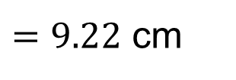
$$a²+b²=c²$$
$7²+6²$
$=49+36$
$=85$
?
$\sqrt{85}$
$=9.22$ cm
$7$ cm
(to $2$ d.p.)
$6$ cm

Slide 9
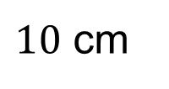
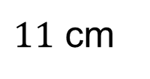
$$a²+b²=c²$$
$11²+10²$
$=121+100$
$=221$
?
$11$ cm
$\sqrt{221}$
$=14.87$ cm
(to $2$ d.p.)
$10$ cm

Slide 10
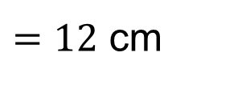
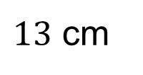
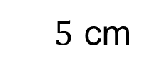
$$a²+b²=c²$$
What’s different this time?
$13²−5²$
$=169−25$
$=144$
$13$ cm
$\sqrt{144}$
$=12$ cm
?
$5$ cm

Slide 12
Answers
1.
a) 5 cm b) 10 m c) 13 cm d) 6.5 mm
2.
a) 8.1 cm b) 9.4 cm c) 13.6 m d) 12.1 cm
3.
a) 13.3 cm b) 12.0 cm c) 19.4 cm d) 12.3 m
e) 7.9 cm f) 3.5 cm g) 1.1 m h) 38.4 mm
4. 26 km
5. 2.7 m
6. 13.4 cm
7. No, the pencil is 1cm too long.
8. 4.3 cm and 10.8 cm²

Slide 13
What will I be able to do by the end of the lesson?
Find out the diagonal length of your exercise book without measuring it.
You’re allowed to measure the length and width though! ☺

Slide 14

Example
Calculate the length $AF$.
$AC=\sqrt{6^{2}+8^{2}}=\sqrt{100}=10$ cm
$AF=\sqrt{{10}^{2}+7^{2}}=\sqrt{149}=12.21$ cm
($2$ d.p.)
$$G$$
$$F$$
$$F$$
$$H$$
$$E$$
$7$ cm
$7$ cm
$$B$$
$$A$$
$10$ cm
$$C$$
$$C$$
$8$ cm
$$A$$
$6$ cm
$$D$$

Slide 16
Answers
1. 34.4 cm
2. 7.84 cm

