Slide 1
Starter
Solve the following equations:
$3x+8=11$ $23=4x−5$
$2x+9=19$ $1=4x+5$
$12x−25=5x−4$ $6−2x=11−7x$
$7x−42=2x−7$ $−3x−5=x+15$
$2(5x+2)=4(2x+3)$ $6(3x+6)=4(5x+2)$
$5(2x+3)=3(3x+5)$ $3(5x−1)=2(7x+2)$

Slide 2
Answers
$x=1$ $x=7$
$x=5$ $x=−1$
$x=3$ $x=1$
$x=7$ $x=−5$
$x=4$ $x=14$
$x=0$ $x=7$

Slide 3
We can plot inequalities on number lines…
$$x≥$$
$x$ is greater than or equal to
$$x≤$$
$x$ is less than or equal to
$$x>$$
$x$ is greater than
$$x<$$
$x$ is less than

Slide 4
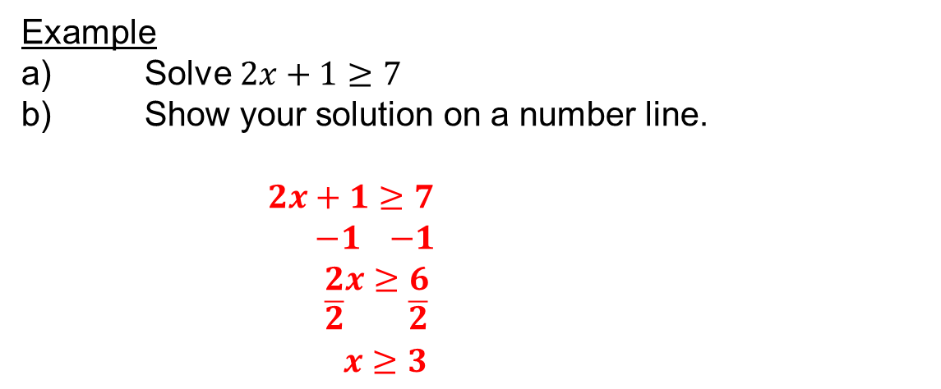
Example
a) Solve $2x+1≥7$
b) Show your solution on a number line.
$2x+1≥7$
$−1$ $−1$
$2x≥6$
$\overline{2}$ $\overline{2}$
$x≥3$

Slide 5
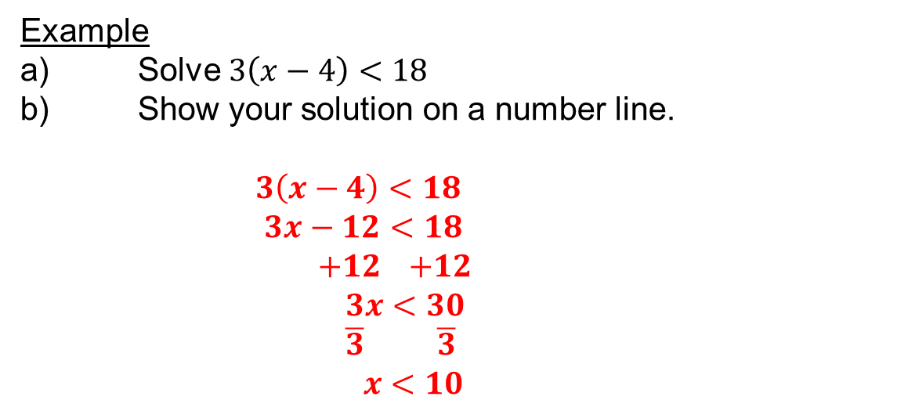
Example
a) Solve $3\left(x−4\right)<18$
b) Show your solution on a number line.
$3\left(x−4\right)<18$
$3x−12<18$
$+12$ $+12$
$3x<30$
$\overline{3}$ $\overline{3}$
$x<10$

Slide 6
Example
a) Solve $4\left(x−4\right)≤x−1$
b) Show your solution on a number line.
$4\left(x−4\right)≤x−1$
$4x−16≤x−1$
$−x$ $−x$
$3x−16≤−1$
$+16$ $+16$
$3x≤15$
$\overline{3}$ $\overline{3}$
$x≤5$

Slide 8
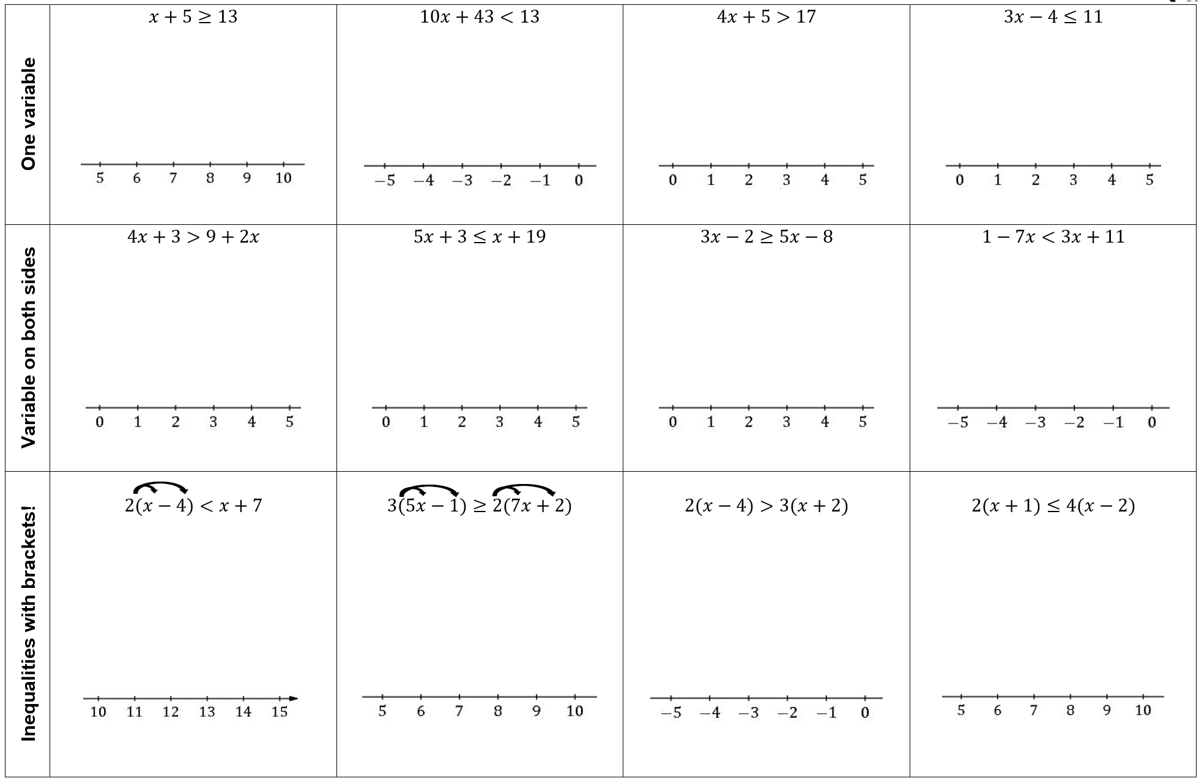
Answers
$−15$ $−14$ $−13$ $−12$ $−11$ $−10$

