Slide 1

Starter
Expand and simplify (where possible):
$6(a+b)$
$x(x+y)$
$4(m+2n)+3(m−n)$
$2x(x+3y)−3x(x−y)$
$=6a+6b$
$=x²+xy$
$=7m+5n$
$=−x²+9xy$

Slide 2
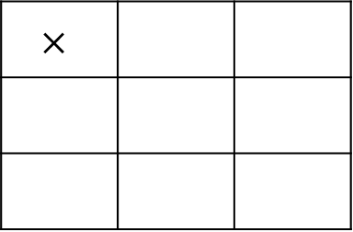

Example
Expand and simplify: $(x+2)(x+4)$
$$×$$
$x$ $+2$
$$x$$
$$+4$$
$$x^{2}$$
$$+2x$$
$$+4x$$
$$+8$$
$$\left(x+2)(x+4\right)=x^{2}+2x+4x+8$$
$$=x^{2}+6x+8$$

Slide 3
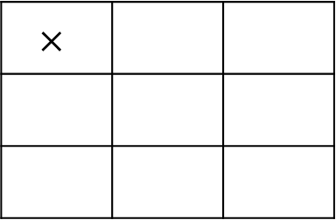

Example
Expand and simplify: $(p+3)(p−7)$
$$×$$
$p$ $+3$
$$p$$
$$−7$$
$$p^{2}$$
$$+3p$$
$$−7p$$
$$−21$$
$$\left(p+3\right)\left(p−7\right)=p^{2}+3p−7p−21$$
$$=p^{2}−4p−21$$

Slide 4
Task – expand and simplify
1. $(x+4)(x+2)$ 2. $(x+7)(x+8)$ 3. $(x+3)(x+2)$
4. $(x+8)(x+11)$ 5. $(x+5)(x+7)$ 6. $(x+4)(x+4)$
1. $(x+4)(x−2)$ 2. $(x−7)(x+8)$ 3. $(x−3)(x+2)$
4. $(x−8)(x−11)$ 5. $(x−5)(x+7)$ 6. $(x−4)(x−4)$
1. $(x+4)(x−4)$ 2. $(x+3)(x−3)$ 3. $(x+3)²$
4. $(x+8)²$ 5. $(x−5)²$ 6. $(x−7)²$

Slide 5
Answers
1. $x²+6x+8$ 2. $x²+15x+56$ 3. $x²+5x+6$
4. $x²+19x+88$ 5. $x²+12x+35$ 6. $x²+8x+16$
1. $x²+2x−8$ 2. $x²+x−56$ 3. $x²−x−6$
4. $x²−19x+88$ 5. $x²+2x−35$ 6. $x²−8x+16$
1. $x²−16$ 2. $x²−9$ 3. $x²+6x+9$
4. $x²+16x+64$ 5. $x²−10x+25$ 6. $x²−14x+49$

Slide 6
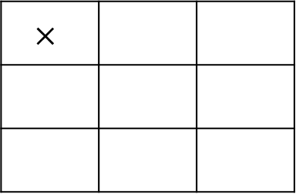

Example
Expand and simplify: $(4y−3)(2y−5)$
$$×$$
$4y$ $−3$
$$2y$$
$$−5$$
$$8y^{2}$$
$$−6y$$
$$−20y$$
$$+15$$
$\left(4y−3\right)\left(2y−5\right)$ $=8y^{2}−6y−20y+15$
$=8y^{2}−26y+15$

Slide 7
Task – expand and simplify
1. $(2x+4)(x+2)$ 2. $(x+7)(3x+8)$ 3. $(5x+3)(x+2)$
4. $(x+8)(3x+11)$ 5. $(2x+5)(3x+7)$ 6. $(4x+4)(3x+4)$
1. $(2x+4)(3x−2)$ 2. $(4x−7)(2x+8)$ 3. $(x−3)(7x+2)$
4. $(3x−8)(4x−11)$ 5. $(6x−5)(2x+7)$ 6. $(3x−4)(5x−4)$
1. $(2x+4)(2x−4)$ 2. $(3x+3)(3x−3)$ 3. $(6x+3)²$
4. $(5x+8)²$ 5. $(4x−5)²$ 6. $(11x−7)²$

Slide 8
Answers
1. $2x²+8x+8$ 2. $3x²+29x+56$ 3. $5x²+13x+6$
4. $3x²+35x+88$ 5. $6x²+29x+35$ 6. $12x²+28x+16$
1. $6x²+8x−8$ 2. $8x²+10x−56$ 3. $7x²−19x−6$
4. $12x²−57x+88$ 5. $12x²+20x−33$ 6. $15x²−32x+16$
1. $4x²−16$ 2. $9x²−9$ 3. $36x²+36x+9$
4. $25x²+80x+64$ 5. $16x²−40x+25$ 6. $121x²−154x+49$

