Slide 1
Starter
What’s the same? What’s different?
4cm
42°
6cm
6cm
42°
9cm
4cm
6cm
42°
32°
8cm
4cm

Slide 2
Definitions
Congruent shapes have all sides and angles equal.
Similar shapes have all angles equal but one is an enlargement of the other.

Slide 3
For triangles to be congruent, three properties must be the same:
3.5cm
6cm
6cm
4cm
3.5cm
4cm
78°
78°
4cm
3.5cm
4cm
3.5cm
side – side – side
side – angle – side
47°
5cm
5cm
4cm
4cm
78°
47°
78°
4cm
4cm
angle – side – angle
right angle – hypotenuse – side

Slide 4
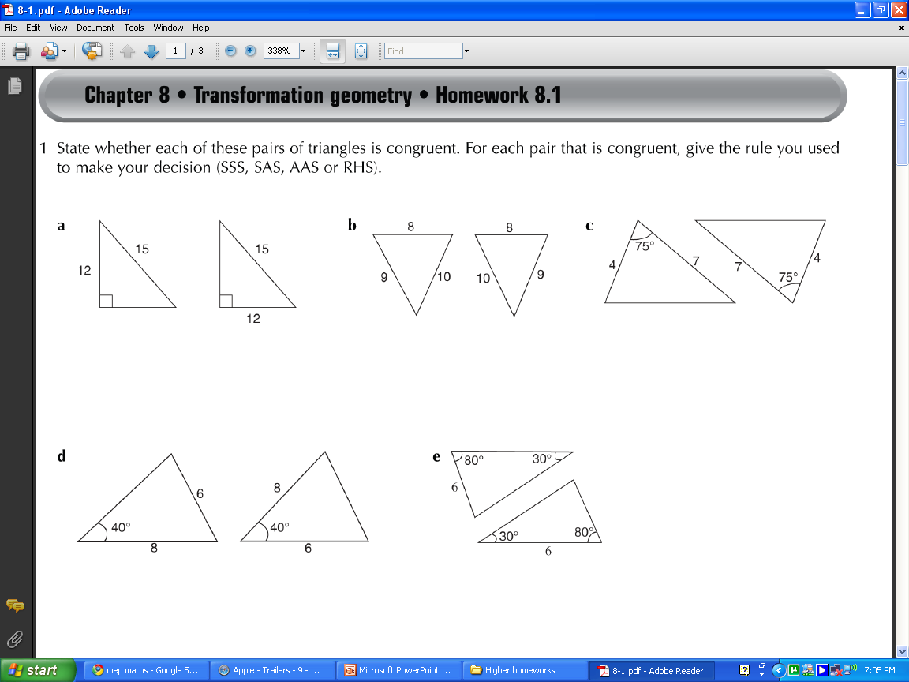
Are these triangles congruent?
☺

Slide 5
Are these triangles congruent?
☺

Slide 6
Are these triangles congruent?
☺

Slide 7
Are these triangles congruent?
☹

Slide 8
Are these triangles congruent?
☹

Slide 9
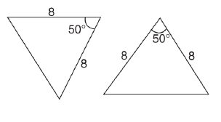
Are these triangles congruent?
☺

Slide 10
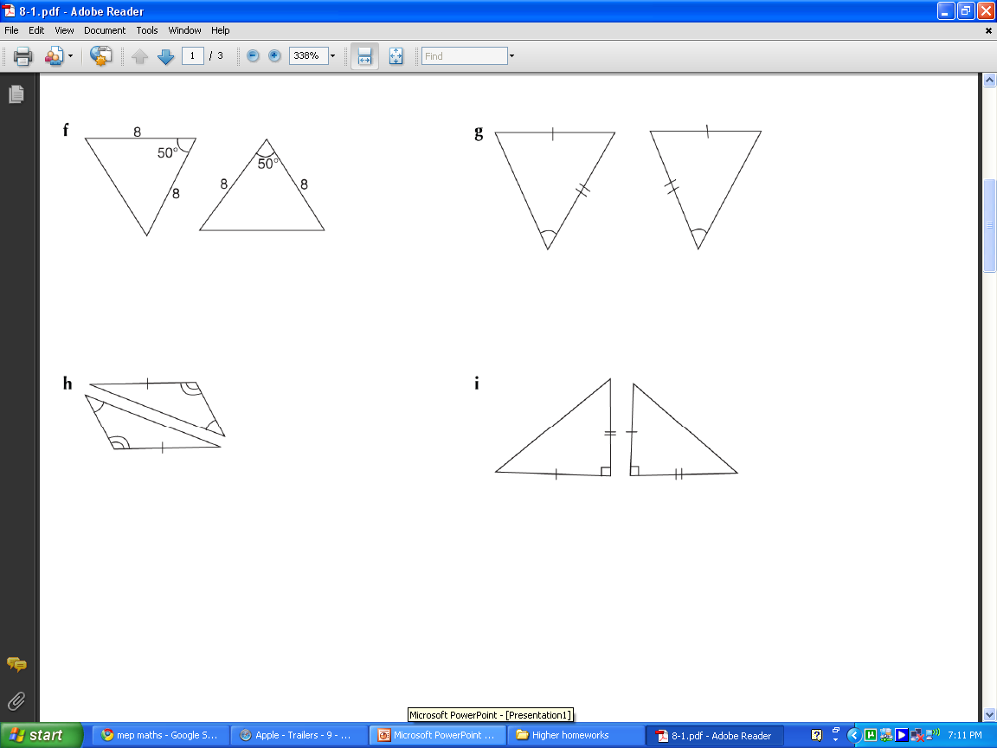
Are these triangles congruent?
☹

Slide 11
Are these triangles congruent?
☹

Slide 12
Are these triangles congruent?
☺

Slide 13

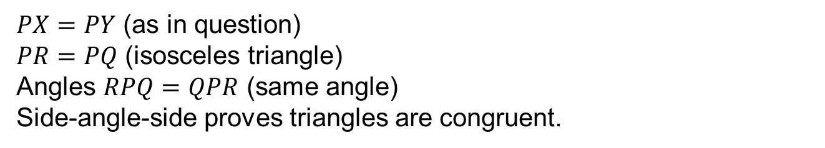
Example
Diagram NOT accurately drawn
Triangle $PQR$ is isosceles with $PQ=PR$.
$X$ is a point on $PQ$.
$Y$ is a point on $PR$.
$PX=PY$
Prove that triangle $PQY$ is
congruent to triangle $PRX$
(Total 3 marks)
$PX=PY$ (as in question)
$PR=PQ$ (isosceles triangle)
Angles $RPQ=QPR$ (same angle)
Side-angle-side proves triangles are congruent.

Slide 15
Answers
Work in pairs using the answers to decide how many marks you would award yourself for each question.

Slide 16
Plenary
Create your own question on proving congruence or similarity.
Make sure you have provided enough information on your diagram.

