Slide 1
Starter
Put the following decimals in ascending order (from smallest to largest).
1. 0.63 0.06 0.6 0.3 0.36
0.06, 0.3, 0.36, 0.6, 0.63
2. 1.8 0.81 1.08 0.18 0.801
0.18, 0.801, 0.81, 1.08, 1.8
3. 0.34 0.304 0.43 3.4 0.4
0.304, 0.34, 0.4, 0.43, 3.4
Challenge question
72 mm 0.071 m 7.04 cm 71.5 mm 7 cm
7 cm, 7.04 cm, 0.071 m, 71.5 mm, 72 mm

Slide 2
$$\frac{40}{100}$$
$\frac{?}{100}$ and simplify
Fraction
Decimal
Percentage
$$40\%$$
$$\frac{2}{5}$$
Reminder…
$×$ 100
Divide
$$0.4×100$$
$$2÷5$$
$$0.4$$

Slide 3
Convert the following to a percentage:
$$0.48$$
$$84\%$$
$$4.8\%$$
A
B
$$480\%$$
$$48\%$$
C
D

Slide 4
Convert the following to a percentage:
$$0.48$$
$$84\%$$
$$4.8\%$$
A
B
$$480\%$$
$$48\%$$
C
D

Slide 5
Convert the following to a decimal:
$$24\%$$
$$0.24$$
$$0.42$$
A
B
$$2.4$$
$$0.024$$
C
D

Slide 6
Convert the following to a decimal:
$$24\%$$
$$0.24$$
$$0.42$$
A
B
$$2.4$$
$$0.024$$
C
D

Slide 7
Convert the following to a fraction in its simplest form:
$$84\%$$
$$\frac{84}{100}$$
$$\frac{42}{50}$$
A
B
$$\frac{21}{25}$$
$$\frac{8}{4}$$
C
D

Slide 8
Convert the following to a fraction in its simplest form:
$$84\%$$
$$\frac{84}{100}$$
$$\frac{42}{50}$$
A
B
$$\frac{21}{25}$$
$$\frac{8}{4}$$
C
D

Slide 9
Convert the following to a decimal:
$$\frac{7}{8}$$
$$0.78$$
$$0.875$$
A
B
$$7.8$$
$$87.5$$
C
D

Slide 10
Convert the following to a decimal:
$$\frac{7}{8}$$
$$0.78$$
$$0.875$$
A
B
$$7.8$$
$$87.5$$
C
D

Slide 11
Convert the following to a percentage:
$$\frac{4}{5}$$
$$4\%$$
$$40\%$$
A
B
$$80\%$$
$$45\%$$
C
D

Slide 12
Convert the following to a percentage:
$$\frac{4}{5}$$
$$4\%$$
$$40\%$$
A
B
$$80\%$$
$$45\%$$
C
D

Slide 13
Convert the following to a fraction in its simplest form:
$$0.08$$
$$\frac{8}{10}$$
$$\frac{8}{100}$$
A
B
$$\frac{8}{25}$$
$$\frac{2}{25}$$
C
D

Slide 14
Convert the following to a fraction in its simplest form:
$$0.08$$
$$\frac{8}{10}$$
$$\frac{8}{100}$$
A
B
$$\frac{8}{25}$$
$$\frac{2}{25}$$
C
D

Slide 15
Convince your partner which is greater of the following pairs:
$60\%$ or $\frac{2}{3}$
$0.54$ or $\frac{3}{5}$
$\frac{1}{3}$ or $33\%$

Slide 16
Step-by-Step Guide
Convert all the fractions and percentages into decimals.
Put the decimals in order from smallest to largest.
Convert the numbers back to their original form.
Example
Order the following:
$\frac{4}{5}$ $0.81$ $78\%$ $\frac{21}{25}$ $76\%$ $\frac{3}{4}$
$0.8$ $0.81$ $0.78$ $0.84$ $0.76$ $0.75$
$0.75$ $0.76$ $0.78$ $0.8$ $0.81$ $0.84$
$\frac{3}{4}$ $76\%$ $78\%$ $\frac{4}{5}$ $0.81$ $\frac{21}{25}$

Slide 17
Step-by-Step Guide
Convert all the fractions and percentages into decimals.
Put the decimals in order from smallest to largest.
Convert the numbers back to their original form.
Your turn…
Order the following:
$\frac{1}{5}$ $21\%$ $0.19$ $\frac{9}{50}$ $\frac{6}{25}$ $0.22$

Slide 18
Extension: Have a look at dividing decimals using their equivalent fractions.

Slide 19
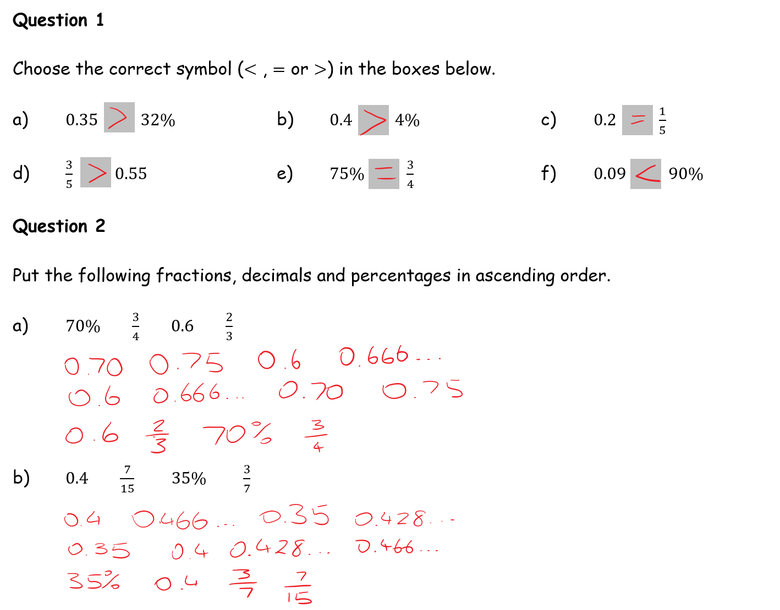
Answers

Slide 20
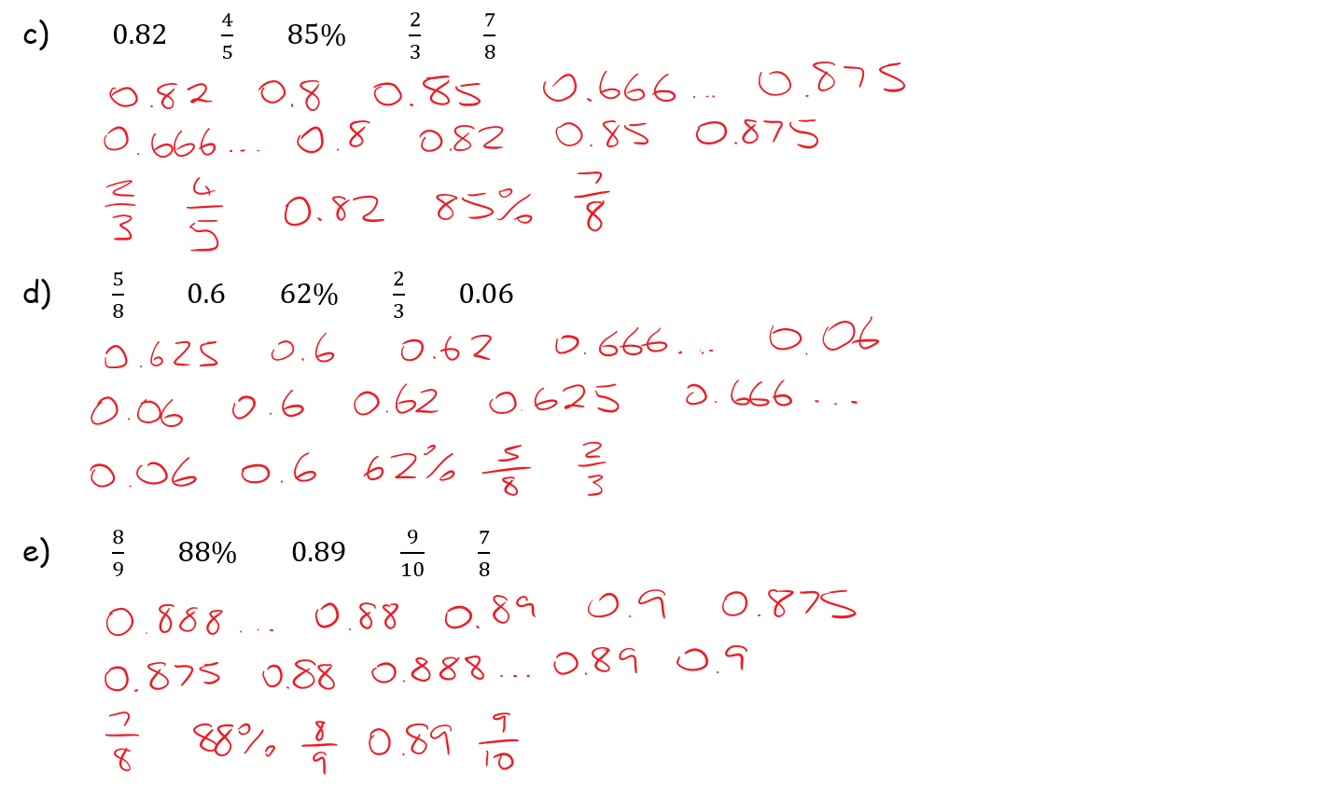
Answers

Slide 21
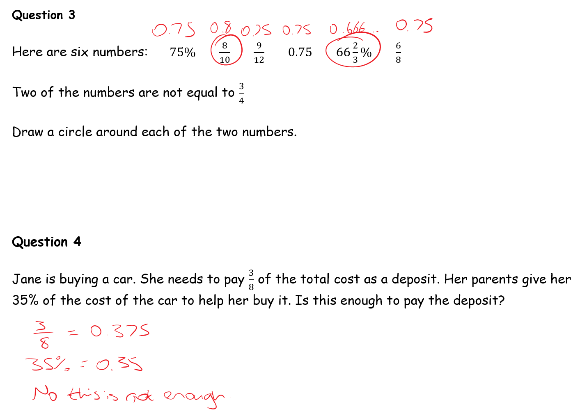
Answers

Slide 22
Answers

Slide 23
Plenary
Create your own question!
Things to think about:
What makes an ordering FDP question more challenging?
What stopped you from drawing diagrams to compare the fractions, decimals and percentages?
Could you create a context to make it a worded question?

