Slide 1
Starter
Match the questions and answers.
3 cakes cost 36p. How much do two cakes cost? | 60p
9 pencils cost £1.17. How much do 2 pencils cost? | £8.90
5 sweets cost 25p. How much do 12 sweets cost? | 26p
7 bananas cost £2.24. How much do 4 bananas cost? | £1.28
2 packs of candles cost £3.56. How much do 5 packs cost? | 24p

Slide 2
Answers
3 cakes cost 36p. How much do two cakes cost? | 24p
9 pencils cost £1.17. How much do 2 pencils cost? | 26p
5 sweets cost 25p. How much do 12 sweets cost? | 60p
7 bananas cost £2.24. How much do 4 bananas cost? | £1.28
2 packs of candles cost £3.56. How much do 5 packs cost? | £8.90

Slide 3
The Unitary Method
Finding the value of one unit to work out the base cost.
For example: 1 can of coke
1 g of butter
1 ml of milk

Slide 4
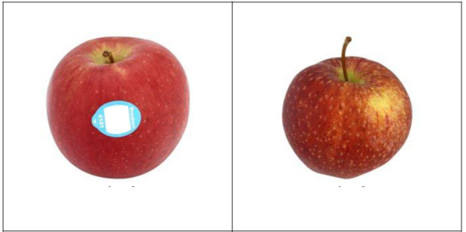
Which bag of apples is the best value?
1.2kg for £3.89
700g for £2.14
What is the price per gram?
1200g = 389p
700g = 214p
÷ 1200
÷ 1200
÷ 700
÷ 700
1g = 0.324p
1g = 0.305p
This is less money per gram, so it is the best value

Slide 5
Which cheese is the best value?
£1.88 per 160g
£13.55 per kg
What is the price per gram?
160g = 188p
1000g = 1355p
÷ 160
÷ 160
÷ 1000
÷ 1000
1g = 1.175p
1g = 1.355p
This is less money per gram, so it is the best value

Slide 6
Order these starting with the best value for money:
A can of coke that costs 60p
4
Buy one can for 70p, get one free
1
Buy 2 can for 60p each, get one free
2
Two cans of coke for £1
3

Slide 7
Order these starting with the best value for money:
5 books for £10
1
One book for £3
4
A £4.80 book has 50% off
2
Buy one book for £5, get one free
3

Slide 8
Extension: Best buys investigation

Slide 9
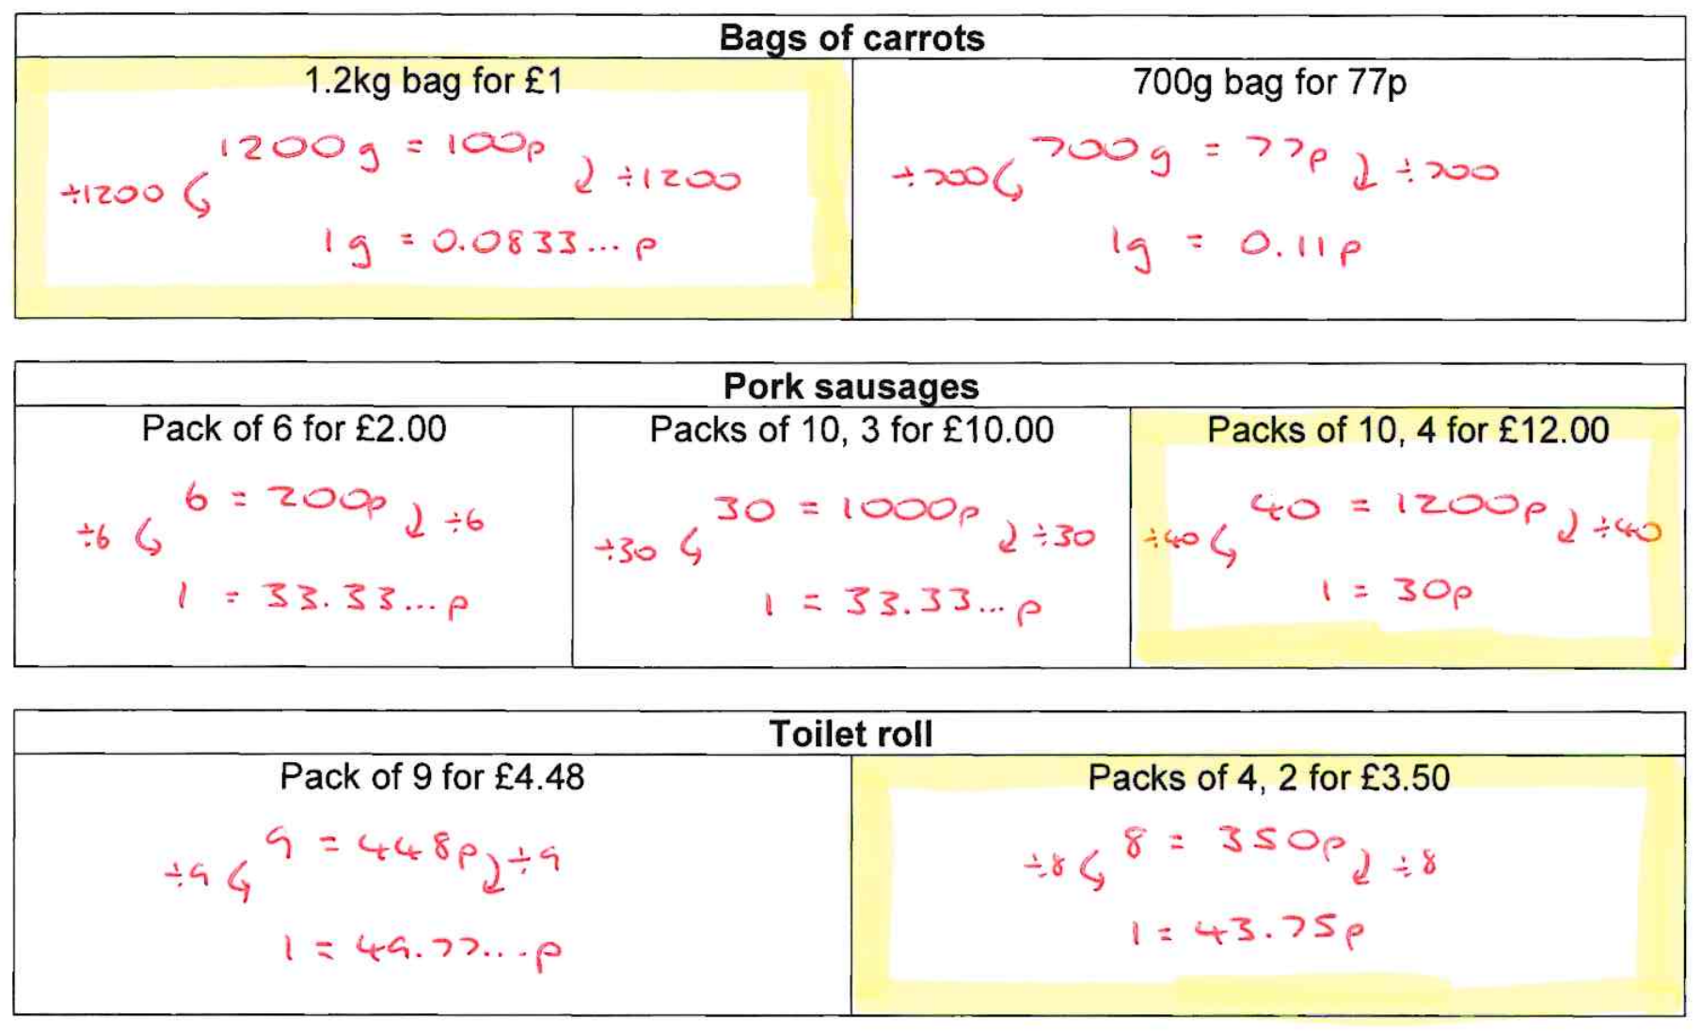

Slide 10
