Slide 1
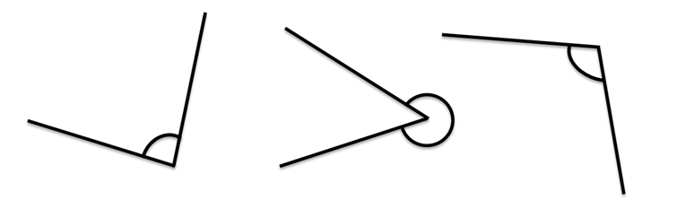

Starter
Measure these angles:
Draw these angles:
$26°$ $154°$ $201°$

Slide 2
Answers

Slide 3
Pie chart proportion bingo
0 5 6 7
9 11 12 13
16 21 23 27
42 44 50 63

Slide 4
The pie chart represents 18 people. How many chose purple?
9
Notes:
4

Slide 5
The pie chart represents 50 people. How many chose purple?
50
Notes:
5

Slide 6
The pie chart represents 42 people. How many chose pink?
0
Notes:
6

Slide 7
The pie chart represents 20 people. How many chose green?
5
Notes:
7

Slide 8
The pie chart represents 46 people. How many chose yellow?
23
Notes:
8

Slide 9
The pie chart represents 56 people. How many chose black?
21
Notes:
9

Slide 10
How many people are represented by the pie chart?
2 people
16
Notes:
10

Slide 11
The pie chart represents 48 people. How many chose black?
6
Notes:
11

Slide 12
The pie chart represents 39 people. How many chose red?
13
Notes:
12

Slide 13
The pie chart represents 28 people. How many chose yellow?
7
Notes:
13

Slide 14
The pie chart represents 22 people. How many chose grey?
11
Notes:
14

Slide 15
The pie chart represents 36 people. How many chose red?
12
Notes:
15

Slide 16
The pie chart represents 72 people. How many chose black?
63
Notes:
16

Slide 17
How many people are represented by the pie chart?
27
9 people
Notes:
17

Slide 18
How many people are represented by the pie chart?
42
21 people
Notes:
18

Slide 19
How many people are represented by the pie chart?
44
11 people
Notes:
19

Slide 20
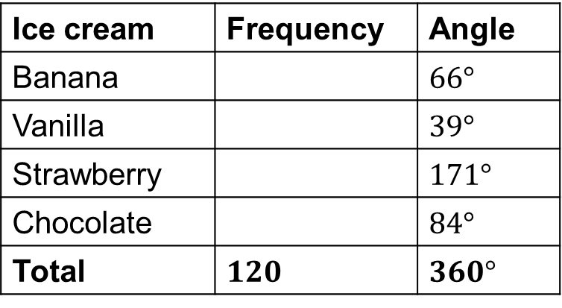
The information in the pie chart shows sales of 120 ice-creams sold from an ice-cream van one Saturday afternoon in the summer. Calculate the number of each type sold.
Banana
Banana
Chocolate
Vanilla
$$66o$$
Ice cream | Frequency | Angle
Banana |  | $66°$
Vanilla |  | $39°$
Strawberry |  | $171°$
Chocolate |  | $84°$
Total | $120$ | $360°$
$$84o$$
$$39o$$
$$171o$$
$$22$$
$$13$$
Strawberry
$$57$$
$$28$$
Check they add up to make the total!
?
$$÷3$$

Slide 22
Answers
SE | 36
NE | 24
M | 22
L | 8
Total | 90
B | 10
C&O | 40
S&V | 55
P | 15
Total | 120
B | 11
G | 3
S | 4
Total | 18
PL | 150
CS | 250
HS | 290
FM | 210
Total | 900

Slide 23
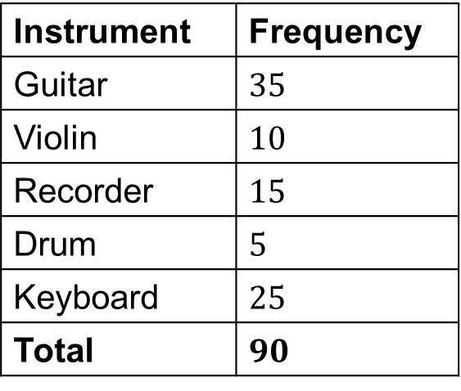
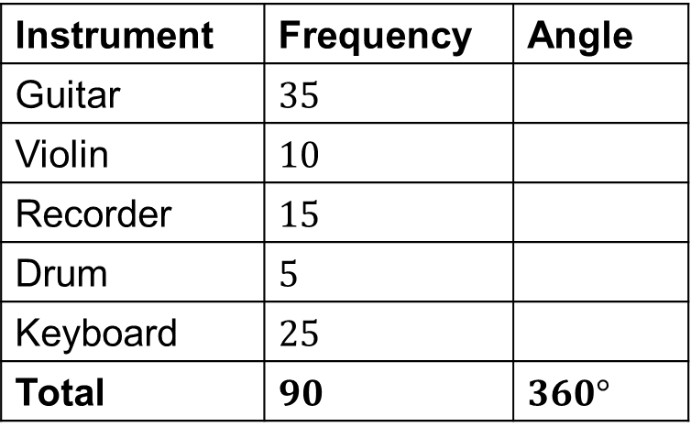
In a survey, people were asked to indicate which one of five musical instruments they played. The information is given in the table. Display the information in a pie chart.
Instrument | Frequency | Angle
Guitar | $35$
Violin | $10$
Recorder | $15$
Drum | $5$
Keyboard | $25$
Total | $90$ | $360°$
Instrument | Frequency
Guitar | $35$
Violin | $10$
Recorder | $15$
Drum | $5$
Keyboard | $25$
Total | $90$
$$140°$$
$$40°$$
$$60°$$
$$20°$$
$$100°$$
Check they add up to make $360°$!
?
$$×4$$

Slide 24
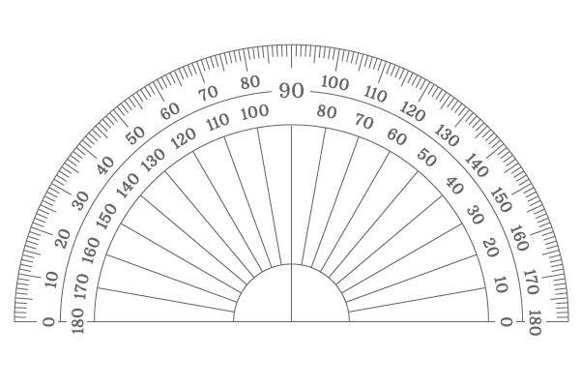
In a survey, people were asked to indicate which one of five musical instruments they played. The information is given in the table. Display the information in a pie chart.
Instrument | Frequency | Angle
Guitar | $35$
Violin | $10$
Recorder | $15$
Drum | $5$
Keyboard | $25$
Total | $90$ | $360°$
Guitar
$$140°$$
$$40°$$
$$60°$$
$$20°$$
$$100°$$
?
$$×4$$

Slide 25
In a survey, people were asked to indicate which one of five musical instruments they played. The information is given in the table. Display the information in a pie chart.
Instrument | Frequency | Angle
Guitar | $35$
Violin | $10$
Recorder | $15$
Drum | $5$
Keyboard | $25$
Total | $90$ | $360°$
Guitar
$$140°$$
$$40°$$
$$60°$$
$$20°$$
Violin
$$100°$$
?
$$×4$$

Slide 26
In a survey, people were asked to indicate which one of five musical instruments they played. The information is given in the table. Display the information in a pie chart.
Keyboard
Instrument | Frequency | Angle
Guitar | $35$
Violin | $10$
Recorder | $15$
Drum | $5$
Keyboard | $25$
Total | $90$ | $360°$
Guitar
$$140°$$
$$40°$$
Drum
$$60°$$
Recorder
$$20°$$
Violin
$$100°$$
?
$$×4$$

Slide 28
Answers

Slide 29
Comparing Pie Charts
BOYS
GIRLS
RED
Answer the first five questions with:
True
False
Cannot tell.
Then have a go at the extension question.
RED
GREEN
GREEN
BLUE
BLUE
There are 3 boys in the school.
There were more girls than boys.
More girls chose red than boys.
Blue was the most commonly chosen colour.
Green was the least commonly chosen colour.
Extension: If the number of boys who chose green was the same as the number of boys who chose blue, what is the smallest number of boys that could have been asked?

Slide 30
Plenary
Name one ADVANTAGE and one DISADVANTAGE of pie charts.
Consider:
Compare them to other types of graph
How easy they are to draw
How easy they are to interpret
Extra formulae needed

