Slide 1
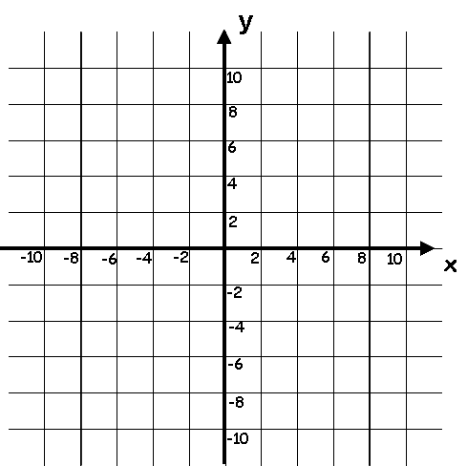
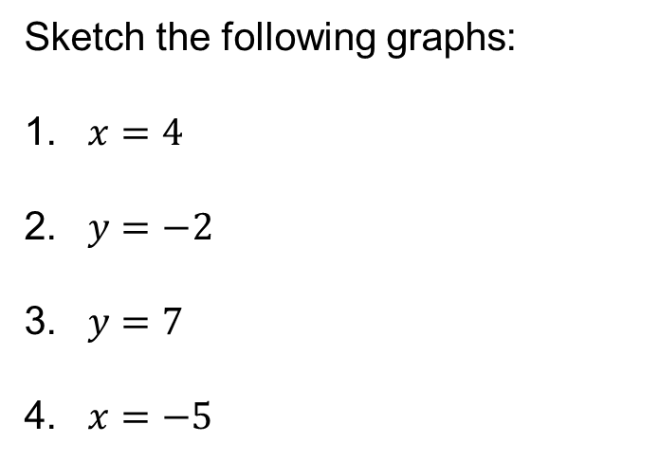




Starter
$$x=−5$$
$$x=4$$
Sketch the following graphs:
$x=4$
$y=−2$
$y=7$
$x=−5$
$$y=7$$
$$y=−2$$

Slide 2
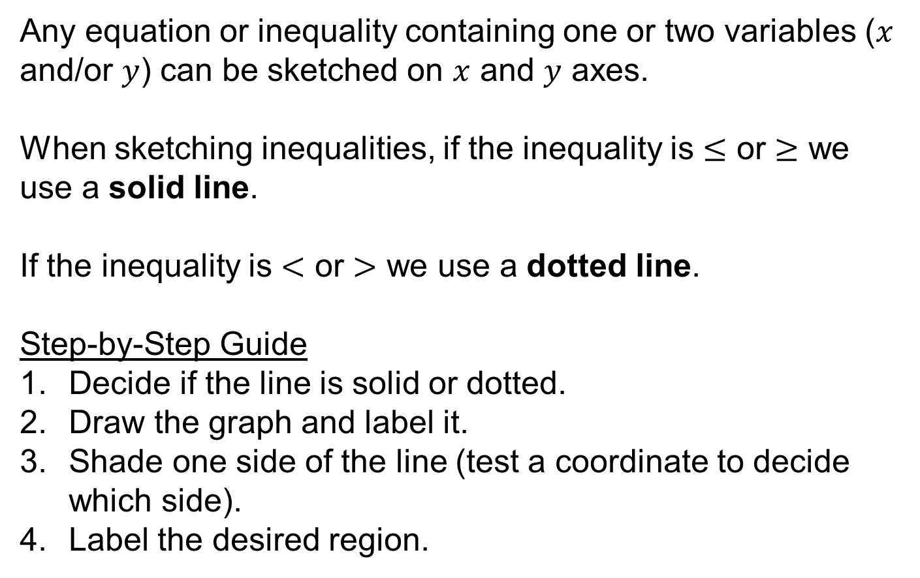
Any equation or inequality containing one or two variables ($x$ and/or $y$) can be sketched on $x$ and $y$ axes.
When sketching inequalities, if the inequality is $≤$ or $≥$ we use a solid line.
If the inequality is $<$ or $>$ we use a dotted line.
Step-by-Step Guide
Decide if the line is solid or dotted.
Draw the graph and label it.
Shade one side of the line (test a coordinate to decide which side).
Label the desired region.

Slide 3

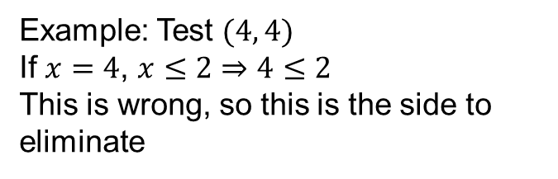

On a set of axes, show the set of values that satisfy the inequality
$$x≤2$$
Could be equal to so use a solid line
Sketch the graph of $x=2$
R
x
Test a coordinate to determine where to shade
Example: Test $(4, 4)$
If $x=4$, $x≤2⇒4≤2$
This is wrong, so this is the side to eliminate

Slide 4
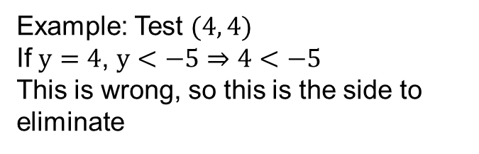
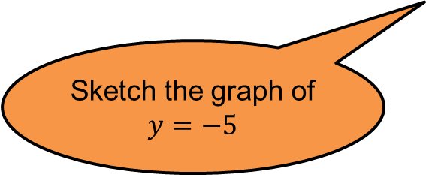
On a set of axes, show the set of values that satisfy the inequality;
$$y<−5$$
Cannot be equal to so use a dotted line
Sketch the graph of $y=−5$
x
Test a coordinate to determine where to shade
Example: Test $(4, 4)$
If $y=4$, $y<−5⇒4<−5$
This is wrong, so this is the side to eliminate
R

Slide 5
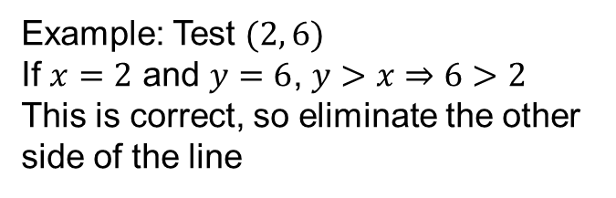

On a set of axes, show the set of values that satisfy the inequality;
$$y>x$$
Cannot be equal to so use a dotted line
Sketch the graph of $y=x$
R
x
Test a coordinate to determine where to shade
Example: Test $(2, 6)$
If $x=2$ and $y=6$, $y>x⇒6>2$
This is correct, so eliminate the other side of the line

Slide 6
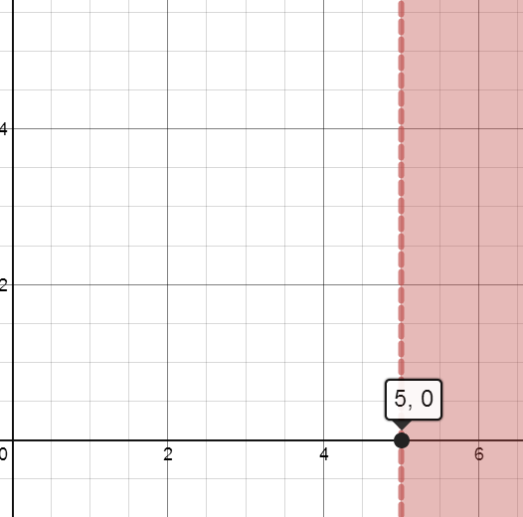




A
$$x<5$$
R
B
$$x≤5$$
C
$$y<5$$
D
$$y≤5$$

Slide 7
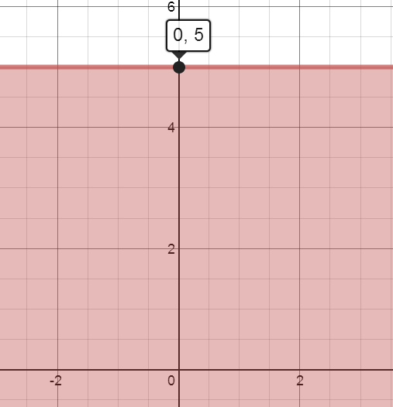




A
R
$$x>5$$
B
$$x≥5$$
C
$$y>5$$
D
$$y≥5$$

Slide 8
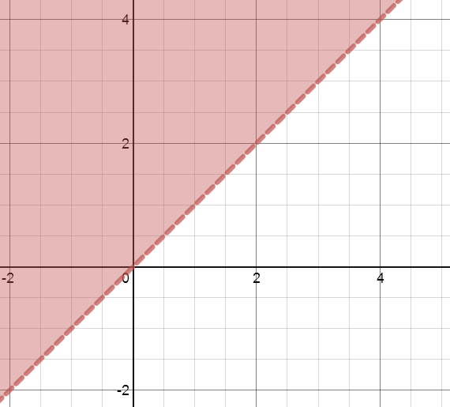
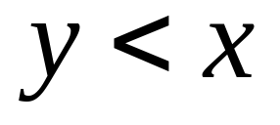
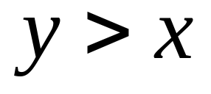
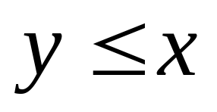
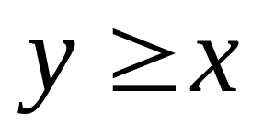
A
B
R
C
D

Slide 9
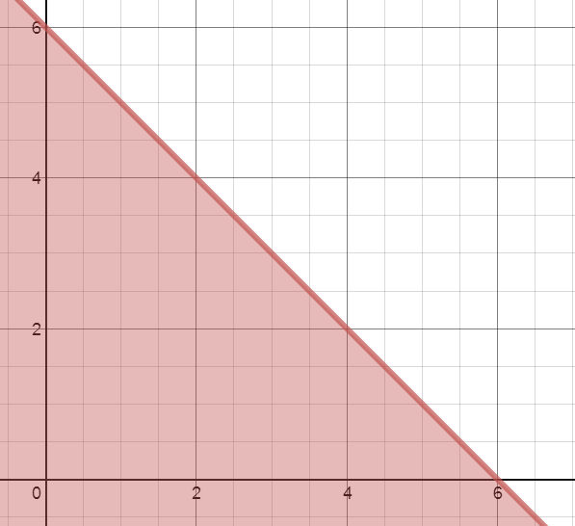
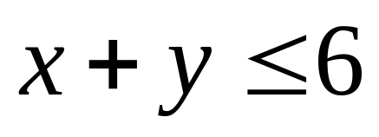
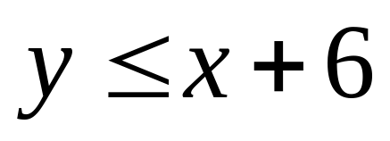
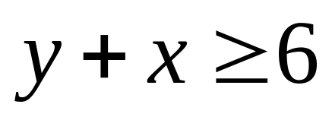
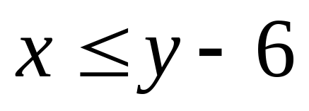
A
B
R
C
D

Slide 10
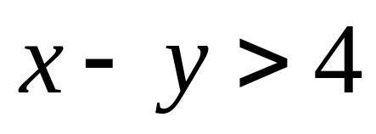
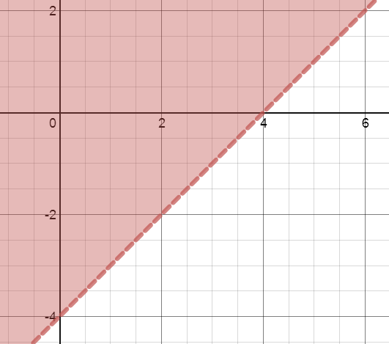
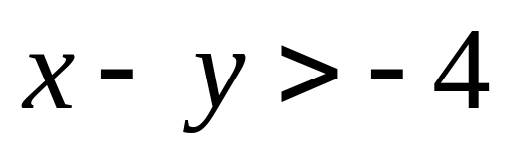
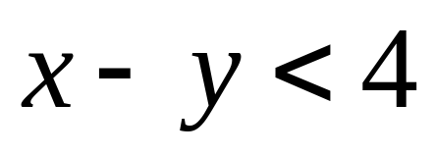
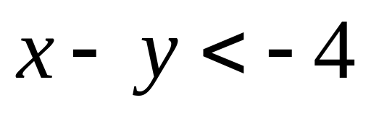
A
B
C
R
D

Slide 11
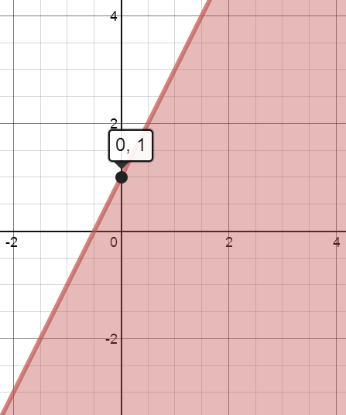
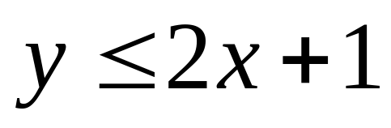
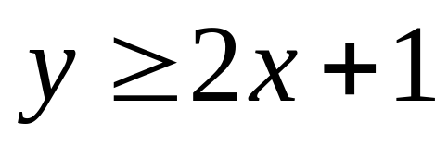
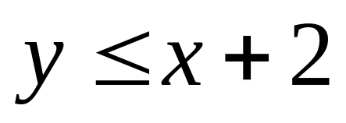
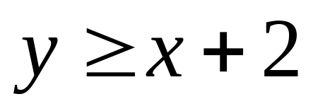
A
R
B
C
D

Slide 12

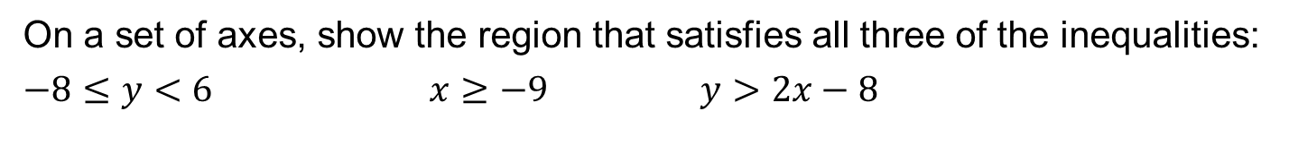
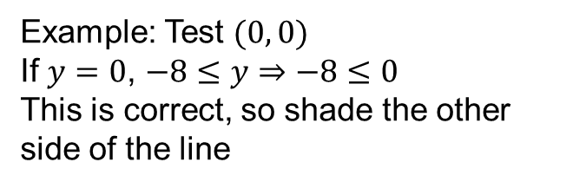

On a set of axes, show the region that satisfies all three of the inequalities:
$−8≤y<6$ $x≥−9$ $y>2x−8$
$$−8≤y$$
Solid line
$$y=−8$$
x
Test coordinate
Example: Test $(0, 0)$
If $y=0$, $−8≤y⇒−8≤0$
This is correct, so shade the other side of the line

Slide 13
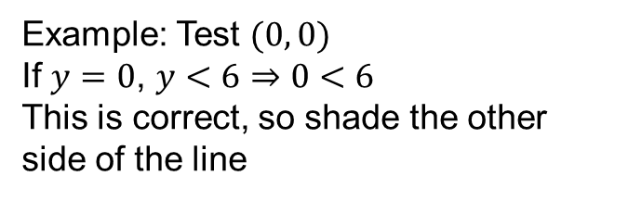


On a set of axes, show the region that satisfies all three of the inequalities:
$−8≤y<6$ $x≥−9$ $y>2x−8$
$$y<6$$
$$−8≤y$$
Dotted line
$$y=6$$
x
Test coordinate
Example: Test $(0, 0)$
If $y=0$, $y<6⇒0<6$
This is correct, so shade the other side of the line

Slide 14
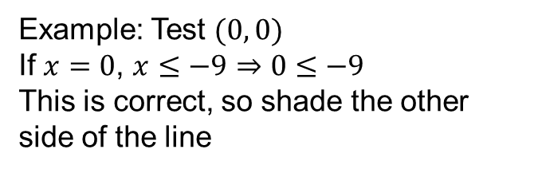
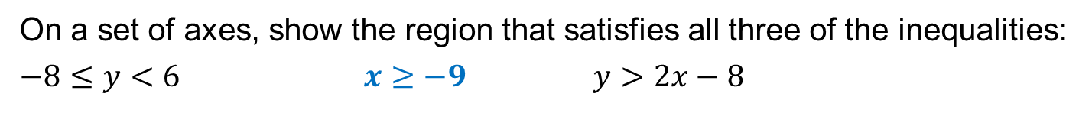

On a set of axes, show the region that satisfies all three of the inequalities:
$−8≤y<6$ $x≥−9$ $y>2x−8$
$$y<6$$
$$−8≤y$$
Solid line
$$x=−9$$
x
Test coordinate
Example: Test $(0, 0)$
If $x=0$, $x≤−9⇒0≤−9$
This is correct, so shade the other side of the line

Slide 15
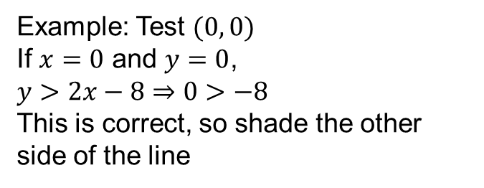

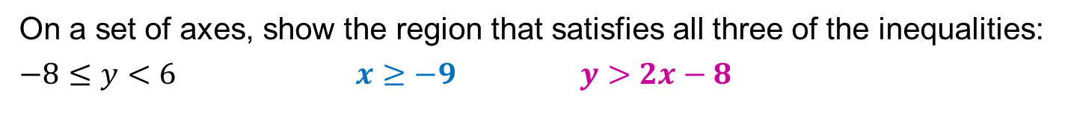
On a set of axes, show the region that satisfies all three of the inequalities:
$−8≤y<6$ $x≥−9$ $y>2x−8$
$$y<6$$
$$−8≤y$$
Dotted line
$$y=2x−8$$
R
x
Test coordinate
Example: Test $(0, 0)$
If $x=0$ and $y=0$,
$y>2x−8⇒0>−8$
This is correct, so shade the other side of the line

Slide 17
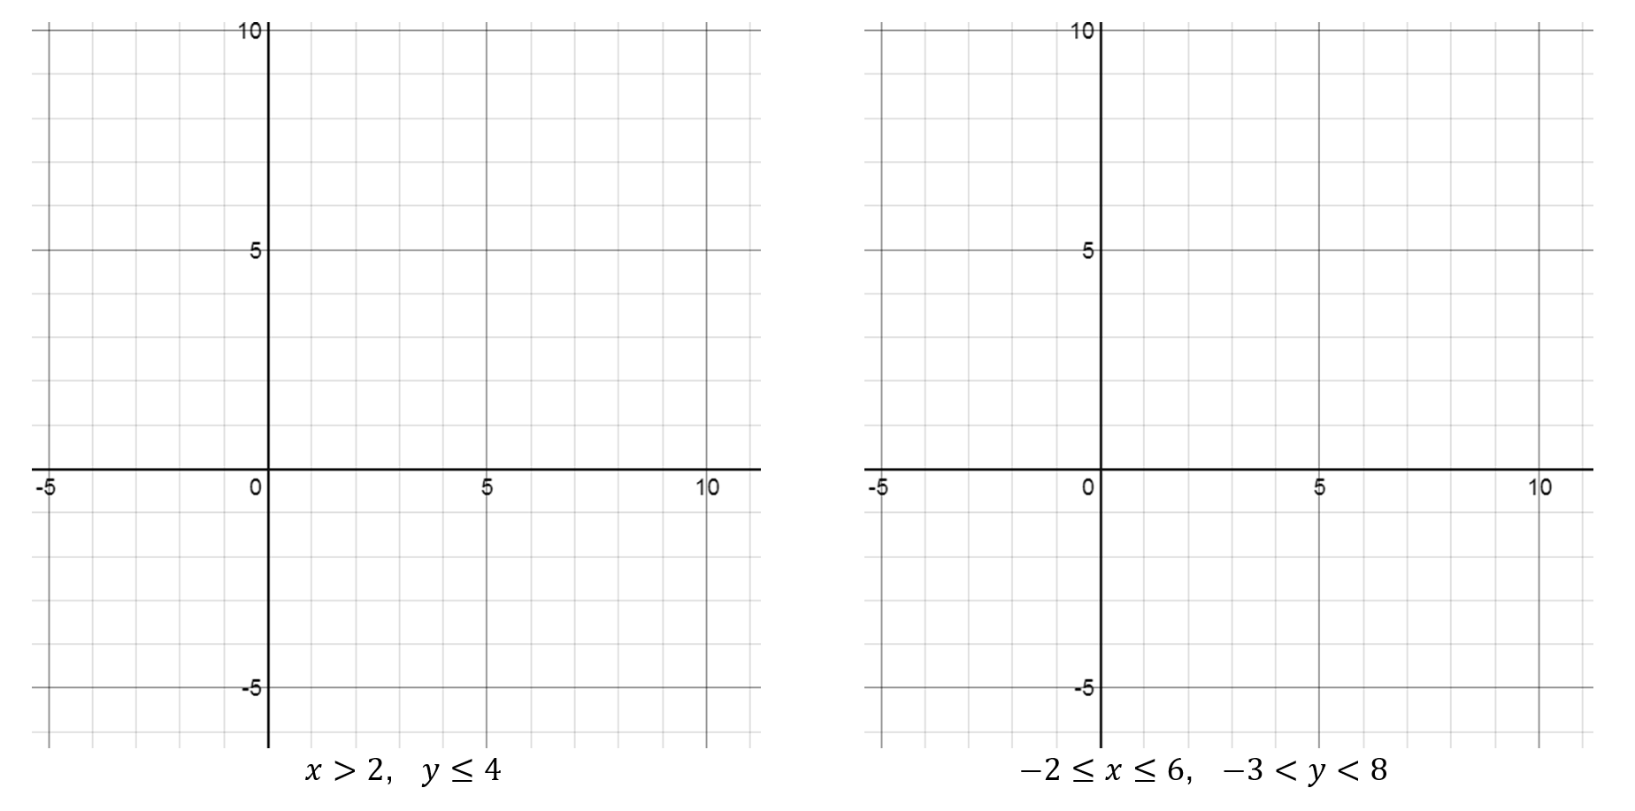
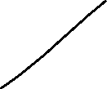




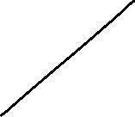
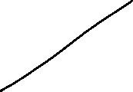




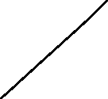






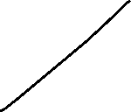





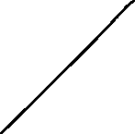

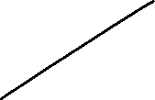




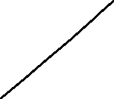




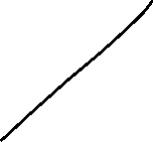
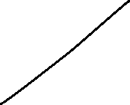





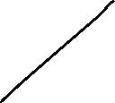
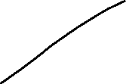








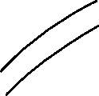









Solutions

Slide 18





















































































Solutions

Slide 19












































































Solutions

